Slide 1

UART
Talha Ahmed

Slide 2
UART
UART – Universal Asynchronous Receiver Transmitter
It transmits data asynchronously.
Hardware peripheral present inside the microcontroller.
It receives 8 Bit parallel data and transmit data by converting it into serial.
It also receive serial data and convert it into parallel.

Slide 3
Why UART
Different other protocols like USB,SPI are used for fast communication.
However, when fast communication is not necessary UART is being used.
UART is cheap.
UART is using single wire for transmitting and receiving the data.

Slide 4
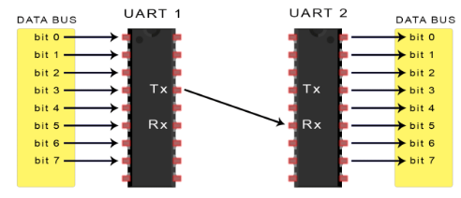
General Working of UART
UART receives data from data bus.
Mainly UART uses 8 data bits for transfer.
Create data packet of parallel data by converting it into serial and adding bits.
Send data through Tx serially.
LSB is send first.
Receiver receives serial data through Rx.
Break serial data into parallel by removing extra bits.
Send the parallel data where it will be needed.

Slide 5
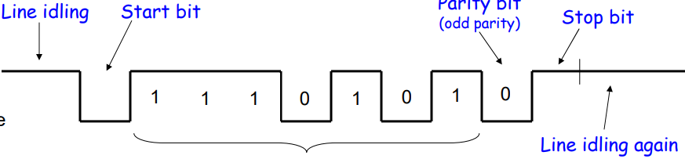
Data Packet of UART
First start bit which is usually ZERO.
Data bits start from LSB.
Parity bit (0 or 1) 1 for odd number of 1’s and 0 for even number of 1’s in data packet.
Stop bit which Is usually ONE.

Slide 6
UART Transmission
Receives data from data bus.
Starting voltage is set to high in UART when there is no any communication occur.
When UART is about to sending data it down the voltage to which is also the starting bit of data packet.
Use shift registers for holding and transforming parallel data into serial.
Create data packet, first place starting bit then place data bits in order of LSB to MSB placement.
In the end of data packet place parity bit by counting total number of 1’s in data and end the data packet by placing 1 in the end as stop bit.
Then use Tx for transmit data.

Slide 7
SHIFT Registers
Shift Registers are used for store and transfer data.
They are made up of flip-flops.
In UART PISO and SIPO shift registers are used.
PISO loads parallel data and store it into shift register and omit data after shifting serially in control of internal clock of UART.
SIPO loads data serially into shift registers in control of internal clock of UART and then omit parallel data after shifting.

Slide 8
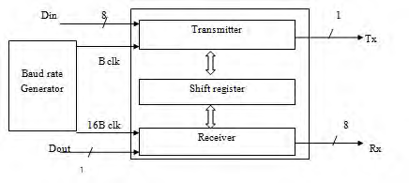
BAUD Generator
Number of bits send per second is known as BAUD Rate.
BAUD Generator generates bit to time ratio for both transmitting and receiving UART’s to attain perfection.

