Slide 1
CS-454 Computer Graphics
Lecture 3

Slide 2
Graphics API
An API is a software interface that provides a model for how an application program can access system functionality such as drawing an image into a window.
Two dominant paradigm of APIs
  Integrated approach of Java where graphics and user interface toolkits are integrated as portable packages that are fully standardized and supported as part of the language
  OpenGL and Direct3D where the drawing commands are part of software library tied to a language

Slide 3
Real Numbers and Vector Space
The set R is the set of real numbers (also called scalars).
For k ≥ 1 an integer, R^{k} is the set of k-tuples of real numbers;
These k-tuples are also called k-vectors when we want to emphasize that R^{k} is a vector space
A k-tuple is a sequence of length k and is represented by the notation
(a₁, a₂, . . . , a_{k})

Slide 4
Vectors and Vector Space
A k-vector u is a sequence of k real numbers,
u = u₁, u₂, . . . , u_{k} .
In computer graphics, we are mostly concerned with vectors with 2, 3, or 4 components.
For k = 2, a 2-vector represents a point in R², the real plane.
Going up a dimension, a 3-vector represents a point in R³, that is, in three-dimensional space.

Slide 5
Vectors and Vector Space
We use 4-vectors mostly to represent points in homogeneous coordinates
The space of all k-vectors is the k-dimensional vector space, sometimes called Euclidean space, and is denoted R^{k} .

Slide 6
Vectors in R²
A vector in R² is a pair of real numbers and is written u = (u1, u2)
As an ordered pair, a vector can be viewed either as a point in the usual xy-plane or as a displacement between two points

Slide 7
Vectors in R²
Points and vectors are different. However, they are both represented by a pair of scalars.
It is convenient to treat vectors and points as being the same kind of object, namely, as a pair of scalars.

Slide 8
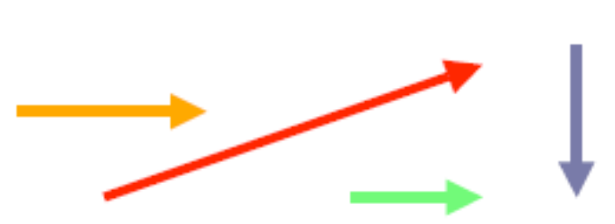
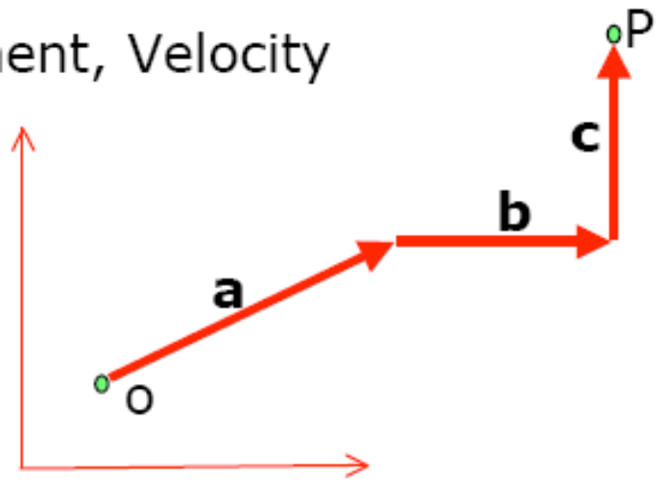
Vectors
Magnitude and Direction
Equal Vectors
  Two vectors are equal if their length as well as direction is same
Examples:
  Force, Weight, Displacement, Velocity
Unit Vector
Zero Vector
Displacement Vector

Slide 9
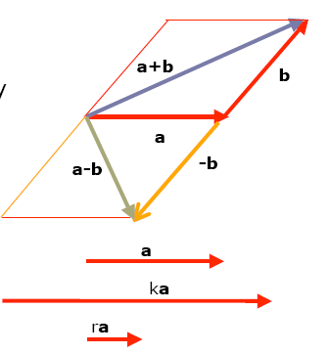
Vector Operations
Vector Addition
  Parallelogram Law
  Head-to-Tail rule
Commutative Property
  a+b=b+a
Vector Subtraction
  Negation: -b reverses the direction
    a-b = a+(-b)
Scaling a vector

Slide 10
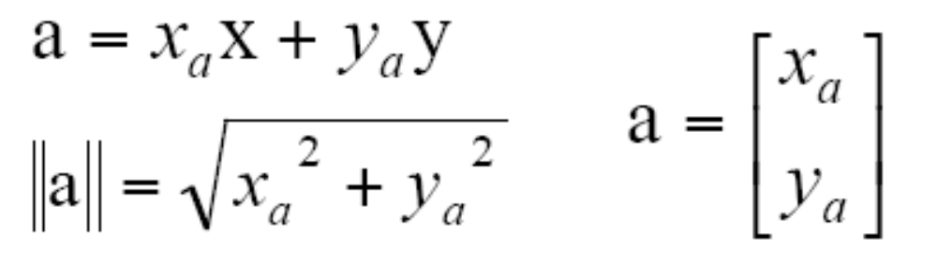
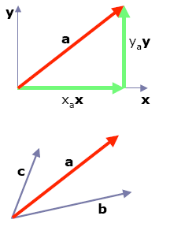

Cartesian Coordinates of a Vector
x-y coordinates
x and y axis are basis vectors
Any two non-parallel vectors can
be used as basis vectors in 2D
space
b_{a} and c_{a} are unique weights

Slide 11
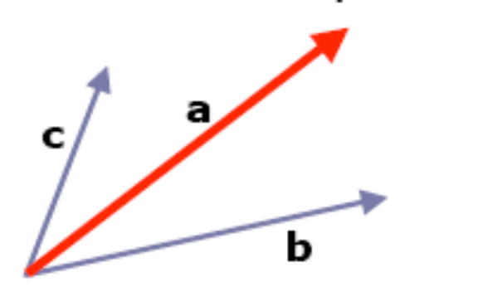
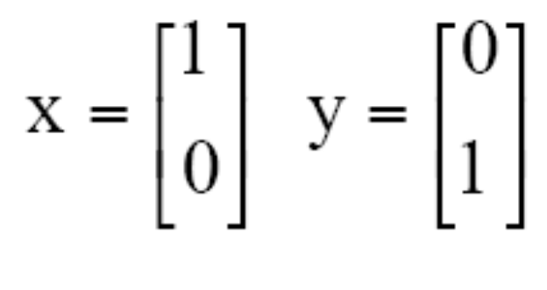
Linear Independence in 2D
In 2D space, two non parallel vectors are always linearly independent:
Two linearly independent vectors form 2D basis
Two orthogonal vectors form orthogonal basis.
Two orthogonal unit vectors form orthonormal basis
x and y coordinates form orthonormal basis

Slide 12
Vectors in R³
The three-dimensional Euclidean space is denoted by R³.
A point or a vector u in R³ is specified by a triple of values, u = (u₁, u₂, u₃).
In computer graphics, it is common to use x, y, z-axes that are oriented as the x-axis points rightward, the y-axis points upward, and the z-axis points toward the viewer.

Slide 13
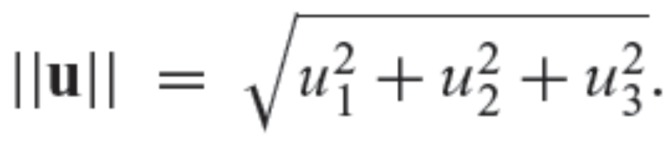
Vectors in R³
The length (usually called magnitude or norm) of a vector in R³ is given by the Euclidean distance formula
A non unit vector u is normalized by the process of replacing it with a unit vector pointing in the same direction.
That is, u is normalized by calculating u / ||u||.

Slide 14
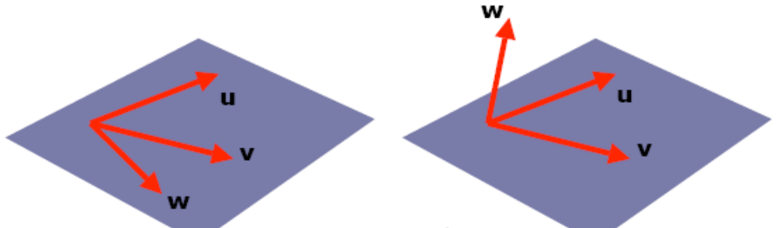
Linear Independence in 3D
Consider the following two cases of three vectors u, v, w
Case 1: u v w lie in the same 2D plane Case 2: w is not in the same 2D plane as u v
In Case 1, w is not so important because we can represent it as a weighted sum of u, v
w in Case 2 is different, we cannot represent it as a weighted sum of u,v

Slide 15
Linear Independence
Dimensions of a space are the maximum number of linearly independent vectors it can contain.
2D space can contain two independent vectors
3D space can contain three independent vectors

Slide 16
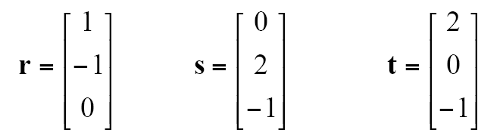
Linear Independence
Question: Are these vectors linearly
independent?
2r + s = t, hence they are not independent (therefore, are coplanar)

Slide 17
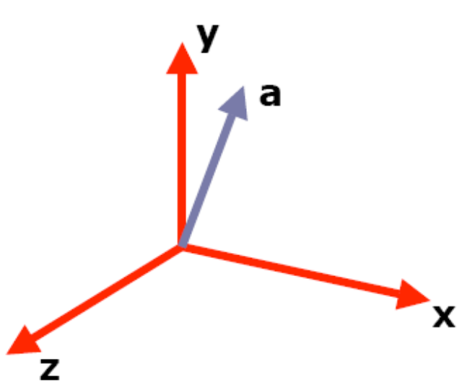
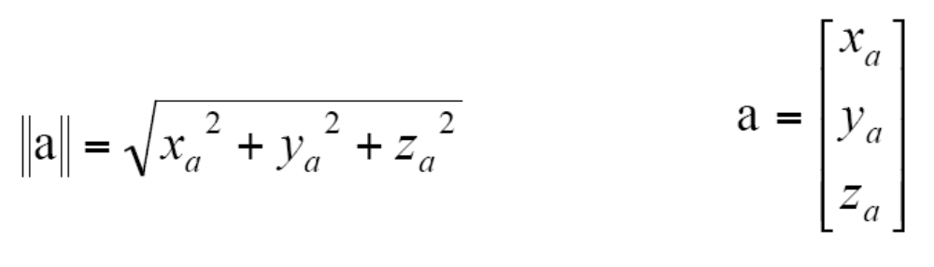
3D Orthonormal Basis
Cartesian Coordinates is an orthonormal basis
x = [1 0 0]^{T}
y = [0 1 0]^{T}
z = [0 0 1]^{T}
Pythagoras theorem holds

Slide 18
Right-Handed and Left-Handed
Coordinate Systems
uvw is right-handed system, if while curling fingers of right hand from u to v (through smaller angle), thumb points in the direction of w
If uvw is right-handed, vwu and wuv are also right-handed, while vuw, wvu, uwv are left-handed
We will use Right-Handed convention in this course

Slide 19
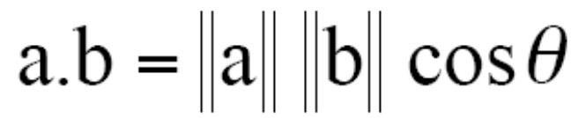
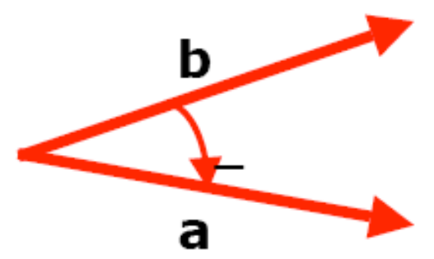

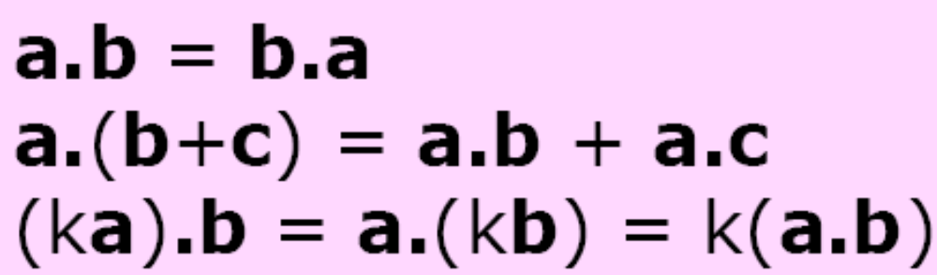
Scalar Product
Simplest way to multiply two vectors which results in a scalar answer
For an orthonormal basis x,y,z
x.x=y.y=z.z=1
x.y=x.z=y.z=0
If vectors are given in the form of components
Properties of scalar
product

Slide 20
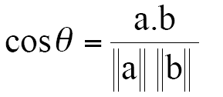
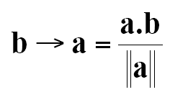
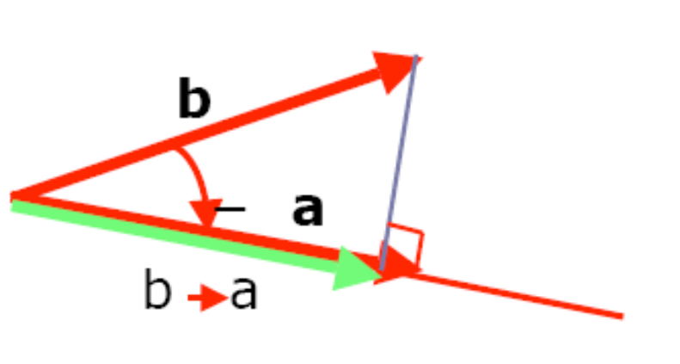
DOT Product applications in Computer Graphics
Finding the angle between two vectors, e.g. between light source direction and surface normal
Finding projection of one vector on another

Slide 21
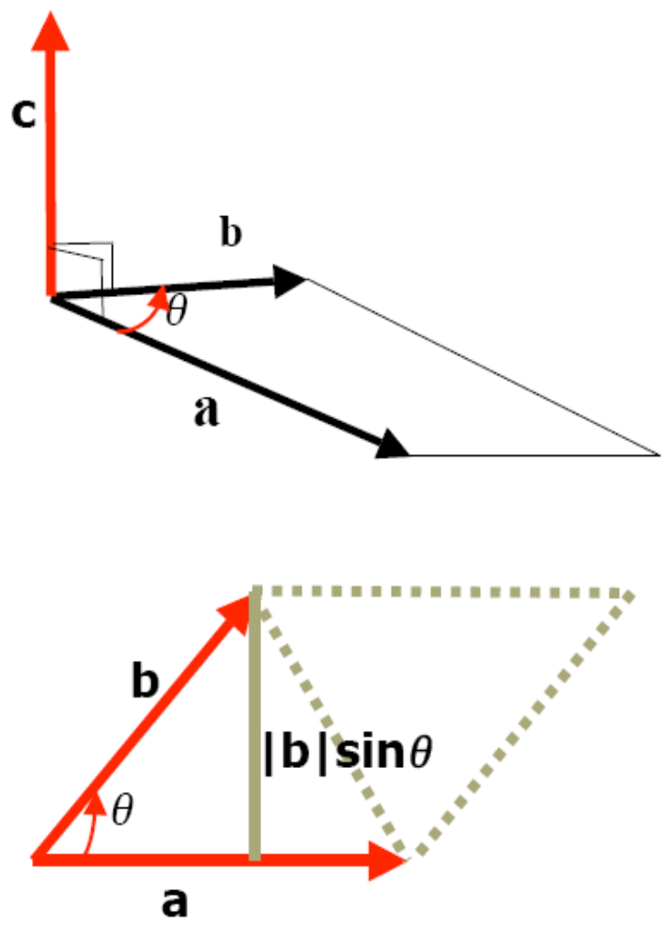
Cross Product
Cross product returns a vector
Perpendicular to the two arguments and given by the Right-Hand-Rule
Length of c:
|a x b| = |a||b|sinθ
|a x b| is also equal to the area of the parallelogram formed by vectors a and b

Slide 22
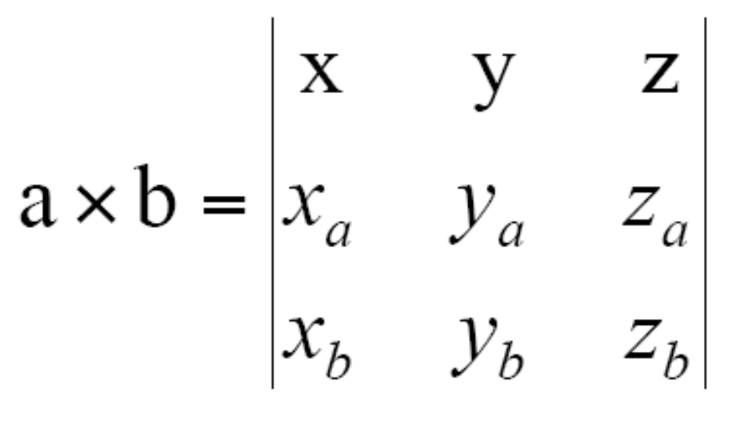
Properties of Cross Product
a x b = -(b x a)
a x (b+c) = a x b + a x c
(ka) x b = ax(kb) = k(axb)
To evaluate a x b in coordinate form, we can evaluate the following determinant

Slide 23
Linear Independence Revisited
Question: Are these vectors linearly independent?
Solution: Find (rxs).t

Slide 24
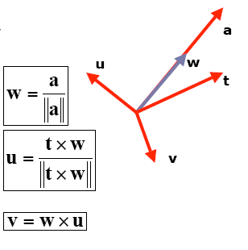
Constructing an Orthonormal Basis
Problem:
  Given a vector a, find a righthanded orthonormal basis uvw, such that w is in the same direction as a
Step 1: Normalize a
Step 2: Pick any vector t that is not parallel to w. Compute u
Step 3: Compute v

Slide 25
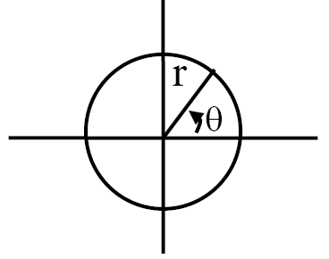
Polar Coordinates
We are used to the standard Cartesian coordinate system of graphing, but there are many other methods.
One common method is the polar coordinate method.
In this system, the origin is at the center of the plane and one specifies coordinates by giving an angle θ and a radius r:
If you need to translate polar coordinates to Cartesian coordinates, use these formulas:
x = r cos θ y = r sin θ
Going from Cartesian to polar:
r = sqrt(x² + y²) θ = tan-1(y/x)

Slide 26
2D Implicit Curves
A curve is a set of points that can be drawn on a piece of paper without lifting the pen.
Is represented commonly using implicit equation
An implicit equation in 2 dimensions is:
f(x,y) = 0
The function f(x,y) returns a real value
The points (x,y) where this function holds are on the curve and the points where the value is non-zero are not on the curve

Slide 27
2D Implicit Curves
Example: Assume f(x,y) is
f(x,y) = (x - x_{c})² + (y - y_{c})² – r²
where (x_{c}, y_{c}) is a 2D point and r is a non-zero real number
If we take f(x,y) = 0, the points where this equality holds are on the circle
Why implicit?
  The points (x,y) on the curve cannot be immediately calculated explicitly from the equation, and instead must be determined by plugging (x,y) into f and finding out whether it is zero, i.e. points are buried implicitly in the equation

Slide 28
2D Implicit Curves
This notation can be compressed using vectors
If c = (x_{c}, y_{c}) and p = (x,y), then our circle with center c and radius r is defined by those position vectors that satisfy: (p – c) . (p – c) - r² = 0.
It reads points p on the circle have the following property: the vector from c to p when dotted with itself has value r²
It is easier to implement vector equations
Because the vector dotted with itself is its own length squared so, ||p – c||² - r² = 0
or ||p – c|| - r = 0
“The points p on the circle are those a distance r from the center point c”.

Slide 29
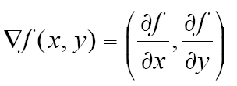
Gradients
For a 2D surface, we often want to compute the gradient.
The gradient of a function f(x, y) is a vector that points in the direction of maximum upslope.
For an implicit curve f(x, y) = 0, the gradient is perpendicular to the tangent vector
Thus, the gradient gives us a normal vector at that point

Slide 30
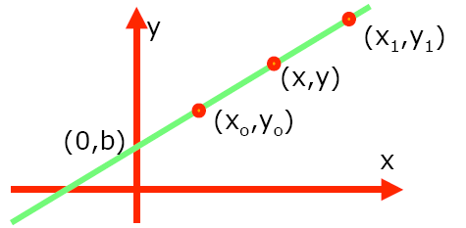
2D Lines
Implicit line equations
  Slope intercept form:
    y=mx+b
    f(x,y)=y-mx-b=0
  General Form
    Ax+By+C=0
  From two known points (xo,yo) and (x1,y1) on the line, we have 2 equations and three unknowns.
  We could set C = 1 i.e. Ax+By+1 = 0 but in this case lines through the origin will have A(0)+B(0)+1 = 0
  To solve this problem, we use gradient.

Slide 31
2D Lines
For the line Ax+By+C=0, the
gradient vector is (A,B) which is perpendicular to the line
Given two points (xo,yo) and (x1,y1) on the line, the vector between them points to the same direction as the line and is perpendicular to (A,B).
This vector is (x1-xo, y1-yo).
There are an infinite number of (A,B,C) that describe the line. We want any one of the valid (A,B,C).

Slide 32
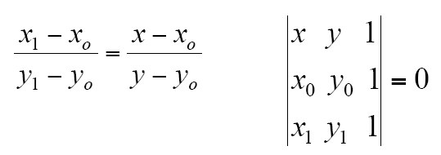
2D Lines
We can start with any one of the
(A,B) which is perpendicular to (x1-xo,y1-yo).
Such a vector is just (A,B) = (yo-y1,x1-xo).
This means equation of the line through points (xo,yo) and (x1,y1) is: (yo-y1)x + (x1-xo)y + C = 0
This can also be written as:
A line is uniquely defined by 2 points

Slide 33
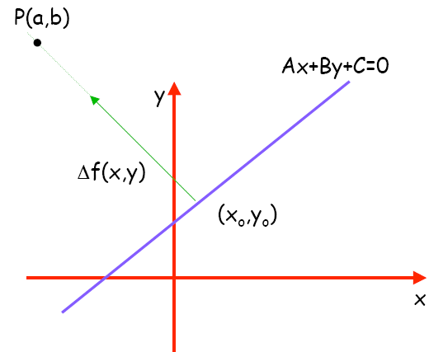
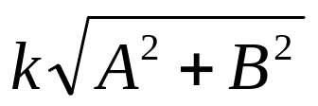
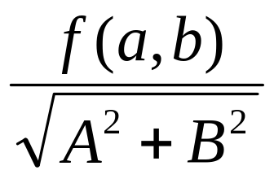
Signed Distance from a Point to a Line
The distance from a point
to a line is the length of the
vector k(A, B), which is:
For the point (x, y) + k(A, B),
the value of f(x,y) = Ax + By + c is
f(x+kA, x+kB) = k(A² + B²)
Signed distance from line Ax + By + C = 0 to point (a,b) is:
  distance =

Slide 34
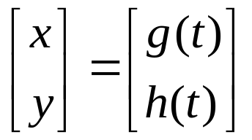
2D Parametric Curves
A parametric form of the curve is controlled by a single parameter and suggests the movement of a point through time
The parameter is the value t (time) and is used to distinguish one point on the curve from another.
Such curves have the form:

Slide 35
2D Parametric Curves
Here (x,y) is the point on the curve and t is the parameter that influences the curve
As t continuously changes, points are swept out in a continuous curve which is a nice feature because we can explicitly construct points on the curve using t.

Slide 36
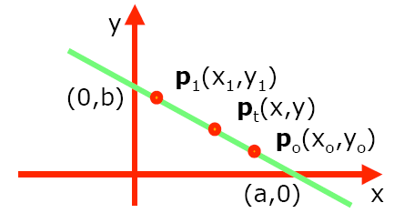
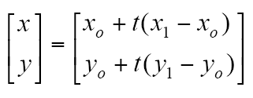
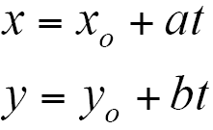
2D Parametric Lines
Parametric form of line equations:
p(t)=po+t(p1-po)
Parametric lines can also be described as just a point and a vector:
p(t) = o + t(d)

Slide 37
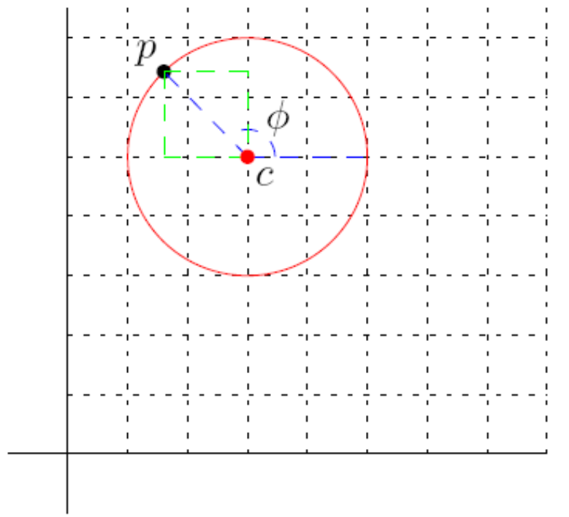
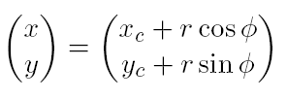
2D Parametric Circles
The parametric equation
of a 2D circle with center
c and radius r is

Slide 38
3D Parametric Curves
A 3D parametric curve operates much like a 2D parametric curve
x = f(t)
y = g(t)
z = h(t)
For example a spiral around z axis is
x = cos t
y = sin t
z = t

Slide 39
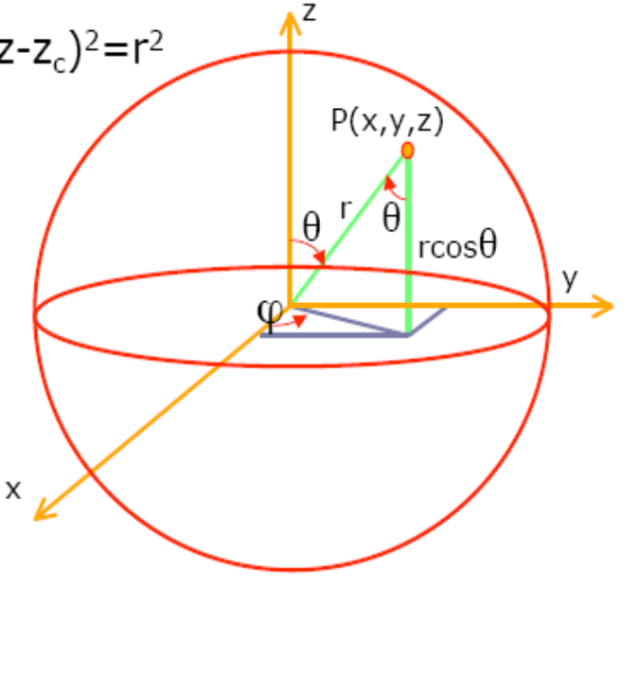
3D Parametric Surface
Sphere: The set of all points in three-dimensional Euclidean space that are located at a fixed distance from a given point.
(x-x_{c})²+(y-y_{c})²+(z-z_{c})²=r²
z=rcosθ
x=rsinθcosφ
y=rsinθsinφ

Slide 40
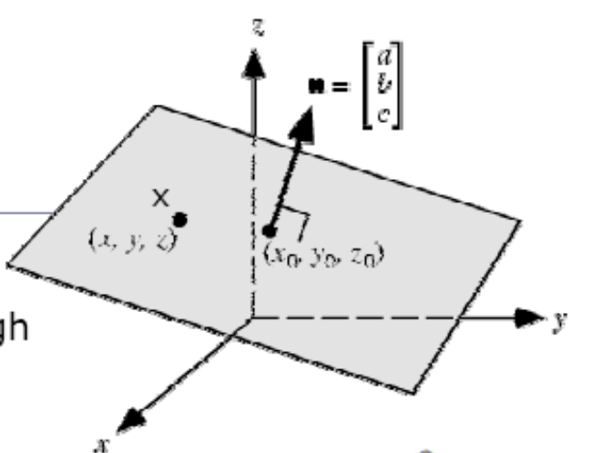
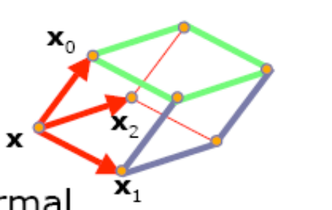
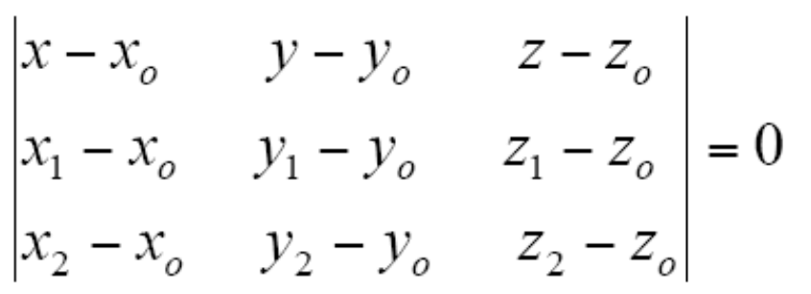
Equation of the Plane
Equation of a plane with non
zero normal vector n through
(xo,yo,zo) is given by:
(x-xo).n=0
General form of plane
equation: ax+by+cz+d=0 where
d=-ax_{o}-by_{o}-cz_{o}
For three points xo, x1, x2 plane
normal can be defined: n=(x1-xo)x(x2-xo)
Implicit plane equation:
(x-xo).((x1-xo)x(x2-xo))=0

Slide 41
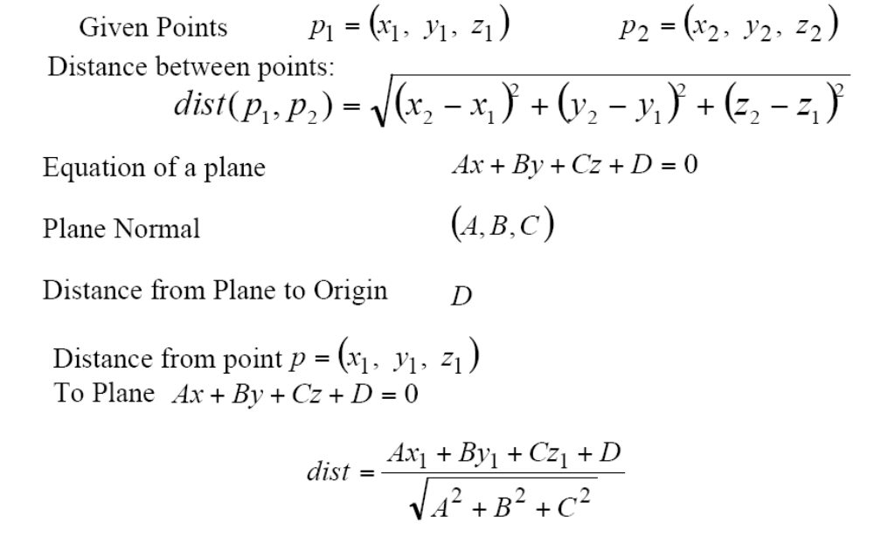
Points and Planes

Slide 42
Triangles
Fundamental modeling primitive in most graphics program.
Often information (e.g. color) is tagged onto triangle vertices, and this information is then interpolated across triangle.
The coordinate system that makes such interpolation straightforward is called barycentric coordinates.

Slide 43
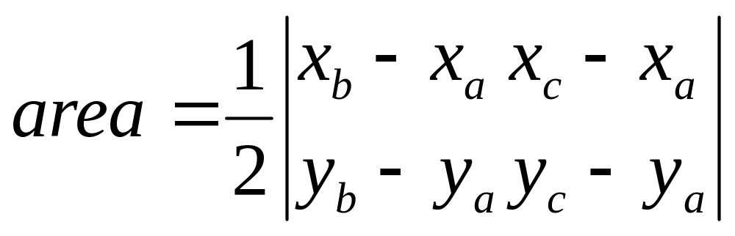
2D Triangles
If we have 2D triangle defined by 2D points a, b, and c, we can first find its area.
area = (x_{a}y_{b} + x_{b}y_{c} + x_{c}y_{a} – x_{a}y_{c} – x_{b}y_{a} – x_{c}y_{b})

Slide 44
Barycentric Coordinates
Often in graphics we wish to assign a property such as color at each triangle vertex and smoothly interpolate the value of that property across the triangle.
There are a variety of ways to do this, but the simplest is to use barycentric coordinates.
One way to think of barycentric coordinates is as a non-orthogonal coordinate system.

Slide 45
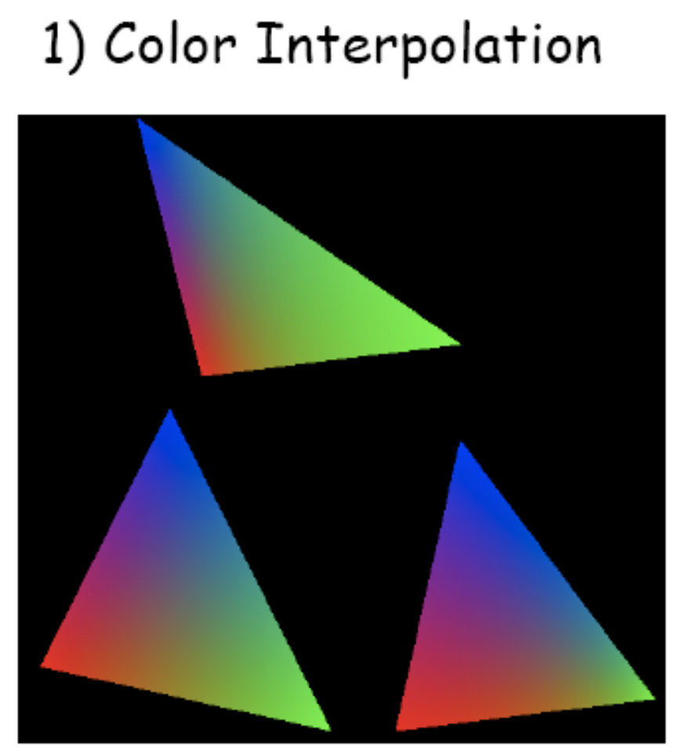
Barycentric Coordinates

Slide 46
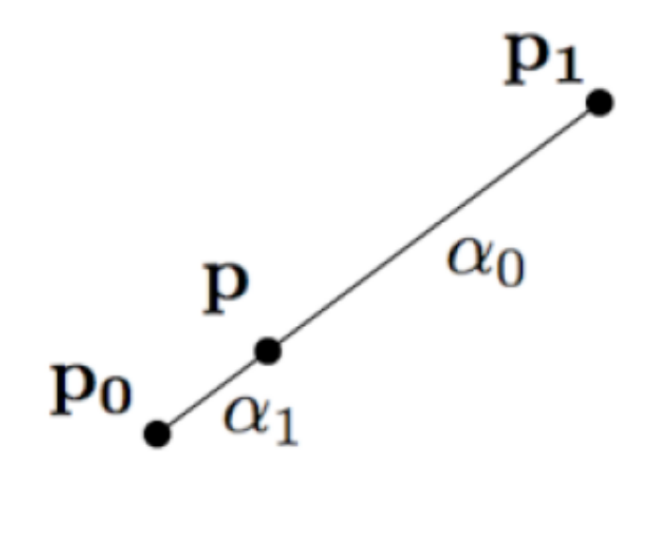
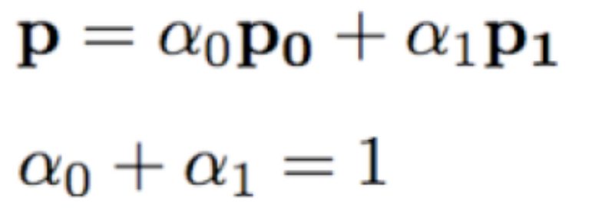
Barycentric Coordinates
Line
Triangle (weighted sum of points)
  Suppose the coordinate origin is at a and vectors from a to b and a to c are basis vectors. With the origin and 2 basis vectors, point p can be written as: p = a + β(b-a) + γ(c-a)
  or p = (1- β – γ)a + βb + γc
  α = (1- β – γ)

Slide 47
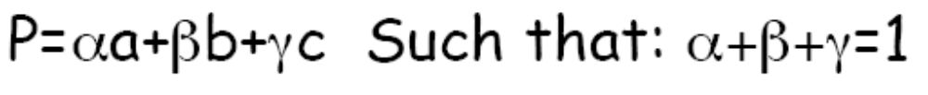


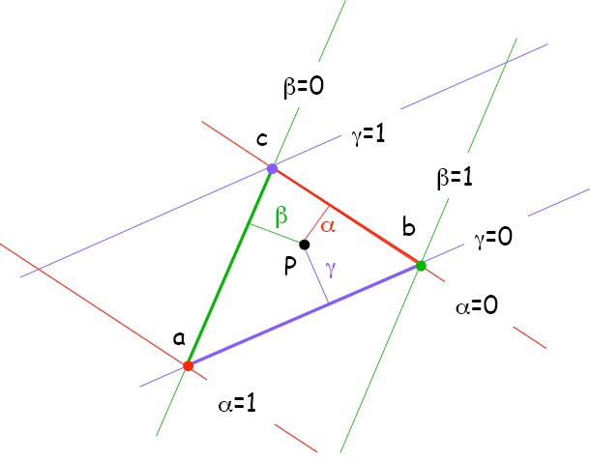
Barycentric Coordinates
Smooth mixing of color of three vertices
Inside abc:
On an edge of abc:
  One parameter is zero
On a vertex of abc:
  Two parameters are zero

Slide 48
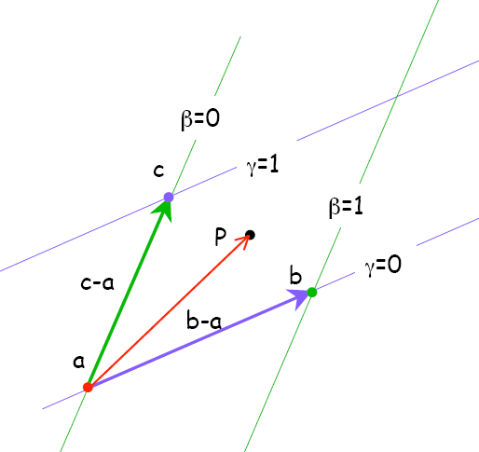
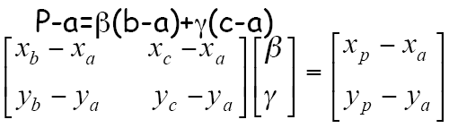
Computing Barycentric Coordinates
Given a point p, how do we compute barycentric coordinates? → various methods
p = a + β(b-a) + γ(c-a)

Slide 49
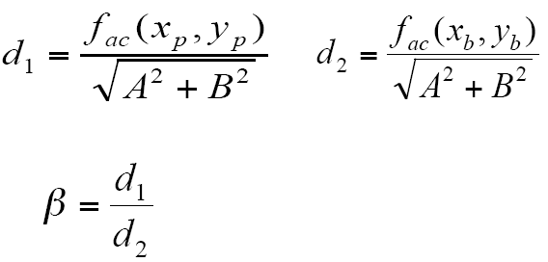
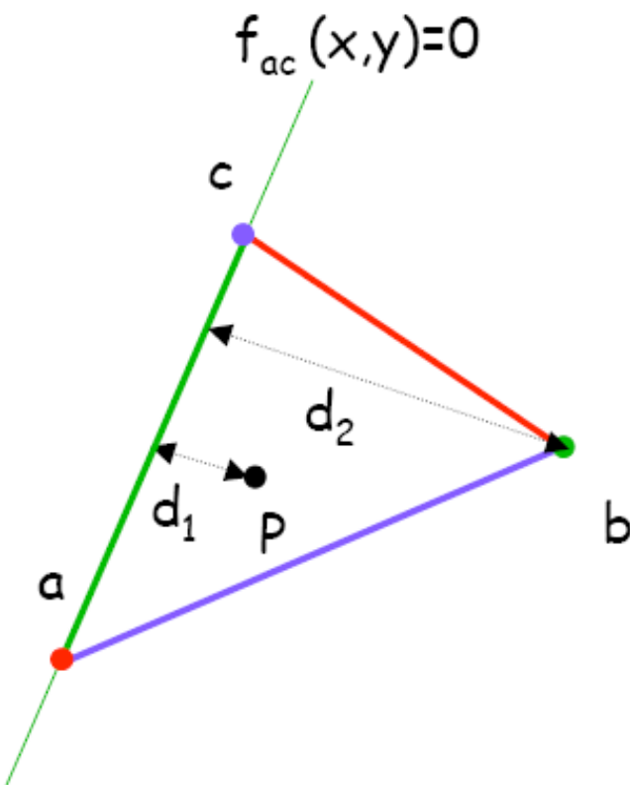
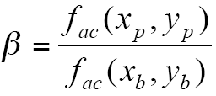

Computing Barycentric Coordinates
Method 2:
  Barycentric coordinates are signed scaled distance from the lines through the triangle sides

Slide 50


Computing Barycentric Coordinates

