Slide 1
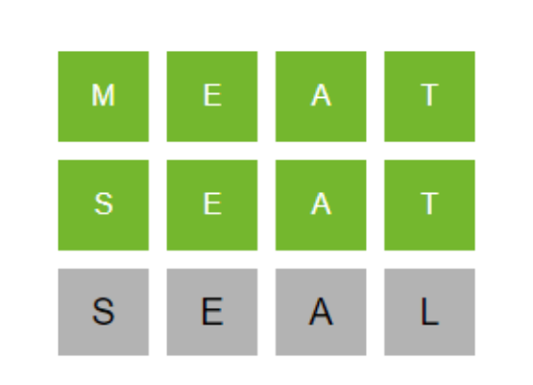
Word Ladder Adventure Game using Artificial Intelligence
Group Members:
Talha Khan (242210)
Ahsan Khan (242206)
Muhammad Rehan Shoukat (242212)
Submitted To:
Aisha Sattar Choudhry
Course:
Introduction To Artificial Intelligence

Slide 2

Outline
Introduction
Problem Statement
Objectives
Problem Solution
Importance of Project
Methodology Overview
Future Work
Conclusion

Slide 3
Introduction
Word Ladder Adventure Game is an AI-based project
Goal is to transform one word into another
Only one letter can be changed at a time
Every word must be a valid English word
AI search algorithms are used to solve the problem

Slide 4

Problem Statement
Finding a valid word transformation path is difficult manually
Large dictionary increases complexity
Restrictions like banned words and limited moves make it harder
Main Challenges:
Validate words
Ensure one-letter change
Avoid repeated or invalid words
Find optimal solution efficiently

Slide 5

Objectives
Design an interactive Word Ladder game
Apply AI search algorithms in real problem
Compare different algorithms
Provide Custom and AI gameplay modes
Visualize word transformations using graphs

Slide 6

Problem Solution
Word Ladder is treated as a state-space search problem
Each word = a state
One-letter change = an action
Target word = goal state
Solution Uses:
Datamuse API for valid words
AI search algorithms
Constraints handling
Graph visualization

Slide 7
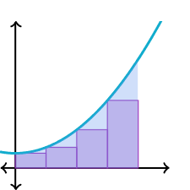
Importance Of Project
Helps understand AI search algorithms practically
Shows real-world API usage
Demonstrates algorithm efficiency and optimization
Makes learning interactive and visual

Slide 8
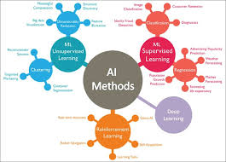
Methodology Overview
Steps followed in the project:
Data Collection
Word Validation
Transition Validation
Neighbor Generation
AI Algorithms
Game Modes
Difficulty Levels
Visualization

Slide 9

Data Collection & Validation
Data Collection:
Datamuse API fetches valid English words
Words are stored in uppercase
Word Validation:
Each word is checked using API
Invalid words are rejected

Slide 10

Transition Rules
A word transition is valid only if:
Word length remains same
Exactly one letter changes
Restricted letters are avoided
Banned words are not allowed
This ensures fair gameplay.

Slide 11
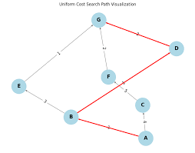
Neighbor Generation
All possible next words are generated
One letter is changed at each position
Only dictionary-valid words are selected
These words are used by AI algorithms

Slide 12

AI Search Algorithms
BFS: Finds shortest path
DFS: Explores deeply, may not be optimal
UCS: Uses uniform cost for best path
GBFS: Uses heuristic for fast decisions
A*: Best performance using cost + heuristic
Algorithms:
BFS
DFS
UCS
GBFS
A*

Slide 13

Game Modes
Custom Mode:
User plays manually
No hints
Every move is validated
AI Mode:
User selects AI algorithm
AI finds solution path
User can ask for hints
Custom Mode
Ai Mode

Slide 14
Difficulty Levels
Level | Word Length | Moves | Restrictions
Beginner | 3 | 10 | None
Advanced | 4 | 15 | None
Challenge | 5 | 20 | Banned & Restricted

Slide 15

Future Work & Conclusion
Performance optimization
Better heuristic functions
Mobile and web version
Support for multiple languages
Performance optimization
Conclusion
Project successfully applies AI algorithms
Combines gameplay, AI, and visualization

Slide 16
Thank You!

