Slide 1

IT-507 3(2-1) DATABASE ADMINISTRATION AND MANAGEMENT

Slide 2

CHAPTER 1 INTRODUCTION TO DATABASE ADMINISTRATION AND MANAGEMENT

Slide 3
What Is Database Administration?
Every organization using a database management system (DBMS) to manage data requires a database administration group to ensure the effective use and deployment of the company's databases.
Most modern organizations of any size use a DBMS, the need for a database administrator (DBA) is greater today than ever before.

Slide 4
Why Learn Database Administration?
Data is at the center of today's applications; today's organizations simply cannot operate without data.
business today is data. Without data, businesses would not have the ability to manage finances, conduct transactions, or contact their customers.
Databases are created to store and organize this data.
The better the design and utility of the database, the better the organization will be positioned to compete for business.

Slide 5
Database Technology
What is Database ?
A database is an organized store of data wherein the data is accessible by named data elements (for example, fields, records, and files).
What is Database management system?
A DBMS is software that enables end users or application programmers to share and manage data. It provides a systematic method of creating, updating, retrieving, and storing information in a database. A DBMS is also generally responsible for data integrity, data security, data access control and optimization, automated rollback, restart, and recovery

Slide 6
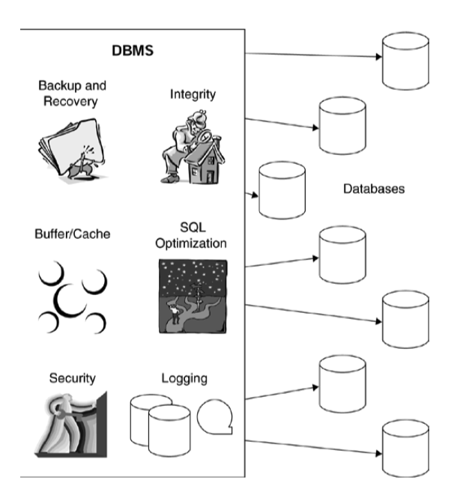
Relationship of DBMS to database
Figure 1.1

Slide 7
The Management PLAN of Database Administration
A proactive database administrator develops and implements a strategic blueprint for deploying databases within the organization.
This plan should address all phases of the application development life cycle. A data specialist, usually the DBA, should be involved during each phase of the cycle, as shown in Figure 1-2.
DBA can help to determine if the required data already exists elsewhere in the organization or if the data is brand new
During the analysis and design phases, the rudimentary data requirements must be transformed into a conceptual and logical data model.

Slide 8
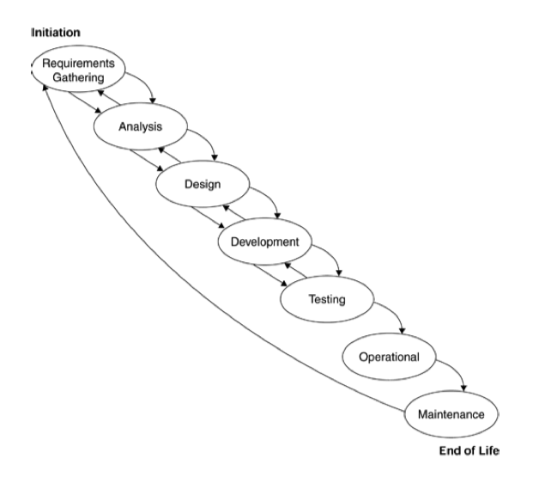
The application development life cycle
Figure 1.2

Slide 9
Data Administration
What is Data Administration ?
Data administration separates the business aspects of data resource management from the technology used to manage data; it is more closely aligned with the actual business users of data. The data administrator (DA) is responsible for understanding the business lexicon and translating it into a logical data model. Referring back to the ADLC, the DA would be involved more in the requirements gathering, analysis, and design phase, the DBA in the design, development, testing, and operational phases.

Slide 10
Data Administration
The DA is responsible for the following tasks:
Identifying and cataloging the data required by business users.
Producing conceptual and logical data models to accurately depict the relationship among data elements for business processes.
Creating an enterprise data model that incorporates all of the data used by all of the organization's business processes.
Setting data policies for the organization.

Slide 11
Data Administration
The DA is responsible for the following tasks:
Identifying data owners and stewards.
Setting standards for control and usage of data.

Slide 12
Data Administration (Metadata)
What is Metadata ?
Metadata is often described as data about data; more accurately, metadata is the description of the data and data interfaces required by the business. Data administration is responsible for the business's metadata strategy.
Example
Examples of metadata include the definition of a data element, business names for a data element, any abbreviations used for that element, and the data type and length of the element. Data without metadata is difficult to use.

Slide 13
Data Administration (Metadata)
Example
The number 12 is data, but what kind of data? In other words, what does that 12 mean? Without metadata, we have no idea. Consider this: Is the number 12
A date representing December, the twelfth month of the year?
A date representing the twelfth day of some month?
An age?
A shoe size?
Is 12 a large number or a small one?
What is its data type?

Slide 14
Database Administration
The first duty of the DBA is to understand the data models built by the DA and to communicate the model to the application developers and other appropriate technicians.
The logical data model is the map the DBA will use to create physical databases.
The DBA will transform the logical data model into an efficient physical database design.

Slide 15
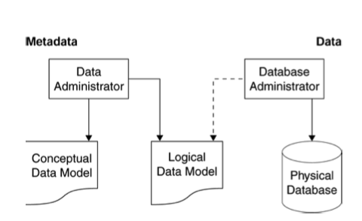
Database Administration
Figure 1.3
DBA vs DA

Slide 16
System Administration
What is System Administration?
The SA is responsible for the installation and setup of the DBMS. The SA typically has no responsibility for database design and support. Instead, the DBA is responsible for the databases and the SA is responsible for DBMS installation, modification, and support.

Slide 17
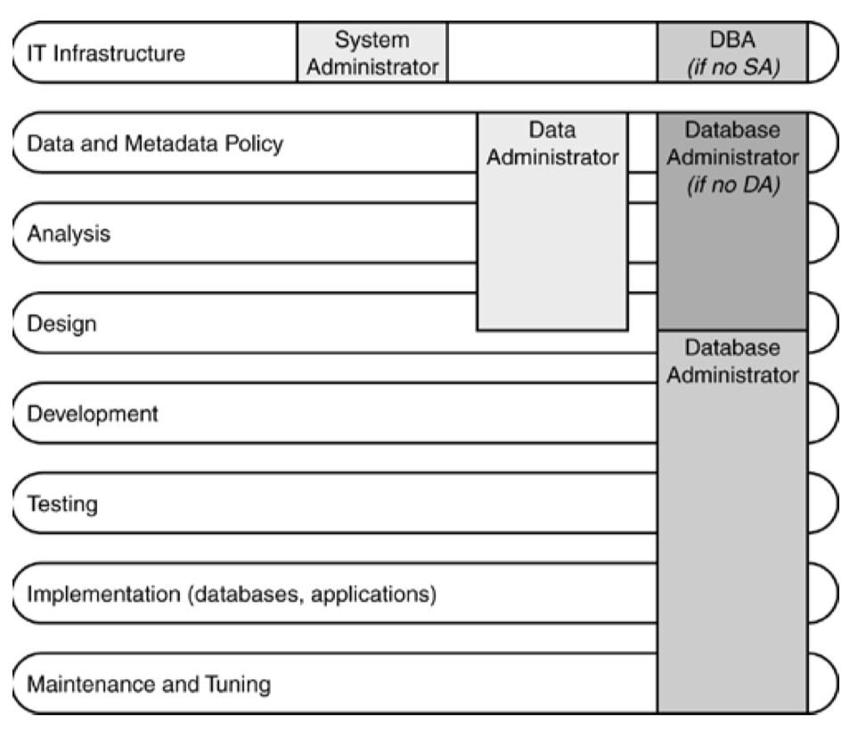
System Administration
This Diagram shows responsibilties
Of DA, DBA and SA.
Figure 1-4
DA, DBA, and SA responsibilities

Slide 18
Database Design
To properly design and create relational databases, the DBA must understand and adhere to sound relational design practices.
The DBA must understand both relational theory and the specific implementation of the relational database management system (RDBMS) he's using to create the database.
Database design requires a sound understanding of conceptual and logical data modeling techniques.
The ability to create and interpret entity-relationship diagrams is essential to designing a relational database.

Slide 19
Database Design
What is a Relational Database (RDBMS)?
A relational database is a type of database that stores and provides access to data points that are related to one another.
They are based on the relational model, straightforward way of representing data in tables.
In a relational database, each row in the table is a record with a unique ID called the key.
The columns of the table hold attributes of the data, and each record usually has a value for each attribute, making it easy to establish the relationships among data points.
A poor Relational Design can result in poor performance.

Slide 20
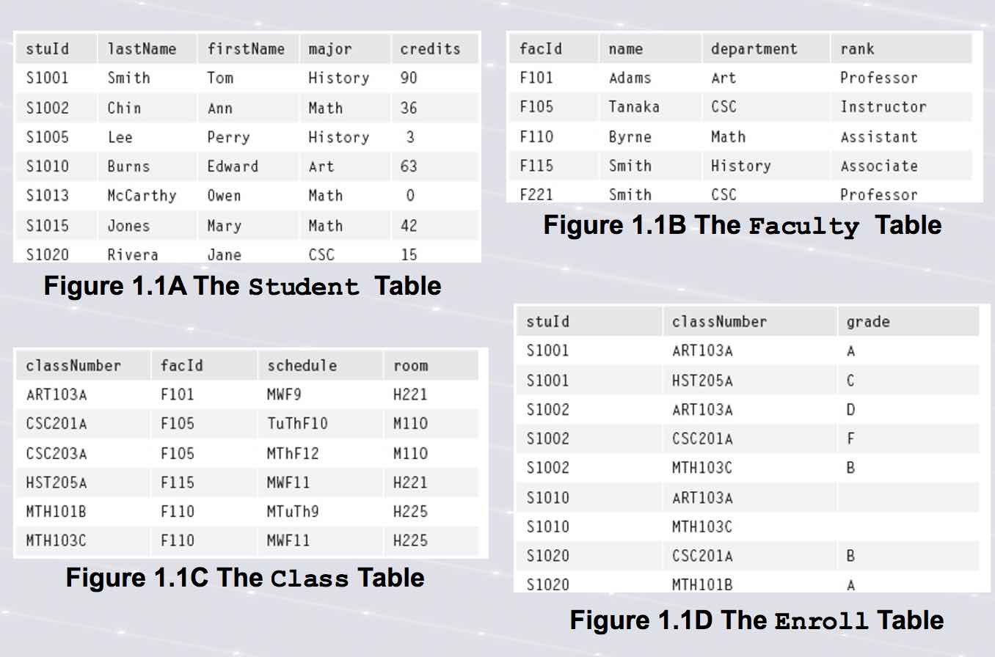
Relational Database
Fig 1.5
Example Relationship between tables

Slide 21

CHAPTER 1 THE END

