Slide 1
CHAPTER
Data Modeling and Normalization
2
This chapter introduces the concepts of Data Modeling and Normalization.

Slide 2
Data Modeling
What is Data Modeling ?
Data modeling is the process of analyzing the things of interest to your organization and how these things are related to each other.
The data modeling process results in the discovery and documentation of the data resources of your business.
Before implementing databases of any sort, a DBA or DA needs to develop a sound model of the data to be stored.

Slide 3
Data Modeling
Before implementing databases of any sort, a DBA or DA needs to develop a sound model of the data to be stored.
Novice database developers frequently begin with the quick-and-dirty approach to database implementation. They approach database design from a programming perspective.
Because novices often lack experience with databases and data requirements gathering, they attempt to design databases like the flat files they are accustomed to using.
This is a major mistake. Indeed, most developers using this approach quickly discover problems after the databases and applications become operational in a production environment.
At a minimum, performance will suffer and data may not be as readily available as required. At worst, data integrity problems may arise, rendering the entire application unusable.

Slide 4
Requirement of Data Modeling
What is required is a practiced and formal approach to gathering data requirements and modeling the data, that is, the discovery and identification of entities and data elements.
Data normalization is a big part of data modeling and database design.
A normalized data model reduces data redundancy and inconsistencies by ensuring that the data elements are designed appropriately.

Slide 5
Data Modeling Concepts
The first objective of data modeling is to understand the requirements.
A data model delivers value by enhancing communication and understanding
It can be argued that these are quite valuable. However, the primary value of a data model is its ability to be used as a blueprint to build a physical database.
When databases are built from a well-designed data model, the resultant structures provide increased value to the organization.

Slide 6
Data Modeling Advantages
Minimized data redundancy
Maximized data integrity
Increased stability
Better data sharing
Increased consistency
More access to data
Better data usability.

Slide 7
The Enterprise Data Model
What is Enterprise Data Model ?
An enterprise data model is a single data model that describes comprehensively the data needs of the entire organization.
Data modeling requires a different mindset than requirements gathering for application development and process-oriented tasks. It is important to think "what" is of interest instead of "how" tasks are accomplished. To transition to this alternative way of thinking, follow these three rules.

Slide 8
The Enterprise Data Model(THREE RULES)
Don't think physical; think conceptual.
Concern yourself with business issues and terms rather than physical storage issues and DBMS constraints.
Don't think process; think structure.
How something is done, although important for application development, is not important for data modeling. The things that processes are being applied to are what is important to data modeling.
Don't think navigation; think relationship.
The way that things are related to one another is important because relationships map the data model. The way in which relationships are traversed is unimportant to conceptual and logical data modeling.

Slide 9
The Enterprise Data Model
Keep in mind
As you create your data models, you are developing the lexicon of your organization's business. Much like a dictionary functions as the lexicon of a given language, the data model functions as the lexicon of business terms and their usage.

Slide 10
Data Modeling
Data Objects
A Data Object is a representation of a composite information that must be understood and processed by the system.
(Example: “Width” cannot be Data Object but “Dimension” can be)
An Entity (i.e Person)
A thing (i.e Report)
An occurrence (i.e Telephone call)
Event (i.e Alarm)
A role (i.e Sales person)
A place (i.e Warehouse)
A structure (i.e File)

Slide 11
Data Modeling
Attributes
An attribute is a characteristic of an entity. Every attribute does one of three things:
• Identifies. An attribute that identifies is a candidate key. If the value of an identifying attribute changes, it should identify a different entity occurrence.
• Relates. An attribute that relates entities is a foreign key. The attribute refers to the primary key attribute of an occurrence of another (or the same) entity.
• Describes. An attribute is descriptive if it depicts or express a characteristic of an entity occurrence, but does not identify or relate.
Every attribute does one of three things: it identifies, relates, or describes

Slide 12
Data Modeling (Keys)
What are Keys ?
Keys consist of the attributes that identify entity occurrences and define the relationships between entities. There are 3 types of Keys:
A candidate key is an attribute, or set of attributes, that can be used to uniquely identify an occurrence of the entity.
The primary key is chosen from the set of candidate keys and is used to identify an entity occurrence.
The primary key must guarantee the uniqueness of an entity occurrence.
The value of any component of the primary key cannot be null.
Primary keys of basic entities should not have embedded meaning.
Primary keys should not be changeable.

Slide 13

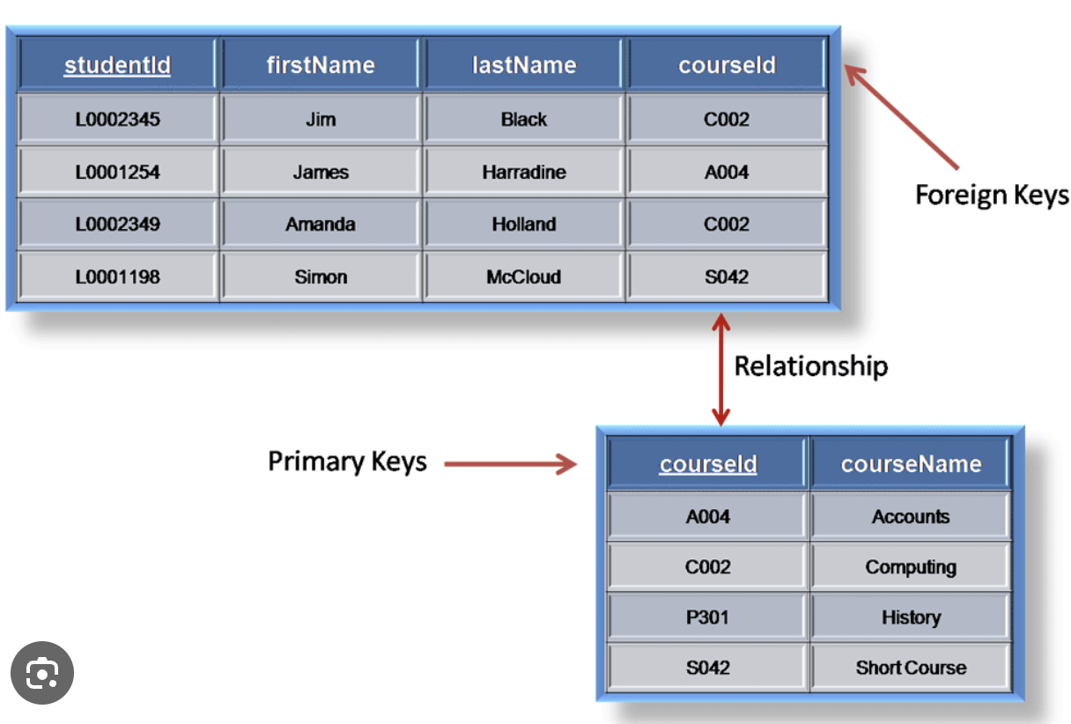
Data Modeling (Keys)
Foreign keys reside in dependent entities to establish relationships. The primary key identifies an entity occurrence; foreign keys identify relationships between entity occurrences.

Slide 14
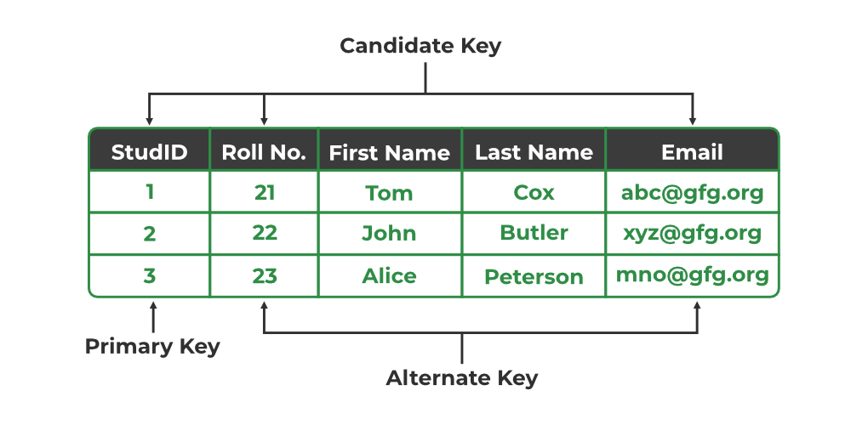

Slide 15
Data Modeling (Relationships)
Relationships define how the different entities are associated with each other. A relationship name should describe the role played by an entity in its association with another (or perhaps the same) entity. The keys define a relationship: the primary key in the parent entity and the foreign key in the dependent entity.

Slide 16
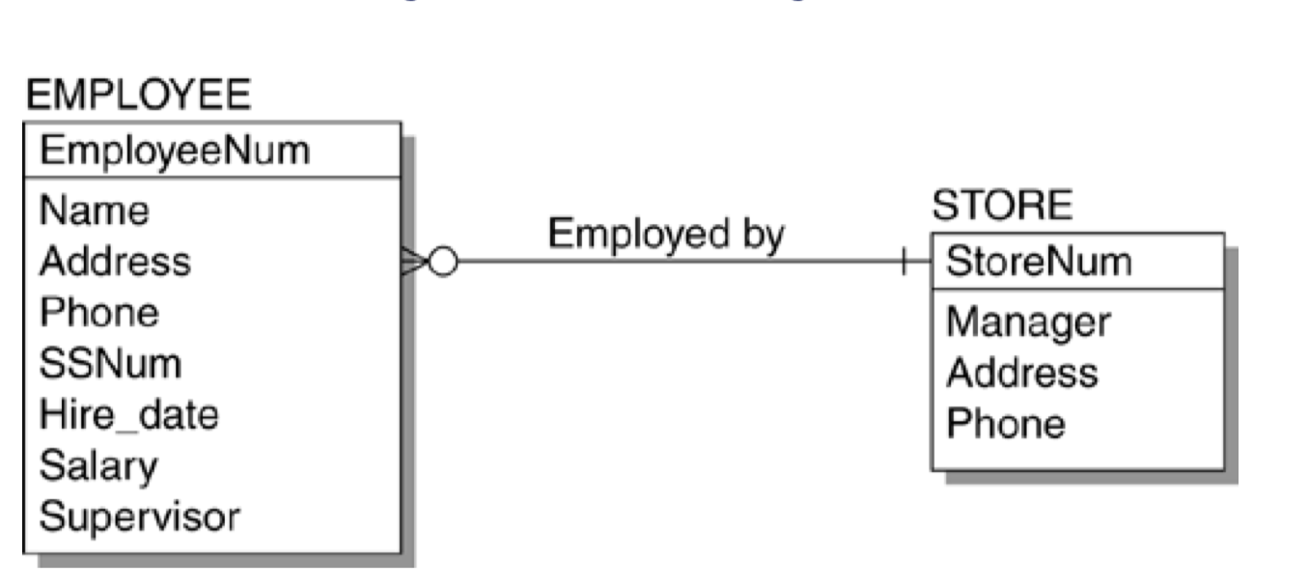
Data Modeling (Relationships)
Optionality
The data model must also capture whether relationships are mandatory or optional. This is commonly referred to as the optionality of the relationship.
Example: This data model fragment clearly states that an EMPLOYEE is employed by a STORE. The STORE can have zero, one, or multiple EMPLOYEEs. If an EMPLOYEE exists, a relationship to a STORE is mandatory. Furthermore, an EMPLOYEE can only work for one store.

Slide 17
Entity-Relationship Diagramming
An E/R diagram graphically depicts the entities and relationships of a data model.
Data models are typically rendered in a graphical format using an entity-relationship diagram, or E/R diagram for short. An E/R diagram graphically depicts the entities and relationships of a data model.

Slide 18
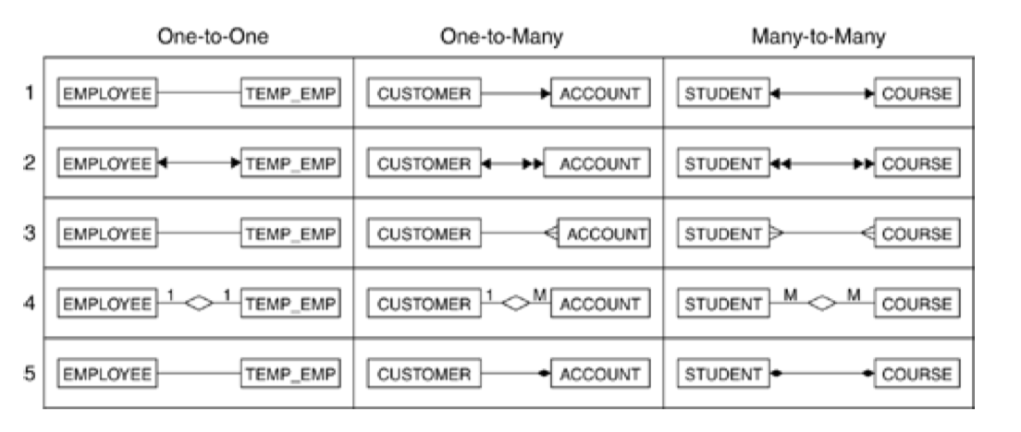
Entity-Relationship Diagramming Methods
E/R diagramming methods: (1) Ross, (2) Bachmann, (3) Martin, (4) Chen, (5) Rumbaugh

Slide 19
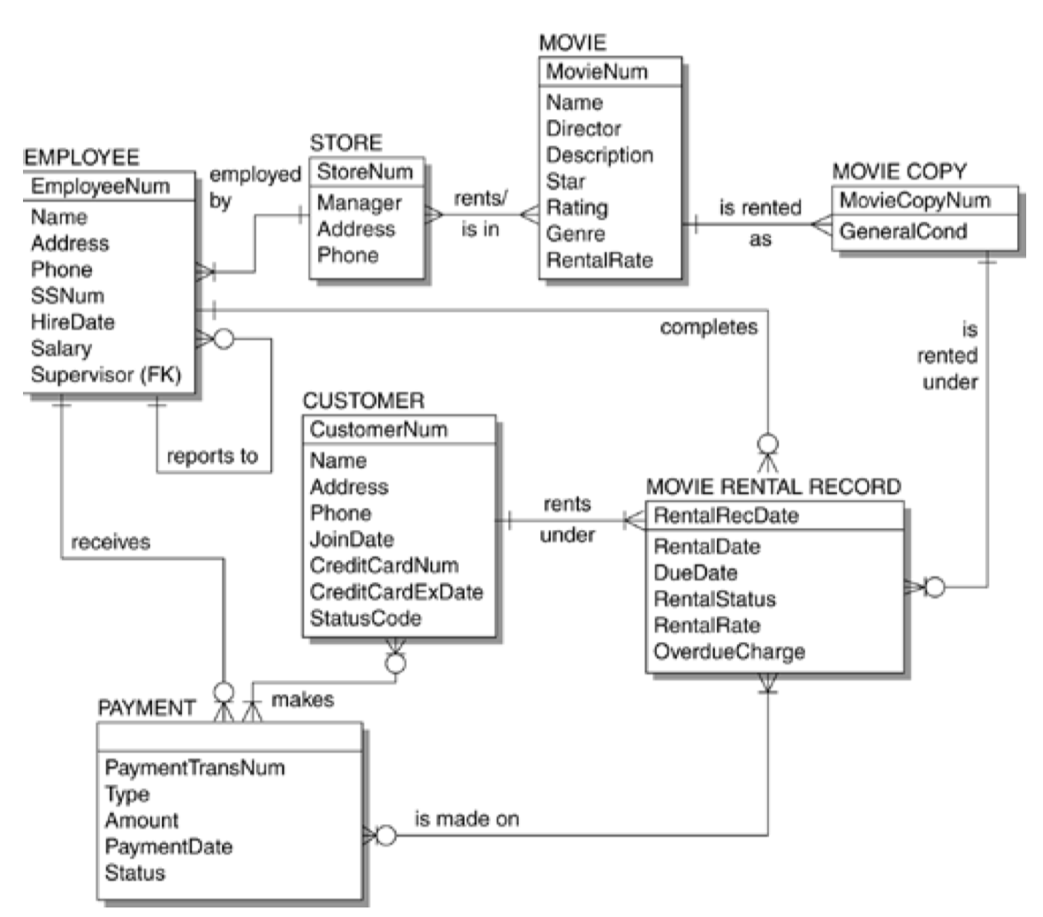
ER - SAMPLE
An E/R diagram will show the entities in boxes and use lines or arrows to show relationships. The format of the boxes and lines differs with the diagramming method.
This diagram is made using ERwin

Slide 20
TO BE CONTINUE

