Slide 1

Web Application Development
AJAX
M. Rehan Abbas Ch, UCP, Lahore

Slide 2
What is AJAX?
AJAX = Asynchronous JavaScript and XML.
AJAX is a technique for creating fast and dynamic web pages.
AJAX allows web pages to be updated asynchronously by exchanging small amounts of data with the server behind the scenes. This means that it is possible to update parts of a web page, without reloading the whole page.
Classic web pages, (which do not use AJAX) must reload the entire page if the content should change.
Examples of applications using AJAX: Google Maps, Gmail, Youtube, and Facebook tabs.

Slide 3
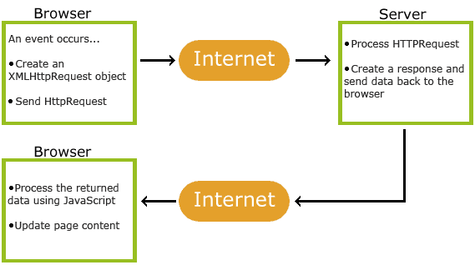
How AJAX works

Slide 4
AJAX is Based on Internet Standards
AJAX is Based on Internet Standards
AJAX is based on internet standards, and uses a combination of:
XMLHttpRequest object (to exchange data asynchronously with a server)
JavaScript/DOM (to display/interact with the information)
CSS (to style the data)
XML (often used as the format for transferring data)

Slide 5
Google Suggest
AJAX was made popular in 2005 by Google, with Google Suggest.
Google Suggest is using AJAX to create a very dynamic web interface: When you start typing in Google's search box, a JavaScript sends the letters off to a server and the server returns a list of suggestions.

Slide 6
The XMLHttpRequest Object
The XMLHttpRequest object is used to exchange data with a server behind the scenes. This means that it is possible to update parts of a web page, without reloading the whole page.
Syntax for creating an XMLHttpRequest object:
variable=new XMLHttpRequest();
Old versions of Internet Explorer (IE5 and IE6) uses an ActiveX Object:
variable=new ActiveXObject("Microsoft.XMLHTTP");

Slide 7
Syntax
var xmlhttp;
if (window.XMLHttpRequest)
{// code for IE7+, Firefox, Chrome, Opera, Safari
xmlhttp=new XMLHttpRequest();
}
else
{// code for IE6, IE5
xmlhttp=new ActiveXObject("Microsoft.XMLHTTP");
}

Slide 8
Send a Request To a Server
To send a request to a server, we use the open() and send() methods of the XMLHttpRequest object:
xmlhttp.open("GET","ajax_info.txt",true);
xmlhttp.send();

Slide 9
The url - A File On a Server
The url parameter of the open() method, is an address to a file on a server:
xmlhttp.open("GET","ajax_test.asp",true);
The file can be any kind of file, like .txt and .xml, or server scripting files like .asp and .php (which can perform actions on the server before sending the response back).

Slide 10
Asynchronous - True or False?
AJAX stands for Asynchronous JavaScript and XML, and for the XMLHttpRequest object to behave as AJAX, the async parameter of the open() method has to be set to true:
xmlhttp.open("GET","ajax_test.asp",true);
Sending asynchronous requests is a huge improvement for web developers. Many of the tasks performed on the server are very time consuming. Before AJAX, this operation could cause the application to hang or stop.
With AJAX, the JavaScript does not have to wait for the server response, but can instead:
execute other scripts while waiting for server response
deal with the response when the response ready

Slide 11
Async=true
When using async=true, specify a function to execute when the response is ready in the onreadystatechange event:
xmlhttp.onreadystatechange=function()
{
if (xmlhttp.readyState==4 && xmlhttp.status==200)
{
document.getElementById("myDiv").innerHTML=xmlhttp.responseText;
}
}
xmlhttp.open("GET","ajax_info.txt",true);
xmlhttp.send();

Slide 12
Async=false
To use async=false, change the third parameter in the open() method to false:
xmlhttp.open("GET","ajax_info.txt",false);
Using async=false is not recommended, but for a few small requests this can be ok.
Remember that the JavaScript will NOT continue to execute, until the server response is ready. If the server is busy or slow, the application will hang or stop.

Slide 13
Note: When you use async=false, do NOT write an onreadystatechange function - just put the code after the send() statement:
Example
xmlhttp.open("GET","ajax_info.txt",false);
xmlhttp.send();
document.getElementById("myDiv").innerHTML=xmlhttp.responseText;

Slide 14
Server Response
To get the response from a server, use the responseText or responseXML property of the XMLHttpRequest object.
Property Description
responseText get the response data as a string
responseXML get the response data as XML data

Slide 15
Server Response
The responseText Property
If the response from the server is not XML, use the responseText property.
The responseText property returns the response as a string, and you can use it accordingly:
document.getElementById("myDiv").innerHTML=xmlhttp.responseText;

Slide 16
The onreadystatechange event
Property | Description
onreadystatechange | Stores a function (or the name of a function) to be called automatically each time the readyState property changes
readyState | Holds the status of the XMLHttpRequest. Changes from 0 to 4: 0: request not initialized 1: server connection established 2: request received 3: processing request 4: request finished and response is ready
status | 200: "OK" 404: Page not found

