Slide 1
REAL-TIME · SERVERLESS · MLOps
Karachi AQI
Predictor
End-to-End MLOps Pipeline for 72-Hour Air Quality Forecasting
0.998
24
96
72h
Best R²
+1h
Models
Trained
Engineered
Features
Forecast
Horizon
Talha Arsh · 10Pearls Shine Program 2026 · aqi-predictor-10pearls.streamlit.app

Slide 2
THE PROBLEM
Karachi's Air Crisis
🏙️ 15 Million Residents
Karachi
Mean AQI
Pakistan's largest city with one of the world's worst air quality records
86
📈 Persistent Moderate-Unhealthy AQI
Mean AQI 86 over 2 years · 96.2% of time in Moderate or worse category
🌫️ No Public Forecast Service
MODERATE
No real-time, freely accessible AQI forecasting tool existed for Karachi
(51-100 EPA scale)
75.4% of all readings
⚕️ Real Health Stakes
Particulate matter exposure causes cardiovascular and respiratory disease

Slide 3
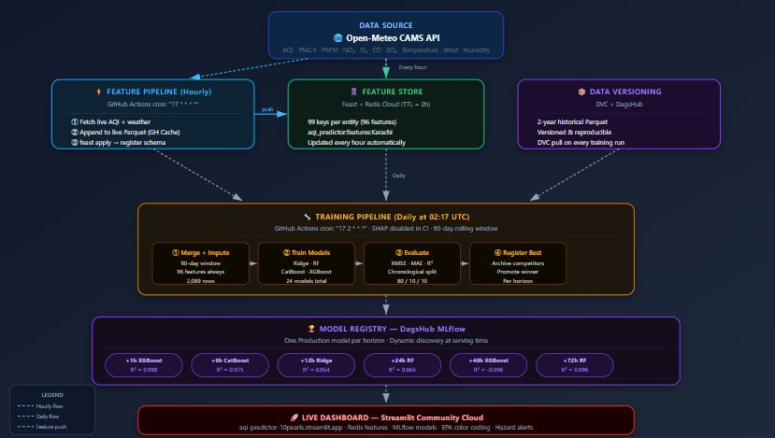
SYSTEM ARCHITECTURE
End-to-End Serverless MLOps Pipeline
GitHub: TalhaArsh/aqi-predictor · Live: aqi-predictor-10pearls.streamlit.app

Slide 4
MODULE 1
Feature Pipeline
Automated · Hourly · Zero API Key
①
Fetch
96 Features
Open-Meteo CAMS API
AQI + 6 pollutants + 6 weather vars
Raw Pollutants
7
②
Append
Raw Weather
6
Live Parquet in GitHub Actions Cache
key: live-parquet-v2-{N}
Time Features
9
AQI Lags
7
③
Engineer
96 features: lags · rolling means
change rates · cyclical time encoding
Rolling Means
5
Change Rates
2
④
Push
Pollutant Lags
24
Redis Cloud · 99 keys · TTL=2h
aqi_predictor:features:Karachi
Weather Lags
36
⏱ cron: "17 * * * *" — 24×/day

Slide 5
MODULE 2
Training Pipeline
1
2
3
4
Merge + Impute
Train 24 Models
Evaluate
Register Best
90-day rolling window
2,089 rows · 96 features
Ridge · RF · CatBoost · XGBoost
× 6 horizons in parallel
RMSE · MAE · R²
Chrono 80/10/10 split
Archive competitors
Promote winner → Production
Champion Models — Latest Production Registry
Horizon
+1h
+6h
+12h
+24h
+48h
+72h
Model
CatBoost
CatBoost
CatBoost
RF
XGBoost
RF
RMSE
±0.9
±2.3
±4.6
±4.1
±12.3
±5.8
R²
0.996
0.965
0.835
0.785
-11.77
-2.78
⏱ cron: "17 2 * * *" — Daily at 02:17 UTC · ~35 min run time

Slide 6
EDA & SHAP INSIGHTS
What the Data Tells Us
📊 AQI Distribution
🕐 Temporal Peak
💨 PM2.5 Dominant
Range 32–161 · Mean 86
75.4% Moderate · 21.2% Unhealthy-S
Peaks at 13-14 UTC (18-19 PKT)
No significant weekday pattern
r=0.72 with AQI — strongest predictor
Ozone shows non-linear SHAP impact
🔁 Autocorrelation
⚡ SHAP: Short Horizon
📅 SHAP: Long Horizon
r=0.98 at 1h · r=0.63 at 24h
r=0.17 at 72h — signal fades fast
+1h: aqi_change_1h dominates
+6h: o3 single most important feature
+48h/72h: 'day' feature dominates
Model relies on calendar seasonality

Slide 7
ENGINEERING CHALLENGES
Problems Solved in Production
⚠ StandardScaler Column Mismatch
CRITICAL FIX
→ Dashboard was predicting +669 AQI delta. Fixed by reading scaler.feature_names_in_ and building a named DataFrame — not a numpy array.
⚠ CatBoost Categorical Type Error
MODEL FIX
→ Time features (hour, day, month) must be passed as strings in a catboost.Pool. Float64 inputs caused immediate inference failure.
⚠ 132-Feature Merge Bug
PIPELINE FIX
→ Live Parquet union with historical created 148 columns → 132 features. Fixed with column intersection to enforce 96-feature schema.
⚠ Double 90-Day Window Filter
TRAINING FIX
→ impute_features.py already filters to 90 days. data_loader.py re-applying it gave 0 training rows. Removed downstream filter.

Slide 8
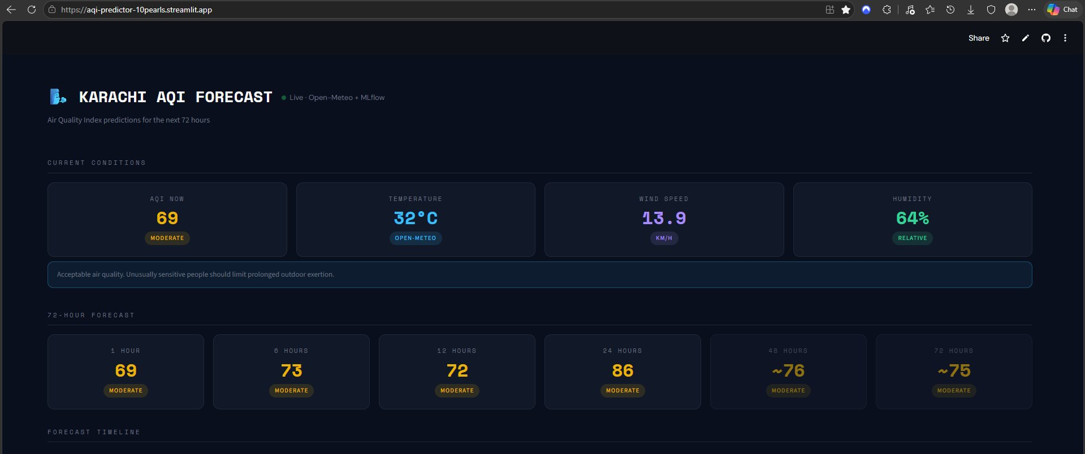
LIVE DASHBOARD
Streamlit Community Cloud
📡
Live Features
Redis Cloud
99 keys · 2h TTL
🤖
Dynamic Models
Auto-loads from MLflow
No hardcoded names
🎨
EPA Colour Coding
Good → Hazardous
Health advisory text
🚨
Hazard Alerts
Triggered at AQI ≥ 150
Per forecast horizon
📊
Live Metrics
RMSE + R² pulled
from MLflow run at startup
🔗 aqi-predictor-10pearls.streamlit.app

Slide 9
KEY FINDINGS
What We Learned
01
90-Day Window >> 2-Year History
+6h R² improved from 0.803 → 0.975 with a 90-day rolling window. Recent data captures current seasonality without concept drift.
02
Feature Column Order is Mission-Critical
StandardScaler scales by column position. Wrong order produced AQI delta of +669. Fixing via feature_names_in_ was the most impactful production change.
03
SHAP Reveals the Prediction Horizon Boundary
At 48h+ the 'day' feature dominates (|SHAP|=4.95–6.78) — proof the model has exhausted its signal and requires weather forecast inputs.
04
Fewer Features Win at Long Horizons
Top-20 feature selection improves 48h Ridge R² from 0.104 → 0.379. With 2,089 rows and 96 features, long-horizon models overfit to noise.
05
CatBoost & XGBoost Dominate Ensembles
Won 4 of 6 horizons. Ridge remains competitive at +12h — fewer parameters, less overfitting on moderate training set size.

Slide 10
🌬️
Karachi AQI Predictor
End-to-End MLOps · Serverless · Live in Production
🚀
📂
📊
Live Dashboard
GitHub Repo
MLflow Experiments
aqi-predictor-10pearls.streamlit.app
github.com/TalhaArsh/aqi-predictor
dagshub.com/TalhaArsh/aqi-predictor.mlflow
✅ Feature Pipeline ✅ Historical Backfill ✅ Training Pipeline ✅ CI/CD (GitHub Actions) ✅ Web Dashboard ✅ EDA Notebooks ✅ SHAP Analysis ✅ Hazard Alerts ✅ Final Report
Talha Arsh · 10Pearls Shine Program 2026 · Data Science Track

