Slide 1


Long Short Term Memory Networks (LSTMs)

Slide 2
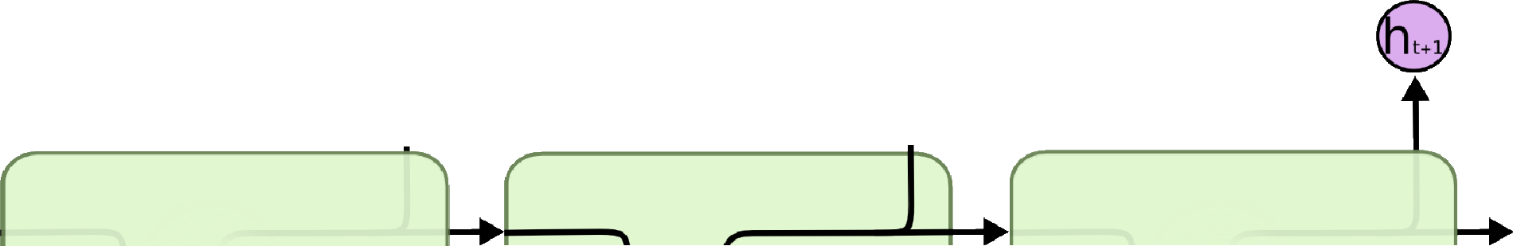


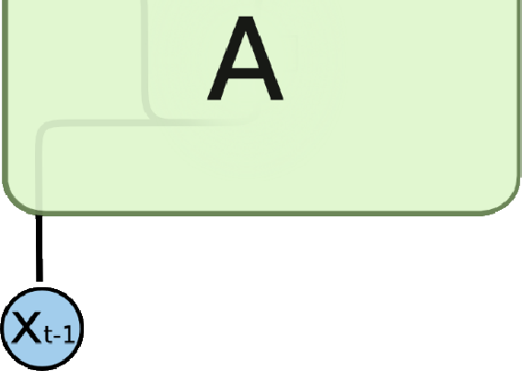
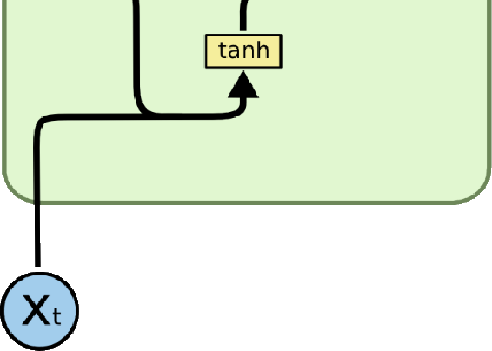
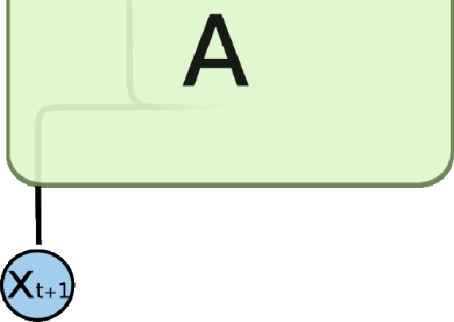
Long Short Term Memory Networks - LSTMs
Long Short Term Memory networks – usually just called “LSTMs” – are a special kind of RNN, capable of learning long-term dependencies.
Repeating module in RNN contains a single layer

Slide 3
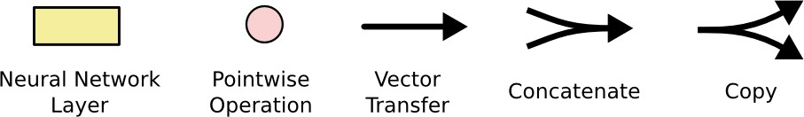
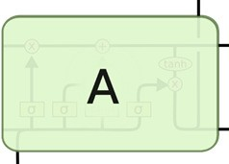

Slide 4
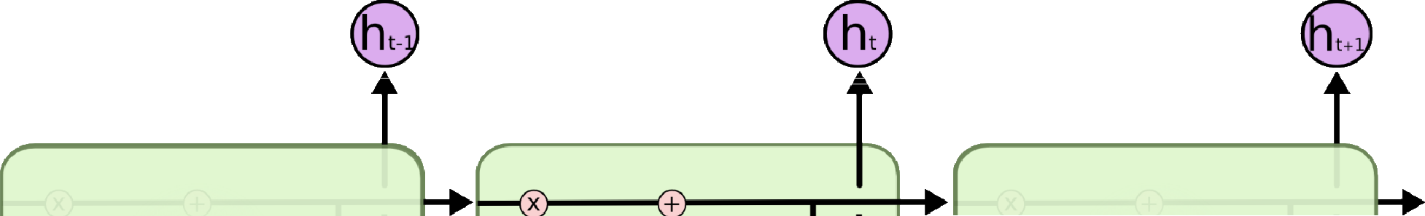
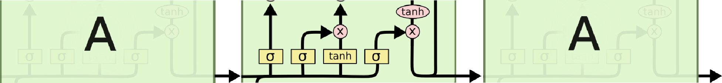
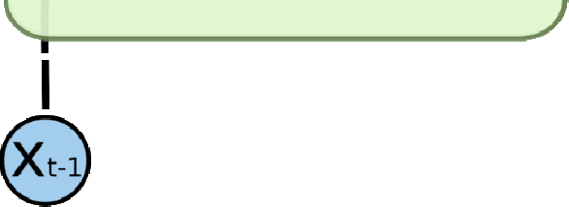
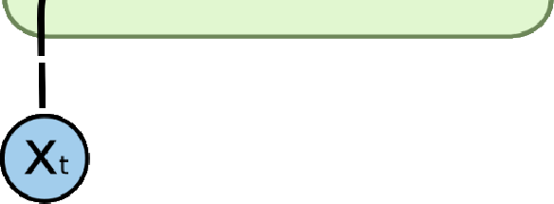
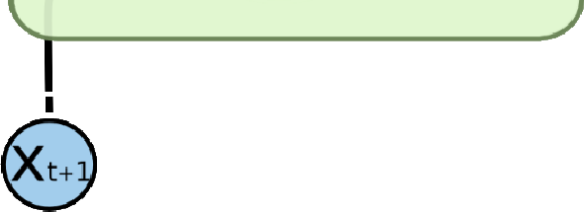
Long Short Term Memory Networks - LSTMs
The repeating unit is more complex in LSTMs

Slide 5
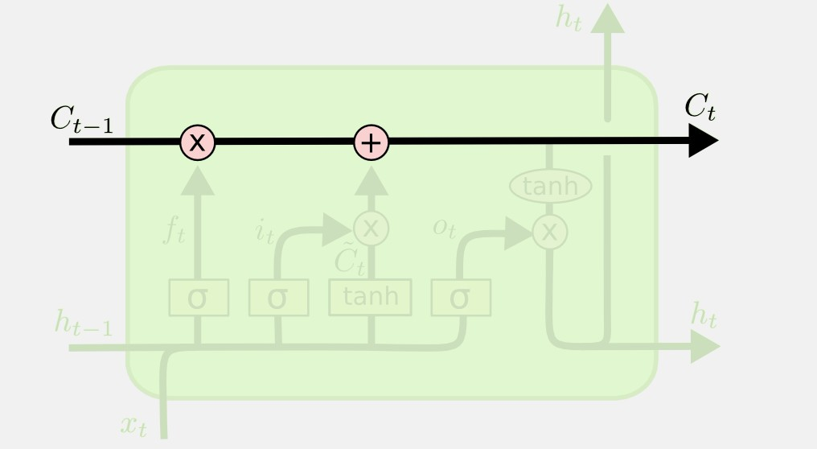
LSTMs
The key to LSTMs is the cell state, the horizontal line running through the top of the diagram.
The cell state is kind of like a conveyor belt.
It runs straight down the entire chain, with only some minor linear interactions.
It’s very easy for information to just flow along it unchanged.

Slide 6
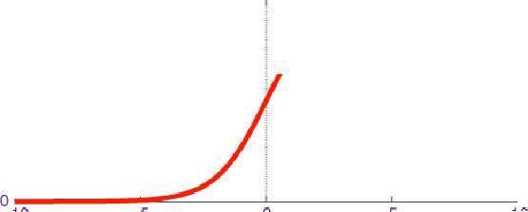



LSTMs - Gates
The LSTM does have the ability to remove or add information to the cell state, carefully regulated by structures called gates.
Gates are a way to optionally let information through. They are composed out of a sigmoid neural net layer and a point-wise multiplication operation.
The sigmoid layer outputs numbers between zero and one, describing how much of each component should be let through.
A value of zero means “let nothing through,” while a value of one means “let everything through!”

Slide 7
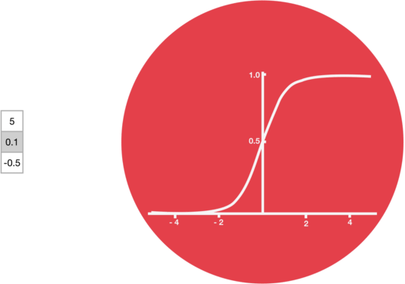
Sigmoid Activation Function
A sigmoid activation is similar to the tanh activation.
Instead of squishing values between -1 and 1, it squishes values between 0 and 1

Slide 8
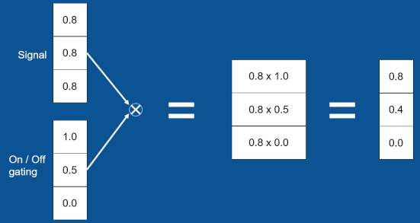
LSTMs - Gates
Concept of Gating

Slide 9
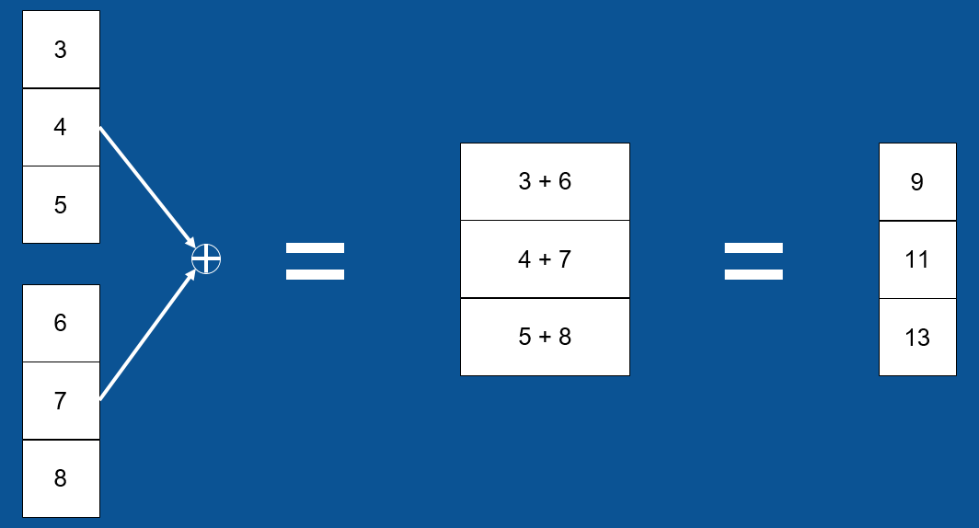
LSTM - Gates
Plus Junction – Point-wise Addition

Slide 10
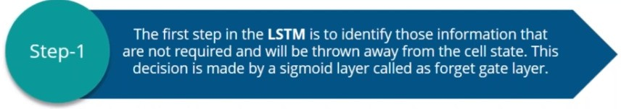
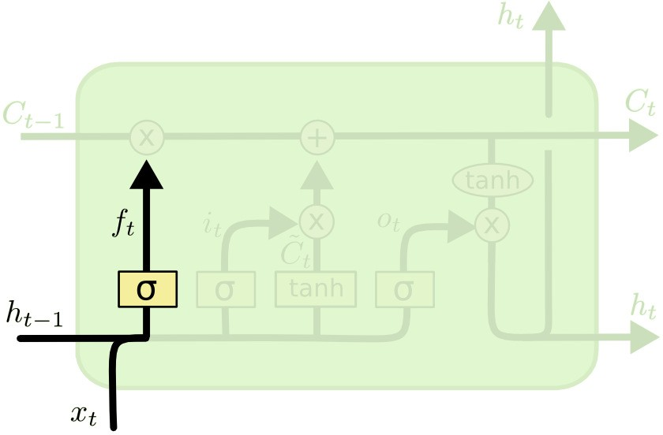
LSTMs
The forget layer looks at h_{t−1} and x_{t}, and outputs a number between 0 and 1 for each number in the cell state C_{t−1}.
A 1 represents “completely keep this” while a 0 represents “completely get rid of this.”

Slide 11
LSTMs – Forget Layer
Example:
  Language model trying to predict the next word based on all the previous ones.
  In such a problem, the cell state might include the gender of the present subject, so that the correct pronouns can be used.
  When we see a new subject, we want to forget the gender of the old subject.

Slide 12
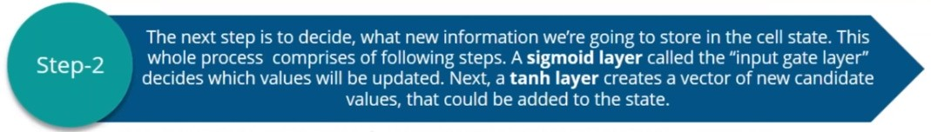
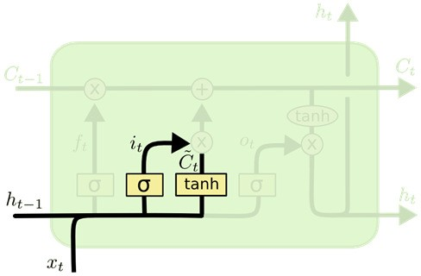

The next step is to decide what new information we’re going to store in the cell state.
This has two parts.
  First, a sigmoid layer called the “input gate layer” decides which values we’ll update.
  Next, a tanh layer creates a vector of new candidate values, Ĉ_{t}, that could be added to the state. In the next step, we’ll combine these two to create an update to the state.

Slide 13
LSTMs – Input Layer
Example
  In the example of our language model, we’d want to add the gender of the new subject to the cell state, to replace the old one we’re forgetting.

Slide 14
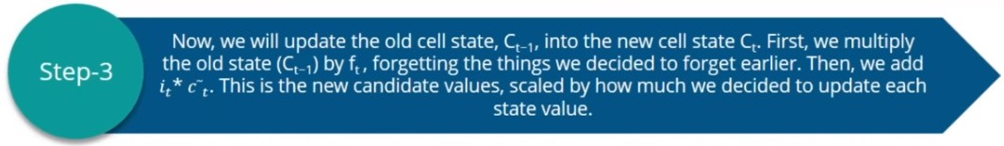
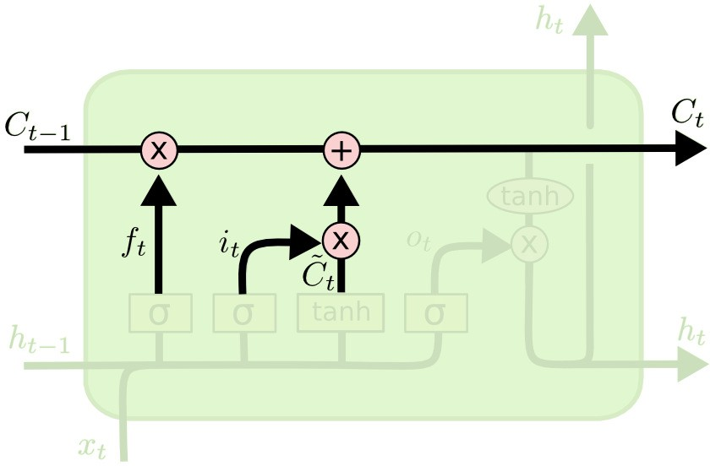

Update the old cell state, C_{t−1}, into the new cell state C_{t}
In the case of the language model, this is where we’d actually drop the information about the old subject’s gender and add the new information, as we decided in the previous steps.

Slide 15
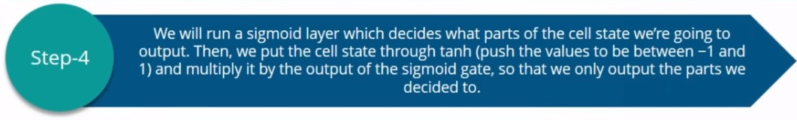
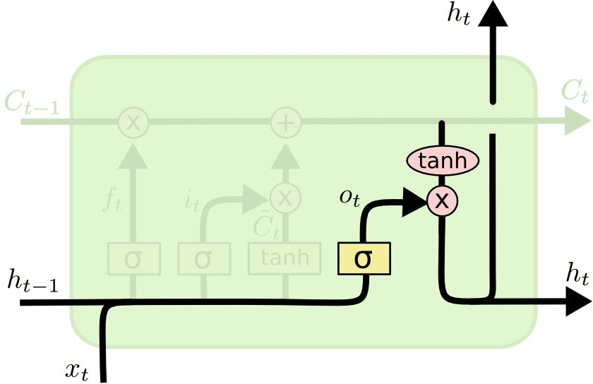
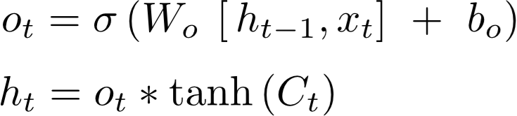
Finally, we need to decide what we’re going to output.

Slide 16
The output will be based on our cell state, but will be a filtered version.
First, we run a sigmoid layer which decides what parts of the cell state we’re going to output.
Then, we put the cell state through tanh (to push the values to be between
−1 and 1) and multiply it by the output of the sigmoid gate, so that we only output the parts we decided to.
For the language model example, since it just saw a subject, it might want to output information relevant to a verb, in case that’s what is coming next. For example, it might output whether the subject is singular or plural, so that we know what form a verb should be conjugated into if that’s what follows next.

Slide 17
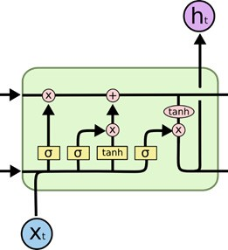


x =
_{x}<1> _{, x}<2>_{, ⋯ , x}<10>
Assume x is 10 dimensional vector
Each LSTM unit has 5 neurons in the hidden layer
ℎ =
_{ℎ}<1> _{, ℎ}<2>_{, ⋯ , ℎ}<5>

Slide 18
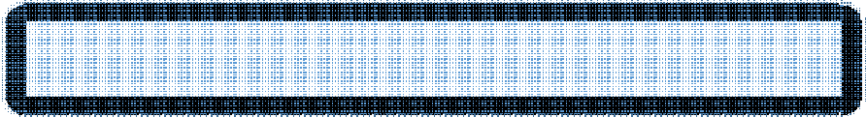
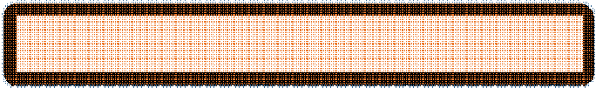
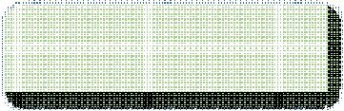

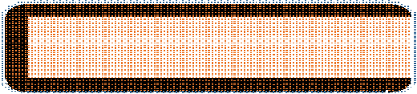
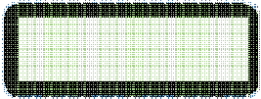
W_{xƒ})
^{ℎ}t–1 x_{t}
W_{ƒ} =
^{W}hƒ
[ℎ_{t–1}, x_{t}] =
f_{t} = σ(W_{hƒ} . ℎ_{t–1} + W_{xƒ}. x_{t} + b_{ƒ})
W_{hƒ} = 5 × 5 W_{xƒ} = 5 × 10
5 × 5 × 5 × 1 + 5 × 10 × 10 × 1 + 5 × 1
5 × 1 + 5 × 1 + 5 × 1 = 5 × 1
x =
_{x}<1> _{, x}<2>_{, ⋯ , x}<10>
ℎ =
_{ℎ}<1> _{, ℎ}<2>_{, ⋯ , ℎ}<5>

Slide 19



f_{t} = σ(W_{hƒ} . ℎ_{t–1} + W_{xƒ}. x_{t} + b_{ƒ})
W
W
^{ℎ}t–1
5 × 1
hƒ
xƒ
5 × 5
5 × 10
W_{ƒ}: 5 × 15
x_{t}
10 × 1
15 × 1
W_{ƒ} =
^{W}hƒ
W_{xƒ}) → 5 × 5 5 × 10) = (5 × 15)
^{ℎ}t–1 x_{t}
x =
_{x}<1> _{, x}<2>_{, ⋯ , x}<10>
5 × 1
10 × 1
[ℎ , x ] =
→
= (15 × 1)
_{ℎ}<1> _{, ℎ}<2>_{, ⋯ , ℎ}<5>
t–1 t
ℎ =

Slide 20


f_{t} = σ(W_{hƒ} . ℎ_{t–1} + W_{xƒ}. x_{t} + b_{ƒ})
^{W}hƒ
^{W}xƒ
b_{ƒ}
5 × 1
5 × 5
5 × 10
W_{ƒ}: 5 × 15
Number of Parameters:
x =
_{x}<1> _{, x}<2>_{, ⋯ , x}<10>
5 × 15 + 5 = 80
ℎ =
_{ℎ}<1> _{, ℎ}<2>_{, ⋯ , ℎ}<5>

Slide 21
Total NW Parameters
80
80
80
80
x =
_{x}<1> _{, x}<2>_{, ⋯ , x}<10>
80 × 4 = 320
ℎ =
_{ℎ}<1> _{, ℎ}<2>_{, ⋯ , ℎ}<5>

Slide 22







Total NW Parameters
Embedding: 100 × 10 = 1000
Dense: 5 × 5 + 5 = 30
LSTM:
5 × 10 × 4 + 5 × 5 × 4 + 5 × 4
= 320
Input to hidden Hidden to hidden
5 × 10 + 5 × 5 + 5) × 4
Bias
LSTM:
= 320

Slide 23
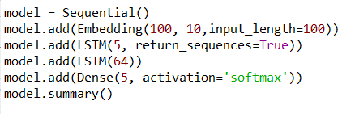
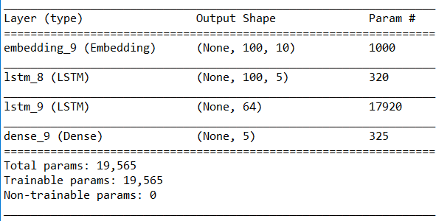
Total NW Parameters
Embedding: 100 × 10 = 1000
Dense: 64 × 5 + 5 = 325
LSTM_1: 5 × 10 + 5 × 5 + 5) × 4 = 320
LSTM_2: 5 × 64 + 64 × 64 + 64) × 4 = 17,920

Slide 24
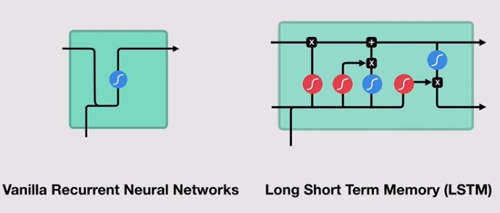
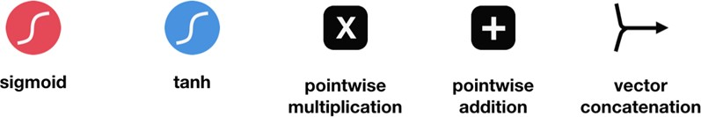
Walk Through
(RNNs and LSTMs)

Slide 25

Example
Online Reviews – Buy a cereal or not

Slide 26
Example
When you read the review, your brain subconsciously only remembers important keywords.
You pick up words like “amazing” and “perfectly balanced breakfast”.
You don’t care much for words like “this”, “gave”, “all”, “should”, etc.
If a friend asks you the next day what the review said, you probably wouldn’t remember it word for word.
You might remember the main points though like “will definitely be buying again”.

Slide 27

Example
LSTMs work in a similar form. They can learn to keep only relevant information to make predictions, and forget non relevant data.

Slide 28
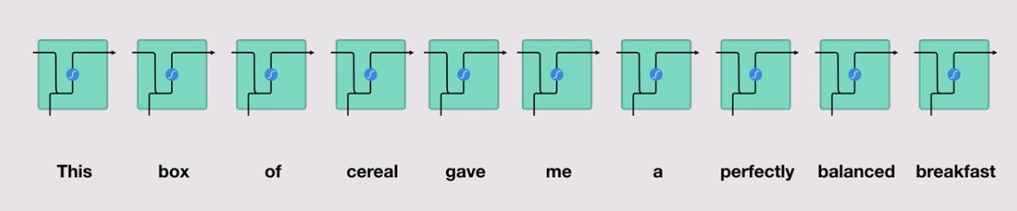
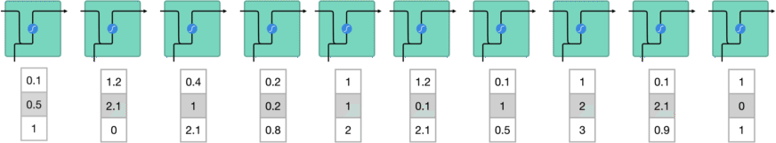
RNN - Walkthrough
Words are transformed to vectors and fed to RNN and processed one by one

Slide 29
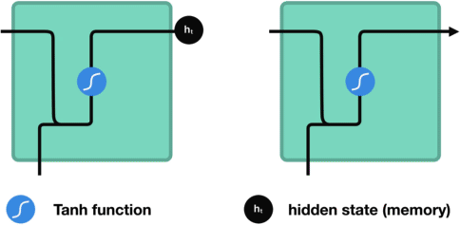
RNN Walkthrough
While processing, it passes the previous hidden state to the next step of the sequence.
The hidden state acts as the neural networks memory. It holds information on previous data the network has seen

Slide 30
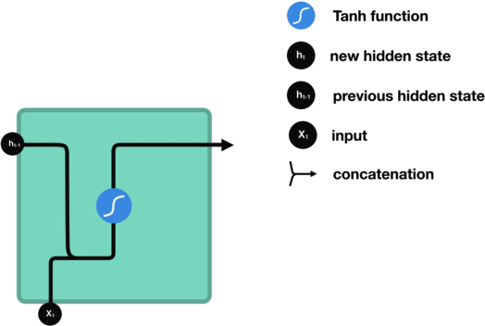
RNN Walkthrough
First, the input and previous hidden state are combined to form a vector. That vector now has information on the current input and previous inputs.
The vector goes through the tanh activation, and the output is the new hidden state, or the memory of the network.

Slide 31
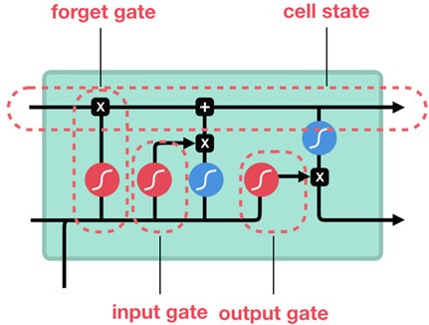
LSTMs Walkthrough
An LSTM has a similar control flow as a recurrent neural network.
It processes data passing on information as it propagates forward.
The differences are the operations within the LSTM’s cells.

Slide 32
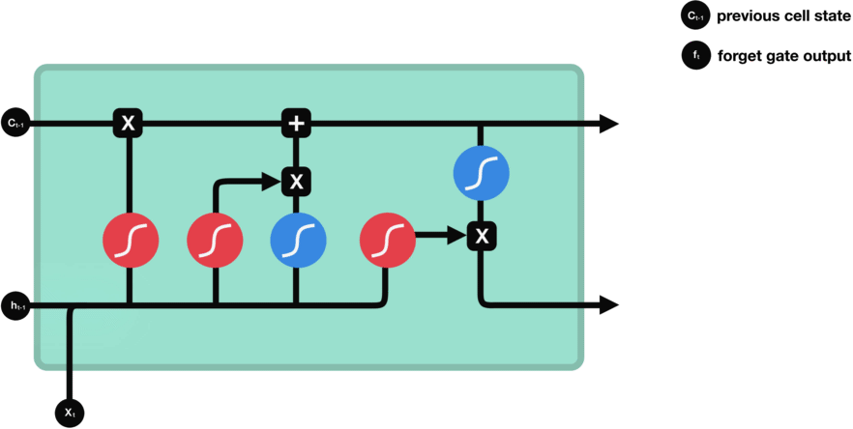
LSTMs Walkthrough
Forget Gate decides what information should be thrown away or kept.
Information from the previous hidden state and information from the current input is passed through the sigmoid function.
Values come out between 0 and 1. The closer to 0 means to forget, and the closer to 1 means to keep.

Slide 33
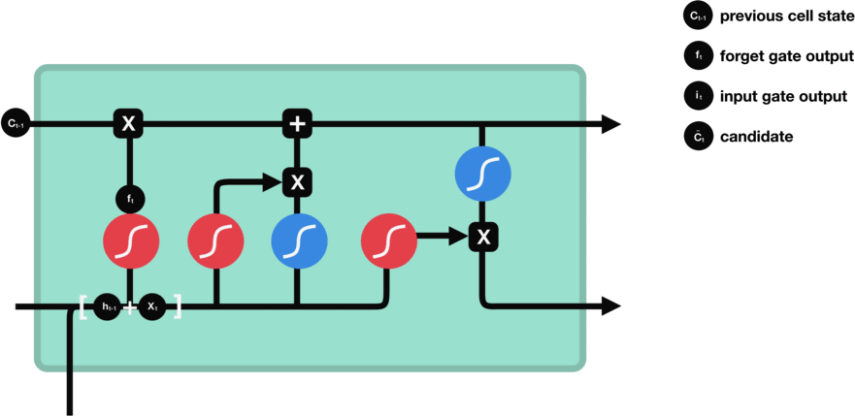
LSTMs Walkthrough
Input Gate updates the cell state
Pass the previous hidden state and current input into a sigmoid function (values is important (1) or not (0))
Pass the hidden state and current input into the tanh function to squash values between -1 and 1 to help regulate the network.
Multiply the tanh output with the sigmoid output.

Slide 34
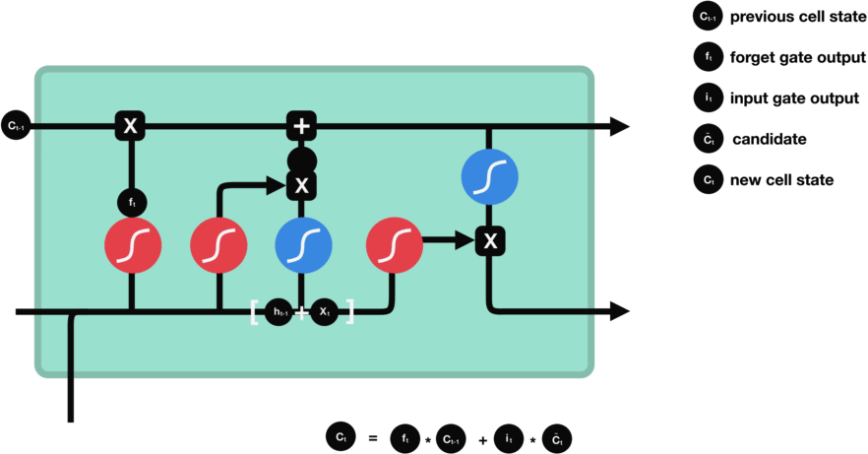
LSTMs Walkthrough
Cell State

Slide 35
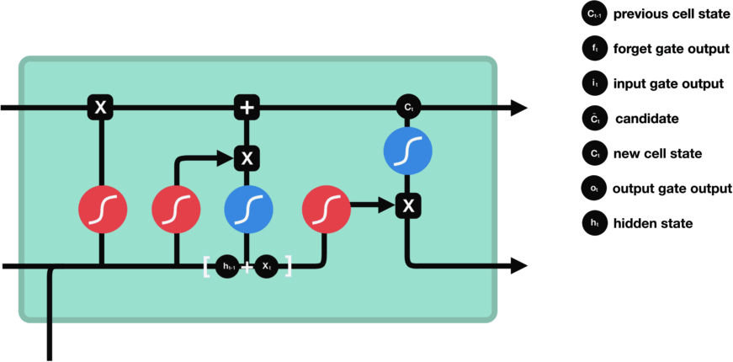
LSTMs Walkthrough
The Output Gate decides what the next hidden state should be.

Slide 36
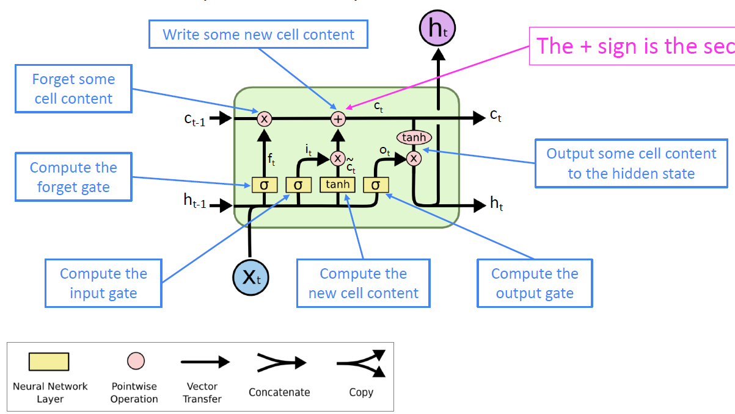

Slide 37
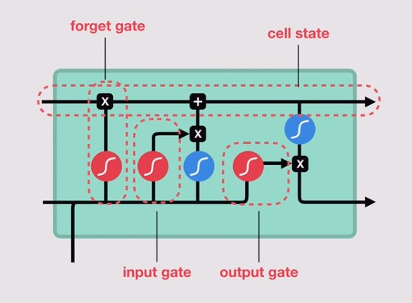
LSTMs Walkthrough - Summary
First, the previous hidden state and the current input get concatenated. We’ll call it combine.
Combine get’s fed into the forget layer. This layer removes non- relevant data.
A candidate layer is created using combine. The candidate holds possible values to add to the cell state.
Combine also get’s fed into the input layer. This layer decides what data from the candidate should be added to the new cell state.
After computing the forget layer, candidate layer, and the input layer, the cell state is calculated using those vectors and the previous cell state.
The output is then computed.
Pointwise multiplying the output and the new cell state gives us the new hidden state.

Slide 38
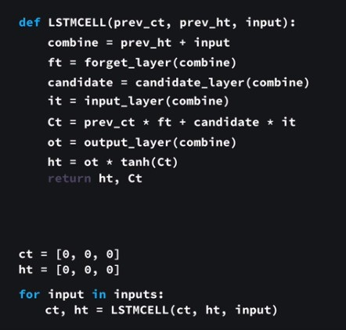
LSTMs Walkthrough – Pseudo code

Slide 39
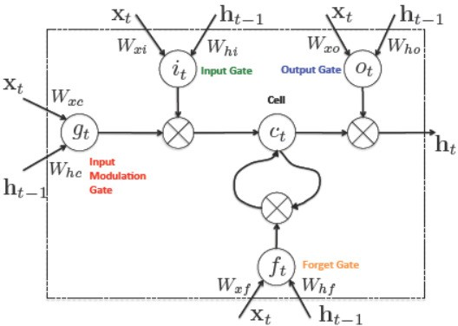
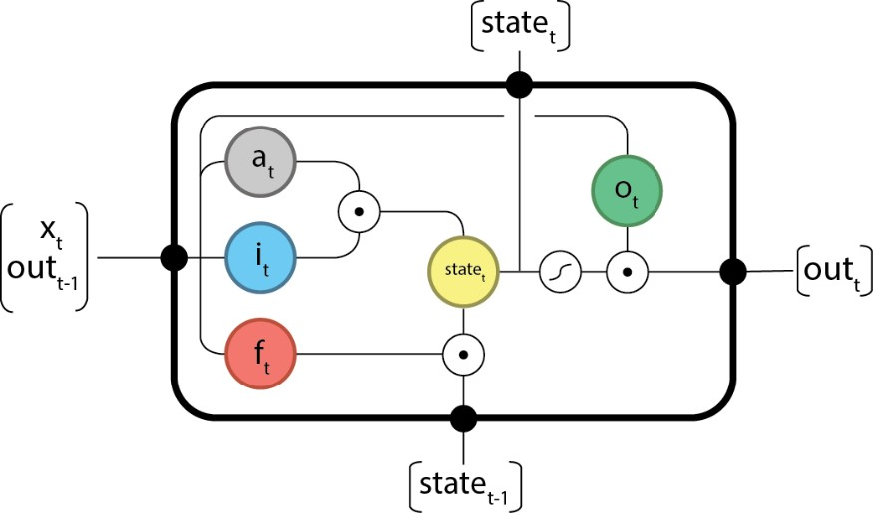
Other Representations

Slide 40
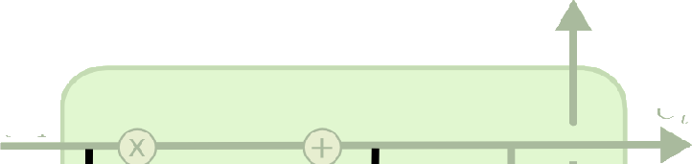



Variants of LSTMs
One popular LSTM variant, introduced by Gers & Schmidhuber, is adding “peephole connections.” This means that we let the gate layers look at the cell state

Slide 41







Variants of LSTMs
Another variation is to use coupled forget and input gates. Instead of separately deciding what to forget and what we should add new information to, we make those decisions together. We only forget when we’re going to input something in its place.

Slide 42









Variants of LSTMs
A slightly more dramatic variation on the LSTM is the Gated Recurrent Unit, or GRU, introduced by Cho, et al. (2014).
It combines the forget and input gates into a single “update gate.” It also merges the cell state and hidden state, and makes some other changes. The resulting model is simpler than standard LSTM models, and has been growing increasingly popular.

Slide 43
Worked Example (LSTMs – Forward Pass)

Slide 44
Worked Example
A sequence of length 2
2D Feature Space – One unit in the LSTM
Two time-steps
x₀ =
1
2
x₁ =
0.5
3
W_{xc} =
0.45
0.25
W_{hc} = | 0.15 |  |  | b_{c} = | 0.20
W_{hi} = | 0.80 |  |  | b_{i} = | 0.65
W_{hƒ} = | 0.10 |  |  | b_{ƒ} = | 0.15
W_{ho} = | 0.25 |  |  | b_{o} = | 0.10
W_{xi} =
0.95
0.80
W_{xƒ} =
0.70
0.45
W_{xo} =
0.60
0.40

Slide 45
Worked Example – Forward Pass @ t=0
Forget Gate:
A sequence of length 2
2D Feature Space – One unit in the LSTM
Two time-steps
x₀ =
1
2
W_{xƒ} =
0.70
0.45
W_{hƒ} = 0.10
b_{ƒ} = 0.15
f₀= σ (W_{xƒ} . x₀ + W_{hƒ} . ℎ_{–1} + b_{ƒ})
f₀ = σ( 0.70 0.45 ¹ + 0.10 × 0 + [0.15])
f_{t} = σ(W_{xƒ}. x_{t} + W_{hƒ} . ℎ_{t–1} + b_{ƒ})
2
f₀ = 0.85195

Slide 46
Worked Example – Forward Pass @ t=0
Input Gate:
x₀ =
1
2
Input Activation:
W_{xc} =
0.45
0.25
W_{hc} =
0.15
b_{c} =
0.20
C˜₀ = tanh W_{xc} . x₀ + W_{hc} . ℎ_{–1} + b_{c}
C˜₀ = tanh( 0.45 0.25 ¹ + 0.15 × 0 + [0.2])
2
C˜₀ = 0.81775
Input Gate:
Input Activation:
C˜_{t} = tanh(W_{xc}. x_{t} + W_{hc} . ℎ_{t–1} + b_{c})
0.95 0.80
0.80
0.65
W_{xi} =
W_{hi} =
b_{i} =
i₀= σ (W_{xi} . x₀ + W_{hi} . ℎ_{–1} + b_{i})
Input Gate:
i₀ = σ( 0.95 0.80 ¹ + 0.80 × 0 + [0.65])
i_{t} = σ(W_{xi}. x_{t} + W_{hi} . ℎ_{t–1} + b_{i})
2
i₀ = 0.96083

Slide 47
Worked Example – Forward Pass @ t=0
Output Gate:
x₀ =
1
2
W_{xo} =
0.60
0.40
W_{ho} =
0.25
b_{o} =
0.10
o₀= σ (W_{xo} . x₀ + W_{ho} . ℎ_{–1} + b_{o})
o₀ = σ( 0.60 0.40 ¹ + 0.25 × 0 + [0.10])
2
o₀ = 0.81757
Output Gate:
o_{t} = σ(W_{xo}. x_{t} + W_{ho} . ℎ_{t–1} + b_{o})

Slide 48
Worked Example – Forward Pass @ t=0
Update Layer:
x₀ =
1
2
Update Cell State:
C₀=C˜₀ ∘ i₀ + f₀ ∘ C_{–1}
C₀= 0.81775 × 0.96083 + 0.85195 × 0
C₀ = 0.78572
Cell State:
C_{t} = C˜_{t} ∘ i_{t} + f_{t}
^{o C}t–1

Slide 49

Worked Example – Forward Pass @ t=0
Output:
x₀ =
1
2
ℎ₀ = tanℎ(C₀) ∘ o₀
ℎ₀ = tanℎ(0.78572) × 0.81757
ℎ₀ = 0.53631
Hidden State/Output:
ℎ_{t} = tanh c_{t} ∘ o_{t}

Slide 50
Worked Example – Forward Pass @ t=1
Forget Gate
x₁ =
0.5
3
ℎ₀ = 0.53631
C₀ = 0.78572
W_{xƒ} =
0.70
0.45
W_{hƒ} = 0.10
b_{ƒ} = 0.15
f₁= σ (W_{xƒ} . x₁ + W_{hƒ} . ℎ₀ + b_{ƒ})
f₁ = σ( 0.70 0.45 ^{0.5} + 0.10 × 0.53631 + [0.15])
3
f₁ = 0.87030

Slide 51
Worked Example – Forward Pass @ t=1
Input Gate
x₁ =
0.5
3
ℎ₀ = 0.53631
C₀ = 0.78572
W_{xc} =
0.45
0.25
W_{hc} =
0.15
b_{c} =
0.20
0.95 0.80
0.80
0.65
W_{xi} =
W_{hi} =
b_{i} =
i₁= σ (W_{xi} . x₁ + W_{hi} . ℎ₀ + b_{i})
C˜ = tanh W
. x + W
. ℎ + b
1 xc 1
hc 0 c
i₁ = σ( 0.95 0.80 ^{0.5} + 0.80 × 0.53631 + [0.65])
C˜ = tanh( 0.45 0.25
^{0.5} + 0.15 × 0.53631 + [0.2])
3
1
3
i₁ = 0.98118
C˜₁ = 0.84980

Slide 52
Worked Example – Forward Pass @ t=1
Output Gate
x₁ =
0.5
3
ℎ₀ = 0.53631
C₀ = 0.78572
W_{xo} =
0.60
0.40
W_{ho} =
0.25
b_{o} =
0.10
o₁= σ (W_{xo} . x₁ + W_{ho} . ℎ₀ + b_{o})
o₁ = σ( 0.60 0.40 ^{0.5} + 0.25 × 0.53631 + [0.10)
3
o₁ = 0.84993

Slide 53
Worked Example – Forward Pass @ t=1
Update Cell State and Give Output
C₁= C˜₀ ∘ i₁ + f₁ ∘ C₀
C₁= 0.84980 × 0.98118 + 0.87030 × 0.78572
C₁ = 1.5176
ℎ₁ = tanℎ(C₁) ∘ o₁
ℎ₁ = tanh 1.5176 × 0.84993
ℎ₁ = 0.77197

Slide 54
References
Understanding LSTMs – Colah’s Blog
Illustrated Guide to LSTM’s and GRU’s: A step by step explanation, Michael Nguyen

Slide 55
Next up….
Applications of LSTMs…..

