Slide 1
GCTConnect
A Social Networking Platform for Government Graduate College Township

Slide 2
Introduction
GCTConnect is a custom social networking platform tailored for Government Graduate College Township, Lahore, designed to facilitate efficient communication among students, teachers, and management.

Slide 3
01
Project Overview

Slide 4
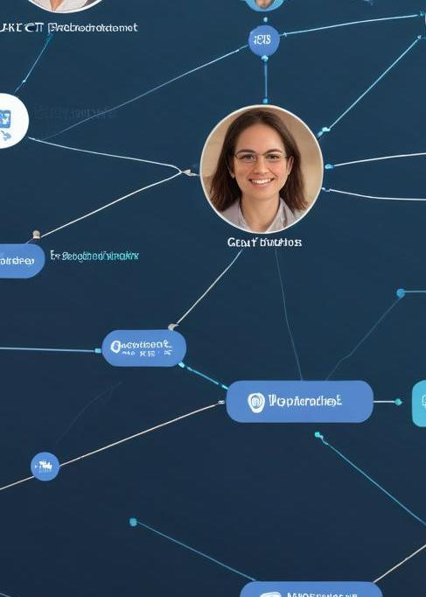
Description of GCTConnect
GCTConnect is designed to streamline communication in the college by eliminating the inefficiencies of multiple WhatsApp groups. The platform allows users to communicate in an organized manner, ensuring that everyone stays informed.

Slide 5
Target Users and Purpose
The platform serves students, teachers, department heads, and higher management, aiming to enhance educational collaboration and administrative communication effectively.

Slide 6
Current Communication Challenges
The college currently relies on WhatsApp for communication, resulting in the creation of multiple groups. This leads to issues like missed announcements, improper group memberships, and fragmented communication channels, impacting both students and faculty.

Slide 7
02
Project Phases

Slide 8
Phase 1: User Registration and Basics
The first phase focuses on user registration through an admin interface, automating group creation, and joining users to relevant groups. Key features include basic chat functionalities, a user-friendly dashboard, and 70% backend and 80% database completion ensuring robust performance.

Slide 9

Phase 2: AI Chatbot Integration
In the second phase, an AI chatbot will be integrated to handle frequently asked questions related to admissions, event dates, and college activities. This feature aims to provide quick and reliable information to users, enhancing user experience.

Slide 10
Phase 3: Advanced Features Development
The final phase involves enabling advanced chat features like individual chats, dynamic group creation, and a comprehensive profile management system. Optimization of code and project deployment are also critical steps for ensuring efficiency and scalability.

Slide 11
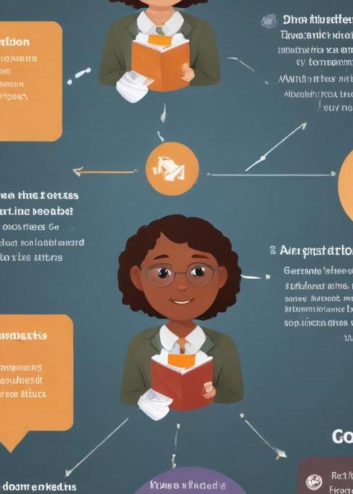
Conclusions
GCTConnect offers an innovative solution to enhance communication within Government Graduate College Township, addressing current inefficiencies. The phased approach ensures structured development and integration of essential features for a cohesive platform.

Slide 12
Thank you!
Do you have any questions?
+91 620 421 838

