Slide 1
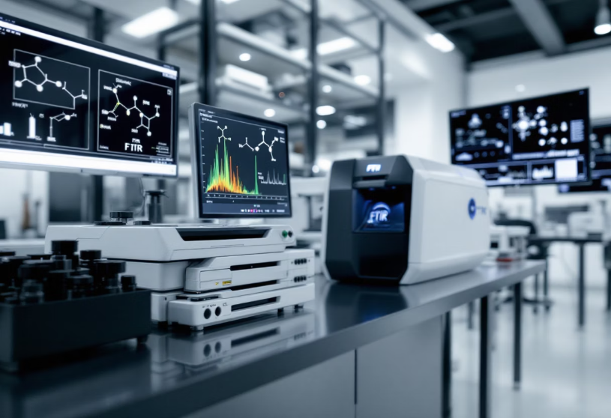
FTIR: Unlocking Molecular Secrets
What is FTIR? Fourier Transform Infrared Spectroscopy analyzes molecular absorption of infrared light.
How it Works: Infrared light passes through a sample, revealing its molecular components by absorbed frequencies.
Key Uses: Material ID, quality control, contamination detection, and quantitative analysis.
Pharmaceuticals: Verify drug identity, purity; detect counterfeit medicines.
Polymers: Analyze composition, additives, and microplastic contamination.
Food Science: Profile fats and proteins; detect food adulteration.
Environmental Science: Measure air and water pollutants accurately.
Forensic Science: Identify unknown substances in crime investigations.

Slide 2
SAMPLE REQUIREMENTS

