Slide 1


Presentation on NoSQL

Slide 2
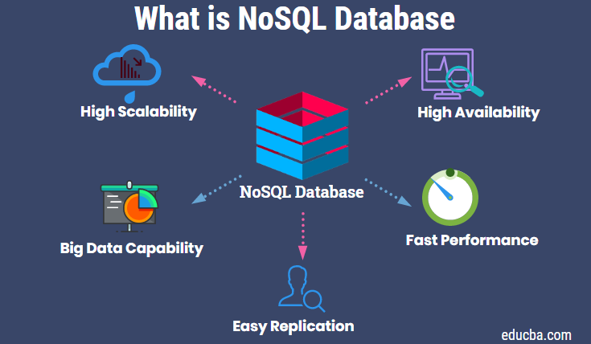
1. What is NoSQL ?
Stands for Not Only SQL. Term was redefined by Eric Evans after Carlo Strozzi.
Class of non-relational data storage systems.
Do not require a fixed table schema nor do they use the concept of joins.
Relaxation for one or more of the ACID properties (Atomicity, Consistency, Isolation, Durability) using CAP theorem

Slide 3
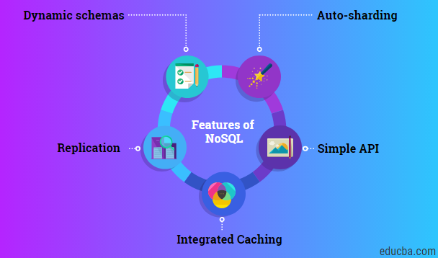
2. Why NoSQL ?
Explosion of social media sites (Facebook, Twitter, Google etc.) with large data needs. (Sharding is a problem)
Rise of cloud-based solutions such as Amazon S3 (simple storage solution).
Just as moving to dynamically-typed languages (Ruby/Groovy), a shift to dynamically-typed data with frequent schema changes.
Expansion of Open-source community.
NoSQL solution is more acceptable to a client now than a year ago.

Slide 4
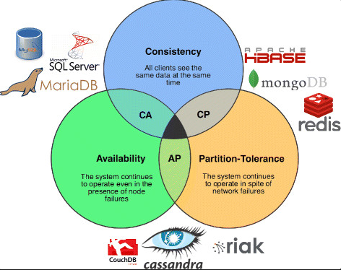
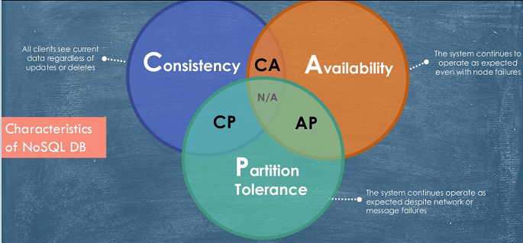
3. Characteristics of NoSQL
Scalability: the ability of a system to handle a growing amount of work.
Availability: the likelihood that the system is operational.
High performance: The performance of a system is often measured by(the response time of an action/request )

Slide 5
4. NoSQL databases types
NoSQL database are classified into four types:
• Key Value pair based
• Column based
• Document based
• Graph based

Slide 6
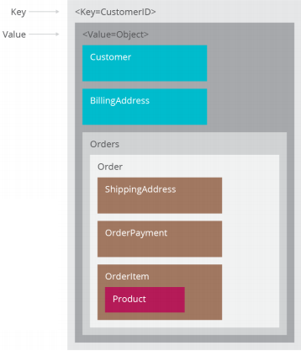
4. NoSQL databases types
Key Value pair based
Designed for processing dictionary . Dictionaries contain a collection of records having fields containing data.
• Records are stored and retrieved using a key that uniquely identifies the record, and is used to quickly find the data within the database.
Example: CouchDB, Oracle NoSQL Database, Riak etc.
We use it for storing session information, user profiles, preferences, shopping cart data.
We would avoid it when we need to query data having relationships between entities.

Slide 7
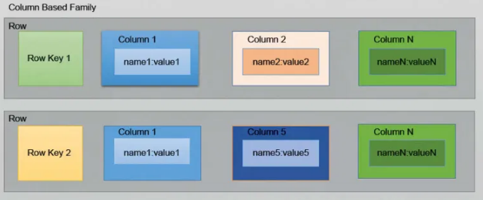
4. NoSQL databases types
Column based
It store data as Column families containing rows that have many columns associated with a row key . Each row can have different columns.
Column families are groups of related data that is accessed together .
Example: Cassandra, HBase, Hypertable, and Amazon
DynamoDB.
We use it for content management systems, blogging platforms, log aggregation.
We would avoid it for systems that are in early development, changing query patterns.

Slide 8
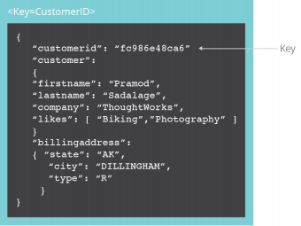
4. NoSQL databases types
Document based
The database stores and retrieves documents. It stores documents in the value part of the key-value store.
Self- describing, hierarchical tree data structures consisting of maps, collections, and scalar values.
Example: Lotus Notes, MongoDB, Couch DB, Orient DB, Raven DB.
We use it for content management systems, blogging platforms, web analytics, real-time analytics, e- commerce applications.
We would avoid it for systems that need complex transactions spanning multiple operations or queries against varying aggregate structures.

Slide 9
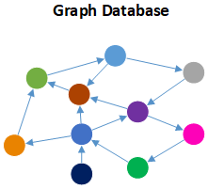
4. NoSQL databases types
Graph based
Store entities and relationships between these entities as nodes and edges of a graph respectively . Entities have properties.
Traversing the relationships is very fast as relationship between nodes is not calculated at query time but is actually persisted as a relationship .
Example: Neo4J, Infinite Graph, OrientDB, FlockDB.
It is well suited for connected data, such as social networks, spatial data, routing information for goods and supply .

Slide 10
5. ACID theorem
ACID
In computer science, ACID (atomicity, consistency, isolation, durability) is a set of properties of database transactions intended to guarantee data validity despite errors, power failures, and other mishaps. In the context of databases, a sequence of database operations that satisfies the ACID properties (which can be perceived as a single logical operation on the data) is called a transaction.
A DBMS is expected to support “ACID transactions,” processes that are:
Atomicity
Consistency
Isolation
Durability

Slide 11
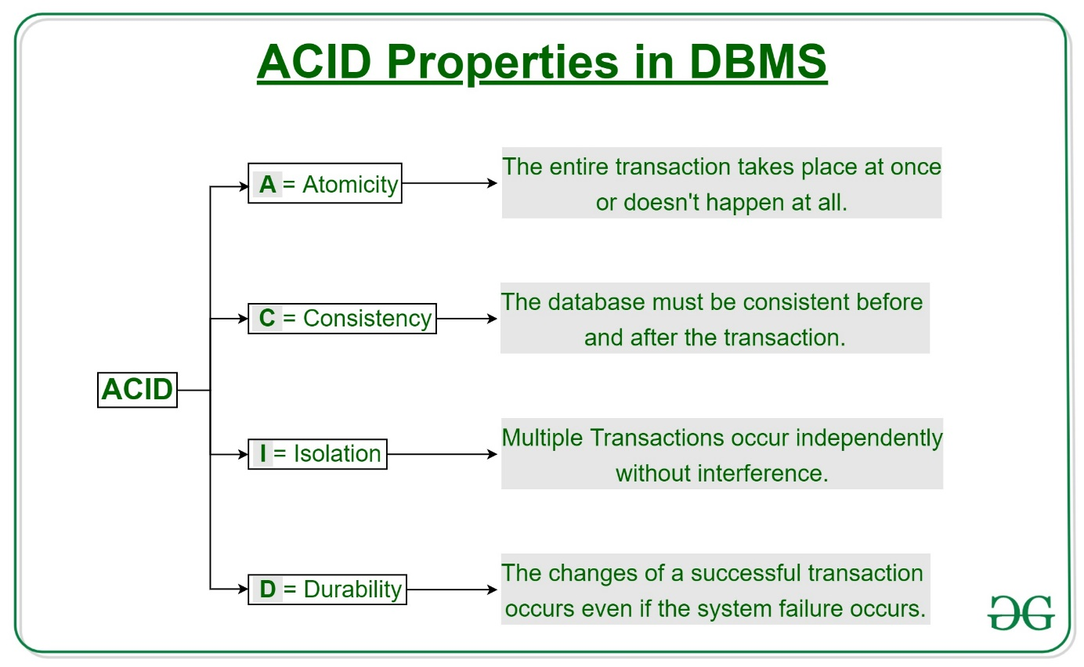
5. ACID theorem

Slide 12
5. CAP theorem
According to Eric Brewer a distributed system has 3 properties :
Consistency
Availability
Partitions
We can have at most two of these three properties for any shared-data system
To scale out, we have to partition. It leaves a choice between consistency and availability. ( In almost all cases, we would choose availability over consistency)
Everyone who builds big applications builds them on CAP : Google, Yahoo, Facebook, Amazon, eBay, etc.

Slide 13
5. Advantages of NoSQL
Cheap and easy to implement (open source)
Massive scalability
Data are replicated to multiple nodes (therefore identical and fault-tolerant) and can be partitioned :
When data is written, the latest version is on at least one node and then replicated to other nodes.
No single point of failure
Easy to distribute
High availability
Don't require a schema
Schema flexibility, sparse & semi-structured data

