Slide 1

GAZA RECONSTRUCTION MANAGEMENT & DAMAGE ASSESSMENT SYSTEM
Graduation Project - GRMDAS
PREPARED BY
SUPERVISED BY
Talha Salah Mahmoud Siam
Dr. Shadia Baroud
Dr.Raed Bulbul
ID: 1301204963
Al-Aqsa University – Gaza | Faculty of Computer Science and IT

Slide 2





INTRODUCTION & BACKGROUND
Context
Current State
Recent conflict in the Gaza Strip has resulted in severe damage to residential, governmental, and essential public infrastructure.
Damage assessment currently relies on manual procedures and fragmented digital tools, leading to significant inefficiency.
Consequences
The Solution
Manual processes cause data inconsistency, duplication of efforts.
The GRMDAS system is proposed to modernize and centralize the damage assessment process through a robust web platform.
"Aiming to support faster recovery efforts and improve coordination among all stakeholders in the reconstruction phase."

Slide 3





PROBLEM STATEMENT
FRAGMENTED DATA
DELAYED INSIGHTS
INEFFICIENT WORKFLOW
TRANSPARENCY GAP
Information is scattered across paper records and isolated spreadsheets, making consolidation difficult.
Decision-makers lack real-time statistics regarding damage types and severity for effective planning.
Manual verification and approval processes are slow, labor-intensive, and prone to human error.
Citizens cannot easily track their reconstruction requests, leading to trust issues and uncertainty.

Slide 4





PROJECT OBJECTIVES
GENERAL OBJECTIVE
To design and implement a centralized, web-based system for managing building damage assessment and reconstruction efforts in the Gaza Strip.
Secure Citizen Portal
Admin Dashboard
Develop a secure, user-friendly interface for citizens to report damages and track their requests.
Create a robust dashboard for administrators to visualize real-time statistics and damage categories.
Automated Workflow
Accurate Data
Streamline the verification and approval process to reduce human error and processing time.
Provide decision-makers with reliable, centralized data to prioritize reconstruction projects effectively.

Slide 5





THEORETICAL FRAMEWORK: TECHNOLOGIES
FRONTEND STACK
BACKEND LOGIC
HTML5, CSS3, JavaScript, and Bootstrap 5. Optimized for RTL (Arabic) and responsive layouts.
PHP for robust server-side processing and secure data handling.
DATABASE MANAGEMENT
ARCHITECTURE
MySQL for structured data storage, ensuring integrity and efficient retrieval.
Client-Server model with a loosely applied MVC pattern for organized code and scalability.
Development Environment: VS Code
Local Server: XAMPP
UI Framework: Bootstrap 5

Slide 6



DEVELOPMENT METHODOLOGY
Agile Development
Prototyping
An iterative approach that ensures flexibility, allowing the system to adapt to evolving requirements and stakeholder feedback throughout the project lifecycle.
Developing functional models of the system to visualize the user interface and refine core functionalities before full-scale implementation.
CORE IMPLEMENTATION PROCESS
01
02
03
04
ANALYSIS
DESIGN
IMPLEMENTATION
TESTING

Slide 7




SYSTEM ARCHITECTURE & DESIGN
SYSTEM ACTORS
Use Case Diagram
Class Diagram
Illustrates interactions between actors and system functionalities.
Represents the logical structure and database entity relationships.
Affected Citizens
Administrative Personnel
Field Engineers (Future)
Sequence Diagram
Activity Diagram
The system defines clear roles and permissions to ensure data security and workflow integrity.
Demonstrates the chronological sequence of system operations.
Explains the workflow involved in submitting damage reports.
Unified Modeling Language (UML) was utilized to translate functional requirements into a technical blueprint.

Slide 8
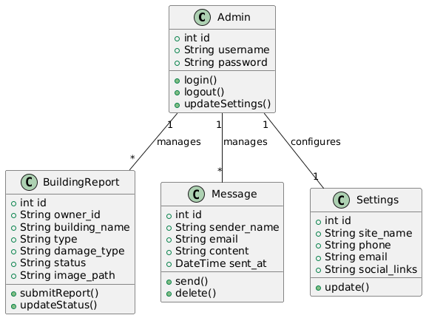
SYSTEM ARCHITECTURE & DESIGN
Class Diagram

Slide 9
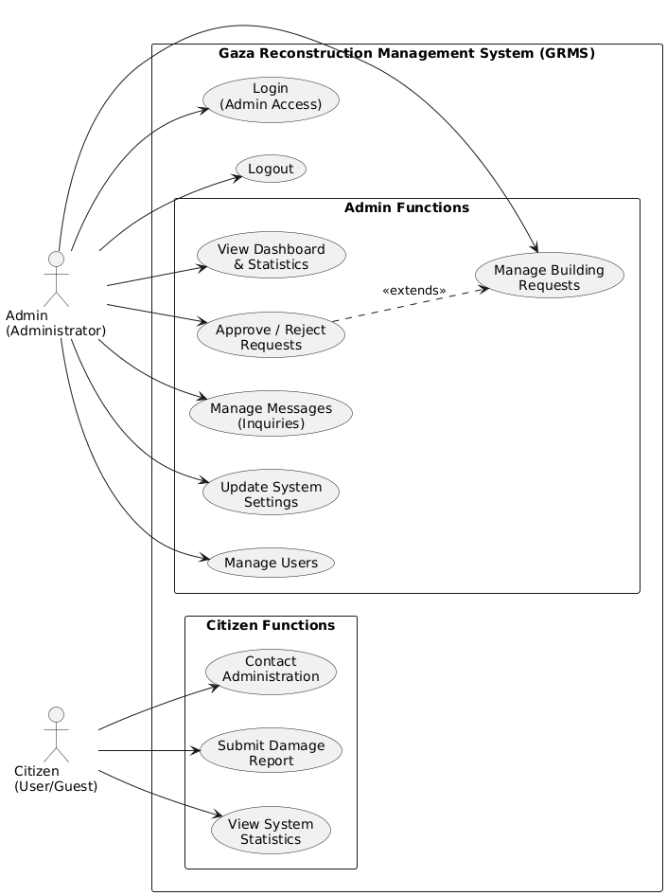
SYSTEM ARCHITECTURE & DESIGN
Use Case Diagram

Slide 10
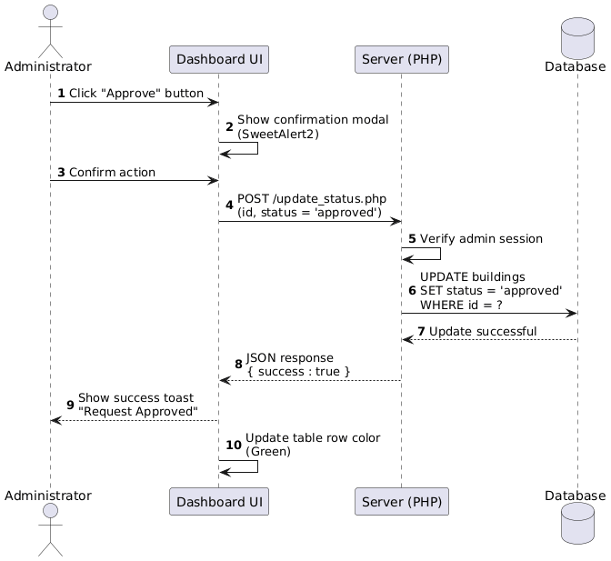
SYSTEM ARCHITECTURE & DESIGN
Sequence Diagram

Slide 11
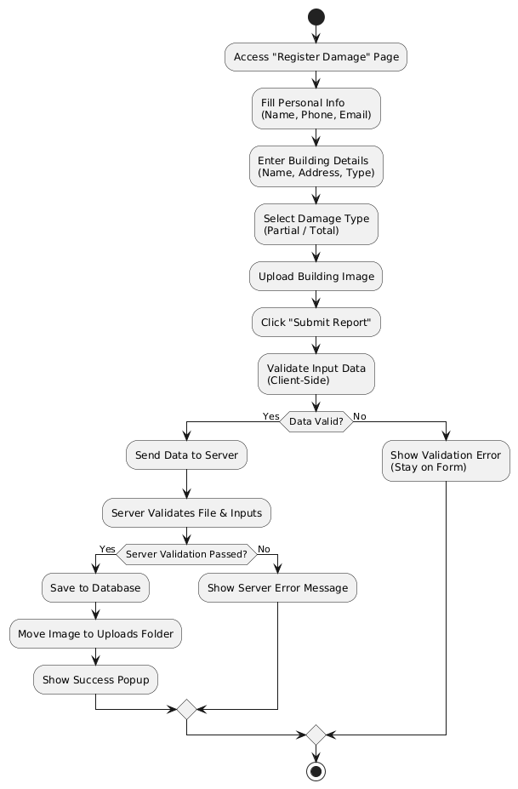
SYSTEM ARCHITECTURE & DESIGN
Activity Diagram

Slide 12





SYSTEM FEATURES: CITIZEN PORTAL (HOME PAGE)
SECURE SUBMISSION
EVIDENCE UPLOAD
A multi-step wizard guides citizens through verification, personal details, and building information to ensure data accuracy.
Integrated functionality for attaching photographic evidence of damages, supporting verification and cost estimation.
REQUEST TRACKING
OPTIMIZED UX
Citizens can securely check the status of their previous submissions (Pending, Approved, Rejected) using their National ID.
Full support for Arabic (RTL) and responsive design ensures accessibility across smartphones, tablets, and desktops.
"Empowering citizens with a transparent and accessible digital interface for reconstruction claims."

Slide 13
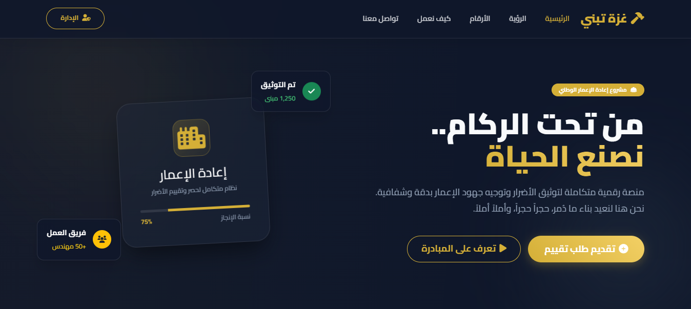
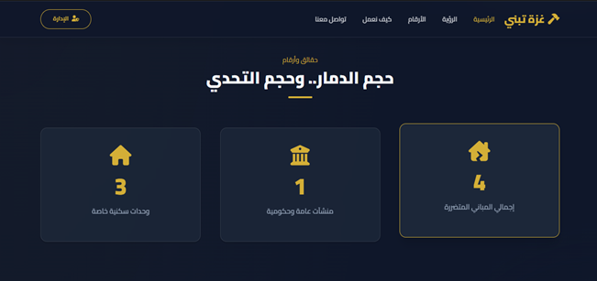
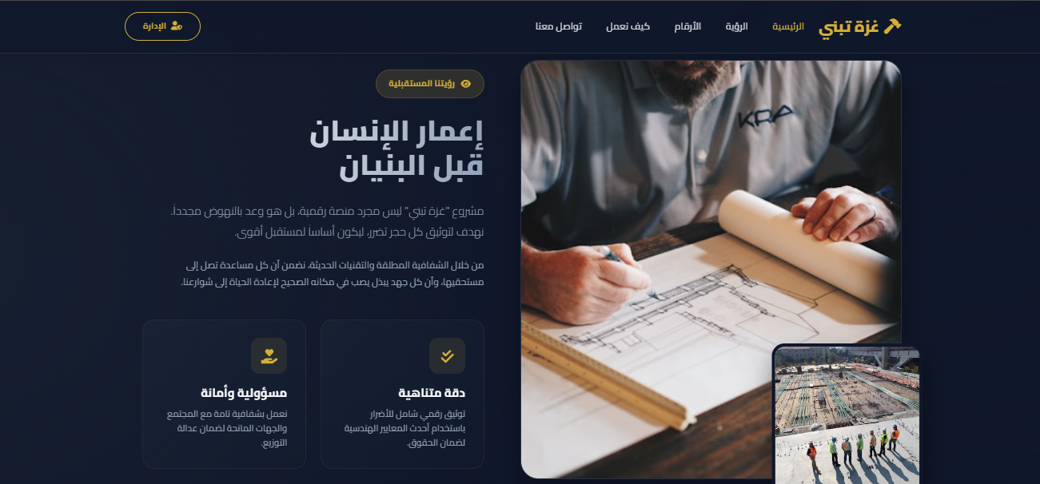
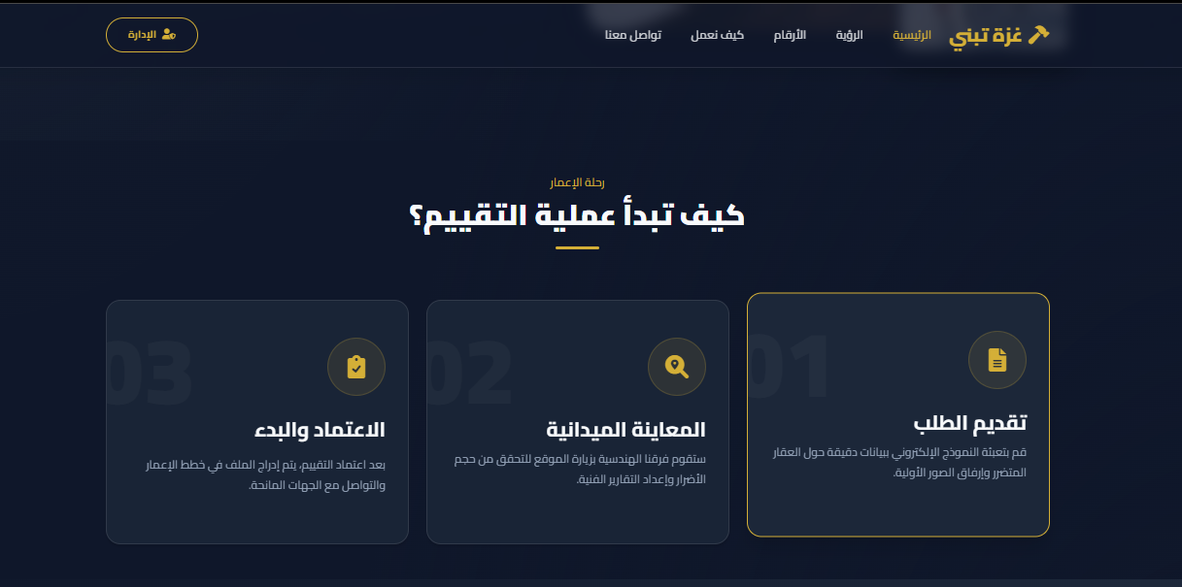

Slide 14
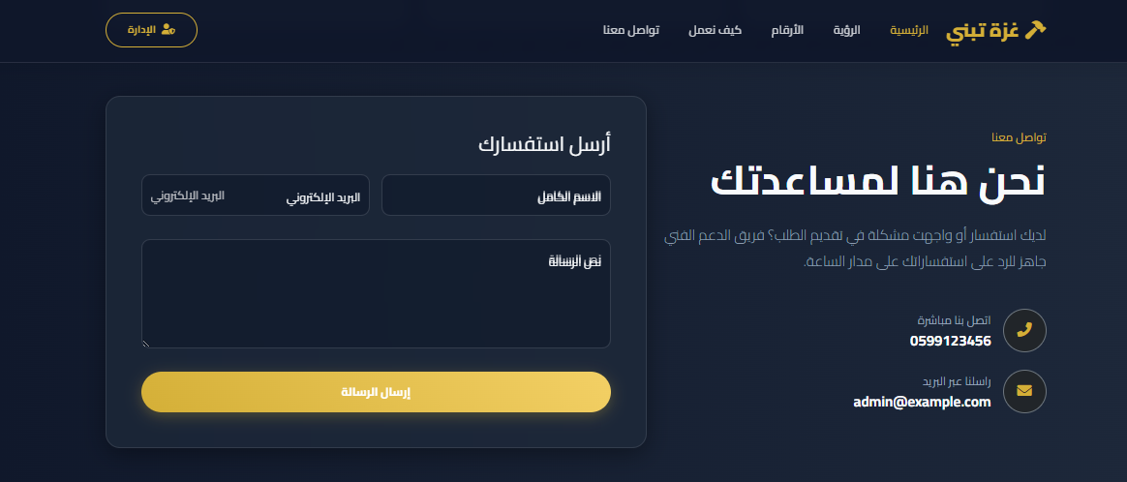
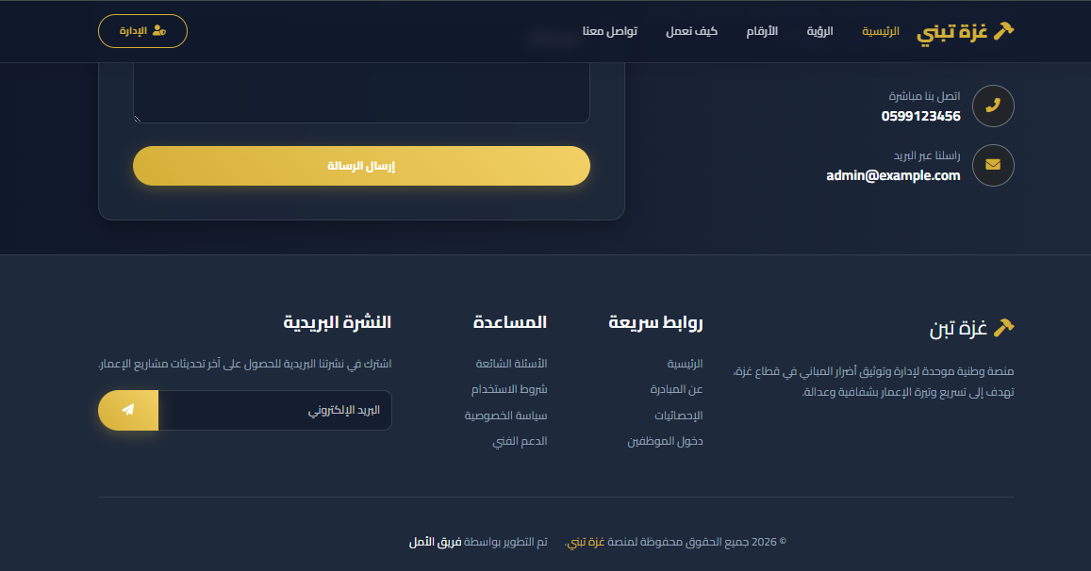
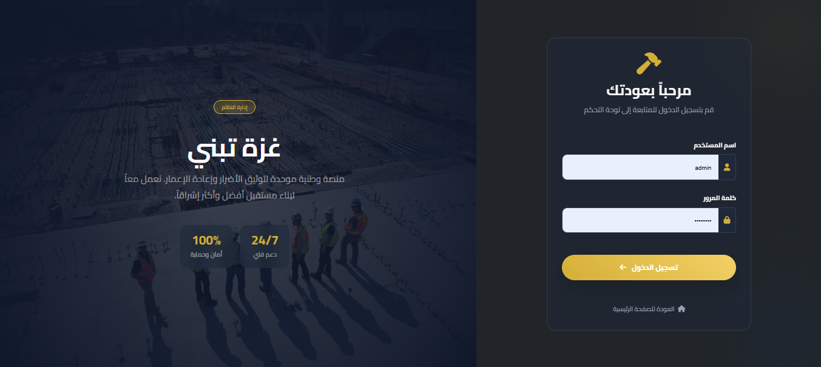

Slide 15


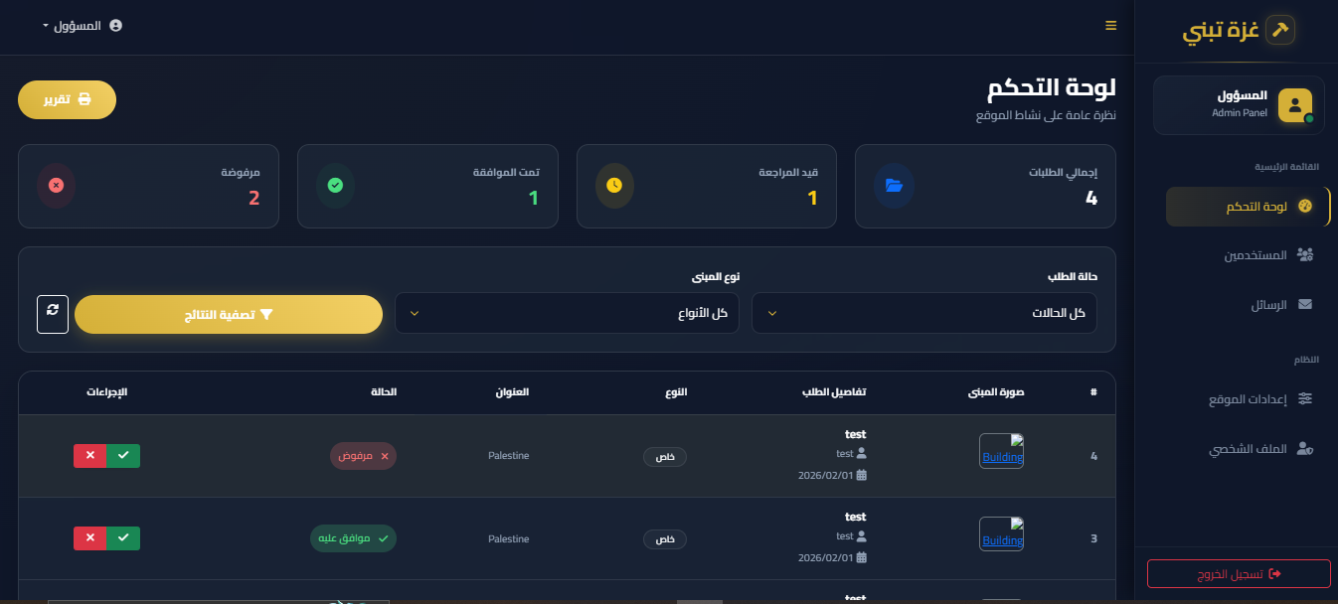


SYSTEM FEATURES: ADMIN DASHBOARD
REAL-TIME STATISTICS
Instant visualization of total, pending, approved, and rejected requests for rapid assessment.
REQUEST MANAGEMENT
Centralized interface to verify submissions, update statuses, and filter data by location or damage type.
USER & SYSTEM CONTROL
Secure management of administrative accounts and global system settings for the GRMDAS platform.

Slide 16
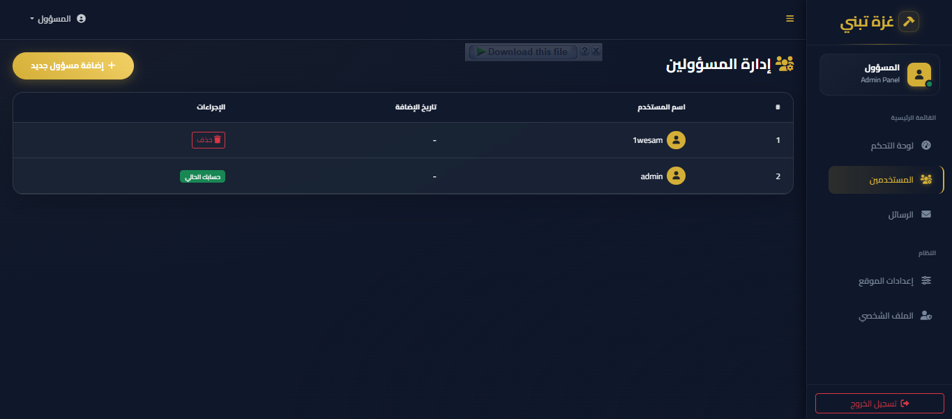
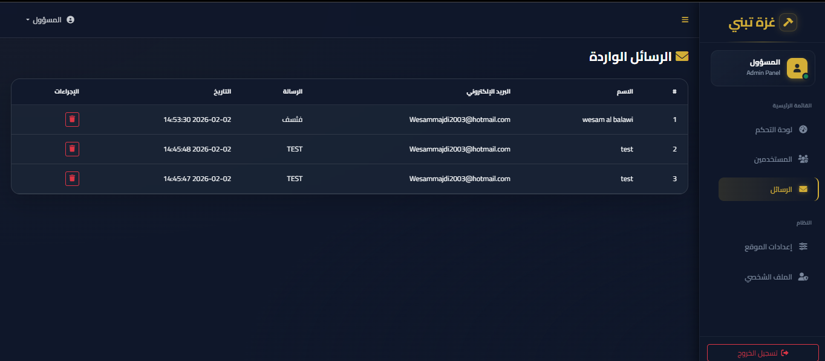
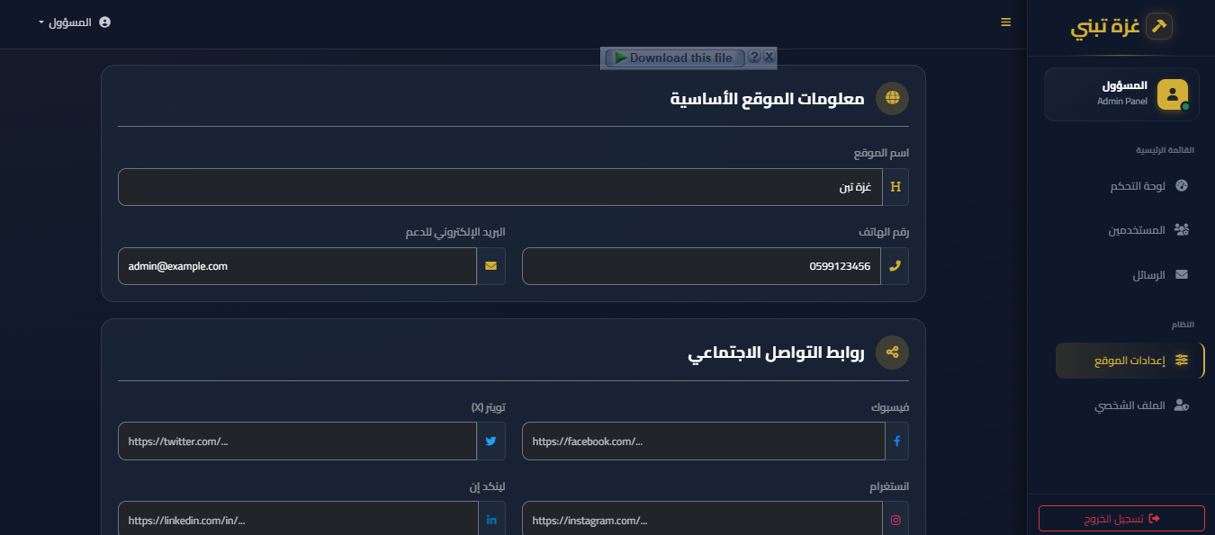
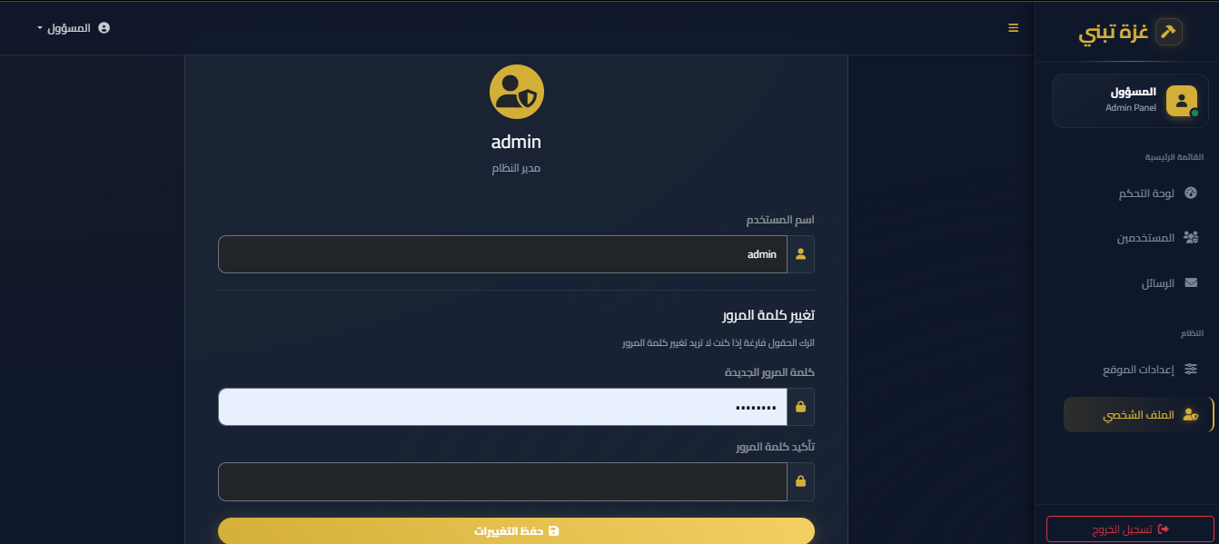

Slide 17

IMPLEMENTATION & TESTING
Test Scenario
Expected Outcome
Status
VISUAL IDENTITY
Submit New Request
Data saved
PASS
Theme: Deep Navy & Gold
Admin Login
Redirect to Dashboard
PASS
Professional, national tone.
Update Status
Real-time UI update
PASS
Typography: Cairo Font
Image Upload
Secure attachments
PASS
Arabic-first legibility.
Input Validation
Blocks invalid input
PASS
Responsiveness
Works on mobile and desktop.
"100% Pass Rate on all critical functional test cases across multiple browsers."

Slide 18




CONCLUSION
DIGITIZATION OF DATA
Successfully replaced manual entry with a secure database system, reducing errors and data loss.
ENHANCED ACCESSIBILITY
Provided citizens with an easy-to-use portal to submit and track their claims from any device.
IMPROVED DECISION MAKING
Empowered administrators with real-time statistics to prioritize reconstruction efforts effectively.
GRMDAS: A scalable solution for organized and transparent recovery.

Slide 19








RECOMMENDATIONS & FUTURE WORK
RECOMMENDATIONS
FUTURE ENHANCEMENTS
Cloud Deployment
GIS Integration
Host on high-availability servers (AWS/Azure) to handle traffic and ensure data redundancy.
Map damaged buildings on interactive maps to visualize geographical distribution of destruction.
Security Audits
AI-Powered Assessment
Conduct regular penetration testing to protect sensitive citizen data against cyber threats.
Utilize Computer Vision to analyze images and provide preliminary damage cost estimates.
Staff Training
Organize workshops for administrative staff to ensure proficiency in verification tools.

