Slide 1

LOGICAL SYSTEM DESIGN PROJECT :
Zehra Gülbil(zehra.gulbil@stu.fbu.edu.tr)
Efkan Kasaboğlu(efkan.kasaboglu@stu.fbu.edu.tr)
Kanan Jafarli(kanan.jafarli@stu.fbu.edu.tr)
Ege Deniz (ege.deniz@stu.fbu.edu.tr)
Talha Semih Gündüz(talha.gunduz@stu.fbu.edu.tr)

Slide 2
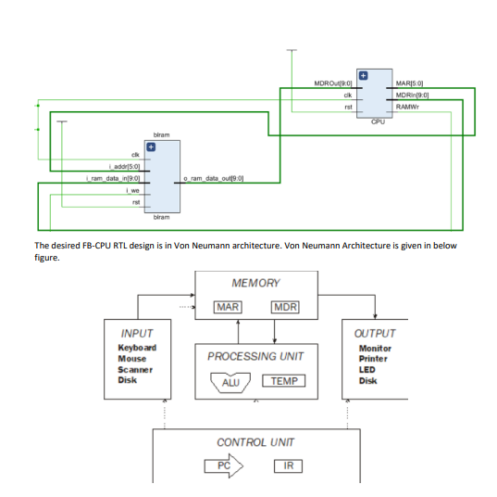
How we created this FBU CPU :

Slide 3
Firstly;
We started by defining a module named tb_fbu_cpu. Inside this module, I instantiate instances of the CPU and memory module (b1ram).
We connected instances fb_cpu and b1ram to each other through various signals. For example, clock and reset, etc.
In the Initial block we set reset to 1 initially and error to 0 and repeated this 10 times at posedge clock. After a delay of one time unit, we assigned the reset to value to 0 and repeated 500 times in posedge clock.

Slide 4
Test Case
This Verilog code is a testbench for a basic processor (fb_cpu) with a memory module (blram). It initializes memory with specific instructions and data for different test cases. The processor executes instructions and checks the results. Clock pulses drive the simulation. The TEST_CASE parameter determines the scenario, and any errors set an error flag. The code is a project for designing and testing a simple processor in Verilog.

Slide 5
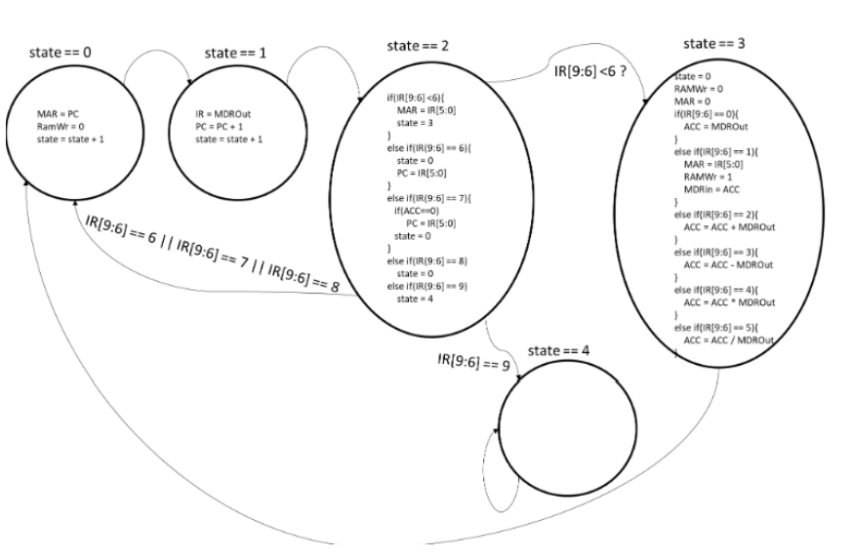
Scheme of the State Machine

Slide 6
State 0
In state zero, we defined MAR as PC, this copies the value of the Program Counter to the Memory adress register.
We also set RamWr to zero, this line of code sets the signal to zero, this means that a write operation to the RAM is not being performed.
We also set stateNext = state + 1, this line increments the current state value by 1 and assigns the next result to stateNext. This is used to transition to the next state in the machine.

Slide 7
State 1
In stage 1 operations are performed based on the content in the Instruction Register and It is used to update the content in IRNext, PCNext and stateNext.

Slide 8
State 2
In state 2, the machine checks the value in bits of the Instruction Register. Depending of the value, it performs different operations such as updating the Memory adress Register. When transfering to state 3 it also updates PCNext and performs conditional jumps based on the value of ACC.

Slide 9
State 3
In stage 3, Various signals are adjusted based on the instruction in the Instruction Register. This is to perform memory operations, arithmetic operations and data movement.

Slide 10
State 4
In state 4, there is not any operations. So it is a halt state that finishes the algorithm.

Slide 11
THANK YOU FOR YOUR ATTENTION

