Slide 1
Thynk Unlimited
Retail
Sale
Analysis

Slide 2
CREATING TABLE

Slide 3


Thynk Unlimited
DATA
CLEANING

Slide 4
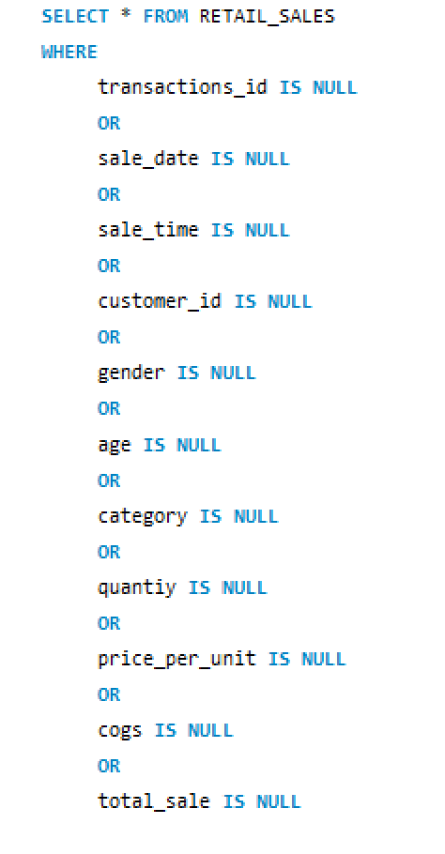
SEEING NULL VALUES IN DATA

Slide 5
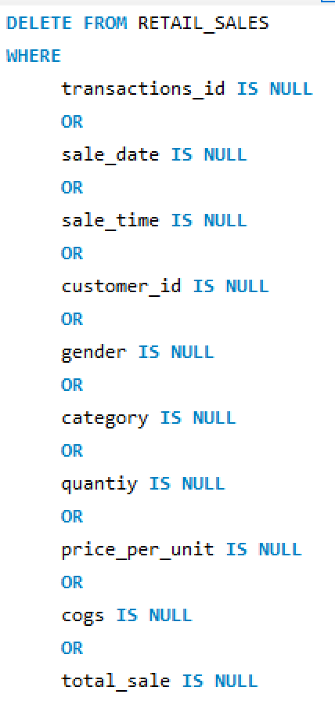
Quantiy , Price_per_unit ,Cogs ,Total_sale has three null value so we will delete it

Slide 6
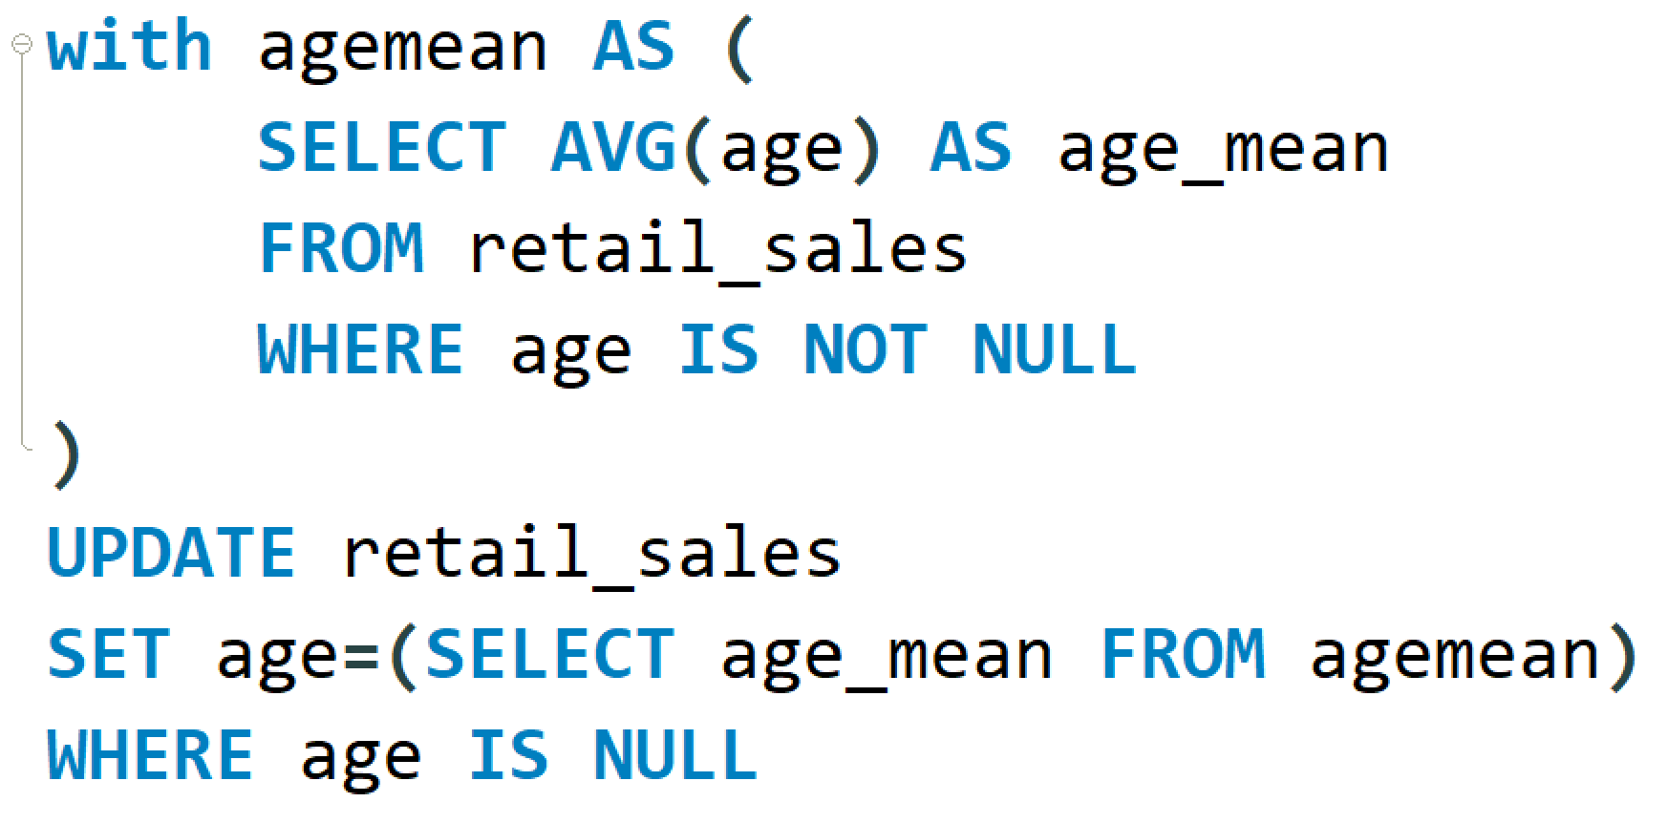
Age has 10 null value replace it with mean

Slide 7
Thynk Unlimited
BASIC
ANALYSIS

Slide 8
1:Seeing how many sales we have ?
2:How many customer we have ?
3:How many category we have ?

Slide 9

Thynk Unlimited
SALE
PERFOMANCE
ANALYSIS

Slide 10
1:Retrieve all transactions for 2022-11-05

Slide 11
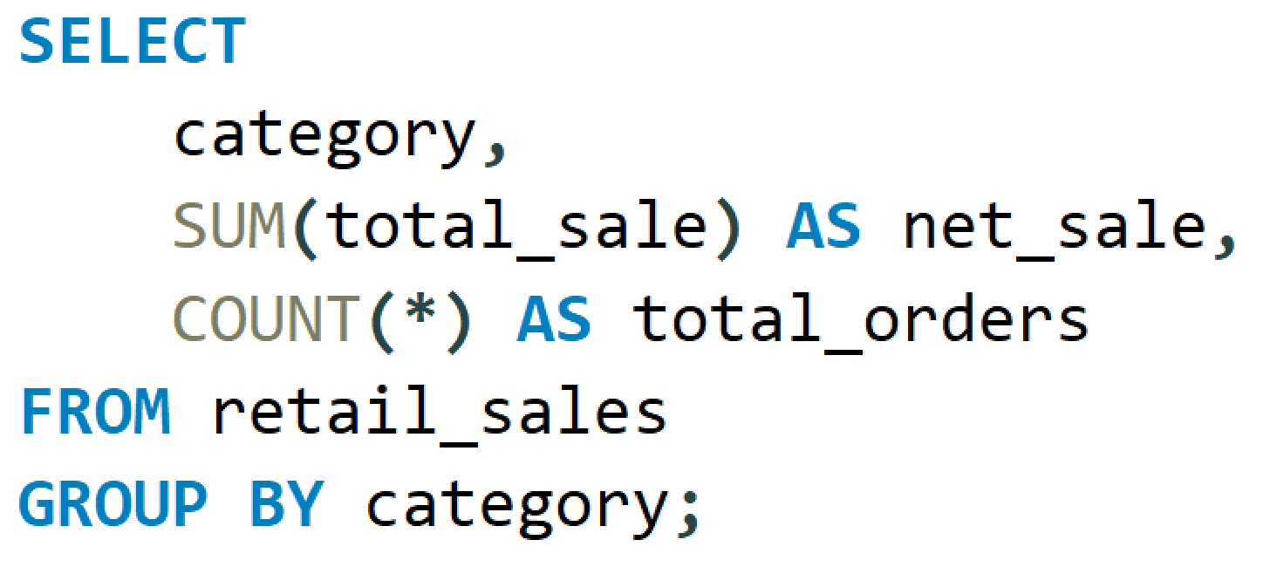
2:Calculate Total Sale For Each Category

Slide 12
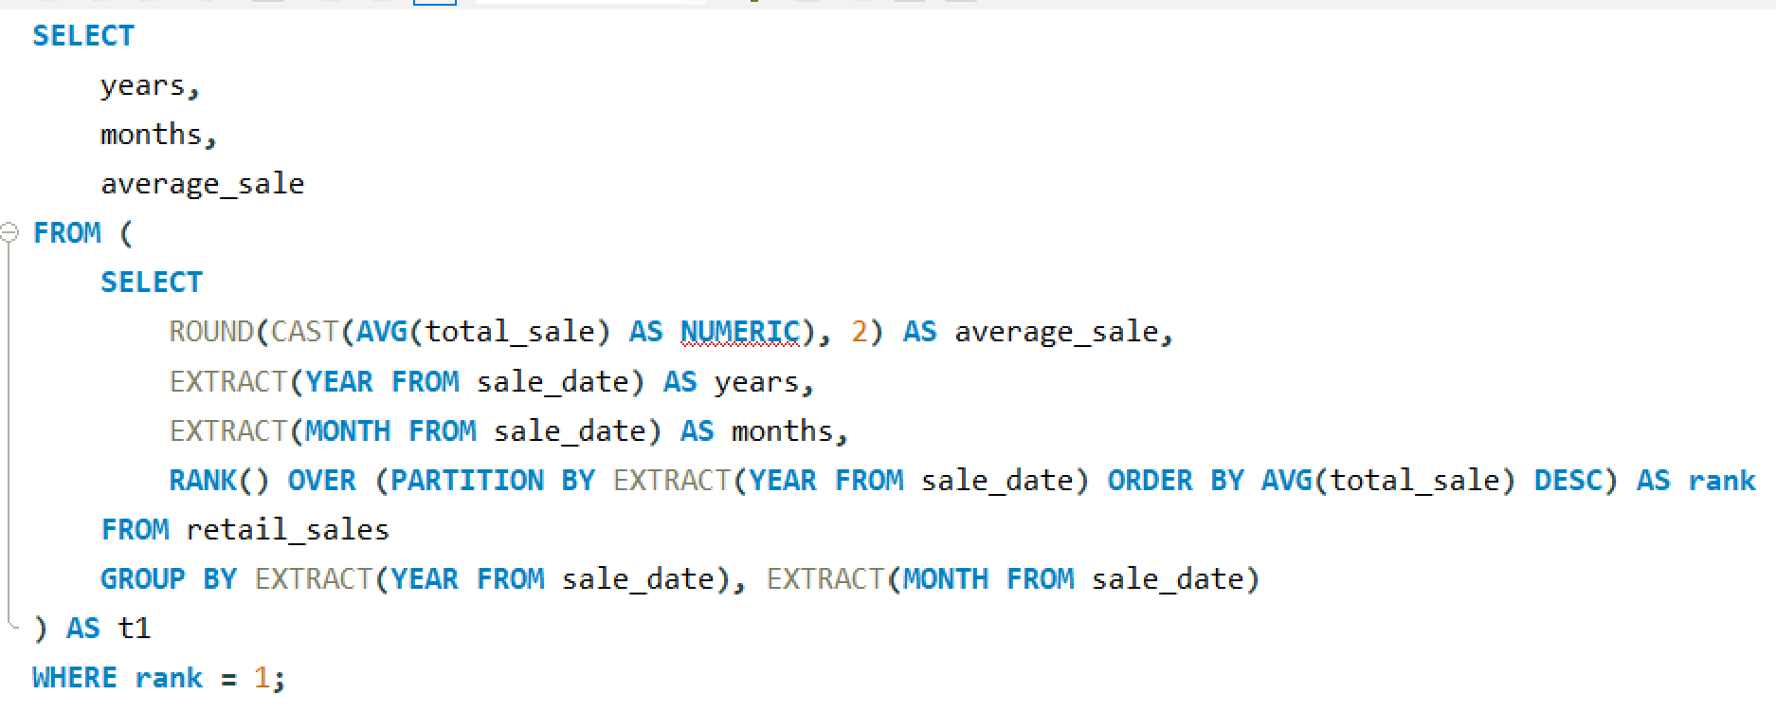
3:Determine The Best Selling Month In Each Year

Slide 13
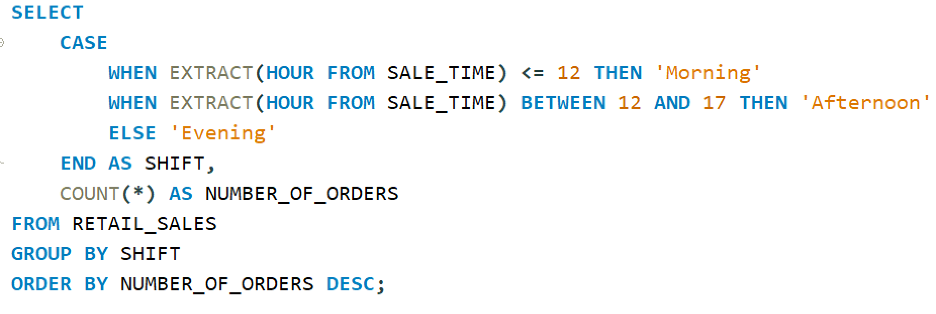
4:Find Total Sale For Each Shift(Morning , Afternoon, Evening)

Slide 14

Thynk Unlimited
CUSTOMER
ANALYSIS

Slide 15
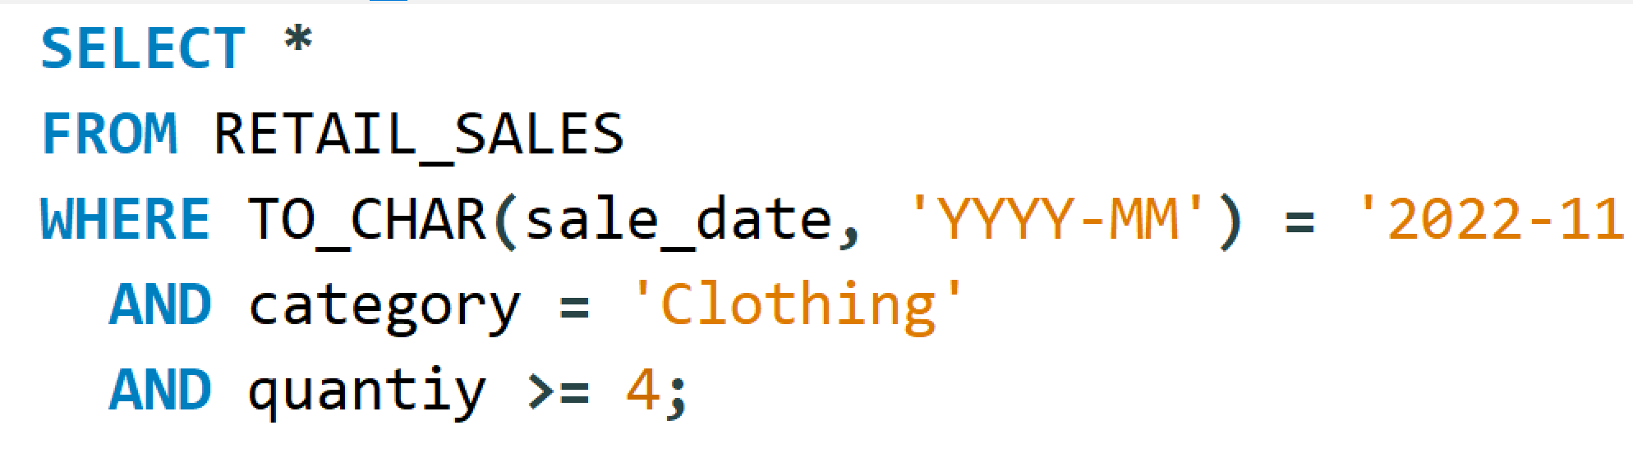
1:Retrieve all transactions where the category is 'Clothing' and the quantity sold is more than 4 in November 2022:

Slide 16
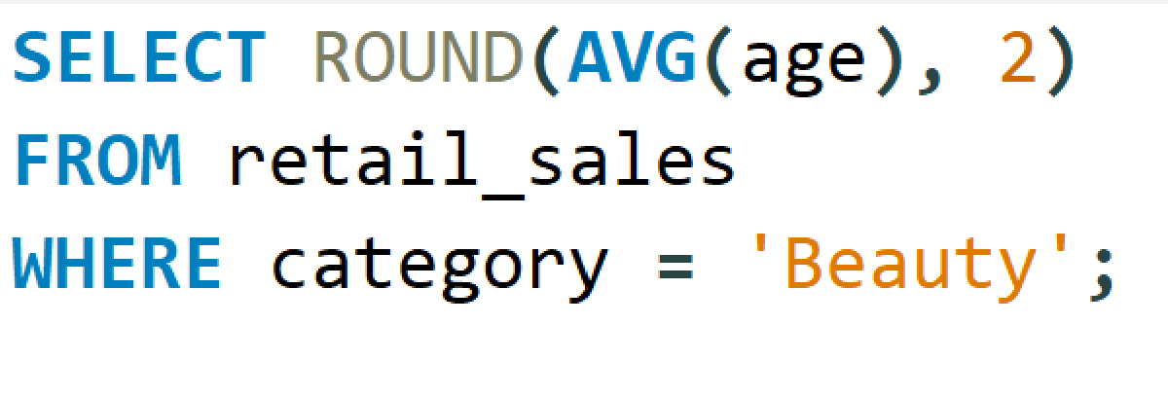
2:Find Average Age Of Customer Who Purchase Item From ‘Beauty’ Category

Slide 17
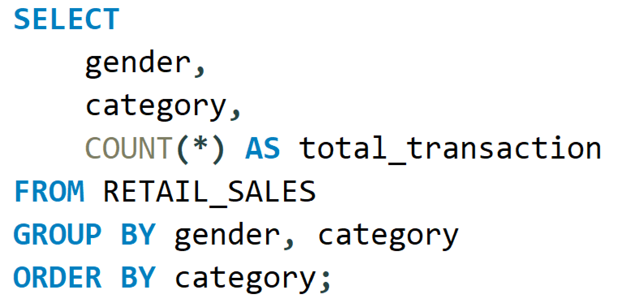
3:Find The Total Number Of Transaction Made By Each Gender In Each Category

Slide 18
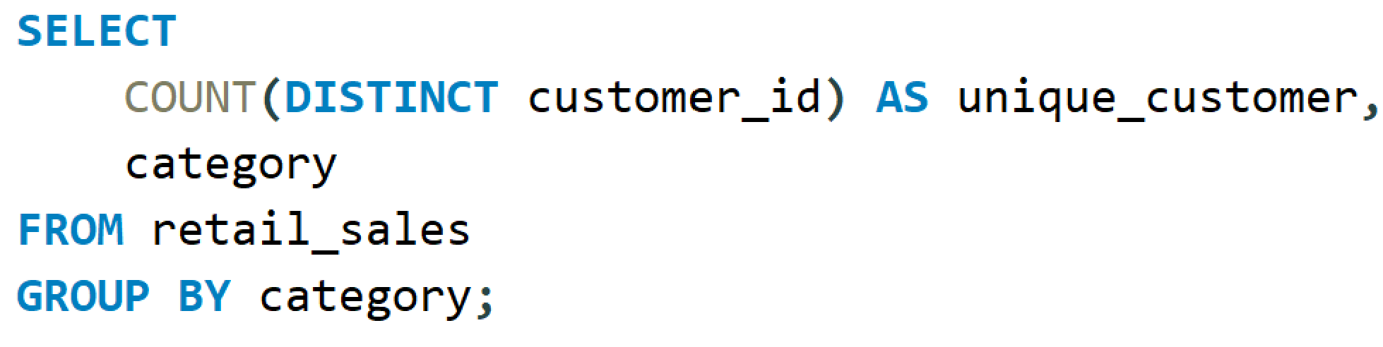
4:Find The Total Number Of Unique Customer Who Purchase Item From Each Category

Slide 19

Thynk Unlimited
HIGH VALUE
TRANSACTION

Slide 20
1:Find The Total Number Of Unique Customer Who Purchase Item From Each Category

Slide 21
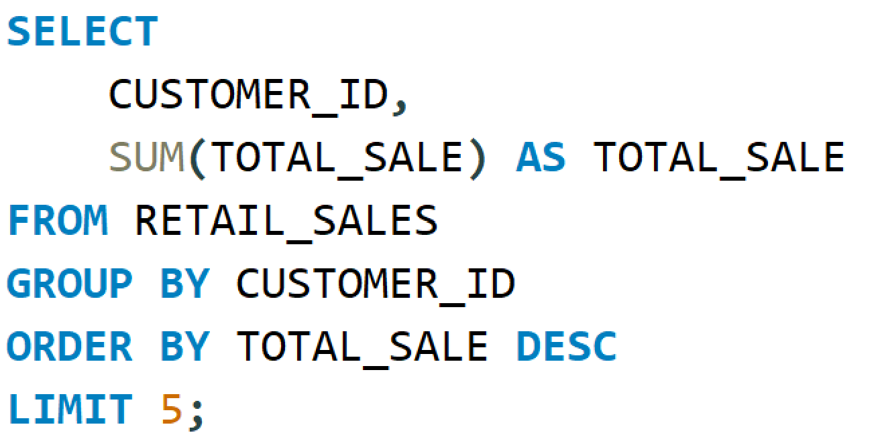
2:Find The Top 5 Customer Based On Highest Total Sale

Slide 22

Thynk Unlimited
PROFITABILITY
ANALYSIS

Slide 23
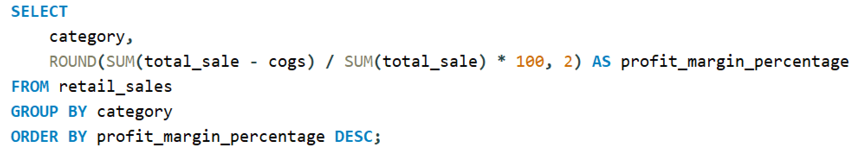
1:Calculate Total Profit Margin Percentage For Each Category

Slide 24
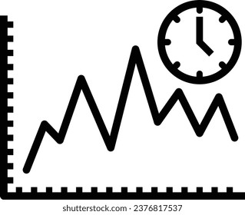
Thynk Unlimited
TIME BASED
ANALYSIS

Slide 25
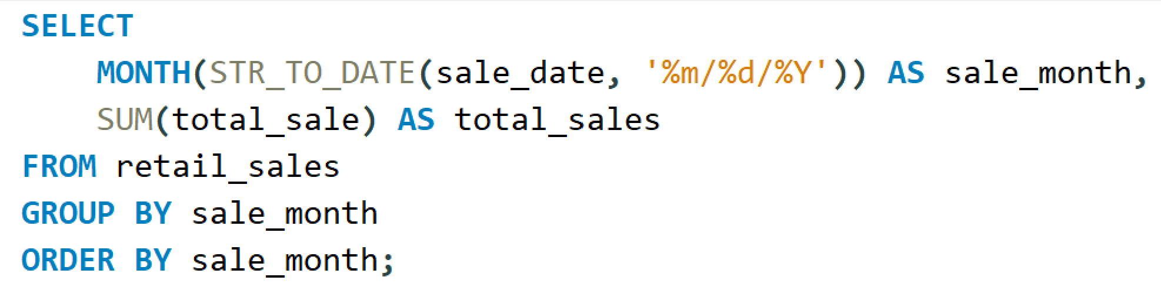
1:Calculate Total Sale By Month

Slide 26
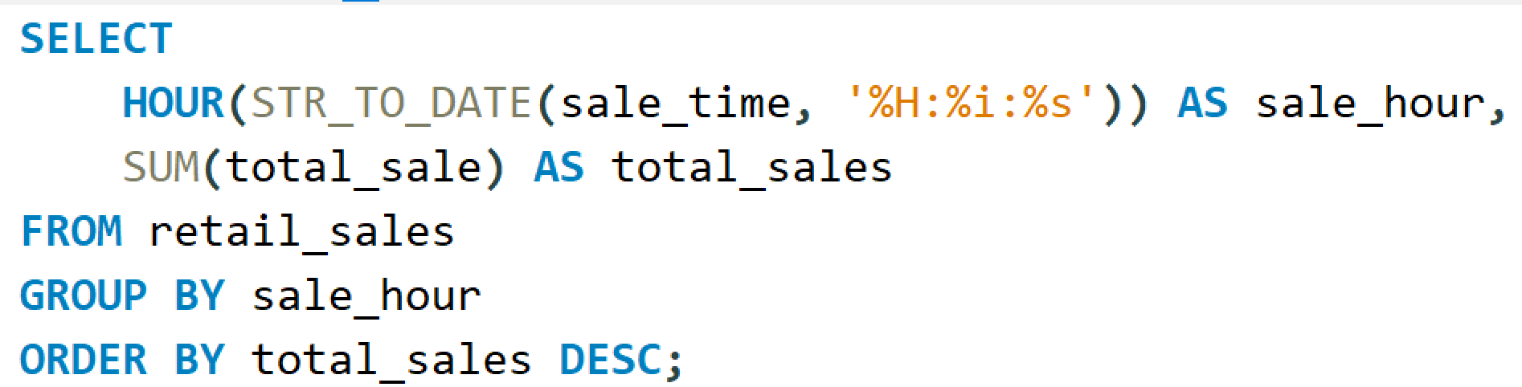
2:Determine Peak Sale Hours

Slide 27

Thynk Unlimited
CUSTOMER
RETENTION

Slide 28
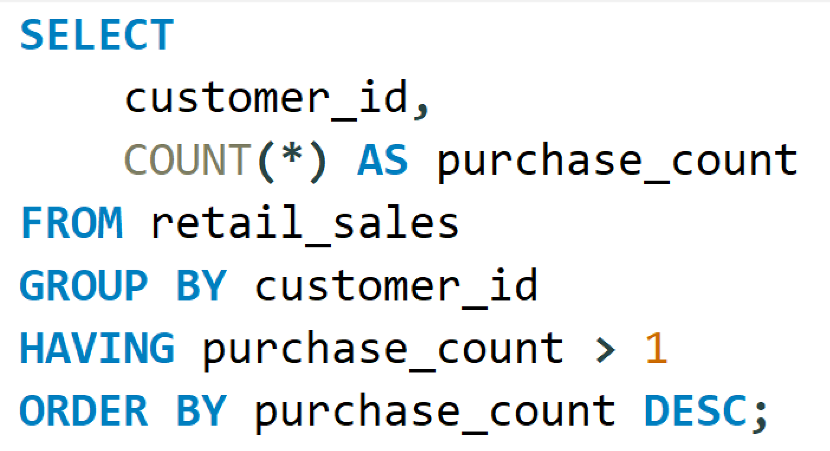
1:Find Customer Who made More Then One Transaction

Slide 29
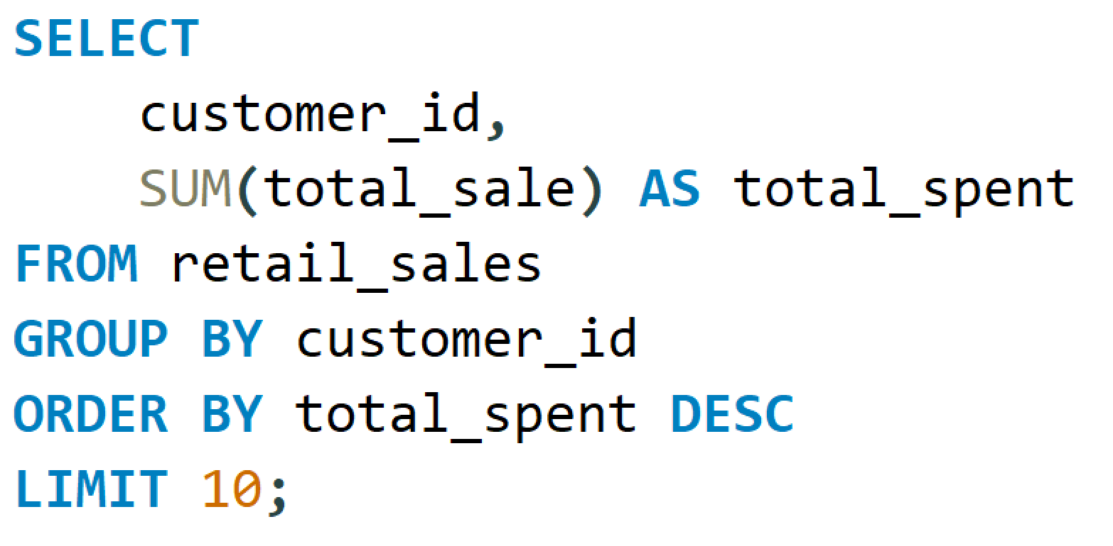
2:Identify Top 10 High Value Customer

Slide 30

Thynk Unlimited
PRODUCT
PERFOMANCE

Slide 31
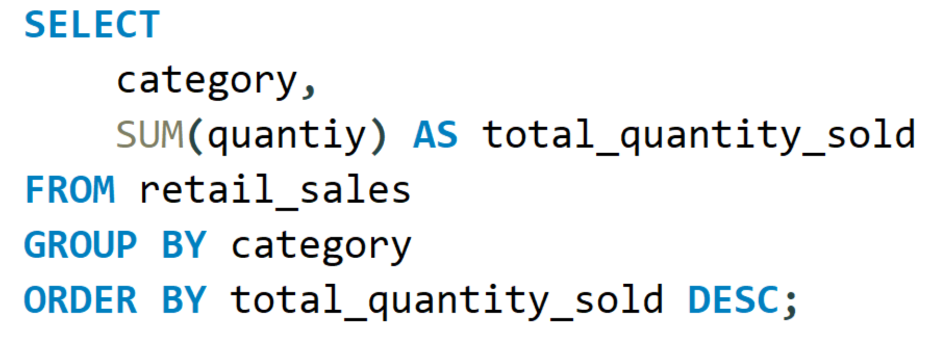
1:Determine The Best Selling Category

Slide 32
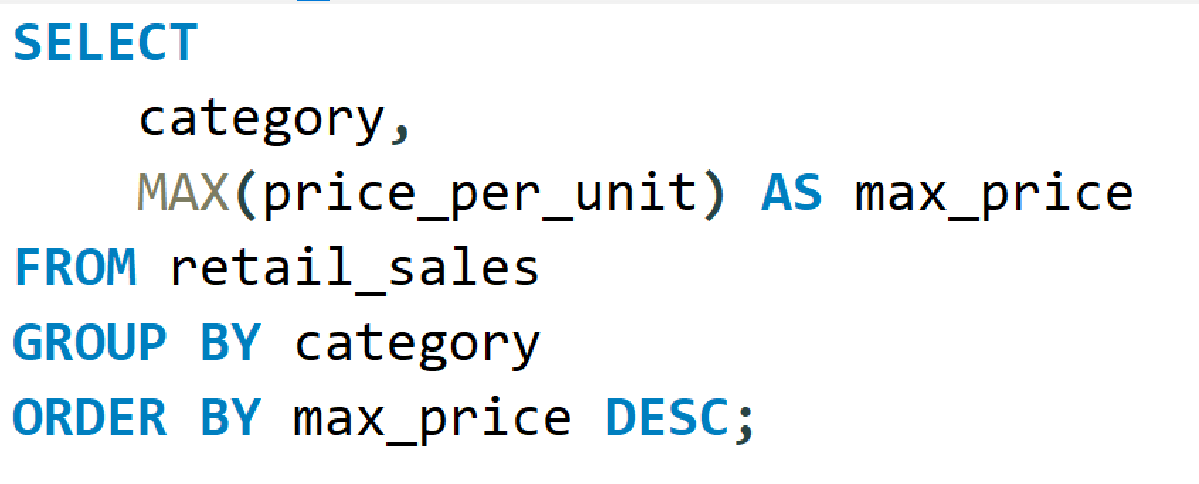
2:Identify The Most Expensive Items Sold

Slide 33


