Slide 1
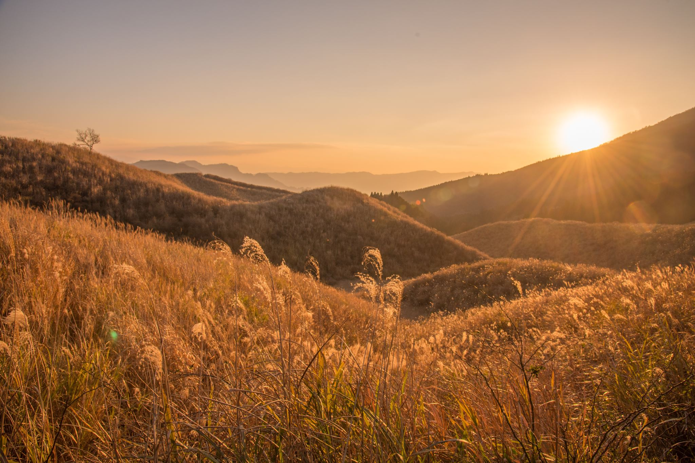
Title : sun flowers

Slide 2
Chapter # 1 :sun flowers

Slide 3
Sun flower
Sunflowers are tall, vibrant plants known for their large, bright yellow flower heads that follow the sun's path across the sky. These striking flowers are native to the Americas but are now cultivated worldwide and are recognized for their beauty and various uses

Slide 4
Growth
Sunflower growth begins with a seed planted in fertile, well-drained soil, ideally in spring. The seed germinates, sending down roots and pushing a sprout upwards. As the sunflower grows, it develops a sturdy, hairy stem, large, rough leaves, and eventually a large flower head.

Slide 5
Seeds
that come from the disk flowers contain a sweet, yellow oil. Sunflower oil is used in cooking and in making soaps and paints. Many people eat dried or roasted sunflower seeds as a snack.

