Slide 1



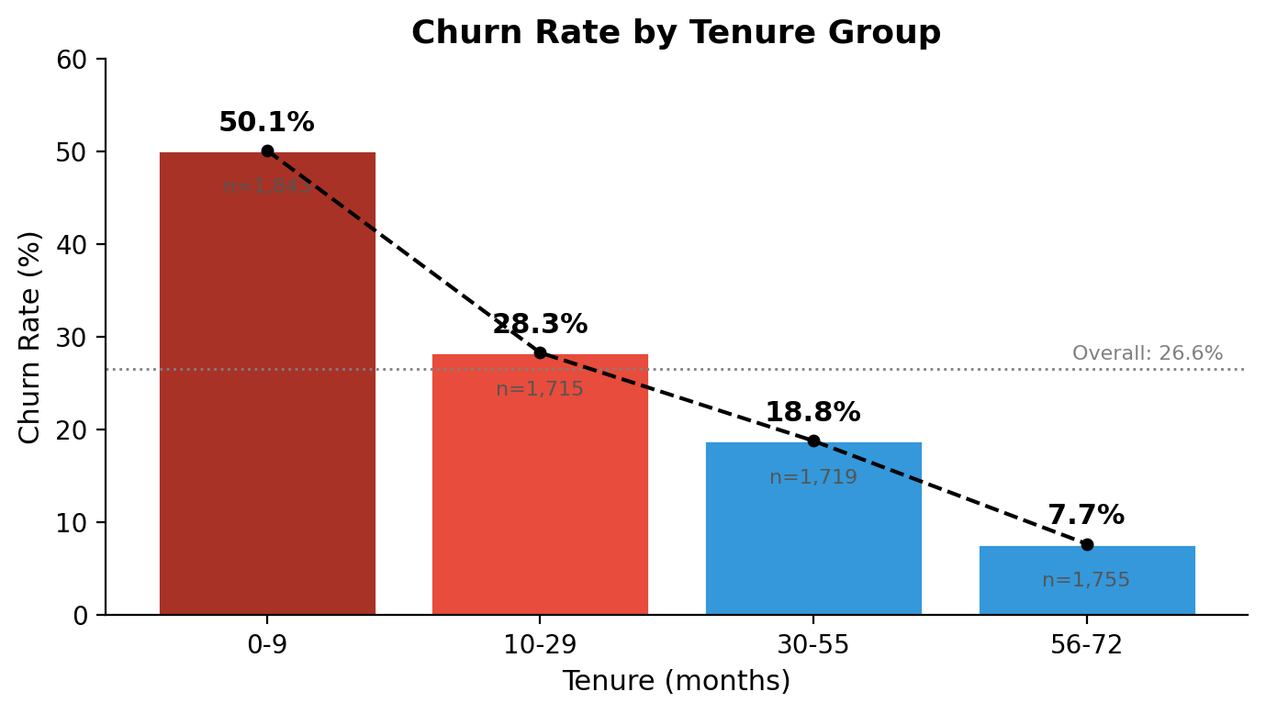
Key Findings
26.6%
50.1%
42.7%
Overall Churn Rate
New Customer Churn
Month-to-Month Churn
1 in 4 customers leaves
First 9 months are a critical retention window; 10–29 months also above average
Largest segment (55% of customers) with highest churn — biggest retention opportunity
Key Takeaways
Churn is not random — it is concentrated in specific, identifiable segments
Tenure and contract type show the strongest association with churn among all tested variables (Chi-square test, p < 0.001)
The first 9 months represent a critical retention window where intervention is most needed
Month-to-month contracts are both the largest segment (55%) and the riskiest — the primary retention opportunity
Customer Churn Analytics | Tal Ilan | Check Point Home Assignment

Slide 2


Interpretation & Next Questions
Why This Matters
What to Explore Next
26.6% churn is consistent and significant — 1 in 4 customers leaves
Contract type — strongest churn driver:
Month-to-month: 42.7% churn (55% of all customers)
Further segmentation required to identify which sub-groups are most at risk and most convertible
Tenure — critical early window:
50% of new customers leave within 9 months
Root cause investigation needed — via data deep-dive or customer surveys — before designing retention programs
Cross-segment deep dives:
Month-to-month + low tenure
Month-to-month + electronic check payment
Month-to-month + no online security
Recommended next steps:
Segment month-to-month customers to prioritize a contract upgrade program (monthly → annual/biannual)
Investigate early churn drivers (first 9 months) via data analysis and/or customer surveys before designing retention offers
Explore additional dimensions (dependents, fiber optic, security services) to build a fuller risk profile
Customer Churn Analytics | Tal Ilan | Check Point Home Assignment

