Slide 1
IoT Security Project
Created by Talisa Powell and Bradley Allen
CSCIU-509
4/20/22

Slide 2
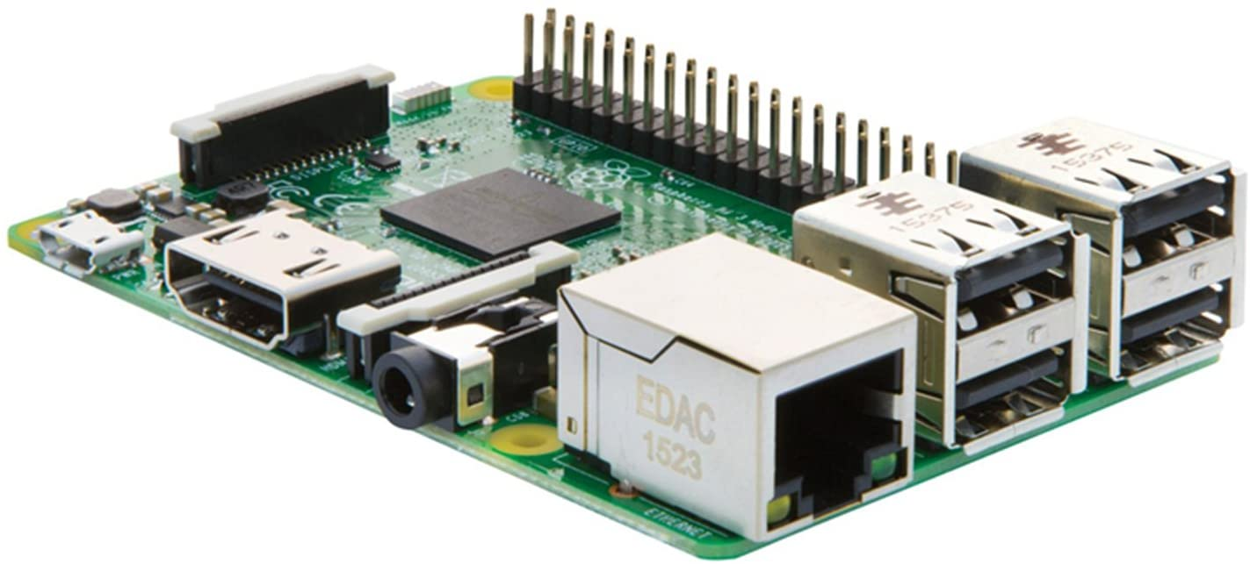
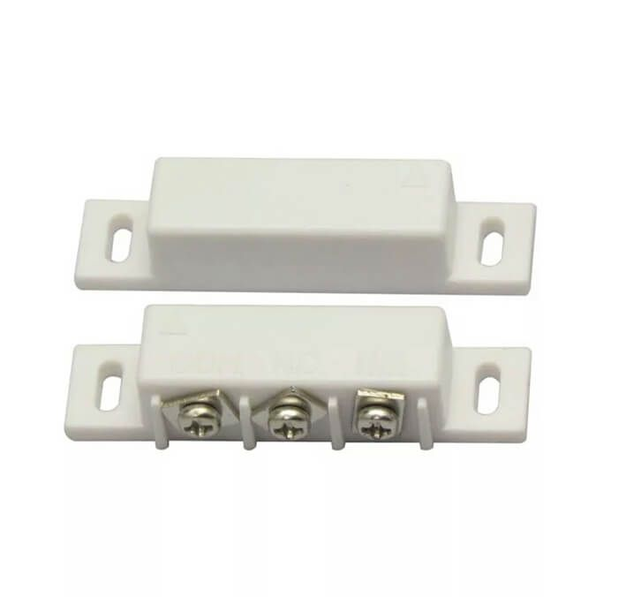
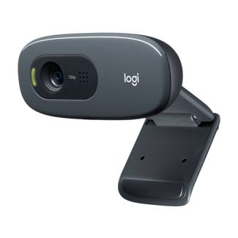
Project Overview
Our project was made using:
Raspberry Pi 3B+
Reed switch (magnetic relay)
Breadboard
Webcam
t

Slide 3
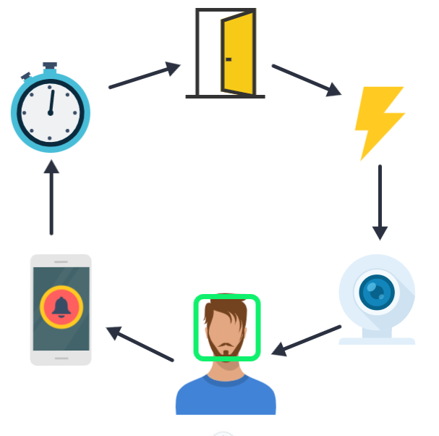
How It Works

Slide 4
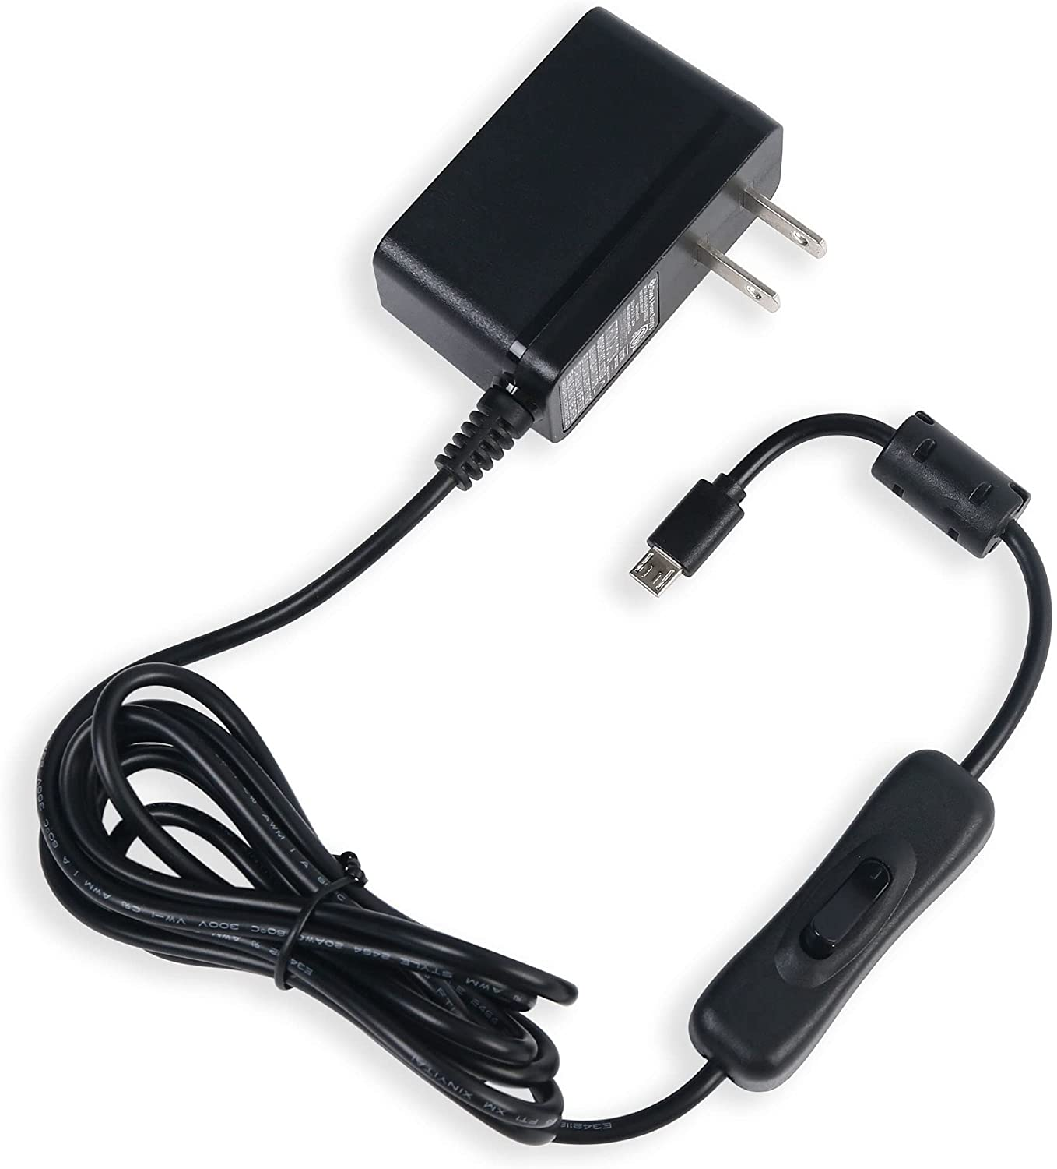
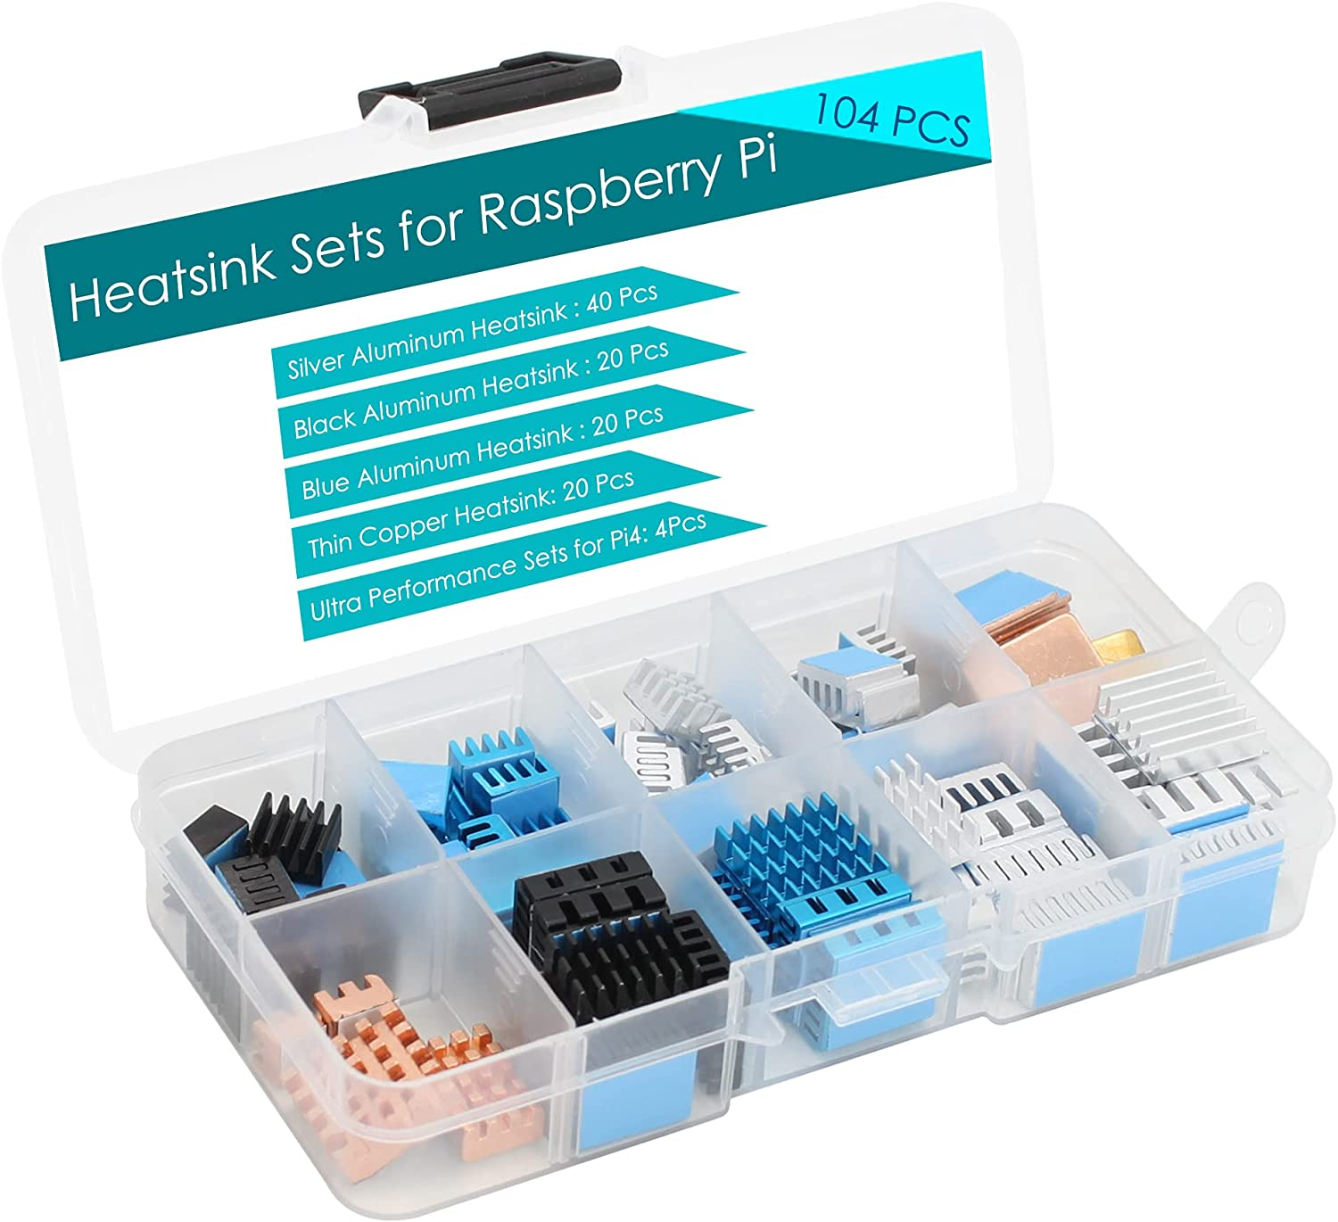
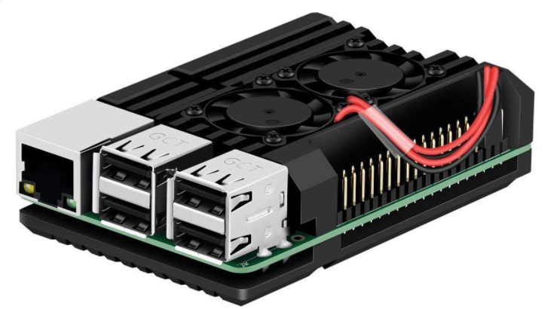
Challenges
Overheating
Shorted reed switch
Low voltage
Frame rate
Segment fault

Slide 5


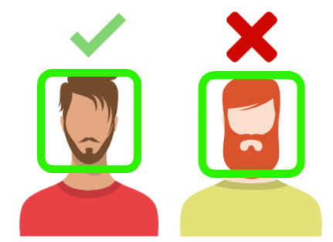

Capabilities
No Notification
Notifies

Slide 6
Limitations
Limited Memory

Slide 7
Possible Improvements
Larger memory storage
Faster processor
Improved facial detection

Slide 8
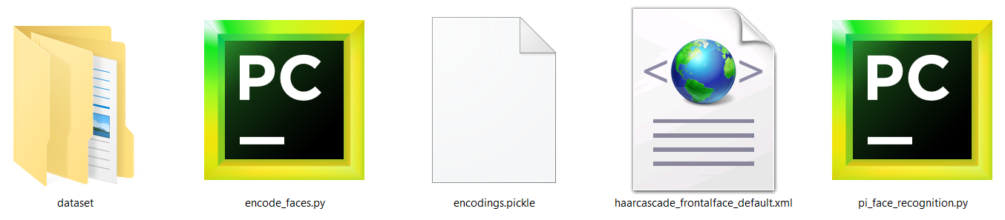
Logical Details (File Structure)

Slide 9
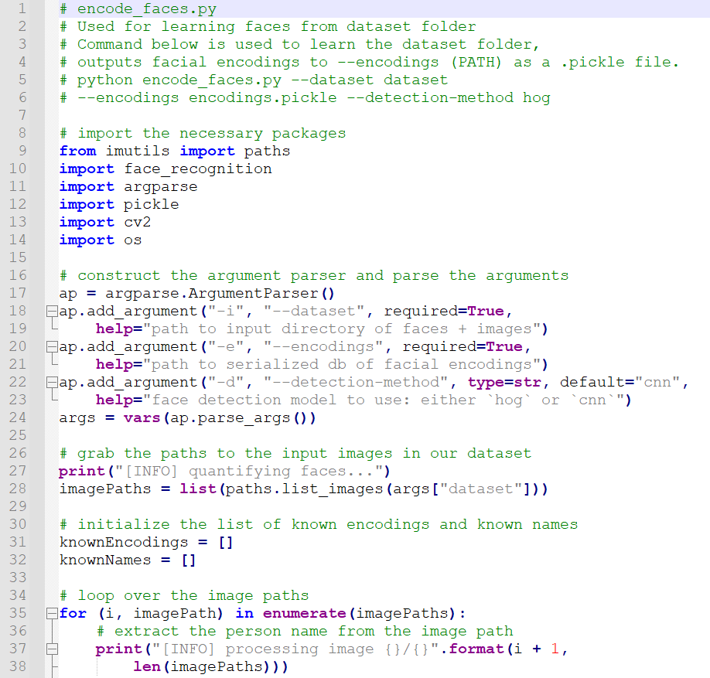
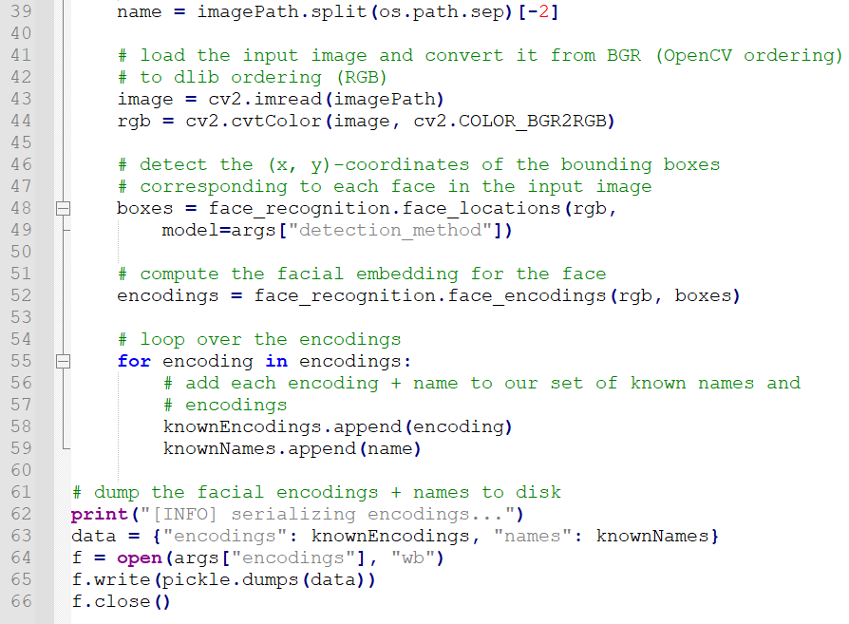
Logical Details (encode_faces.py)

Slide 10
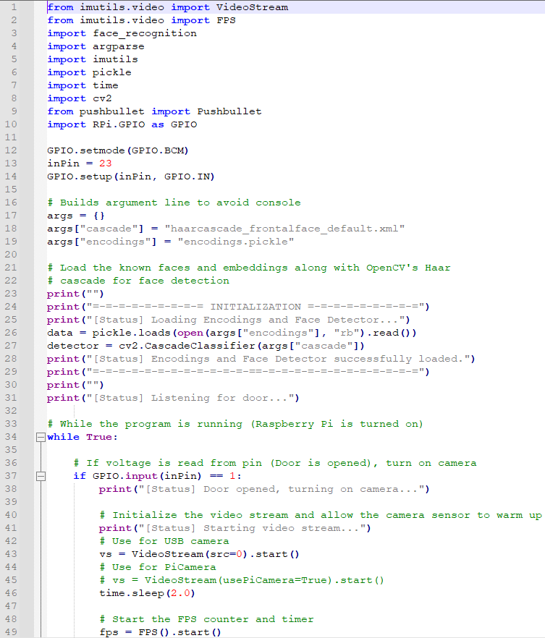
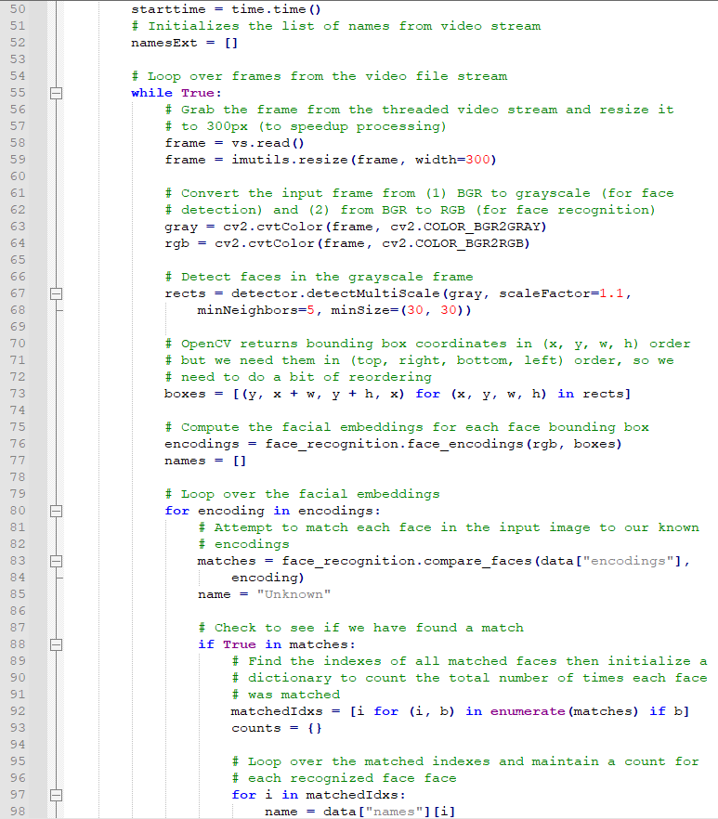
Logical Details (pi_face_recognition.py)

Slide 11
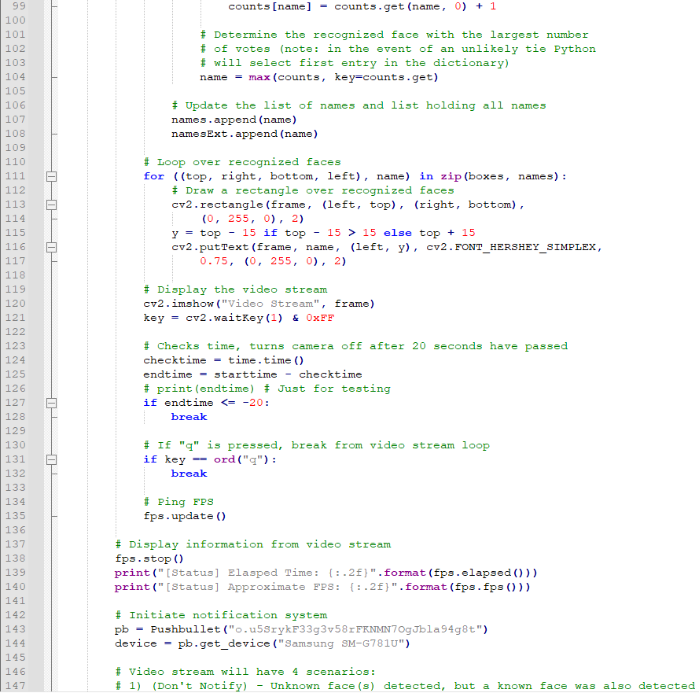
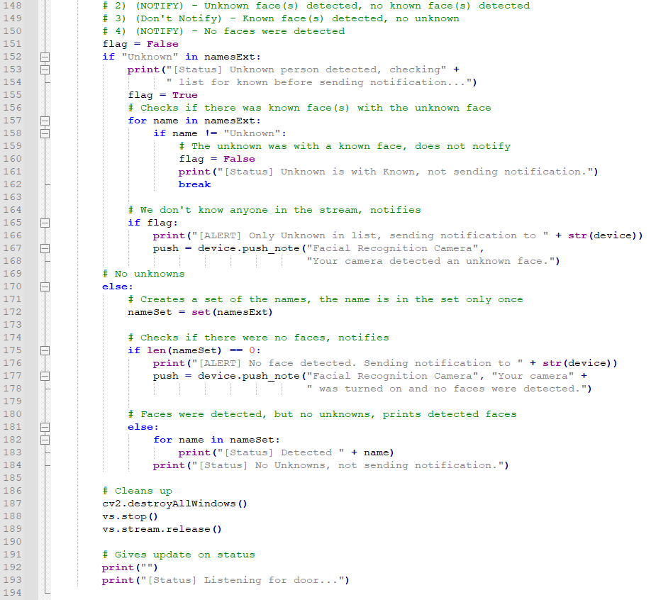
Logical Details (pi_face_recognition.py)

