Slide 1
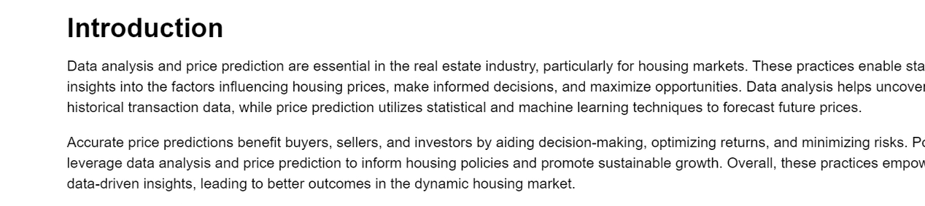
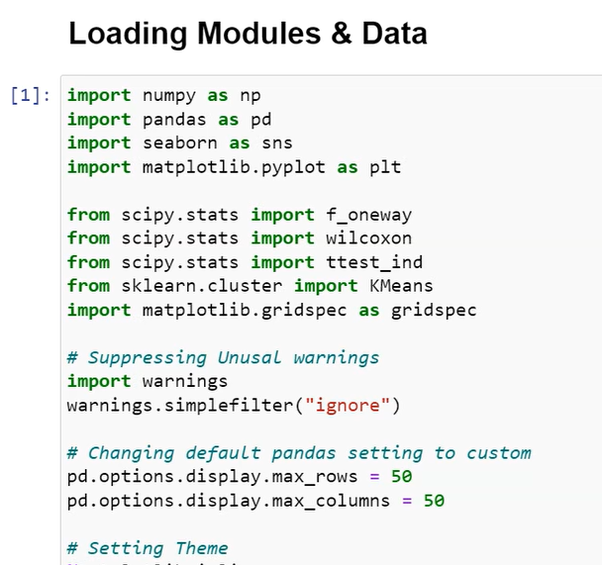
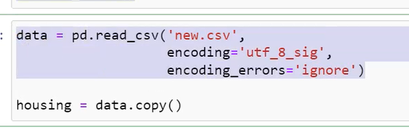
You can find some introduction about the project in the code file .ipyj
The project starts importing the libraries need use to perform different functionality, then also suppresses the warnings so that the output should look very simply. So, it shouldn't present a lot of warnings.
I also, custom the default pandas setting to display only 50 rows and 50 columns.
After that I read the data then I add a copy of the original data to keep it safe as it is.

Slide 2

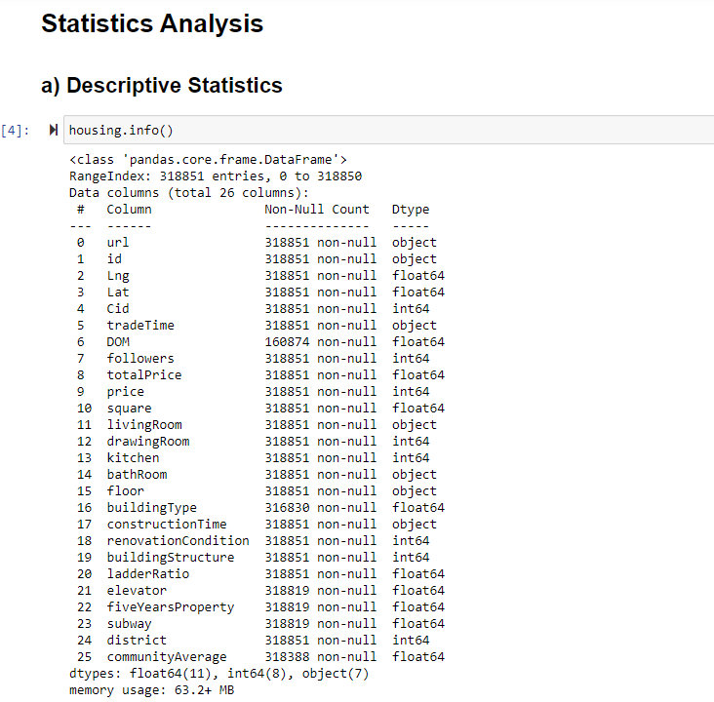
, then I check the shape of the data as you can see it has 3,8????? 36 columns
Following on the requirement I’ve separate the Statistics analysis accordingly.
First, I start from different statistics.
Basically, the purpose of descriptive analysis is to check the distribution of the data like how are data is distributed and it looks like such kind of characteristics we can find though the analysis. E.g Data types and so on.

Slide 3
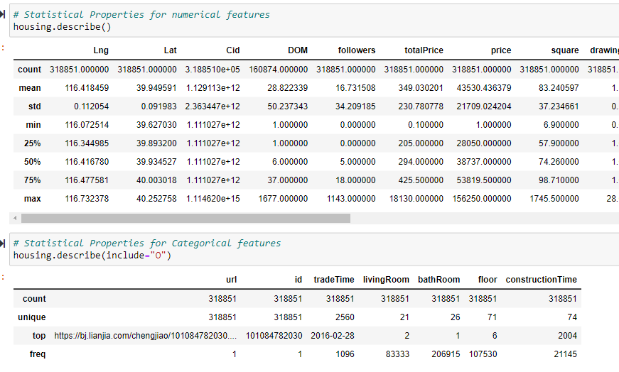
After that I check this statistics properties for numerical features using the .describe function. You can performance the whole statistical analysis using only this descriptive function First displayed is numerical features then I checked for categorical features.

Slide 4
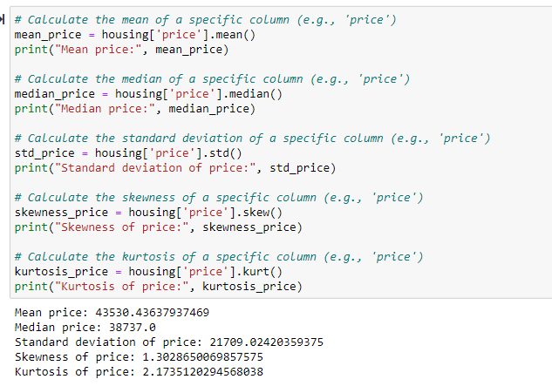
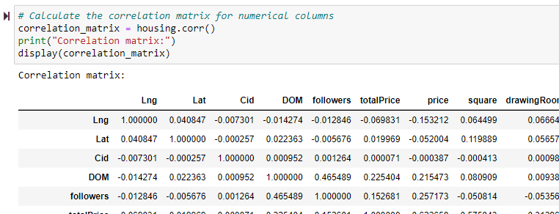
After that I performed some descriptive analysis on our target features that is basically is the price. It was checked the mean, median standard deviation, skewness and kurtosis of the price feature.
Then I checked the correlation numerical that you can see here.

Slide 5
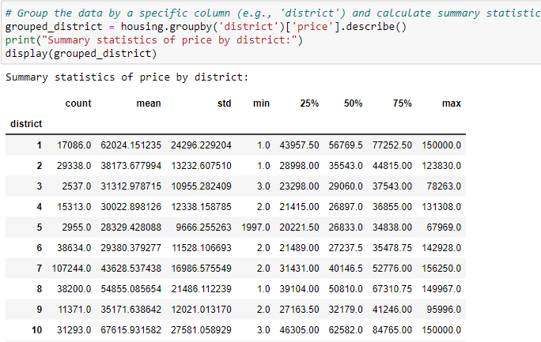
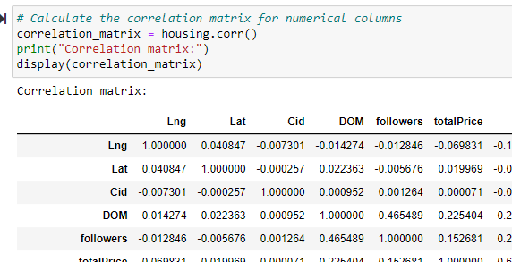
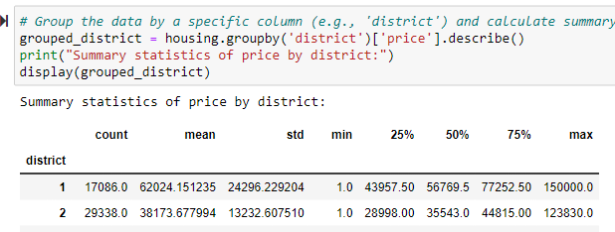
Accordingly, with the district was performed for each district I get statical properties separately E.g mean, standard deviation and so on.
It was the descriptive analyze performed. I’ve also, added some other things in descriptive analyze like correlation matrix and district wise properties the values for price feature.

Slide 6
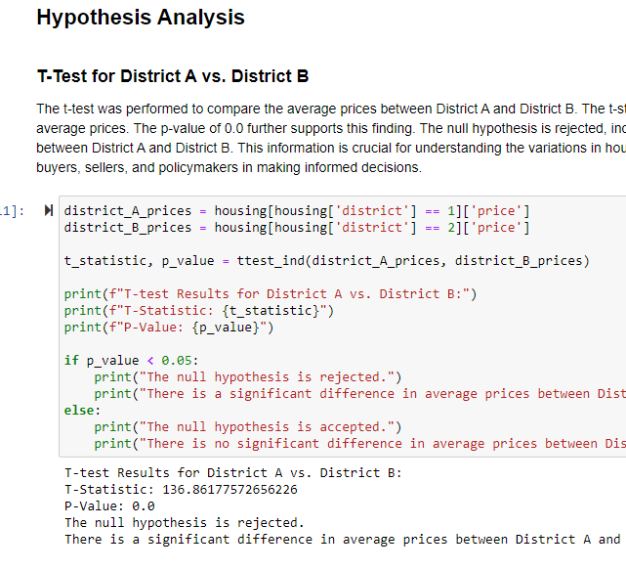
Then Hypothesis Analysis where hypothesis test was performed and try to figure out the relationship between different features of the data. You can find the analysis in detail I want to check the price of two different districts. E.g. I own a house in district A and also, own a house in district B then will the price change or not? For this kind of relationship T-Test was used. You can see by the result obtained that the hypothesis was rejected. There is no relationship identified, there is no change between the price but there is a significant difference in average price between District A and B according with the hypothesis analysis.

Slide 7
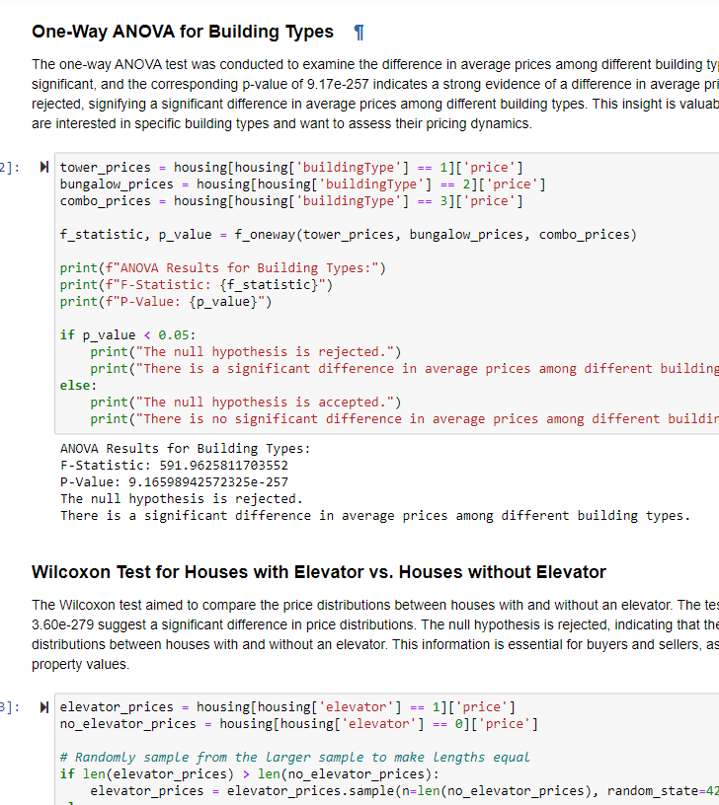
One Way ANOVA - to check the difference between numerical values of multiple groups. You can find also, the Wilcoxon test, Correlation analyses and so on.

Slide 8
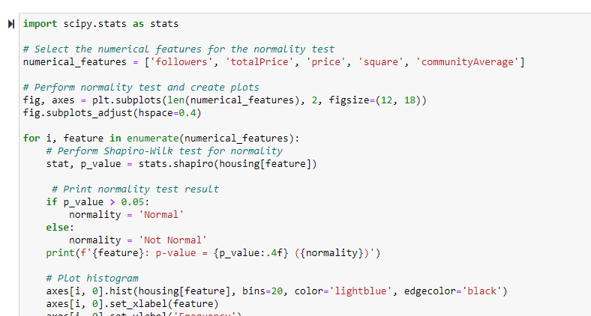
After the hypothesis analysis we need to explore the data through visualization. For this I’ve made different types of visualization. I also, performed cluster analysis and there are a lot of exploration using different kind of graphs . First of all, I made different plot for this columns – followers, totalPrice, price, square, communityAverage. To check the distribution of our numerical features, I used Shapiro test to check the normal distribution of each numerical feature.

Slide 9
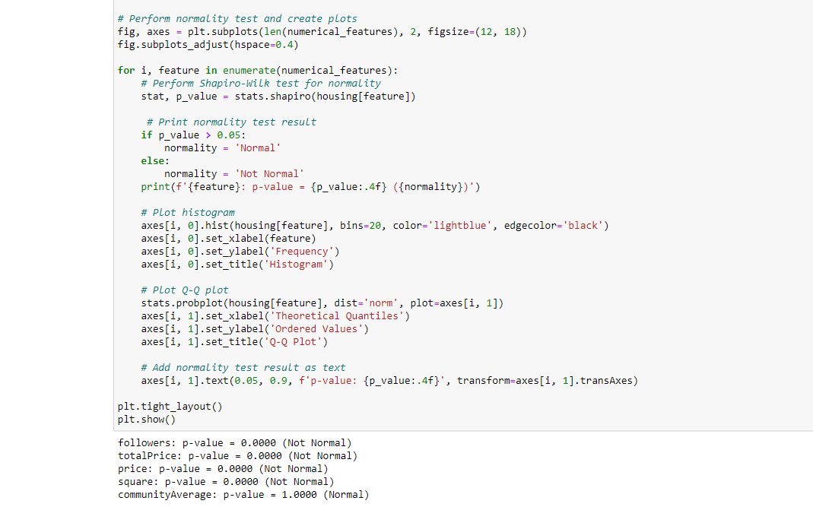
This is normal distribution that I tested. A single feature was selected and created plots. After that I treated the feature one by one and performed Shapiro test on that particular feature if is that in normal distribution or not. If it is in normal distribution value will be ‘normal’ otherwise will be ‘not normal’. Then for this feature I made two plots, first plot was histogram, and second plot was Q-Q plot. It basically shows how the data varying from average value.

Slide 10
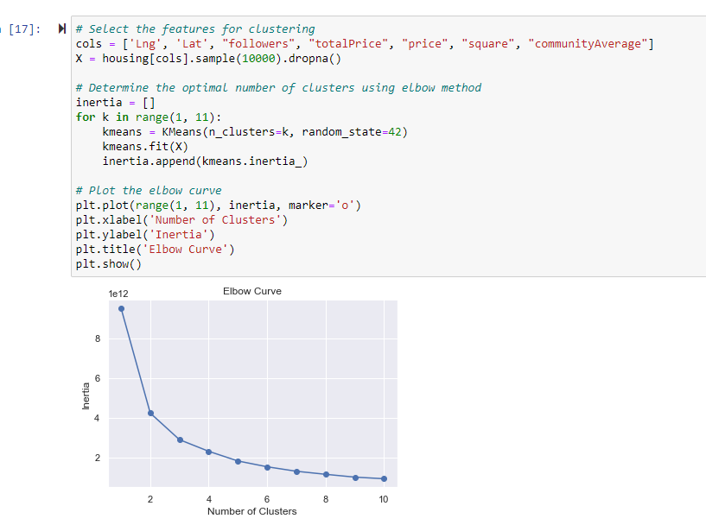
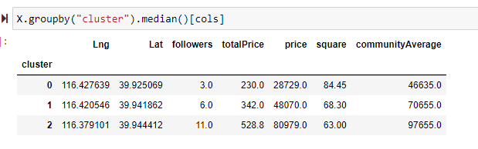
Cluster analysis was performed to find different groups and patterns. It was only performed on numerical features. K means clustering. Before applying K clustering was applied elbow curve test.
The median was used here to analyze the different between clusters.

Slide 11
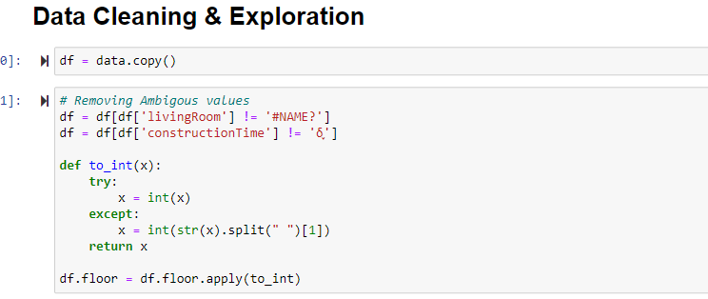
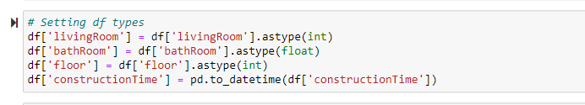
Data Cleaning for ML modules. Exploration for visualization First, I created a copy od the data. Ambiguous values were removed as they were found in the dataset. Was identified string values not having proper integer data type so I wrote a function and check if it is identified integer values if it is not supply it accordingly to the surpass and only get the value, drop any symbol then the data should get to work in integer.
Some data types and features were not in correct format, so I created setting as below shows for these.

Slide 12
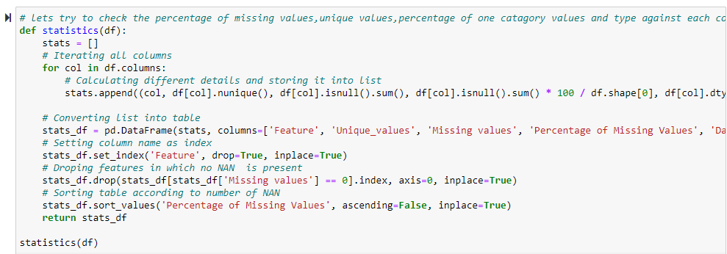
I wrote a function to calculate the missing values, percentage, data type in each of the features. So, this function take the data frame as an input will read all columns, will calculate the values as shows below.

