Slide 1
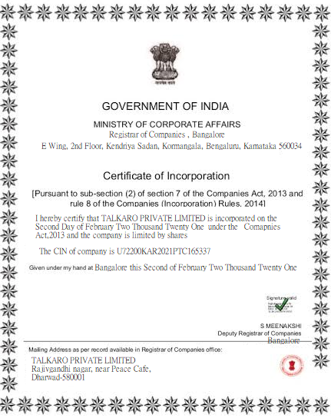
CERTIFICATE OF INCORPORATION

Slide 2
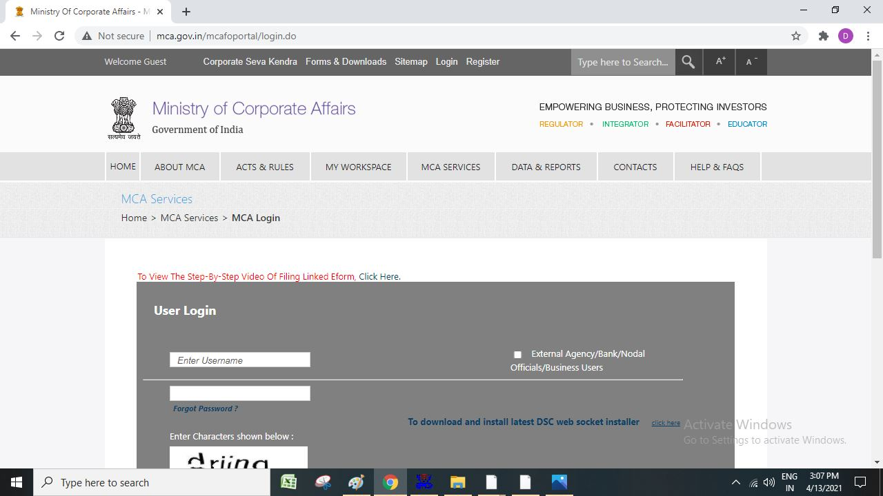
Our company filed for Certificate of Incorporation digitally Website: MCA.gov.in
Following Steps were followed
Fill spice+ Part A
Fill spice + Part B
Provide attachments of MOA and AOA
Payment
Click Register Spice Part A

Slide 3
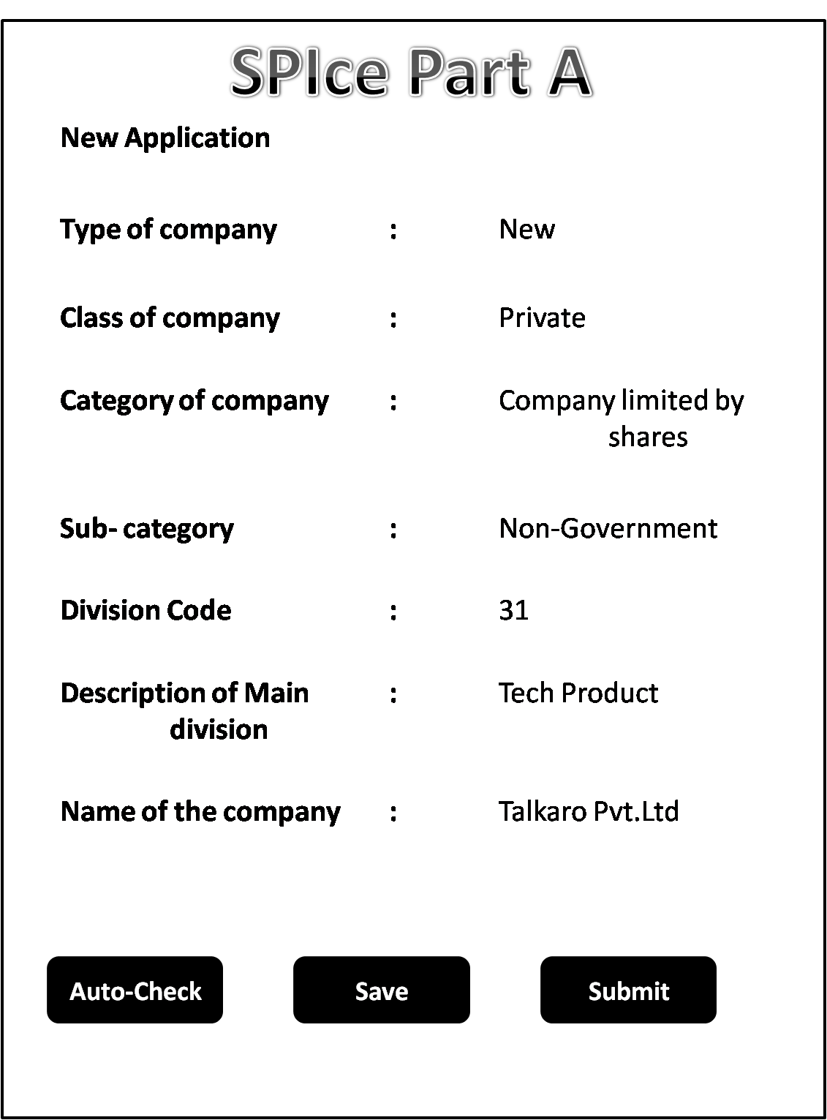
The details of Spice Part A were filled
When clicked on Auto-Check button it displayed that the company name is available Press Submit

Slide 4
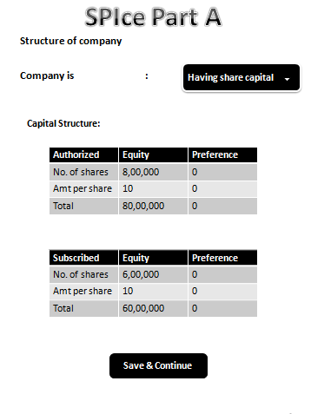
The website directs to fill the structure of the company and its capital structure
When filled , it should be saved and continued

Slide 5
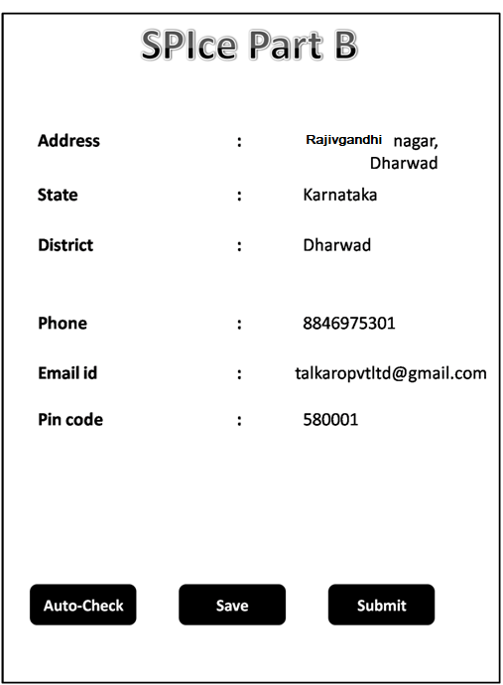
Spice Part B was filled
It asked about the details like address, state , district, phone number, email id and pin code It was submitted by clicking on the submit button

Slide 6
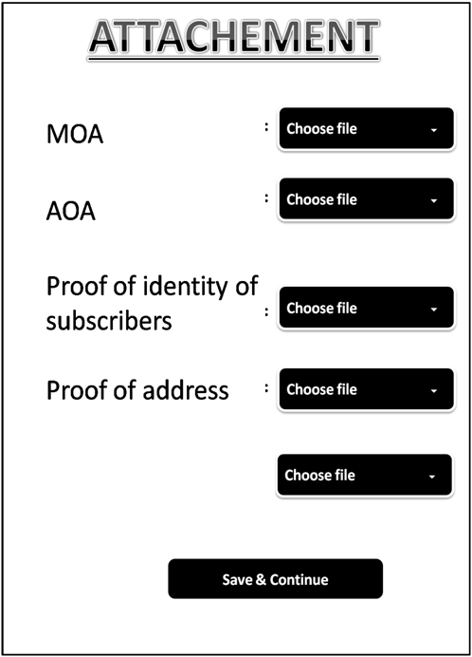
Finally,
Memorandum & Articles of Association are to be attached
For the proof of identity of subscribers, PAN card was submitted
For the proof of address of the company, electricity bill was submitted
NOC from Directors will be submitted stating that they have willingly become the directors of the company
NOC of Directors
:

Slide 7
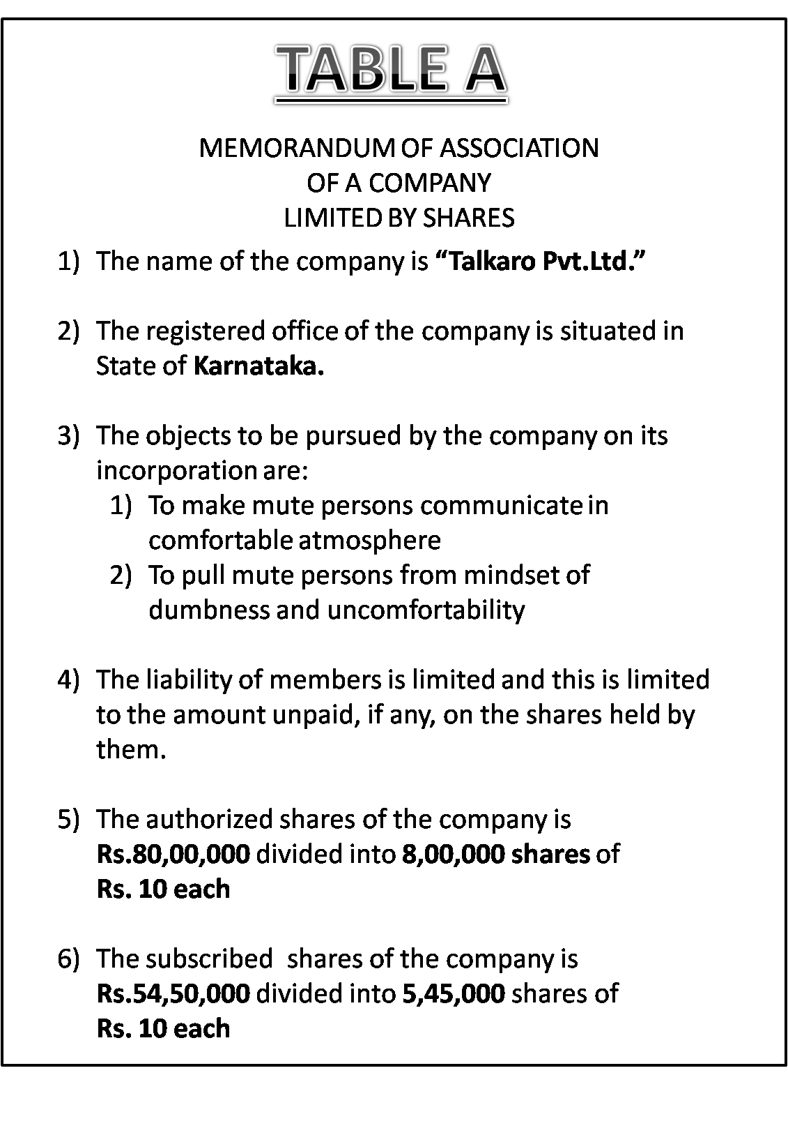
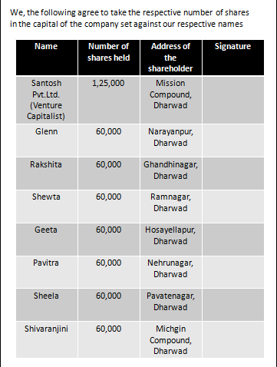
Signatures of BODs

Slide 8

At the end amount of Rs.2,000 was paid electronically through NEFT

Slide 9
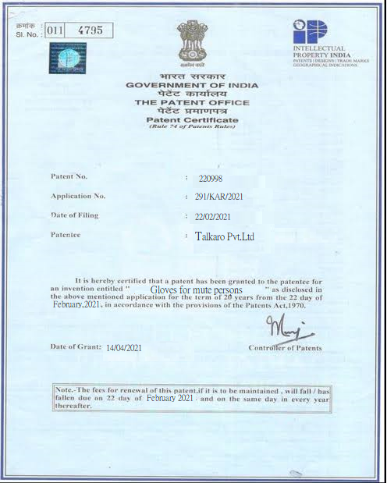
Patent Certificate

Slide 10
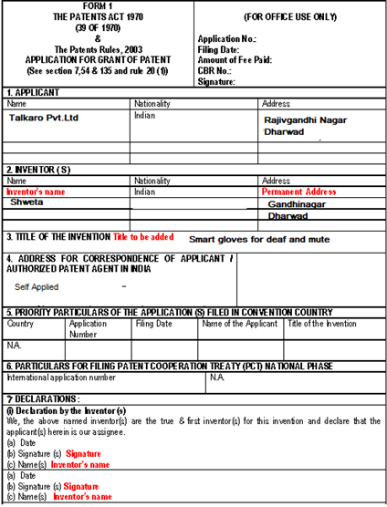
Form 1 of the Patent Act was filled and submitted along with the letter disclosing the Points of Parity and Points of Difference with the competitors

Slide 11
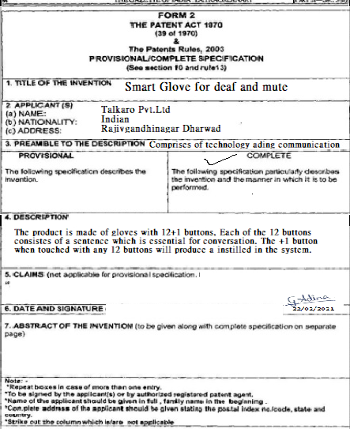
Form 2 of the patent Act was filled and submitted for filing of patent for the next 20 years, we had filed for complete specification

Slide 12
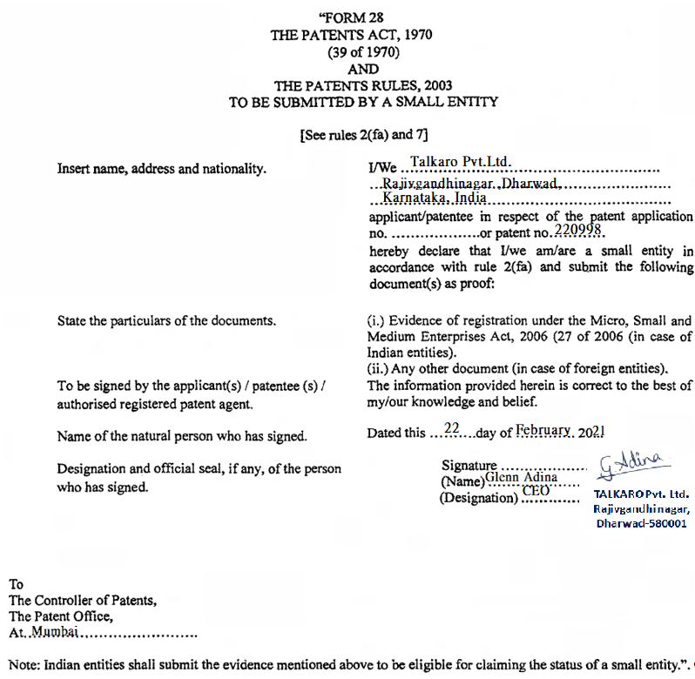
Form 28 was filled and submitted as Talkaro Pvt.Ltd. is start up established by 7 persons

Slide 13
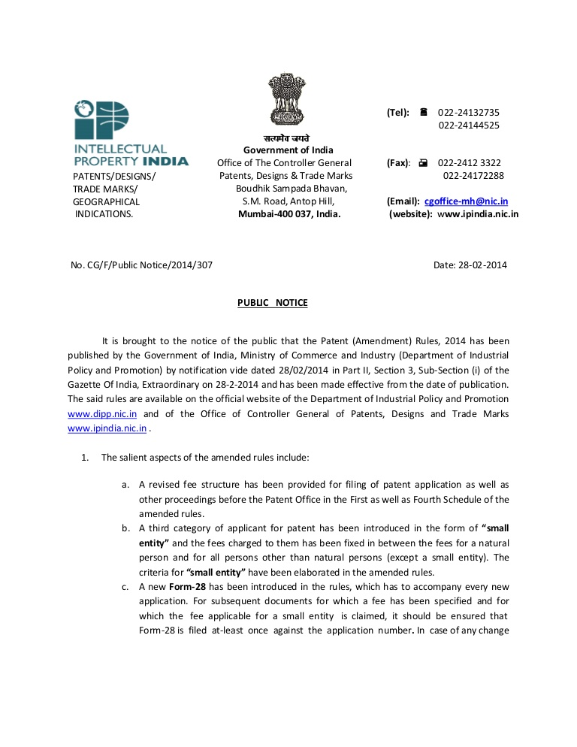
Ever application is published in the official journal after 18th months period from the date of filling of application
The files are examined and patent is granted for the period of 20 years

