Slide 1
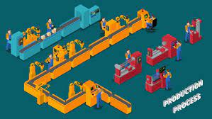

Slide 2
Production Manager
Name : Santosh
Absent

Slide 3
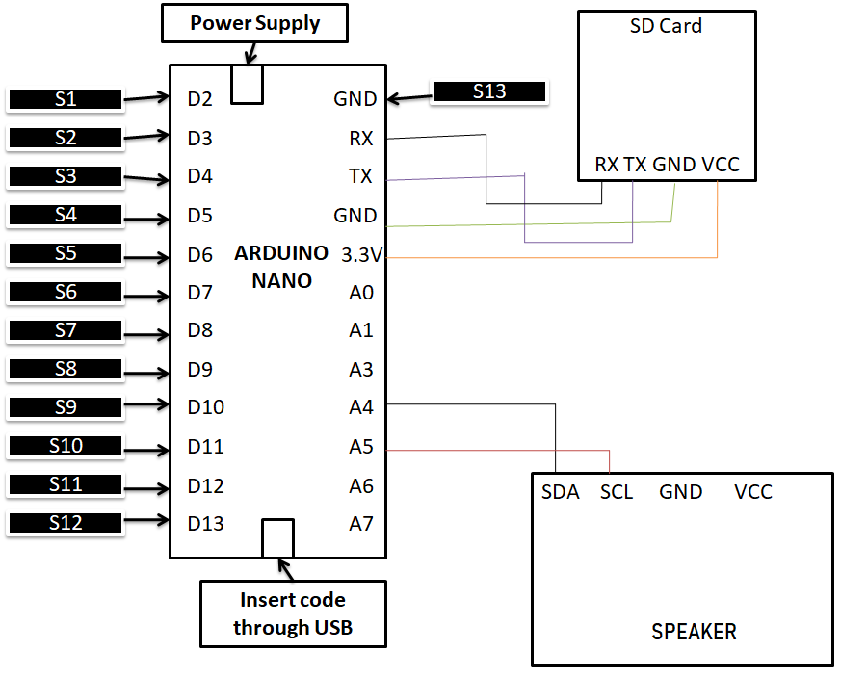

Slide 4
Production Process
12 Jumper wires are attached to digital pins of Arduino Nano
1 jumper wire is attached to Negative i.e. Ground(GND)
RX of Arduino Nano is attached to RX of SD card
TX of Arduino Nano is attached to TX of SD card
RX and TX pins are used to receive and transmit data.
The sentences are received by Arduino Nano
A4(Analog) is connected to SDA(Short for Data Line)
A5(Analog) is connected to SCL(Short for Clock Line)
Speakers receive the data the data from Arduino and provides output
Code of C++ is inserted to Arduino Nano through U.S.B. It was written in Arduino IDE(Integrated Development Environment) software.
Power is supplied to Arduino through a battery

Slide 5
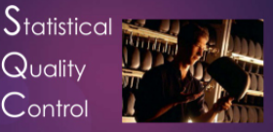
To control the quality Statistical Quality Control is used
The technique of SQC used is C-chart
C-chart is used when in case of uniformity in the number of samples.
Every week 20 samples are to be checked

Slide 6
UCL= Average + 3 S.D.
CL= Average
Defects in quality
LCL= Average – 3 S.D.
Month
The products process will be rejected if the points goes beyond and upper & lower control limit respectively

Slide 7
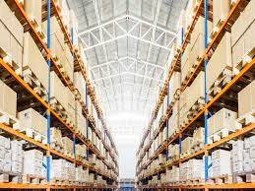
WAREHOUSE

Slide 8
There are 4 rows:
Raw Materials
Picking Level
Finished Goods
Raw Materials
Overstock Level
Finished Goods

Slide 9
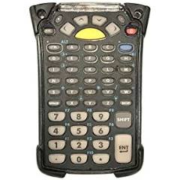
Software used to manage inventory is Motorola’s mobile computer
It scans the inward and outward items separately

Slide 10
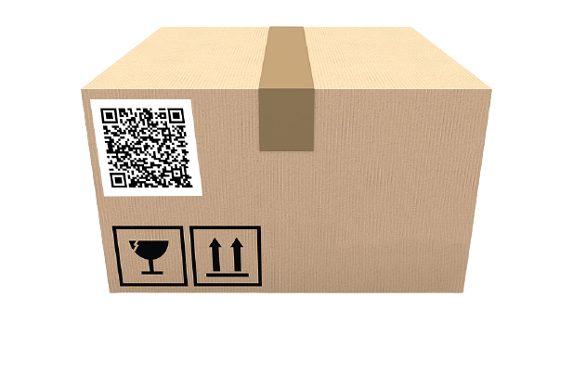
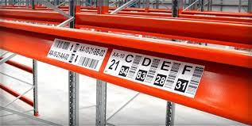
There are two types of labeling
Pallet Label
Racking Label
The mobile computer scans the products in the carton.
This helps to know the number of items in the carton.
The pallet box is kept in the rack shelf
The Racking label is scanned. This helps to know the number of cartons in the racking shelf
The mobile computer also generates the pay slip at the time of sales.

Slide 11
Uses of Mobile computer
Real time inventory count.
The mobile computer is digital and hence can be linked to our server which in turn helps in accounting.
Coordination of resources available.
Reduces employee theft.
Reduced HR involvement.

