Slide 1


Slide 2
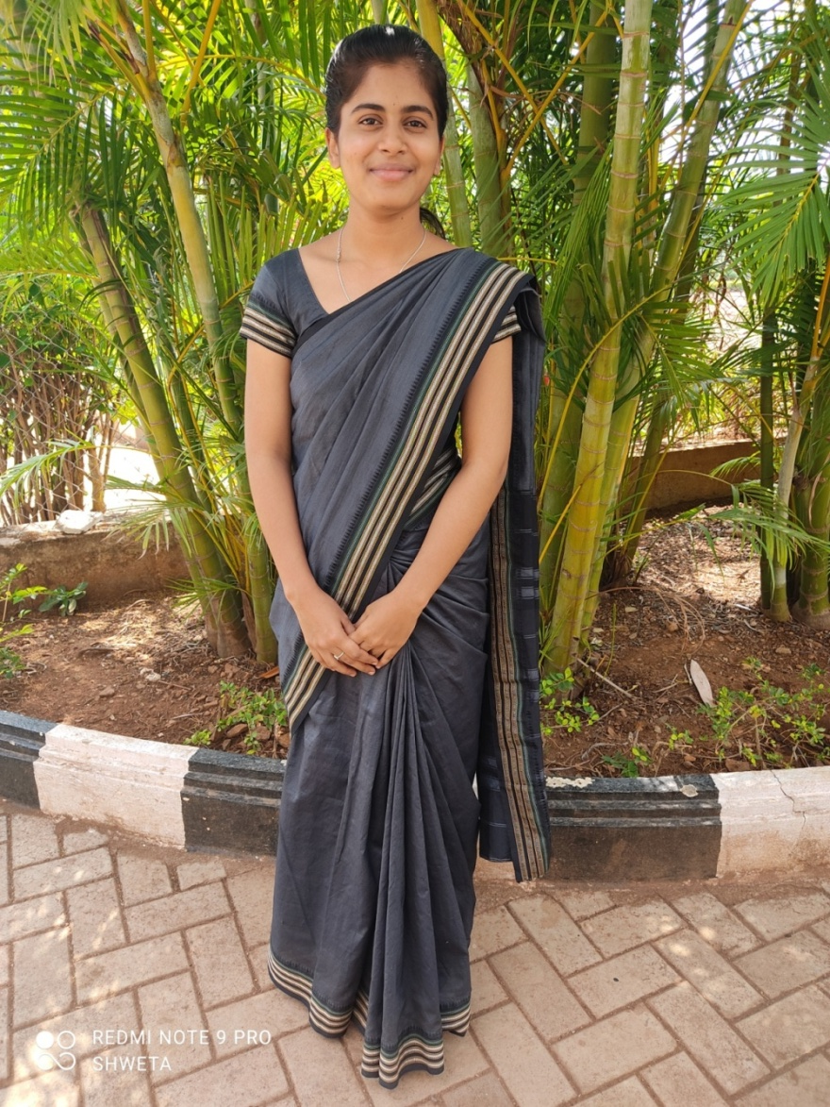
Research & Development
Officer
Name : Pavitra

Slide 3
Research & development process
Problem identification.
Solution with Our product.
Survey and feedback.
Idea for future product.

Slide 4
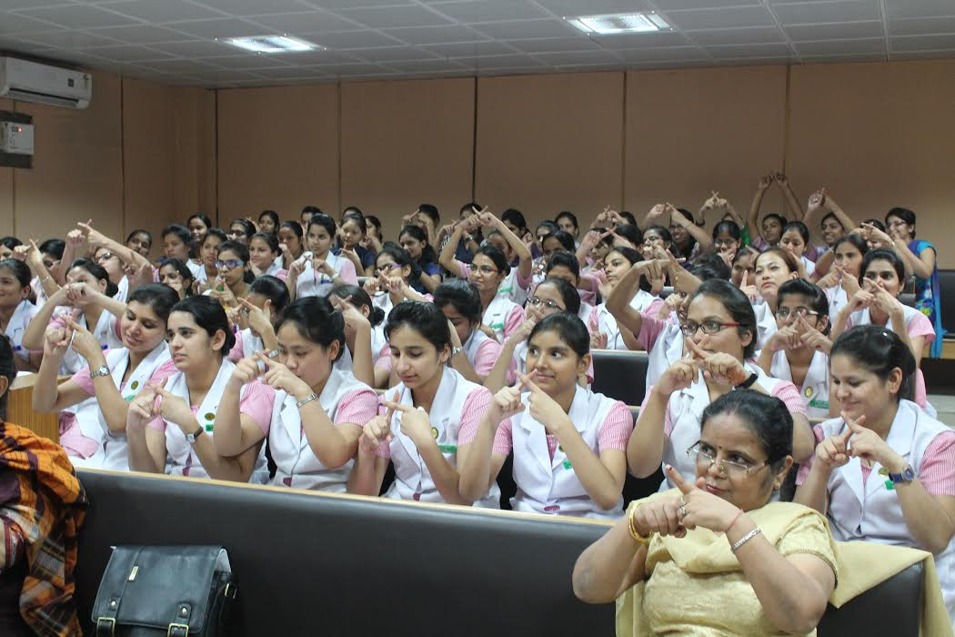
Problem identification
Mute persons communicate through sign language. It can be only decoded by person who understands sign language. Hence, mute persons have difficulty in communication.

Slide 5
Solution With our product.
Our product, glove-dial provides solution to this problem. There are 12 buttons in one glove and each button has a sentence inserted in them. those sentences are the one which are frequently used.
In single glove can have up to 26 buttons in them, that means 26 sentences can be spoken.

Slide 6
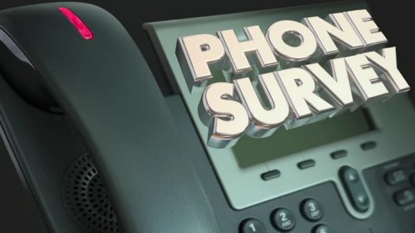
Survey and feedback.
We conducted survey through telephone. We called Shastri school for deaf and dumb children. She gave an up vote for the product, but complained about the less number of combinations.

Slide 7
Idea for future product.
Planning to create a product which would convert sign language into vocal communication.

