Slide 1
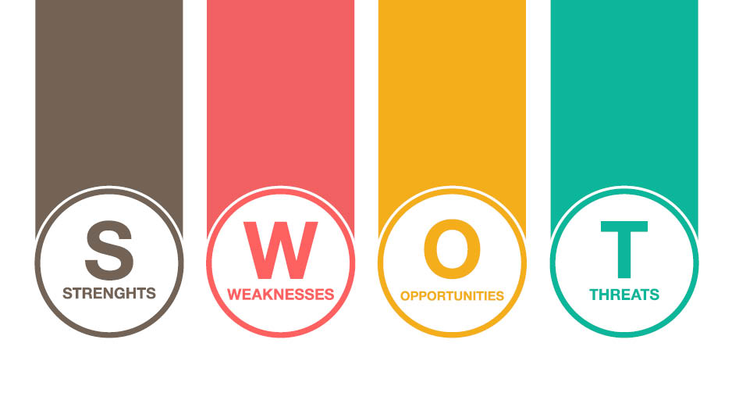

Slide 2

It requires fewer components so its cost is low.
Small in size: due to small size we can place it on our hand easily.
Easy fit to our hand.
Light weight.
Flexible to users.
Easy to operate: anyone can operate it easily.
Real time translation.

Slide 3

Range up to 100 m only.
Facial expressions are not considered.
Less combinations.

Slide 4

Expansion of market policy in future.
Still no competitors adopted first in market.
Strong ,fast product development and growth.

Slide 5

Competitors may quickly adopt this technology.
Not much scope for technical implementation.
Down turn in economy leads to low purchase.

