Slide 1
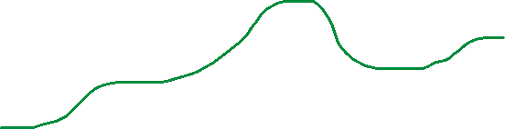
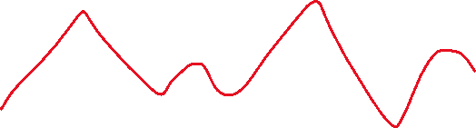

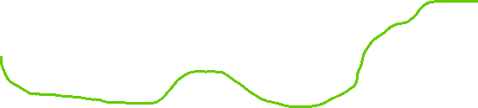
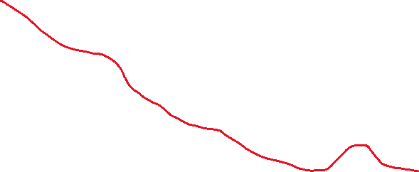
>7.5%
20%
2-7.5%
17.5%
25%
-(2-7.5)%
17.5%
< -7.5%
15%
Today
Action period start
Action period end

