Slide 1
Scenarios with Applicable Solutions for VACs

Slide 2
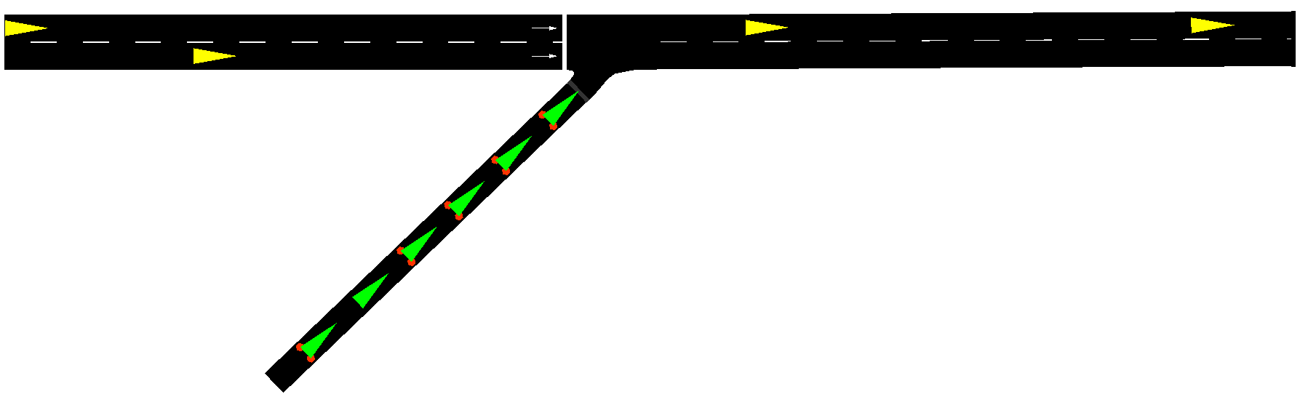
1. Merge
Problem:
Merge of cars into highway causes deceleration and congestion.
Solutions:
- Force Avs to slow down on the right lane if a merging car approaching the intersection.
- Requires tunning of – Slow down speed desired, where and when to slow down, dependence on traffic demands.
- Online slow-down policy depending on current road state using sensors.

Slide 3
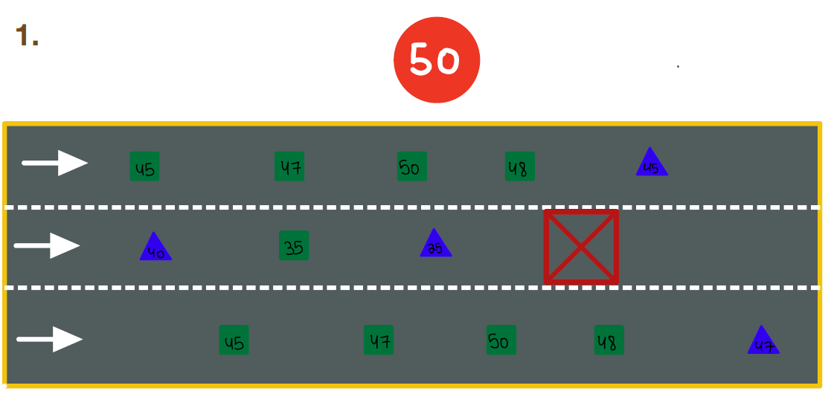
2. Blocked Lane
Problem:
Unexpected blocked lane (weather, accident, road repairs, etc.) causes merging to other lanes in low speed due to short distance before accident is seen.
Solutions:
- Use one AV at a time as a volunteer to slow down the traffic before the blocking.
- Force other vehicles (AV+HDV) to change lanes before.
- Safety + Motivation issues.

Slide 4
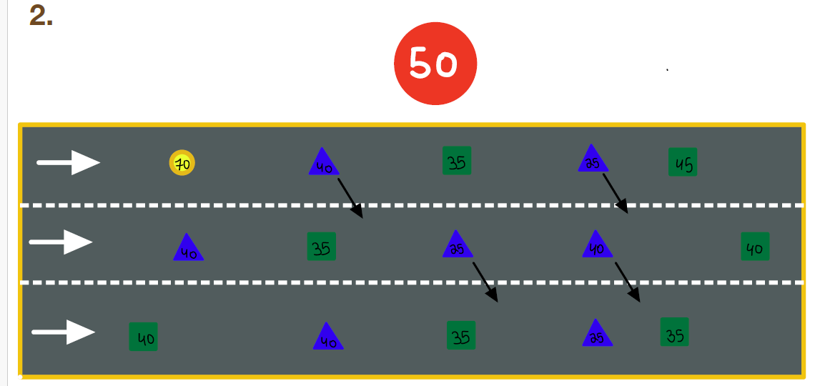
3. Emergency Car
Problem:
Emergency car (police, ambulance) requests to drive much faster than the allowed speed.
Solutions:
- Move all Avs from the lane before arrival.
- Move Avs from adjacent lanes to allow merging cars.
- Other solution – Don’t be there at all.

Slide 5
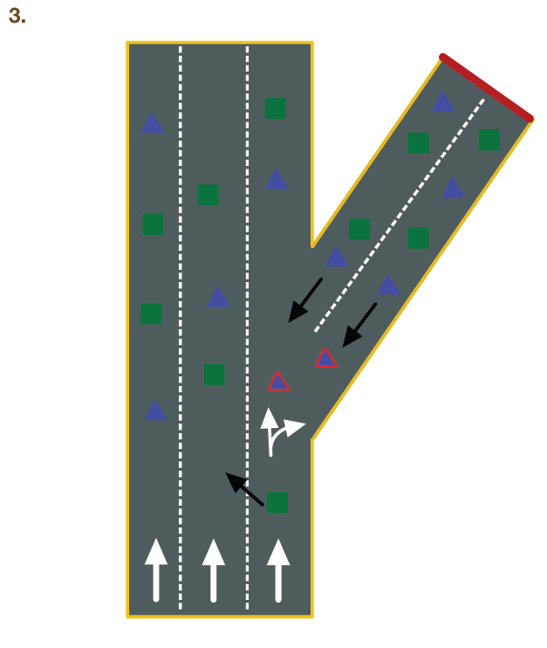
4. Extreme example – Blocked road
Problem:
A whole road is blocked (hard accident, flooding, etc.) and all cars need to reverse their way back to the main road.
Solutions:
- Use AV volunteers to block the road and merging lanes.
- USE AV voulnteers to lead the HDV in reverse. volunteers

Slide 6
5. Rush Zone + Reverse lanes
Problem:
Many cars wish to drive in one direction on specific hours and on the opposite direction on different hours.
Solutions:
- Can be solved using reversing lanes, but also applies to HDVs.
- Problems with pedestrians in urban areas.

