Slide 1
SKYTRAX AIRLINE REVIEW ANALYSIS
Key Insights:
- Total reviews analyzed: 1500
- Average rating: 4.11
- Positive reviews: 948
- Negative reviews: 537
- Common complaints: Delays, customer service, and food quality.

Slide 2
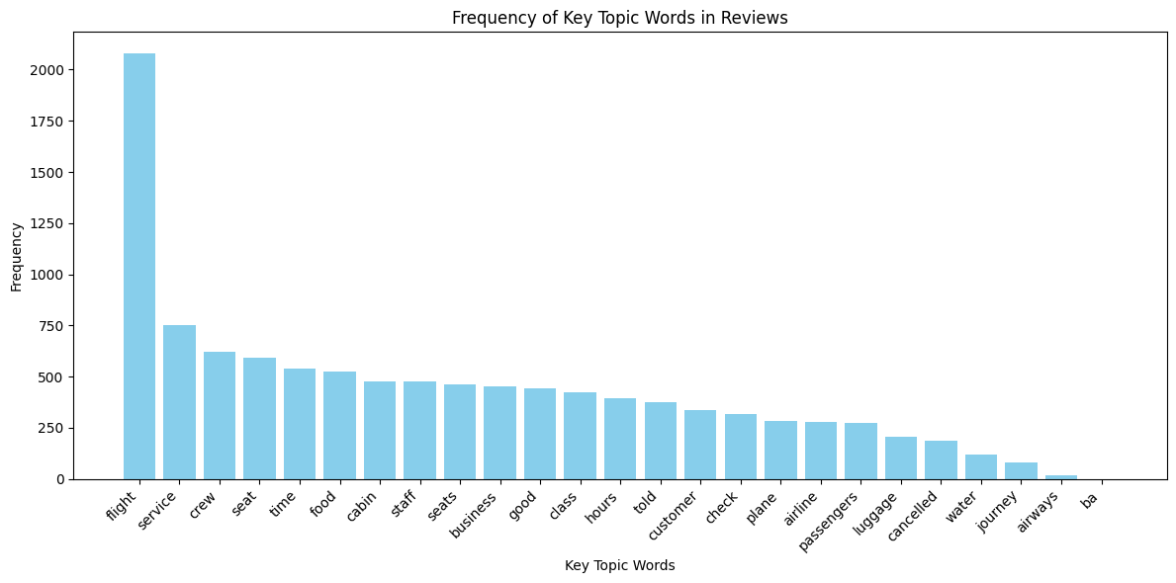
RESULT 1
Key topics The frequency chart below shows that the key topics within the reviews include “service”, “seat”, “crew” and “staff”, showing that people are actively talking about their experience and staff.

Slide 3
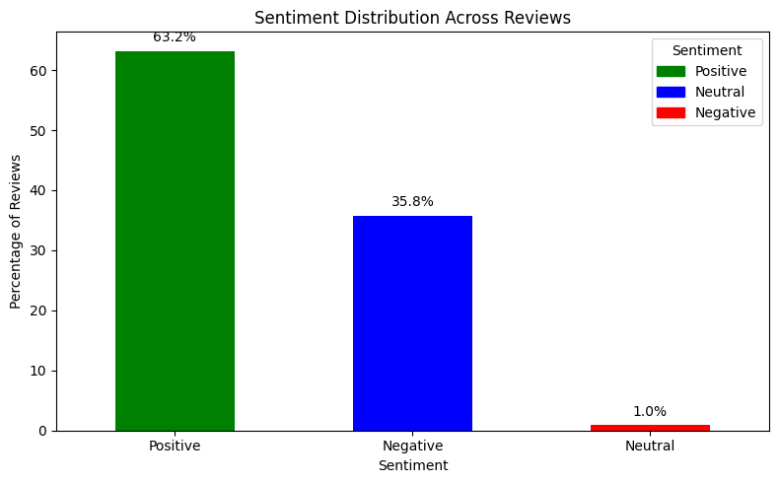
RESULT 2
Out of 1500 reviews, 948 were positive, 537 were negative, and 15 were neutral

