Slide 1


Department of Computer Science and Engineering
Virtual Project Review System for Streamlined Evaluation and Performance Optimization
MUKKUNDHAN N (210701170)
NAVEENKUMAR S (210701175)
NAVNEETH SURESH (210701176)
Supervisor
Mrs. JANANEE V
Assistant Professor(SG)

Slide 2
Introduction
Effective management of academic research is essential. The proposed Academic Review System is a web-based platform designed to simplify this process for both students and coordinators. It offers students tools for submission checks, progress tracking, and document uploads, while allowing coordinators to review, approve, and provide feedback on submissions. The system streamlines research project management by incorporating real-time progress monitoring. Prioritizing security, privacy, and ease of use, this platform aims to improve the efficiency and success of academic research projects within educational institutions.

Slide 3
Problem Statement
The manual review and paper submission process in academia is inefficient, leading to delays and increased workload. Students struggle with ensuring originality and compliance, while supervisors face challenges in managing multiple reviews and providing timely feedback. Administrators are burdened with overseeing the entire process and maintaining consistency. This results in errors and inefficiencies, affecting the quality of academic assessments. The proposed application aims to automate and streamline the review process. The streamlined review-application aims to enhance accuracy, speed, and user experience, reducing manual workload and improving overall efficiency in academic assessments.

Slide 4
Abstract
The proposed Academic Review System is a web-based platform designed to enhance the management of academic research projects for students and coordinators. This system streamlines research processes by offering tools for progress tracking, document uploads, and submission management. Coordinators can efficiently review, approve, and provide feedback on student submissions. With a focus on security, privacy, and ease of use, this platform aims to improve the efficiency and success of academic research projects within educational institutions.

Slide 5
Objectives
1. Simplify Research Management: Provide a user-friendly platform that streamlines the management of academic research projects for both students and coordinators.
2. Enable Progress Tracking: Allow students to track their research progress and submit updates regularly, giving coordinators a clear view of each project’s status.
3. Streamline Document Handling: Provide a centralized system for document uploads, storage, and retrieval, making it easier for students to submit work and for coordinators to access and review it.

Slide 6
Literature Review
For literature review or survey refer this link.
https://docs.google.com/spreadsheets/d/1H4_8eP0_ISJ9k9rKSLwXCQRLwfw6nDHw9ET8w-It2IA/edit?gid=1563789228#gid=1563789228

Slide 7
Summary of Literature Review
The literature survey reviews 20 papers on various systems for project management, student tracking, and educational tools. Key innovations include integrating local expertise in international projects, real-time geospatial progress monitoring, and dashboards for tracking student projects and academic progress. Moodle-based LMS increased student engagement, and recommender systems showed promise in academic decision-making. Cloud-based systems and web platforms automated project and research management processes, improving efficiency. However, limitations across the studies include scalability issues, dependence on data accuracy, and the need for more empirical validation to extend findings beyond controlled environments. Overall, the papers highlight advancements in technology-driven management and education systems but also reveal areas requiring further development.

Slide 8
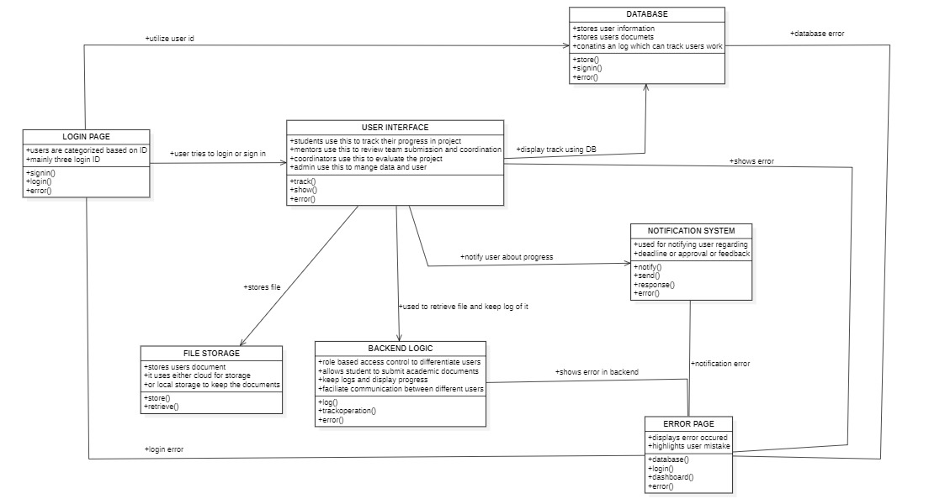
System Architecture

Slide 9
List of Modules
Admin module
Student module
Mentor module
Coordinator module

Slide 10
Functional Description for each modules
Student Module: A centralized hub for students to submit projects, track feedback, and stay organized with automated notifications and progress tracking.
Admin Module: Ensures smooth system operation by managing user roles, monitoring workflows, and maintaining security and system integrity.
Coordinator Module: Streamlines review schedules, mentor allocation, and progress monitoring to ensure timely and quality project reviews.
Mentor Module: Facilitates effective mentoring by providing tools for feedback, progress tracking, and direct communication with students.

Slide 11
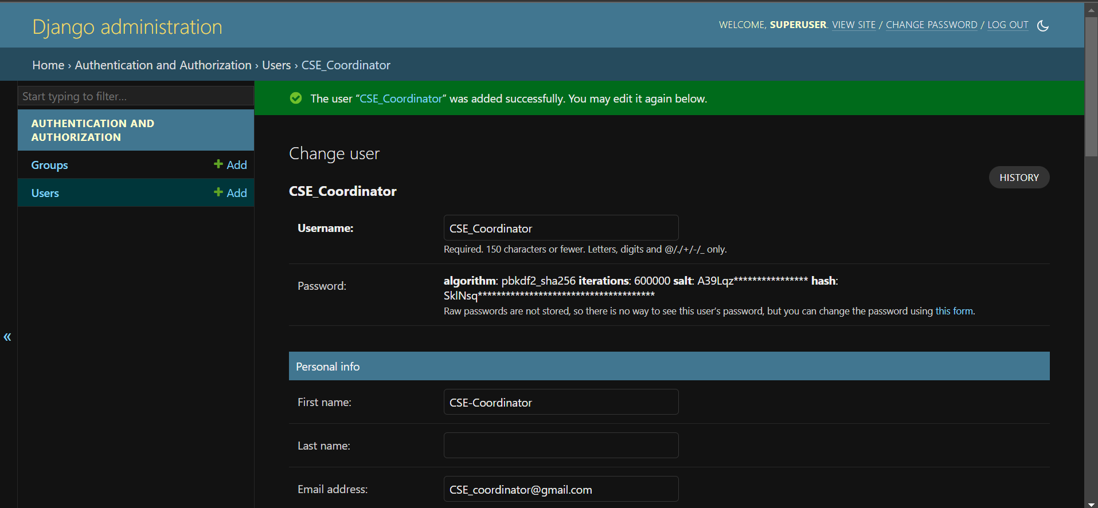
Implementation & Results of First Module

Slide 12
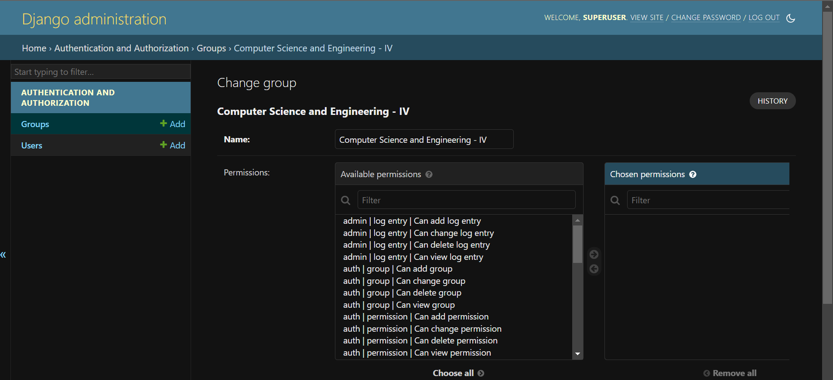

Slide 13
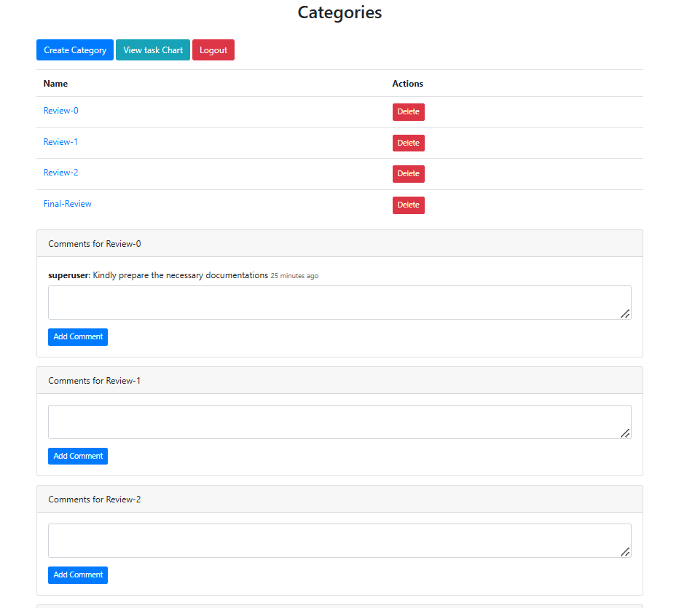

Slide 14
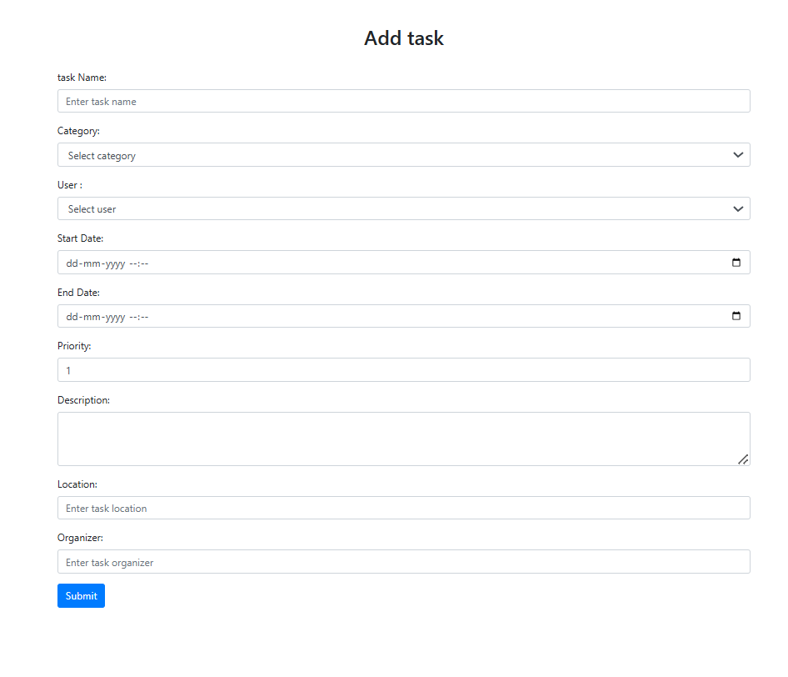

Slide 15
Conclusion & Work for Phase II
The Admin and Coordinator Module has been successfully developed, enabling coordinators to efficiently manage academic submissions, track student progress, and admins to manage users and groups. This simplifies the review process, improves workflow transparency, and enhances the control over user access management.
Phase II will focus on integrating the remaining users: Student and Supervisor. This phase will also focus on creating an AI powered plagiarism system that not only helps in fairness of originality assessments in academic research, but also helps in ranking the academic research papers accordingly.

Slide 16
References
To view the reference papers taken, refer this link.
https://docs.google.com/document/d/1iuwn45qG8NnpisrswR8wjkvZZD--fP7zDj3wnKNz3EE/edit?usp=sharing

Slide 17
Paper Publication Status
TITLE : VIRTUAL PROJECT REVIEW SYSTEM FOR STREAMLINED EVALUATION AND PERFORMANCE OPTIMIZATION
AUTHORS : Mrs. Jananee V, Mukkundhan N, Naveenkumar S, Navneeth Suresh
CONFERENCE : INTERNATIONAL CONFERENCE ON COMPUTER, COMMUNICATION AND SIGNAL PROCESSING 2025- ICCCSP2025
MODE OF SUBMISSION : ONLINE
STATUS : SUBMITTED AND WAITING FOR ACCEPTANCE

Slide 18
Thank You

