Slide 1
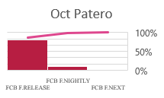
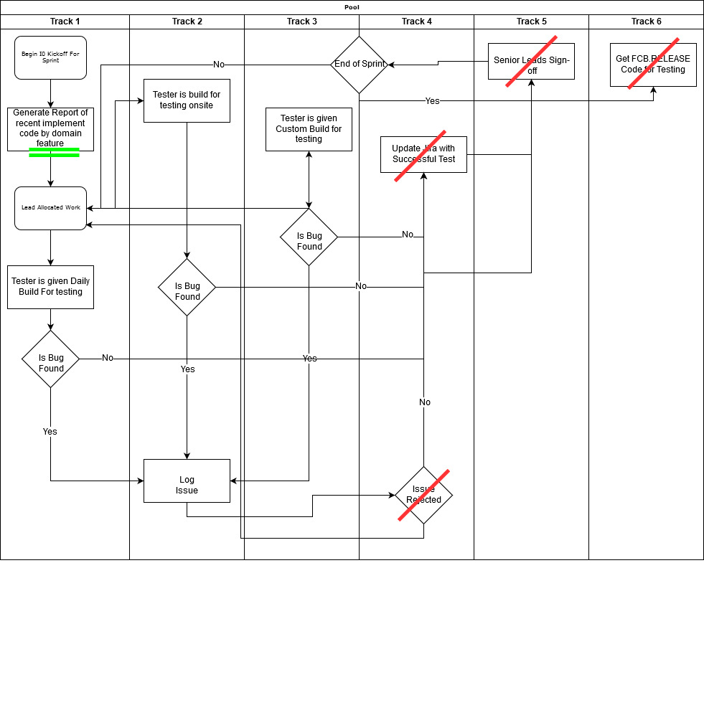
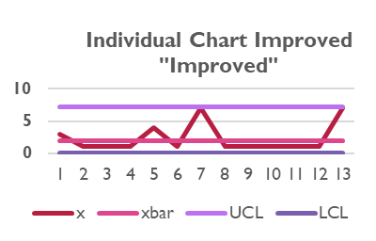
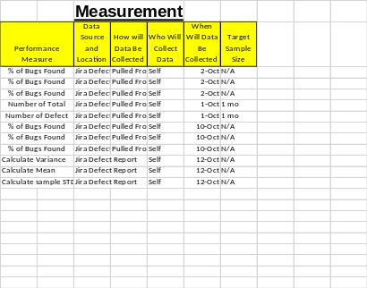
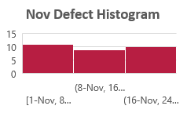
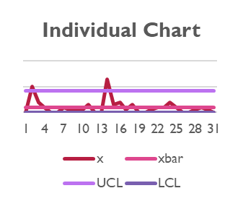
Defect Count Improvement
Process owner: Aaron Talley
Key Dates --->
Team
Launch
Define 19/10/1
Measure 19/10/5
Analyze 19/10/12
Improve 19/10/16
Control 19/11/20
DEFINE
Disproportionate defects found in releases
MEASURE
Allow for more detailed testing
ANALYZE
IMPROVE
Problem Statement
Bug detection can seriously hinder software development projects. Where defects should have be identified and catalogued in a testing sprint are now being found by validation teams and processes causing projected development resources to be reassigned to bug found in code from prior software release iterations.
Steps deemed extra and unnecessary were
Mean: 2.0
Range:0 – 13
Mode: 0
S. Std: 2.9
Median: 1
Calculations are missing 10 days worth of data
Improved SQL: 1.9
t = x – µo/(s/sqrt(n))
Z = 2.3 – 2/(2.9/sqrt(30))
Z = .3/(0.529465)
Z = .56 => P = 0.71
Business Impact
Since bug detection and fixes are primarily the responsibility of the supplier and the supplier has been tasked with arriving at “0 bug” by 12/31/2019, late bug detection impacts the supplier’s ability reach the goal of “0 bug”
Current SQL: 1.7
CONTROL
Eliminated processes that were deemed unnecessary
Provide report of all changes to source codes and domains before work is allocated
Due to changes in position, the remaining 10 days of November were not accessible, and the data wasn’t calculated into the Individual Chart and SQL calculation
Defect count spike
Looking at the improved section, we’ve failed to reject the null
Hypothesis Test:
H₀: mu = 2
H_{a}: mu != 2
α= 0.05

Slide 2
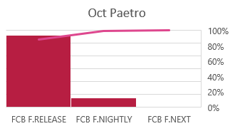
MEASURE
During the Measure Phase all metric will be accounted for and calculated according to the Measurement Plan
  Defect(Types of Defects counted):
    FCB.RELEASE
    FCB.NIGHTLY
    FCB.NEXT
Number of Defect (whole number count)
Day Defect(s) logged/created (dd-mm format)
SQL Quality Level (measures the defects product opportunity per million)
The XMR/IMR charts (To create a controls for the previous month measured)
Paetro Chart (Graphical representation of what defect type accounts for its proportion of data.
SIGMA QUALITY LEVEL:
D(Defect) |  | 3
U(Unit "30 Days) |  | 30
D*U |  | 90
A(Actuals) |  | 36
A/DU = DPO |  | 36/90
DPOx10^6 |  | 400,000
SQL |  | 1.7
Oct. Descriptive Metrics:
xbar/Mean | 2.0 | Min | 0
sampel Std. Dev | 2.9 | Variance | 8.2
Mode | 0 | Count | 31
Max | 13 | Median | 1

Slide 3
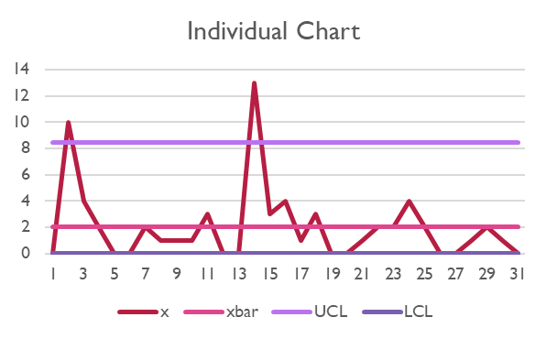
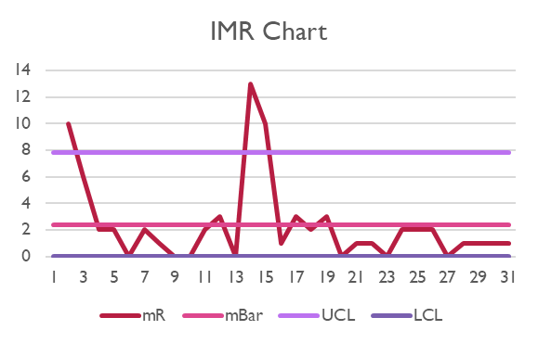
MEASURE CONTINUED
Above are the Individuals (Xbar Chart) and the IMR (Individual Moving Range) chart for the month of October
  The Upper Control Limit (UCL) and Lower Control Limit (LCL) are thresholds where the process/defect control should not theoretically pass if a process is in control

Slide 4
ANALYZE
After collecting and measuring the available and desired data, updates to the current process map were added.
It was deemed that there were 4 steps that added no value to customer(crossed out in red):
  Senior Leads Sign-off
  Get FCB.RELEASE Code for Testing
  Update Jira with Successful Test Case
  Issue Rejects
An additional step was added for business value to allow for testers to have detailed info on testing task)s(underscored in green:
  Generate Report of Recent implemented code by domain feature

Slide 5
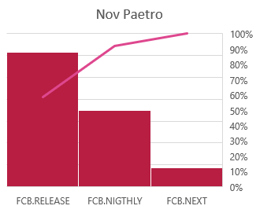
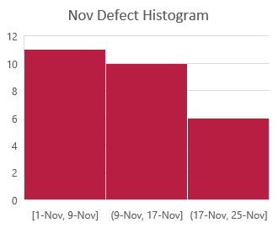
ANALYZE CONTINUED
The charts above are the calculated Paetro and histogram charts after the modified Process map was implement over the course of a month.

Slide 6
ANALYZED CONTINUED
HYPOTHESIS TESTING
To test where or not the newly implemented process map a Hypothesis test is conducted:
  H₀: mu = 2
  H_{a}: mu != 2
  α= 0.05
Where H₀ claims that our improved process doesn’t change the average number of defects counted and H_{a} claims there is a change and we want to be 95% confident of this change.

Slide 7
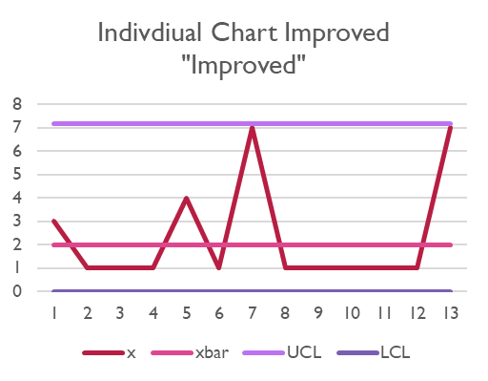
IMPROVE
IMPROVED SQL SCORE
Improved SQL: 2.0
D(Defect) |  | 3
U(Unit "30 Days) |  | 30
D*U |  | 90
A(Actuals) |  | 30
A/DU = DPO |  | 27/90
DPOx10^6 |  | 333,333
SQL |  | 1.9

Slide 8
IMPROVE CONTINUE
z = x – µo/(s/sqrt(n))
Z = 2.3 – 2/(2.9/sqrt(30))
Z = .3/(0.529465)
Z = .56 => P = 0.71
P > 0.05
Given that our calculated P values, there is not enough evidence in the data to reject the null (H₀) Hypothesis.
Using the sample standard deviation calculated from October and sample mean we get the following:

Slide 9
CONTROL
Eliminated processes that were deemed unnecessary
Provide report of all changes to source codes and domains before work is allocated
Due to changes in position, the remaining 10 days of November were not accessible, and the data wasn’t calculated into the Individual Chart and SQL calculation

