Slide 1

Migrating legacy UIs with Microfrontends
Real-life usage of Webpack 5 Module Federation plugin

Slide 2

Malwarebytes
We provide cybersecurity
- for personal use
- for small and medium businesses
- we partner with resellers
More at malwarebytes.com

Slide 3

Who am I?
- Software Engineer @ Malwarebytes
- JavaScript at backend & frontend

Slide 4

01
The problem
Two legacy UIs that are doing mostly the same thing

Slide 5


Our customers
BUSINESS
PROVIDER

Slide 6
Both customers have separate UIs

Slide 7
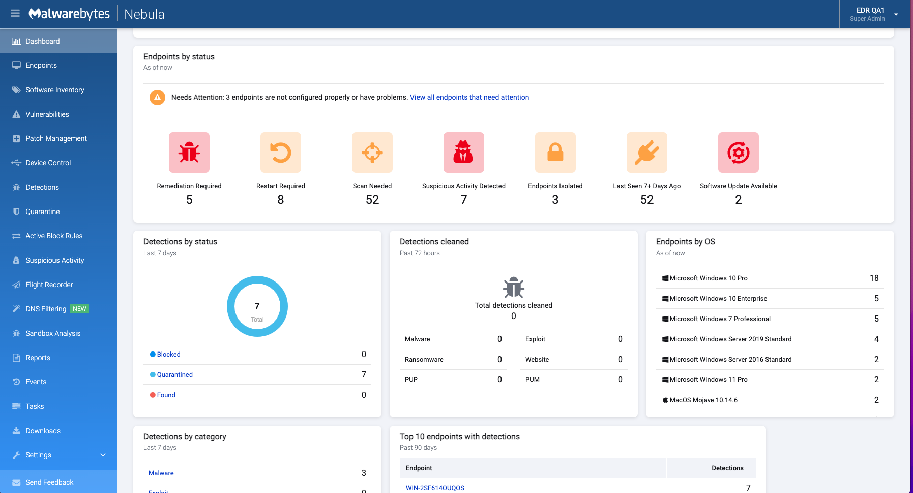
BUSINESS UI
- created in 2016
- still actively used
- is generating revenue from small/medium businesses

Slide 8
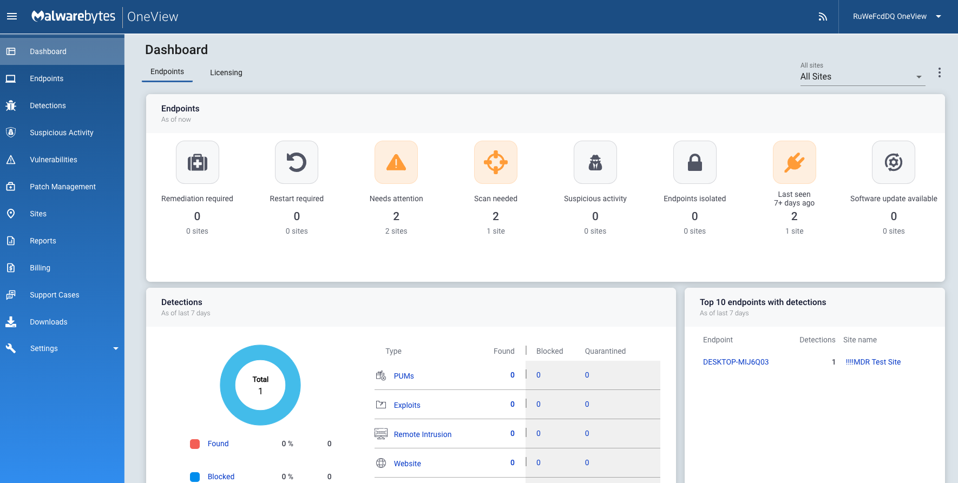
PROVIDER UI
- created in 2019 as proof-of-concept
- gained a lot of success right from the start
- generating revenue from MSPs

Slide 9
How things are being created
1. New feature is built and released for BUSINESS

Slide 10
How things are being created
1. New feature is built and released for BUSINESS
2. PROVIDERs start to want this feature

Slide 11
How things are being created
1. New feature is built and released for BUSINESS
2. PROVIDERs start to want this feature
3. We decide weather build it for PROVIDER

Slide 12
How things are being created
1. New feature is built and released for BUSINESS
2. PROVIDERs start to want this feature
3. We decide weather build it for PROVIDER
4. If yes – we build the entire thing from scratch again

Slide 13
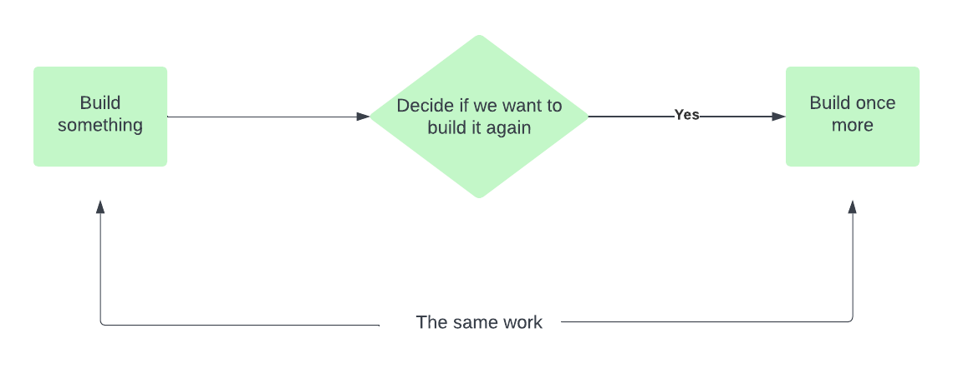
This way of building software is far from being ideal

Slide 14
02
Let’s try to solve it
Microfrontends will (probably) help us

Slide 15
Possible options
#1. Aggressive
- Pause shipping new features
- Build the UI for BUSINESS + PROVIDER
- When done – proceed with new features

Slide 16
Possible options
#1. Aggressive
- Pause shipping new features
- Build the UI for BUSINESS + PROVIDER
- When done – proceed with new features
Stakeholders will never allow that

Slide 17
Possible options
#2. Lazy
- Do nothing
- Continue effort duplication
- Maybe merging UIs is not a feasible option?

Slide 18
Possible options
#2. Lazy
- Do nothing
- Continue effort duplication
- Maybe merging Uis is not a feasible option?
Productivity falls down

Slide 19
Possible options
#3. Smart
- A combination of #1 and #2 - We keep on shipping new features
- This time we build them only one time
- We also create combined UI - And migrate existing things there
- Minimal extra effort

Slide 20
Possible options
#3. Smart
- A combination of #1 and #2 - We keep on shipping new features
- This time we build them only one time
- We also create combined UI - And migrate existing things there
- Minimal extra effort
Looks like an ultimate solution

Slide 21

But how?
Webpack 5 Module Federation

Slide 22
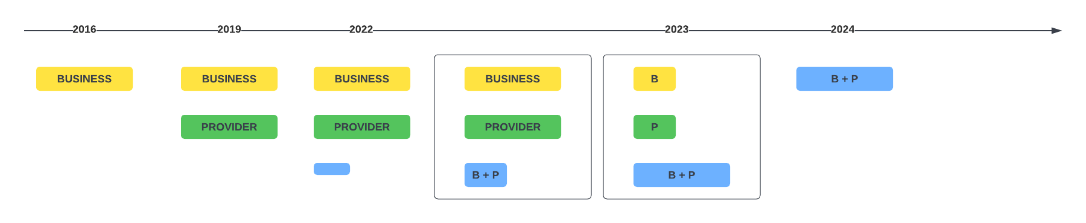
A possible timeline

Slide 23
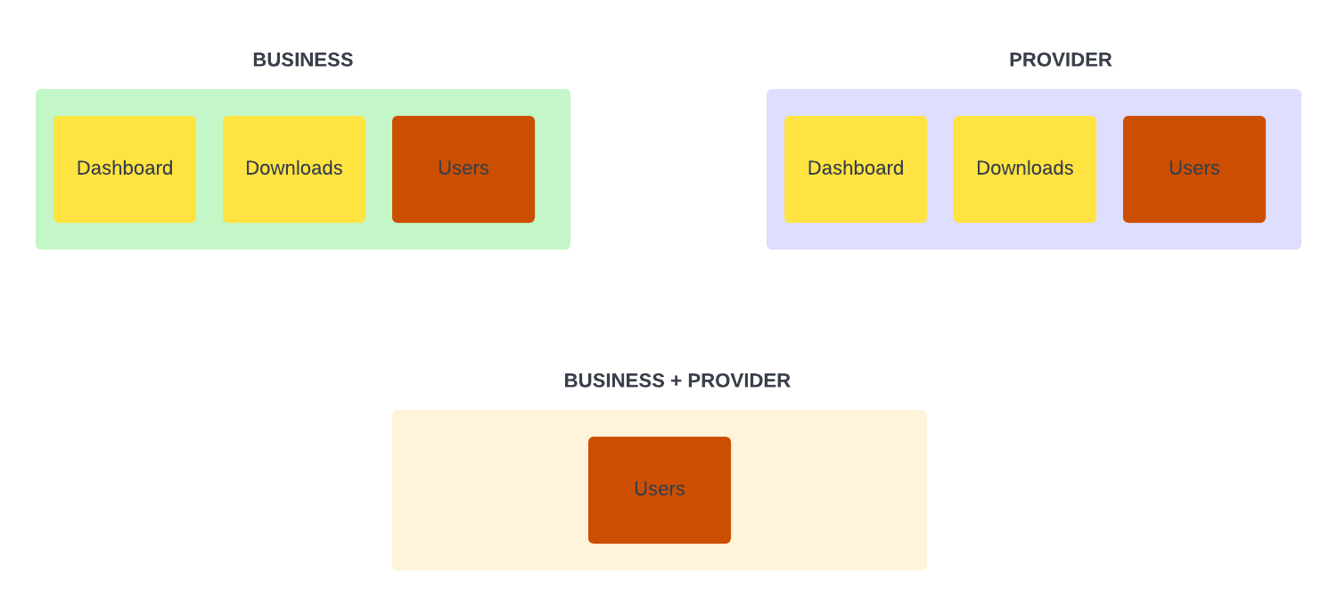
Instead of building another monolith…

Slide 24
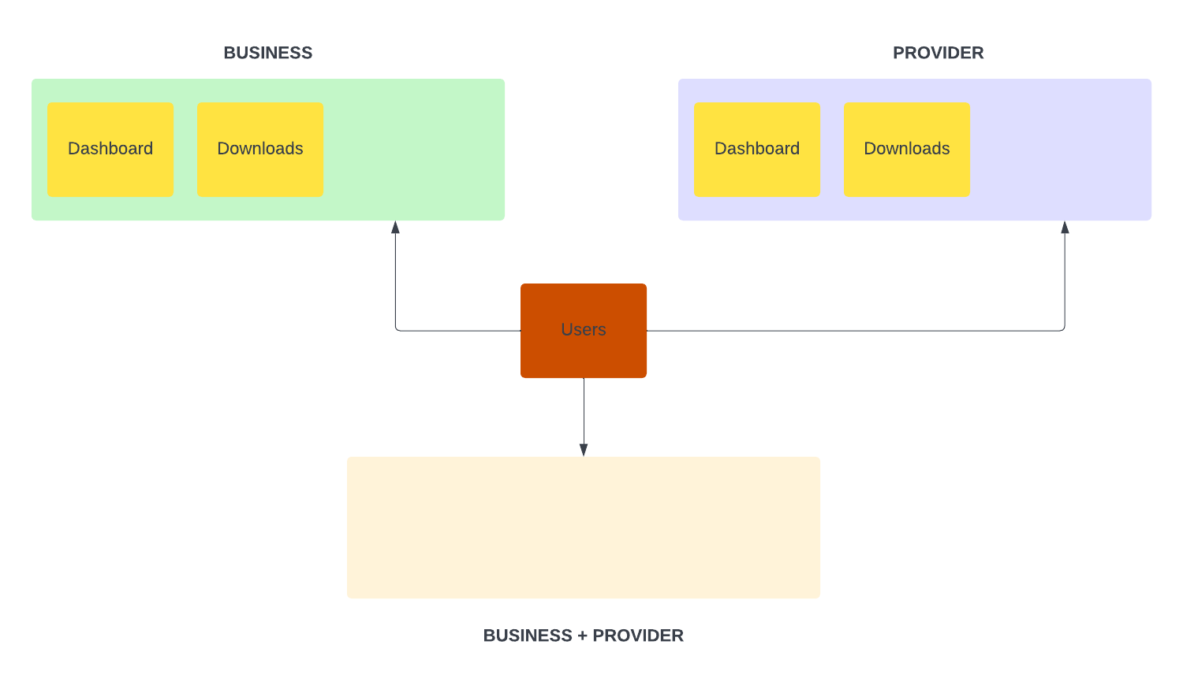
…let’s split everything into pieces…

Slide 25
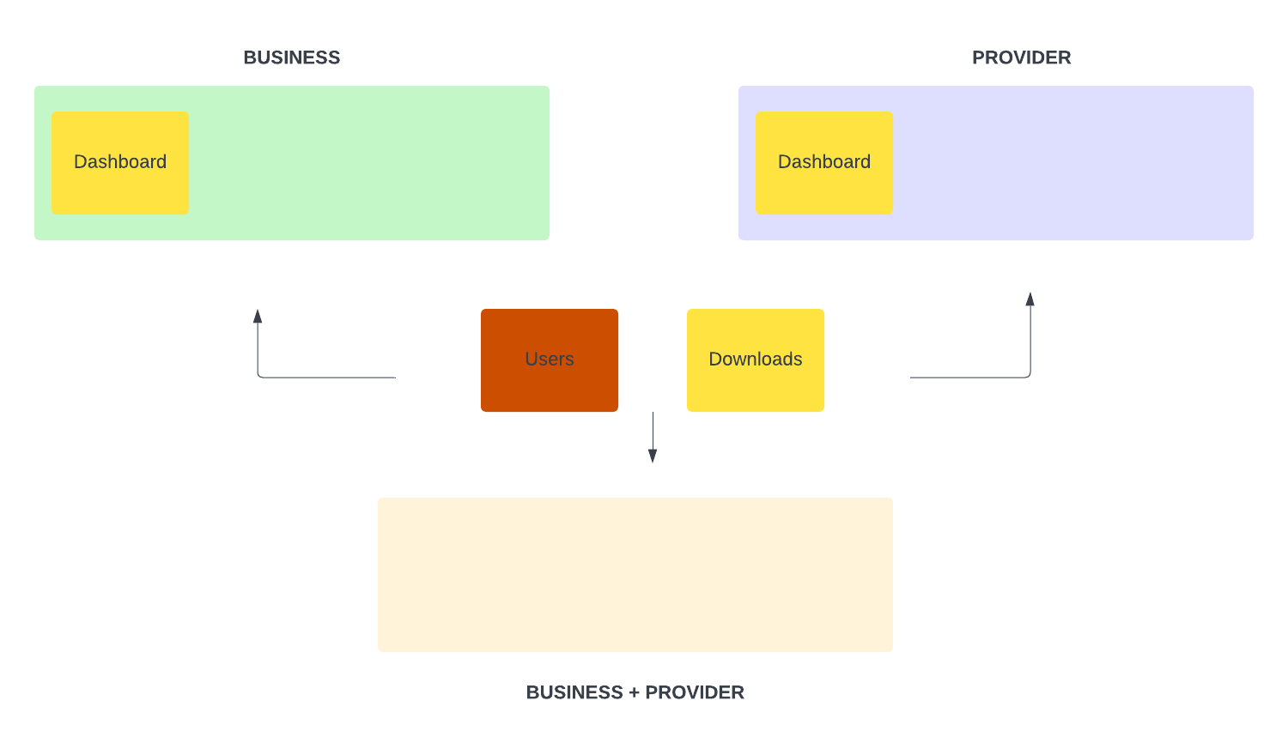
…and further…

Slide 26
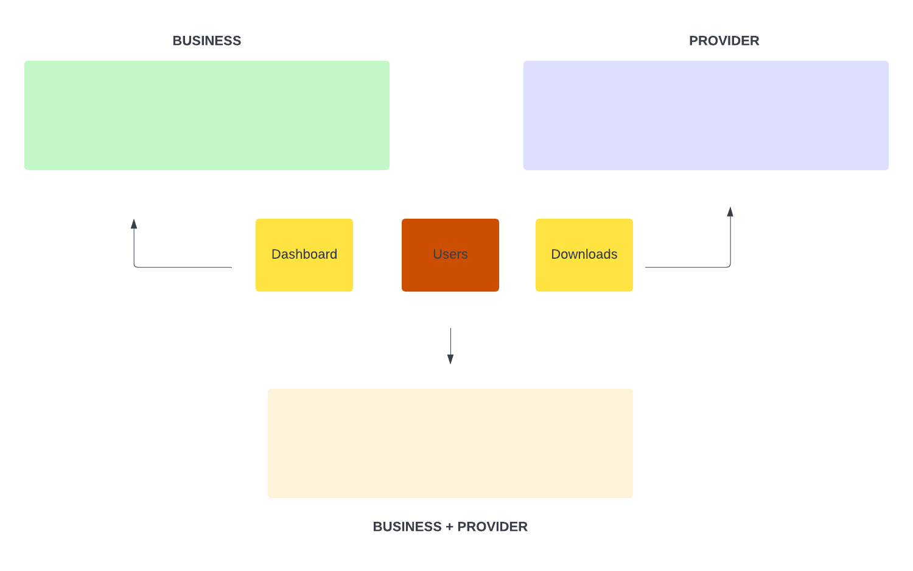
…and even more…

Slide 27
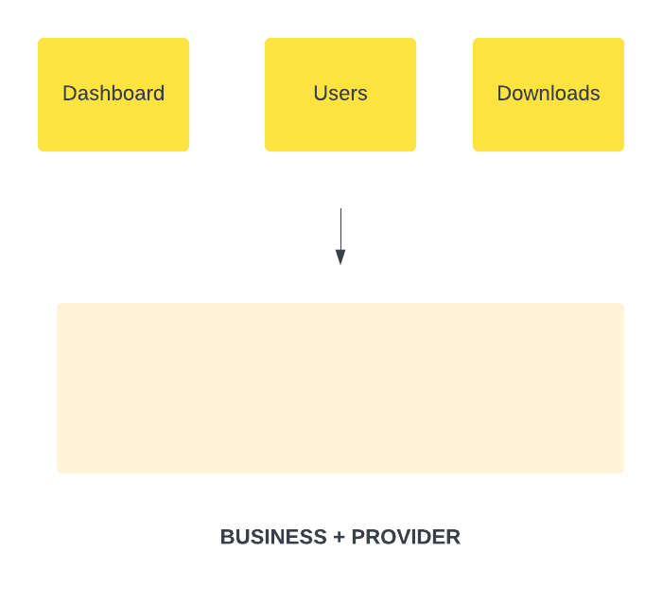
…and finally

Slide 28
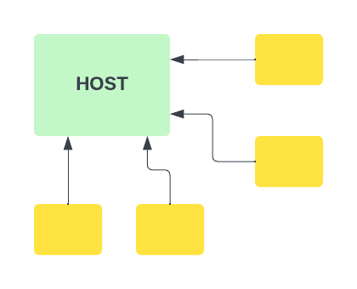
Let us agree on the terms
HOST A shell UI
- Performs orchestration of clients
- Has “infrastructural components” (auth, toasts, modals…)

Slide 29

Let us agree on the terms
CLIENT UI belong to the same domain area
- A page or a set of pages
- Built, tested and shipped in isolation
- May be owned by a separate team

Slide 30
Finally…
Let’s check some code

Slide 31
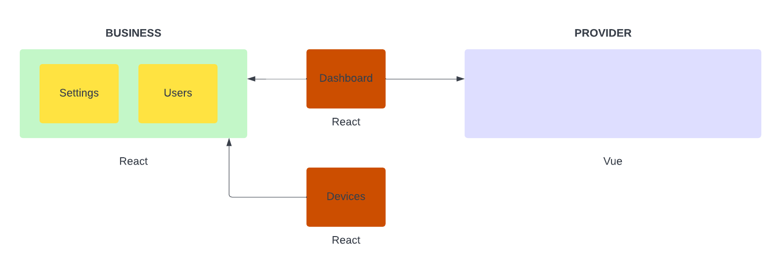

Slide 32
Let’s proceed in the IDE
PowerPoint is not the best tool for dealing with JavaScript

Slide 33
03
Obstacles
A couple of gotchas

Slide 34
react-scripts
This thing makes our lives far simpler, but comes with a price

Slide 35
react-scripts
Create React App hides Webpack configuration
It gives you its own simplified abstraction in return
How can we add Module Federation plugin in this case?

Slide 36
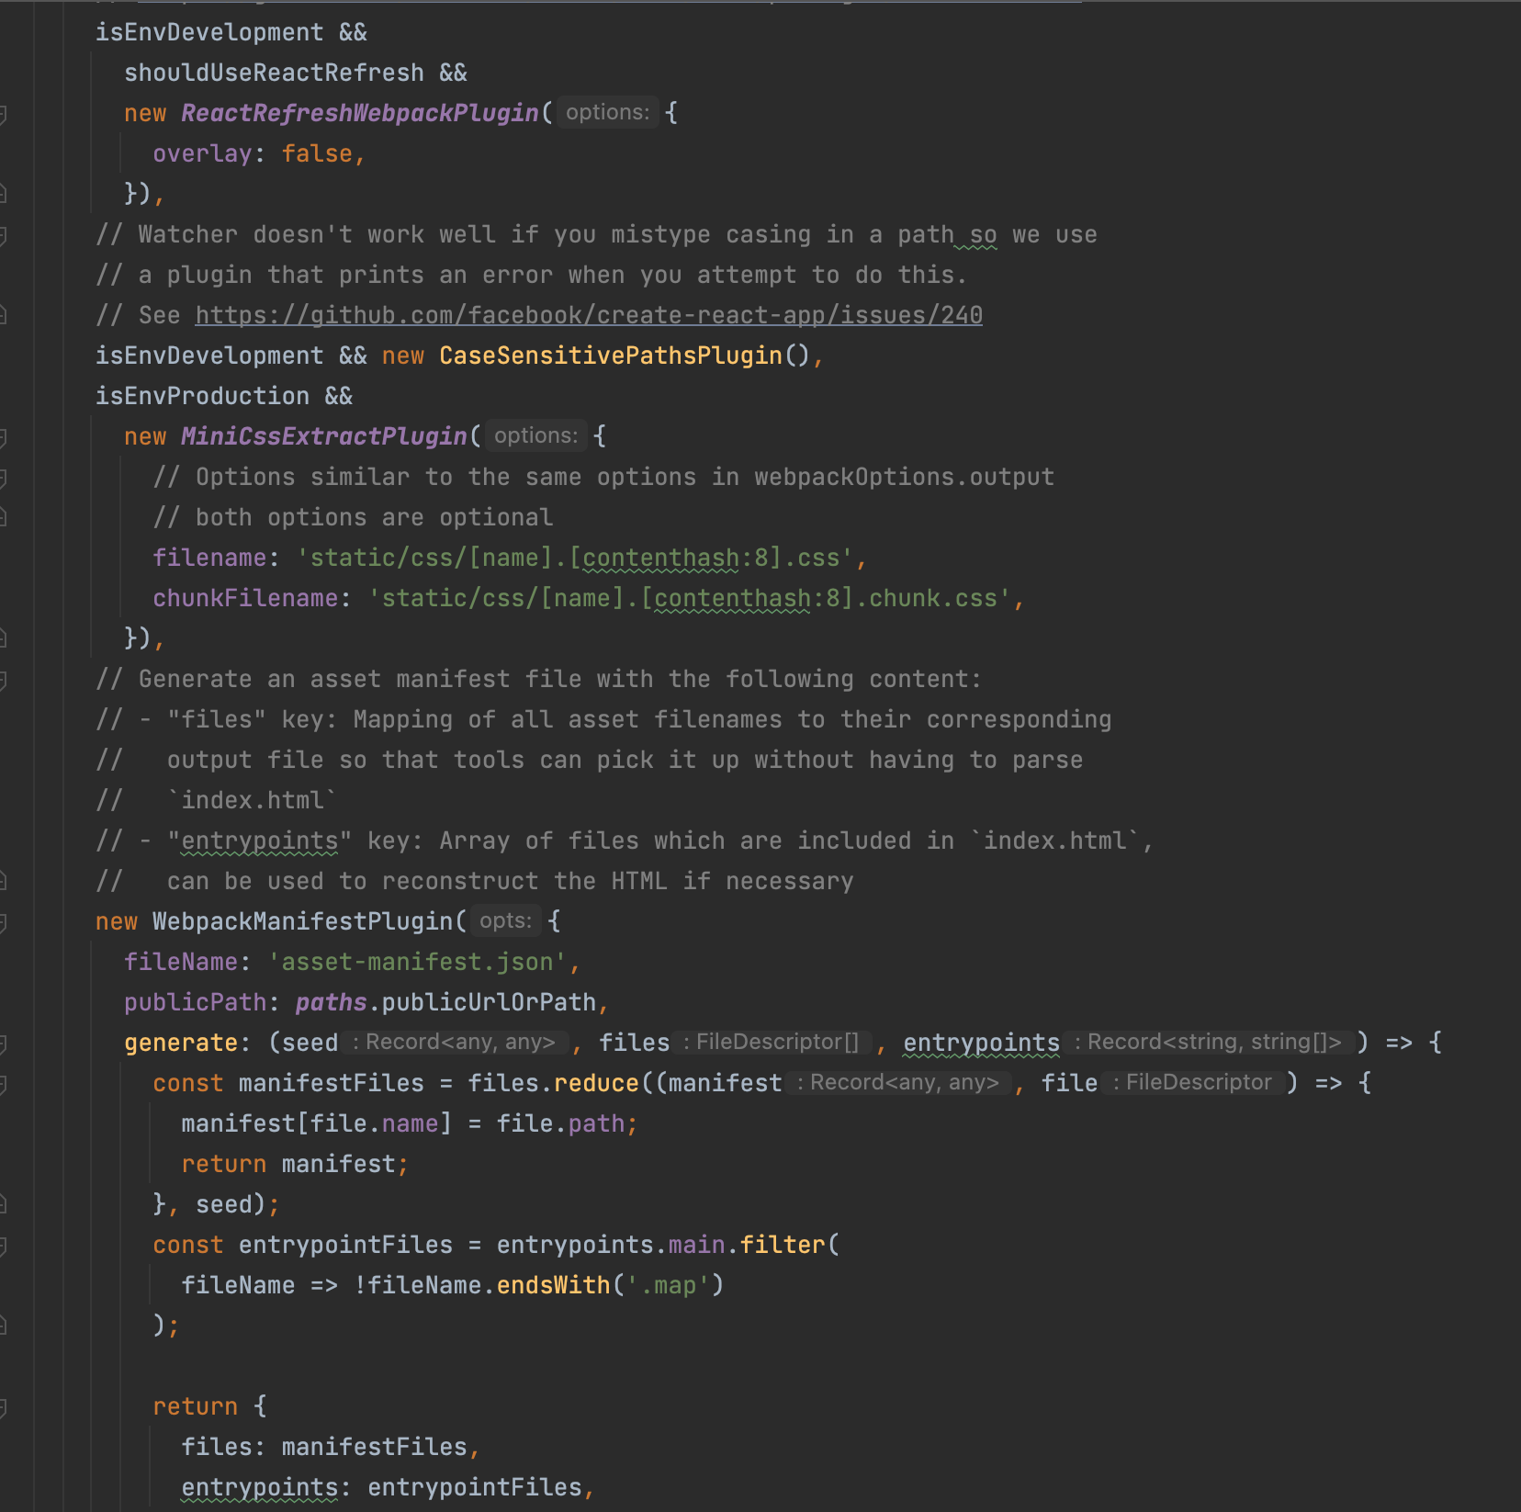
Maybe let’s eject?
npm run eject
You are NOT going to like the result
~1000 lines of configuration
Now it’s yours

Slide 37
CRACO
Create React App Configuration Override
@craco/craco
Allows you to add things to Webpack config without ejecting

Slide 38
CSS
This one is a bit more tricky

Slide 39
CSS
Microfrontends are isolated, but styles may be not
If you use global CSS (high chance that you are), you may have unexpected troubles

Slide 40
Let’s check!

Slide 41
There is no silver bullet
Host MAY use global CSS – we can deal with that
It’s better if it does not, though
Client should always used isolated CSS
For example, typed-css-modules

Slide 42
04
Out of scope
What else we may be interested in?

Slide 43
More things to look into
Web Components
Shadow DOM
This technology may provide a better approach to isolate CSS

Slide 44
More things to look into
Sharing authentication
User authenticates at Host
Auth data should be available for all Client modules

Slide 45

Questions?
If anyone wants to keep in touch:
linkedin.com/in/avorozheev

