Slide 1
Penalties Sized to the Gain
When do random audits stop AI agents from over-using a shared resource?
Ameer Alhashemi
PhD catch-up
King's College London, 13 October 2026
Notes:
Hi everyone. My project asks one question: when do random spot-checks stop AI agents from over-using something they share?

Slide 2
The Project in One Slide
01 WHY
02 WHAT I BUILT
03 WHAT I TESTED
04 WHAT I FOUND
Oversight of AI agents is sampled
A shared resource with checks
Consequences and penalty size
Checks work through consequences
Six agents draw on one renewable resource over many rounds. A reviewer sets how much each may take, and a few agents are checked at random each round.
What a caught agent should face (a fine, a memory of the offence, or both), and whether the fine that stops an agent can be predicted before it is tried.
AI agents are starting to act on resources they share with others, such as compute, energy and budgets. Whoever oversees them can usually check only a few of their actions.
Checks reduced harm only when a catch had a consequence. The stopping fine could be predicted from how much an agent gains by over-taking, for programmed agents and for language models.
The next slides go through the setting, the method and the main findings, then what is still running
2
Notes:
AI agents are starting to share resources like compute, energy and budgets, and whoever oversees them can only check a sample of what they do. I built a simulated shared resource: six agents draw on it over many rounds, a reviewer sets how much each may take, and a few agents are checked at random each round. I tested what should happen to an agent that gets caught taking too much, and whether the fine that stops it can be worked out in advance. Short answer: checks only help when a catch has a consequence, and the stopping fine can be predicted from how much an agent gains by cheating. That held for programmed agents and for language models.

Slide 3
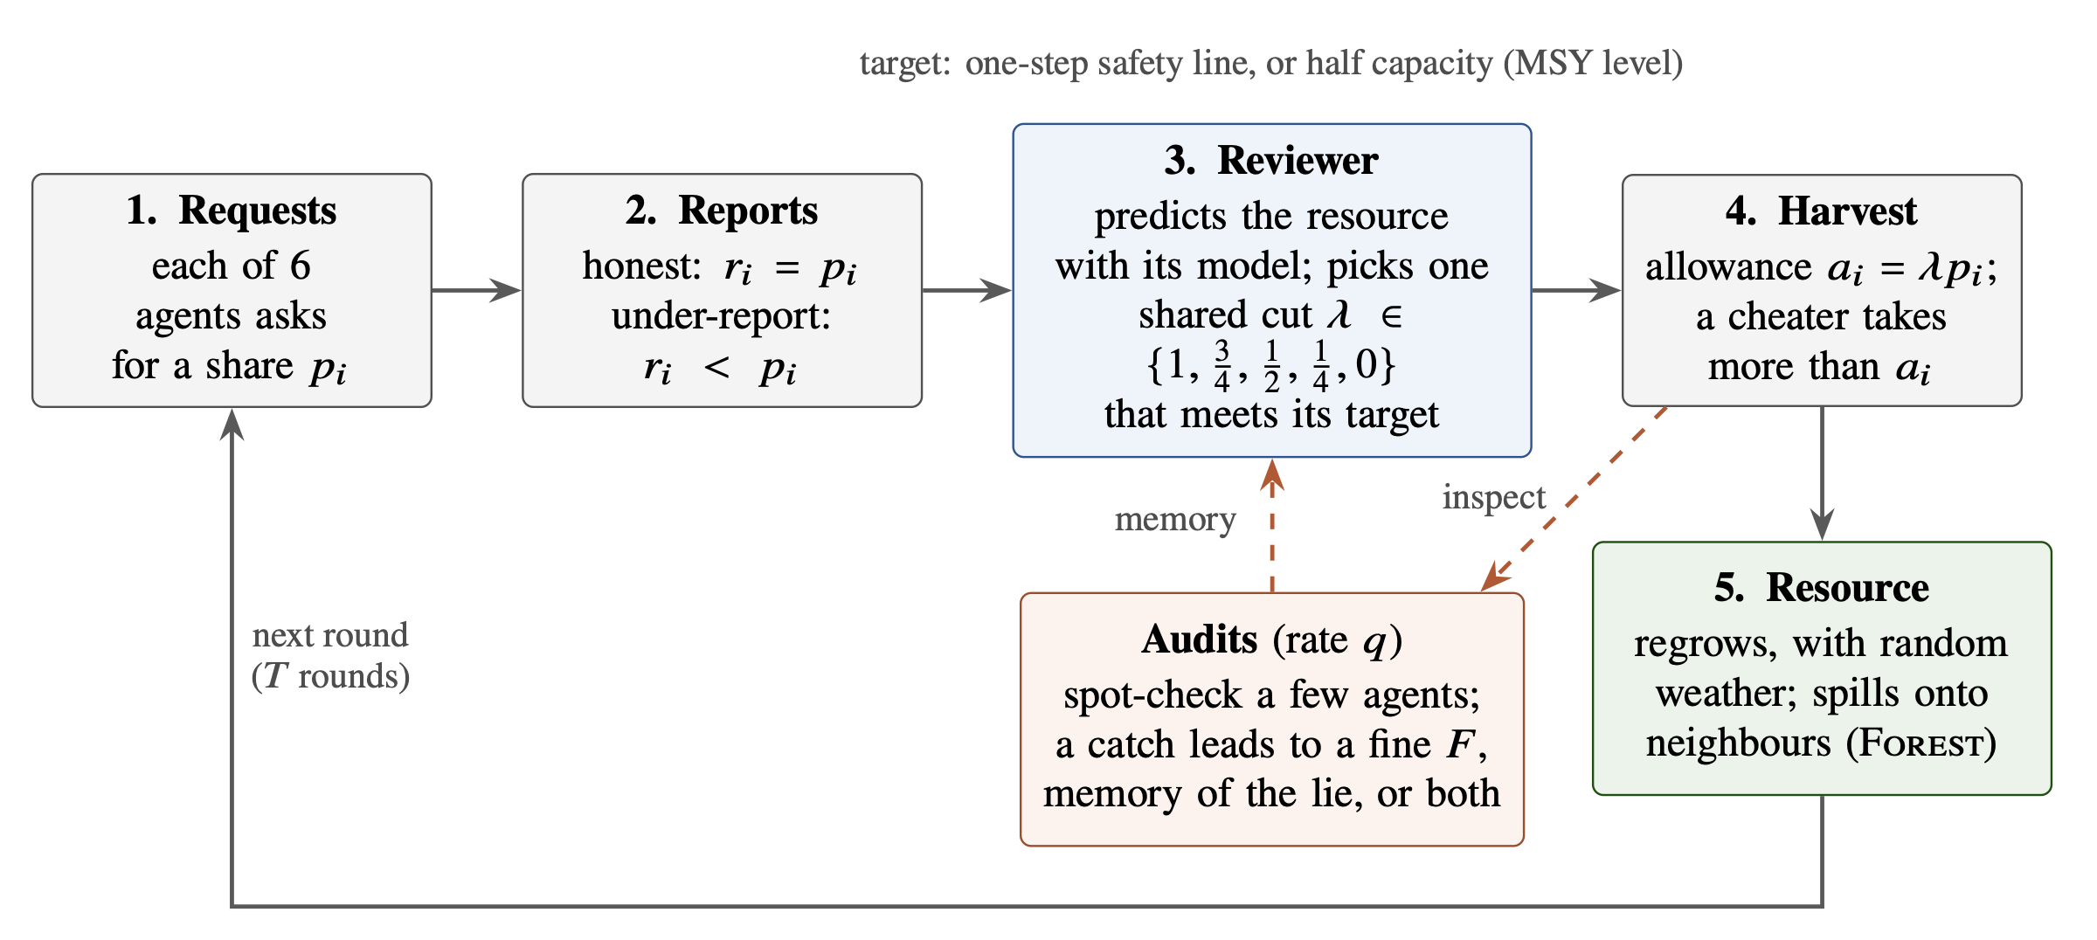
How One Round Works
Each round: agents ask for a share, the reviewer scales all requests by one factor, agents take their allowance or more, the resource regrows, and a few agents are checked. The same round runs in three settings where harm spreads differently: Fishery, Forest and River.
Harm = the resource falling below half its capacity, the level at which it regrows fastest
3
Notes:
One round: every agent asks for a share; the reviewer predicts the effect and scales everyone's request by the same factor if needed; each agent then takes its allowance, or more if it cheats; the resource regrows; and a few agents are checked. Harm means the resource falling below half its capacity, the level where it regrows fastest. I run this in three settings where harm spreads differently, one shared pool, neighbour damage on a ring, and pollution that is harmful in combination, so results don't rest on one structure.

Slide 4
How I Test It
Key quantities
01
Run the setting
Six agents share the resource for many rounds; the reviewer sets allowances; a few agents are checked at random each round.
q
chance that an agent is checked in a round (1 in 6 for the language models)
02
Measure the gain
F
fine paid when a check finds an agent over its allowance
Run games without any fine and record how much an agent gains from one round of taking more than its allowance.
e = q × F
expected fine for one round of over-taking
03
Predict, then freeze
Work out the fine that should stop over-taking and record the prediction before any game with that fine is run.
g
what an agent gains from one round of over-taking
04
Test on games the prediction never saw
e > g
the prediction: over-taking stops once the expected fine is larger than the gain (Becker 1968)
Run the predicted fine and the fines around it on new games, and report the result whether or not it matches.
4
Notes:
The method: run games with no fine, measure how much an agent gains from one round of over-taking, predict the fine that should stop it, write that prediction down, then test it on new games. The one formula is Becker's rule from 1968: the expected fine is the chance of a check times the fine, and over-taking should stop once that beats the gain. With a 1 in 6 chance and a 30 tonne fine the expected fine is 5 tonnes, just above the roughly 4.5 tonnes the models gained.

Slide 5
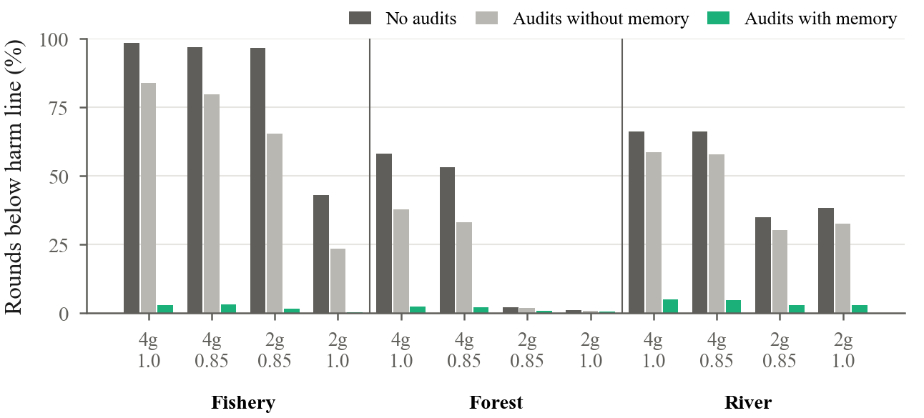
Finding 1: A Catch Needs a Consequence
The setting
Some agents report less than they intend to take, so the reviewer underestimates their use unless a check catches them.
Checks without memory
Correcting only the round in which a lie was caught removed 10–46% of the harm.
Checks with memory
Remembering each caught lie and adjusting that agent's later allowances reduced harm in all 12 settings tested. In Fishery, rounds below half capacity fell from 43–99% to 0.3–3%.
Share of rounds below half capacity when some agents under-report. Dark: no checks. Light: checks without memory. Green: checks with memory. Each group has four settings: 2 or 4 misbehaving agents (2g, 4g) and two regrowth rates (1.0 and 0.85 of normal).
5
Notes:
First finding, with programmed agents that under-report. If the reviewer only corrects the round in which it catches a lie, only 10 to 46 percent of the harm goes away. If it remembers each caught lie and adjusts that agent's later allowances, harm drops in all 12 settings, in Fishery from up to 99 percent of rounds below half capacity to under 3 percent. A catch needs a consequence.

Slide 6
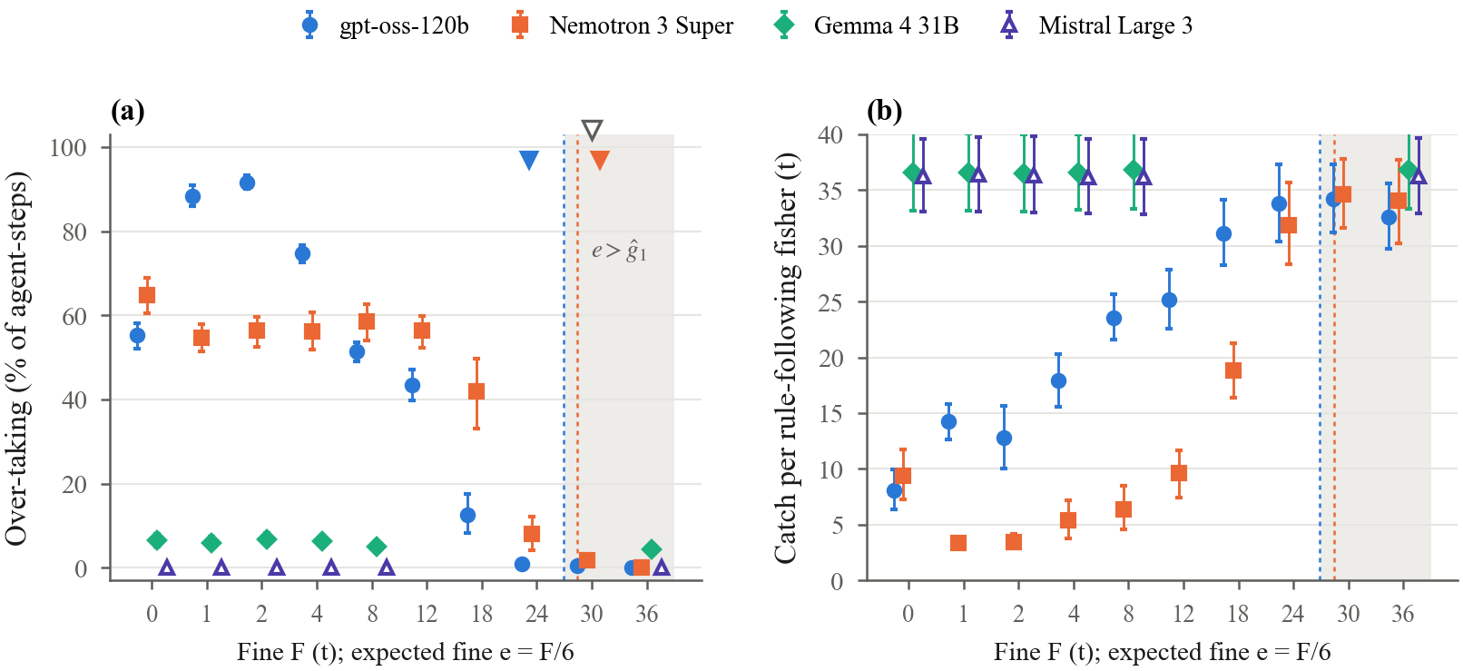
Finding 2: Language Models Stop Where Predicted
Four open language models each controlled four of the six fishers (520 games). Left: share of rounds in which a model took more than its allowance, at each fine, with a 1 in 6 chance of a check. Triangles: stopping fine predicted before testing (open) and observed (filled). Right: catch left for the two rule-following fishers.
Predicted before testing: 30 t. Observed: 30 t (Nemotron 3 Super), 24 t (gpt-oss-120b)
6
Notes:
Second finding, with language models: four open models controlled four of the six fishers, 520 games. Two of them, gpt-oss and Nemotron, over-took on purpose. From their no-fine behaviour I predicted both would stop at 30 tonnes, before running those fines. Nemotron stopped exactly at 30 and gpt-oss one step early at 24. One surprise: a small fine made gpt-oss cheat more, as if the fine were a price.

Slide 7
More Findings, in Brief
01 PROGRAMMED
02 AUDIT DESIGN
03 LANGUAGE MODELS
04 LANGUAGE MODELS
The stopping fine is predictable
Two shortcuts backfire
Memory works without a fine
One round's gain predicts the stop
Always checking the largest request caught 25% of liars, against 100% with random checks. Lowering everyone's allowance let cheaters gain more than with no checks (142 vs 113).
With checks and memory but no fine, gpt-oss took more than its allowance in 20% of rounds instead of 55%, and no lake collapsed (5 of 10 without memory).
Predicted in advance from games without checks: in 5 of 5 new settings, the observed stopping point was within one step of the prediction.
Not what over-taking earned over the whole game. Both models also stopped earlier, and more gradually, than a perfect payoff-maximiser would.
Each of these is shown in full in the backup slides
7
Notes:
A few more results, briefly; the backup slides have each in full. The stopping fine for programmed agents was predicted in 5 of 5 new settings. Two shortcuts backfire: always checking the biggest request misses most liars, and cutting everyone's allowance rewards the cheaters. Memory works for language models too, cutting gpt-oss's over-taking from 55 to 20 percent without any fine. And what predicts where models stop is the gain of one round, not what cheating earns over the whole game; they also stopped earlier than a perfect optimiser would.

Slide 8
Running Now (Results Soon)
Expected fine, or the size of the fine?
Result (to fill in):
Same expected fine (2 t or 3 t), made up differently: 1 in 3 checked with a small fine, 1 in 6, or 1 in 12 with a large fine. gpt-oss-120b, 20 new games per condition.
Does the prediction hold on new games?
Result (to fill in):
Stopping fine recorded in advance (30 t for both models), tested on 10 new games and with the rules reworded.
What if nothing is ever checked?
Result (to fill in):
Rules that never mention checks, compared with checks that carry no fine.
Does over-taking spread to neighbours?
Result (to fill in):
Forest: one programmed over-taker among five language-model agents; neighbours' cuts either hidden or visible.
Next: AAAI-27 workshop and arXiv (20 Nov), then a main conference in January (IJCAI or ICML; dates estimated)
8
Notes:
These are running now, so the boxes are empty. The main one tests whether models respond to the expected fine or to the fine's size, by keeping the expected fine fixed and changing the mix of check chance and fine. The others check the prediction on new games and reworded rules, what happens with no checks at all, and whether cheating spreads to neighbours in Forest. Next: a workshop paper and arXiv in November, then a main conference in January.

Slide 9
Questions for You
01
Is "taking more than your allowance" a fair stand-in for an AI agent misbehaving?
02
If a fine works under one wording of the rules, how far would you trust it under another?
03
Where in your own work does someone check only a sample, and what happens after a catch?
9
Notes:
I'd love your views on these.

Slide 10
Thank You
13 October 2026
Ameer Alhashemi
k26108758@kcl.ac.uk
10
Notes:
Thanks.

Slide 11
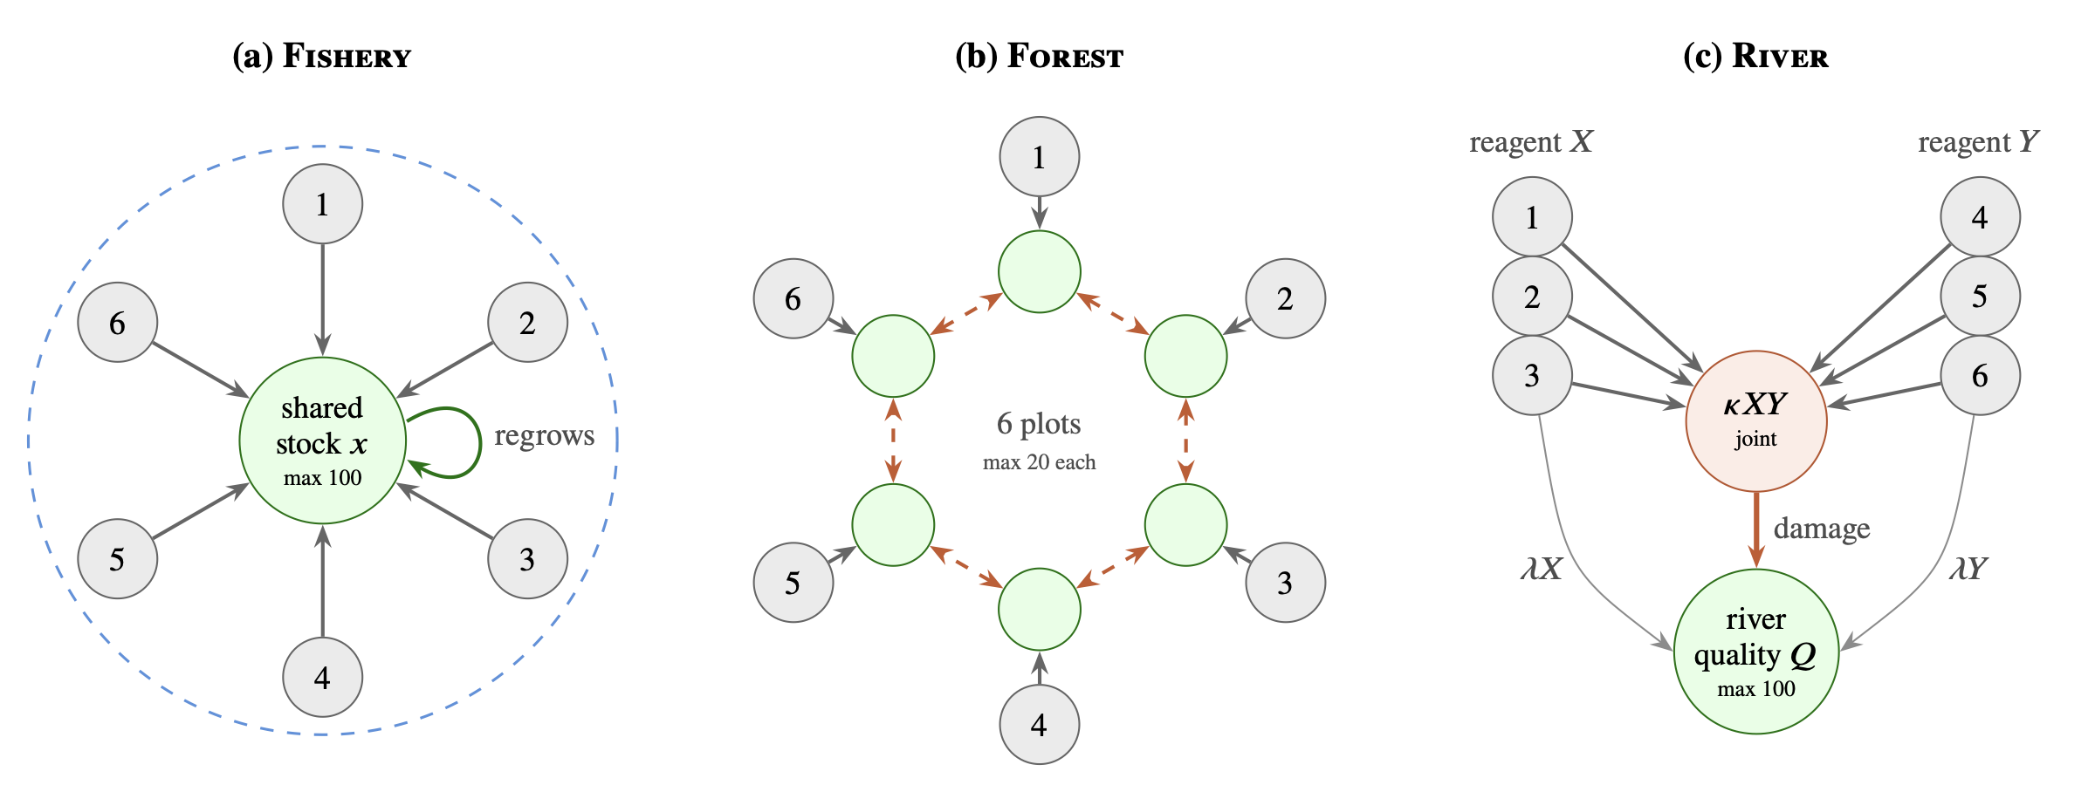
Backup: The Problem and the Settings
A limited, shared resource
Each agent receives an allowance: the amount it may take this round. Taking more helps that agent and leaves less for everyone else.
Oversight by sampling
Checking every action costs too much, so an overseer spot-checks a few, as tax and fisheries inspectors do.
The open question
When does a sampled check stop agents taking more than their allowance, and how large does the penalty need to be?
The same question in three settings, chosen because one agent's over-use reaches others in a different way in each: through a single shared pool (Fishery), through damage to direct neighbours (Forest), and through harm that appears only when two kinds of use combine (River). A result that holds in all three does not rest on one structure.
11
Notes:
Let me make the problem concrete. Each agent gets an allowance, the amount it's allowed to take this round. Taking more than that helps the agent and leaves less for everyone else.
Checking every action costs too much, so the overseer spot-checks a few, the way tax inspectors or fisheries inspectors do. The open question is when a sampled check actually stops over-use, and how big the penalty has to be.
I ask this in three settings, on the right. They aren't three toy problems; I picked them because harm travels differently in each:
- in Fishery, everyone draws from one shared stock;
- in Forest, each agent has its own plot, but over-cutting damages your two neighbours;
- in River, two kinds of pollution are mostly harmless alone and harmful together.
If a result holds in all three, it isn't an artefact of one particular structure.

Slide 12
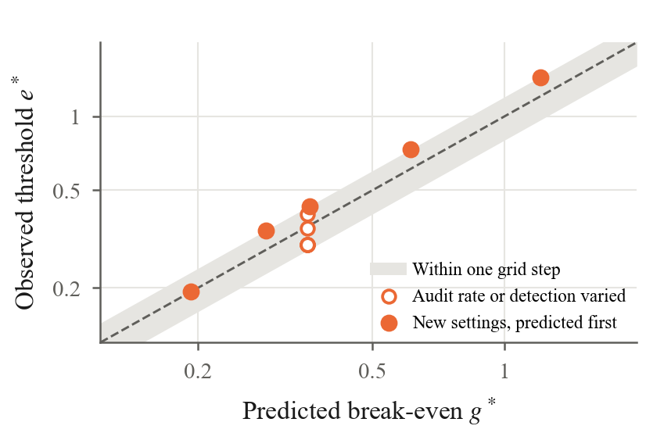
Backup: A Predictable Threshold
What was predicted
Programmed agents choose how much to over-take so as to earn the most. From games without checks, we predicted the expected fine at which they would stop.
The result
In 5 of 5 new settings, the observed stopping point was within one step of the prediction.
Why this comes first
These agents are built to maximise their payoff, so this checks the measurement method before it is used on language models.
Observed against predicted stopping point (expected fine). Filled: new settings predicted in advance. Open: the checking rate, or the chance that a check catches the cheat, was varied. The band marks one step of the tested grid.
12
Notes:
Second finding. These programmed agents choose how much to over-take so as to earn the most. Using only games without any checks, I predicted the expected fine at which they'd stop. In five out of five new settings, the stopping point landed within one step of the prediction.
To be fair about it: these agents are built to maximise their payoff, so this is mostly a check that my measurement method works before I try it on language models.

Slide 13
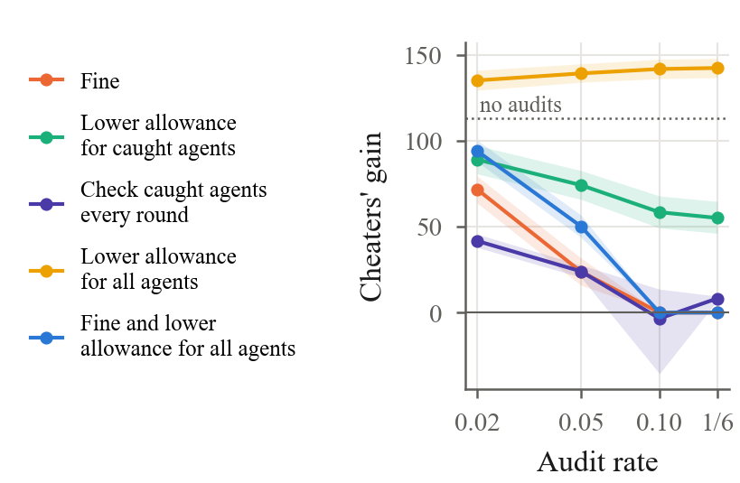
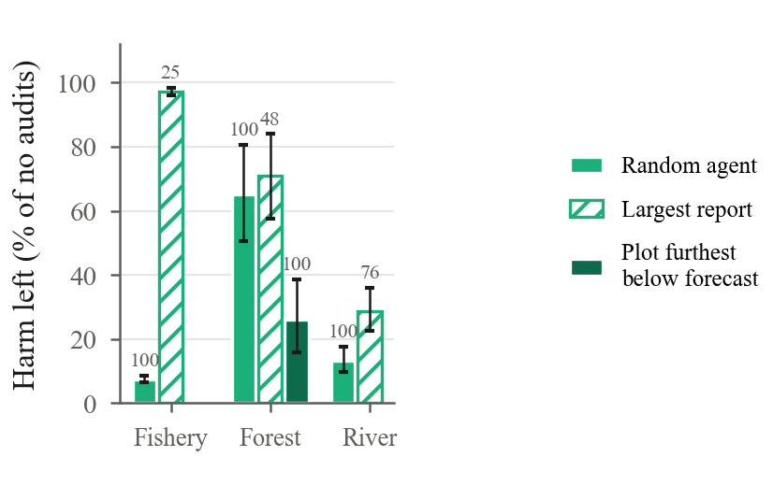
Backup: Two Shortcuts That Backfire
Lowering every agent's allowance to make up for known cheaters let the cheaters gain more than with no checks at all (142 vs 113); honest agents paid for it.
Always checking the agent with the largest report caught 25% of liars over a game, against 100% with random checks: the largest reporter is often honest.
Shortcuts that save checks can open blind spots
13
Notes:
Third finding: two shortcuts that look sensible and backfire.
On the left, the overseer knows there are cheaters and lowers everyone's allowance to make up for them. Cheaters actually gained more than with no checks at all, 142 against 113, and honest agents paid for it.
On the right, the overseer always checks whoever asks for the most. Over a game that caught only 25 percent of the liars, against 100 percent with random checks, because the biggest requester is often honest, so the same honest agent keeps getting checked.
The lesson is that shortcuts which save checks can open blind spots.

Slide 14
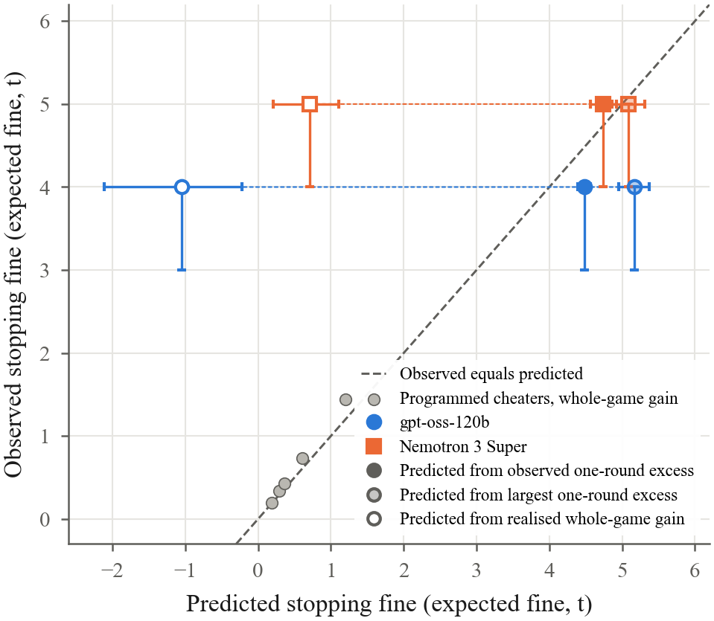
Backup: One Round's Gain Matters
What predicted it
How much each model took above its allowance in one round without a fine (4.5–4.7 t).
What did not
What over-taking earned over a whole game: about −1 to +0.7 t per round, because over-taking depleted the lake.
Compared with an ideal optimiser
An agent that maximised its expected payoff would keep over-taking until 36 t. Both models stopped earlier, and gradually.
Each point compares a predicted and an observed stopping fine; points on the dashed line were predicted exactly.
14
Notes:
Fifth finding: which gain predicts the stop. It was how much the model took above its allowance in a single round, about 4.5 to 4.7 tonnes.
It was not what over-taking earned over the whole game. Over the whole game their cheating gained little or even lost fish, because it depleted the lake, and yet they kept going.
They also stopped earlier than a perfect payoff-maximiser would. That agent would hold out until 36 tonnes; both models stopped before that, and gradually.
I want to be careful here: this tells us what predicts where they stop, not why they stop.

Slide 15
Backup: Memory for Language Models
Checks only
Checks + memory
Reduced, not stopped
Memory protected the lake without any fine, but some over-taking remained. For Nemotron 3 Super, over-taking fell from 65% to 33%.
Rounds with over-taking
55%
→
20%
With a large enough fine
Rounds below half capacity
92%
→
20%
Fines above the gain stopped over-taking and kept the harvest at 0.99 of the maximum the lake can sustain.
Lakes collapsed (of 10)
5
→
0
gpt-oss-120b, no fine in either condition, 10 games each
15
Notes:
And memory works for language models too. With checks and memory, but no fine at all, gpt-oss over-took in 20 percent of rounds instead of 55. Rounds below half capacity fell from 92 to 20 percent, and no lake collapsed, against 5 out of 10 without memory.
So memory reduced over-taking but didn't stop it. A big enough fine did stop it, and cost nothing in efficiency.

Slide 16
Backup: Where This Is Going
Sep – 8 Oct
12 – 14 Oct
20 Nov
Jan 2027
Programmed agents in all three settings; language models in Fishery
Follow-up tests asked for by two outside reviews
Workshop submission (AAAI-27 WMAC) and arXiv
Main conference: IJCAI or ICML
Each study has a protocol written down before its code; predictions that failed are reported.
16
Notes:
The plan:
- The programmed-agent work and the first language-model studies are done.
- The follow-ups finish in the next day or so.
- I'm aiming for an AAAI workshop on 20 November, plus arXiv.
- Then a main conference in January, IJCAI or ICML. Those dates are estimates, because the calls aren't out yet.
Every study had its plan written down before the code, and I report the predictions that failed.

