Slide 1
Penalties Sized to the Gain
When do random audits stop AI agents from over-using a shared resource?
Ameer Alhashemi
PhD catch-up
King's College London, 13 October 2026
Notes:
One sentence: I test when spot-checks actually stop AI agents from taking more than their share, and whether we can predict the penalty that does it.

Slide 2
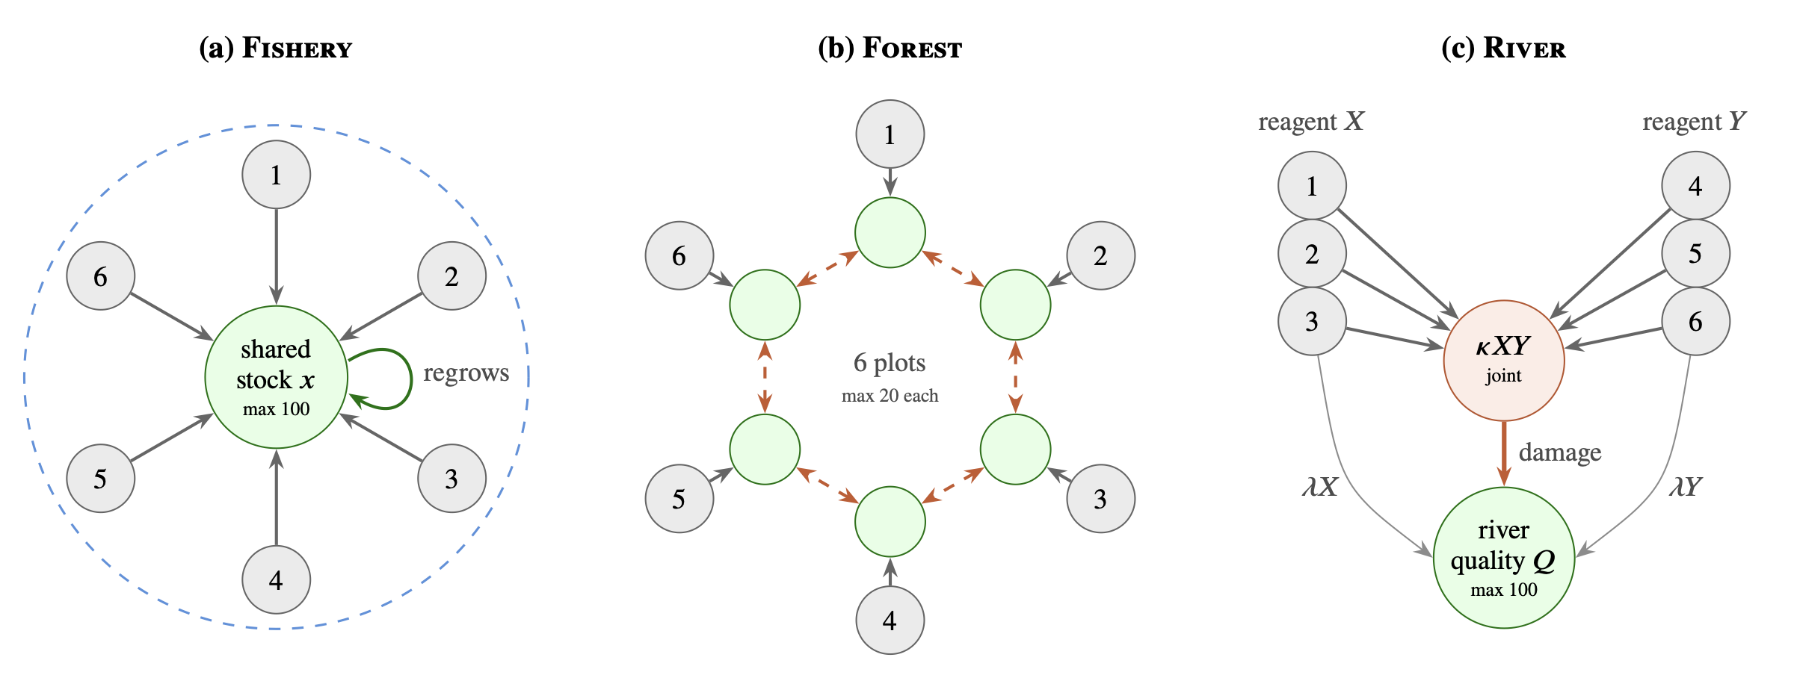
The Problem
AI agents share limited things
Compute, energy, money, a fish stock. Each agent is told how much it may take.
Checking is expensive
An overseer can only spot-check a few agents each round, like a tax audit or a fishing inspection.
What we don't know
Do spot-checks stop agents taking more than their share? And how big must the penalty be?
Three toy worlds with six agents each. Fishery: one shared stock. Forest: over-cutting damages your two neighbours. River: two pollutants that are harmful mainly together.
2
Notes:
Keep this concrete: six agents, one renewable resource, an overseer that cannot check everyone.

Slide 3
01
What must follow a catch?
Three Questions
A fine, a memory of the offence, or nothing: which of these makes spot-checks reduce harm?
02
Can we predict the stopping penalty?
Economics says cheating stops once the expected fine beats the gain. Does that hold, and can we predict it in advance?
03
Do LLMs follow the same rule?
If four of the six agents are LLMs, do they stop where we predict, and which gain do they act on?
3
Notes:
These are the three questions the paper answers.

Slide 4
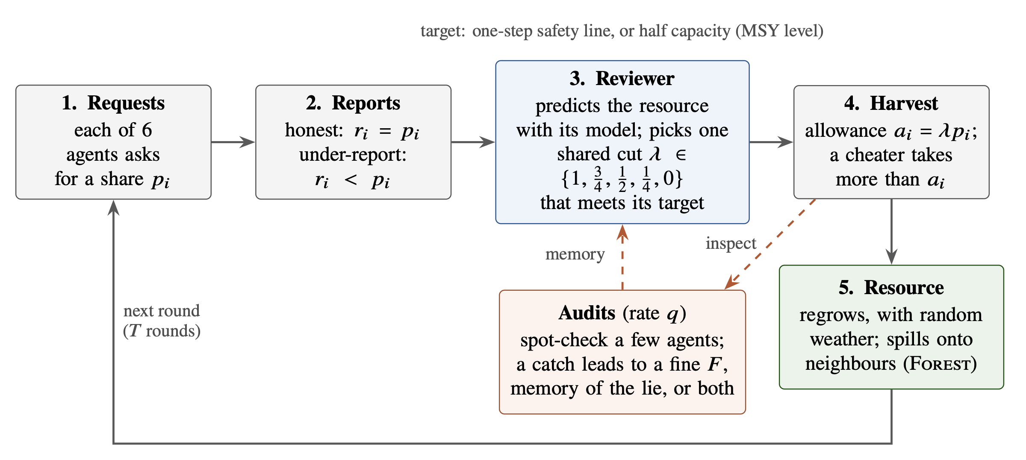
How One Round Works
Each round: agents ask for a share, a reviewer scales every request by one factor to keep the resource at half capacity, agents take their allowance or more, the resource regrows, and a few agents are spot-checked.
Harm = the resource falling below half capacity, where it regrows fastest
4
Notes:
Half capacity is the maximum-sustainable-yield level from fisheries science. Same harm line in all three games.

Slide 5
The Rule From Economics
q × F
1/6 × 30 t
≈ 4.5 t
expected fine = chance of being checked × size of the fine
= 5 t expected fine per round of cheating
what a model gained per round of cheating, with no fine
Cheat while the gain beats the expected fine
This is Becker's 1968 rule. So a 30 t fine should stop an agent that gains 4.5 t per round, and a 24 t fine (4 t expected) should not.
But which gain?
The gain from one round, or the gain over the whole game once the stock is depleted? The two differ, and that turns out to matter.
5
Notes:
This is the benchmark, not a new theorem. The interesting part is testing it in advance.

Slide 6
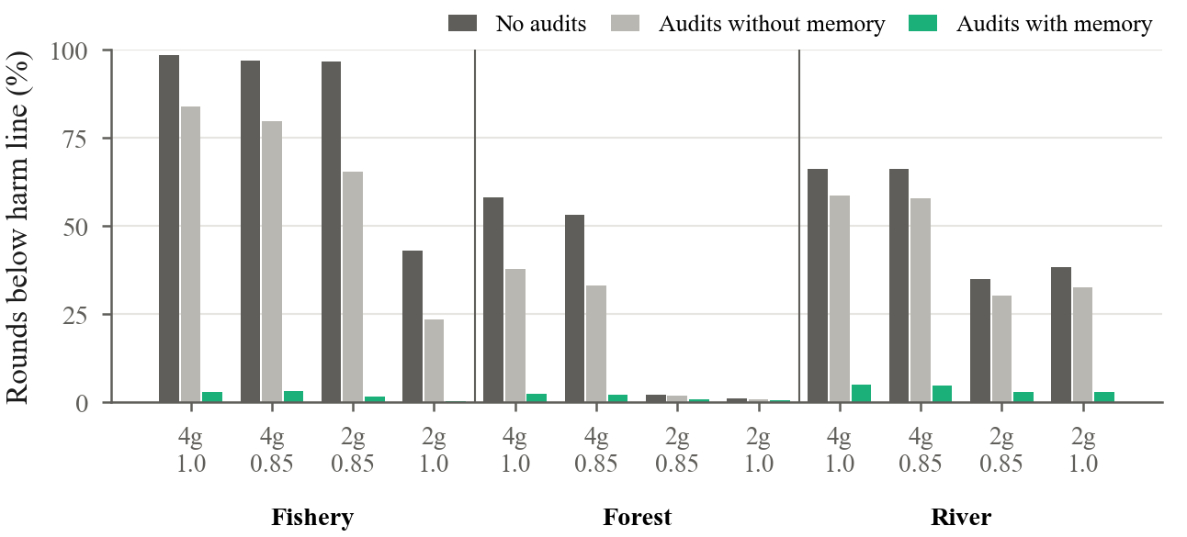
Finding 1: Catching Alone Barely Helps
Remembering each caught lie works
Memory gave less harm than audits without memory in 12 of 12 settings across the three games.
The numbers
Rounds below half capacity fell from 43–99% to 0.3–3% in Fishery and from 35–66% to 3–5% in River.
Audits without memory
Correcting only the current round removed just 10–46% of the harm.
Share of rounds below half capacity with lying agents. Dark: no audits. Light grey: audits without memory. Green: audits with memory.
6
Notes:
Programmed agents, 64 populations per setting. The point: a catch has to have a consequence.

Slide 7
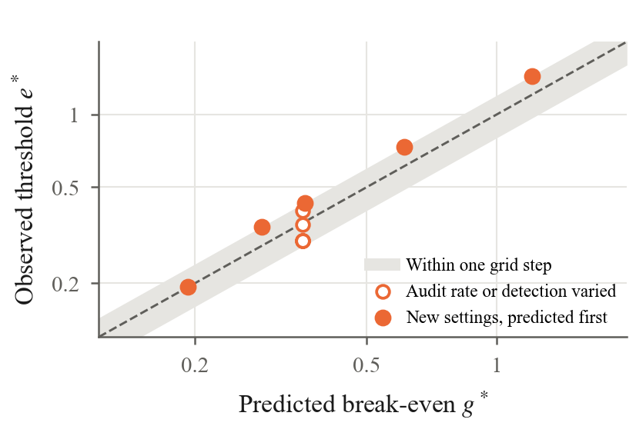
Finding 2: A Predictable Threshold
Predicted before testing
From runs without audits, we predicted where cheating would stop in five new settings.
5 of 5 within one step
Every observed threshold landed within one step of the prediction, for thresholds from 0.19 to 1.20.
Why it matters
This checks our measurement method before we try it on LLMs.
Observed against predicted threshold. Filled: new settings predicted first. Open: audit rate or detection varied.
7
Notes:
These agents are built to optimise, so this is a validation of the measurement, not a surprise.

Slide 8
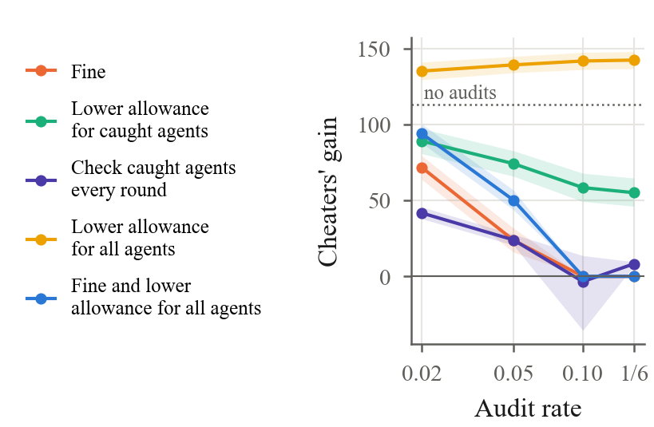
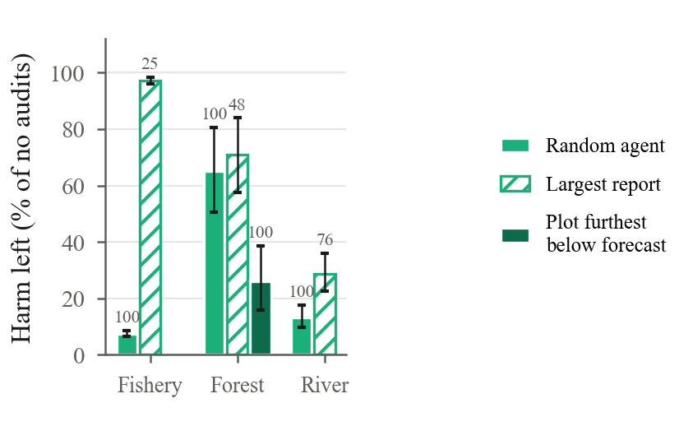
Finding 3: Two Shortcuts That Backfire
Lowering everyone's allowance to absorb cheaters made cheating pay more than no audits at all (142 vs 113).
Always checking the largest report caught 25% of liars, against 100% with random checks.
Keep checks unpredictable and covering everyone
8
Notes:
Both shortcuts save audits but create blind spots. Targeting where the outcome falls short of the forecast did best in Forest.

Slide 9
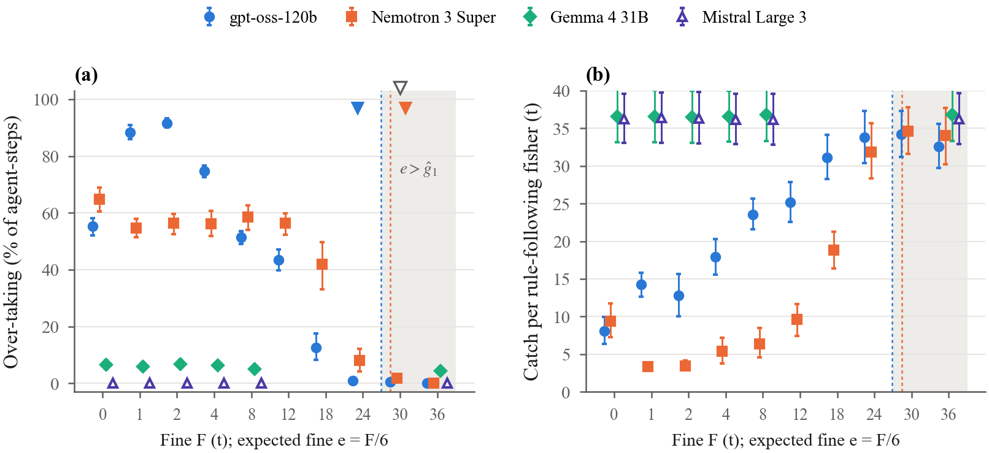
Finding 4: LLMs Stop Where Predicted
Four LLMs, 520 games, 81,232 decisions. Left: how often each model took more than its allowance, by fine. Triangles: predicted stop (open) and observed stop (filled). Right: fish left for the rule-following agents.
Predicted 30 t: Nemotron stopped at 30 t, gpt-oss one step early at 24 t
9
Notes:
Gemma rarely over-took and Mistral never did, so they say nothing about the threshold. A small fine made gpt-oss cheat more (55% to about 90%): a fine works like a price.

Slide 10
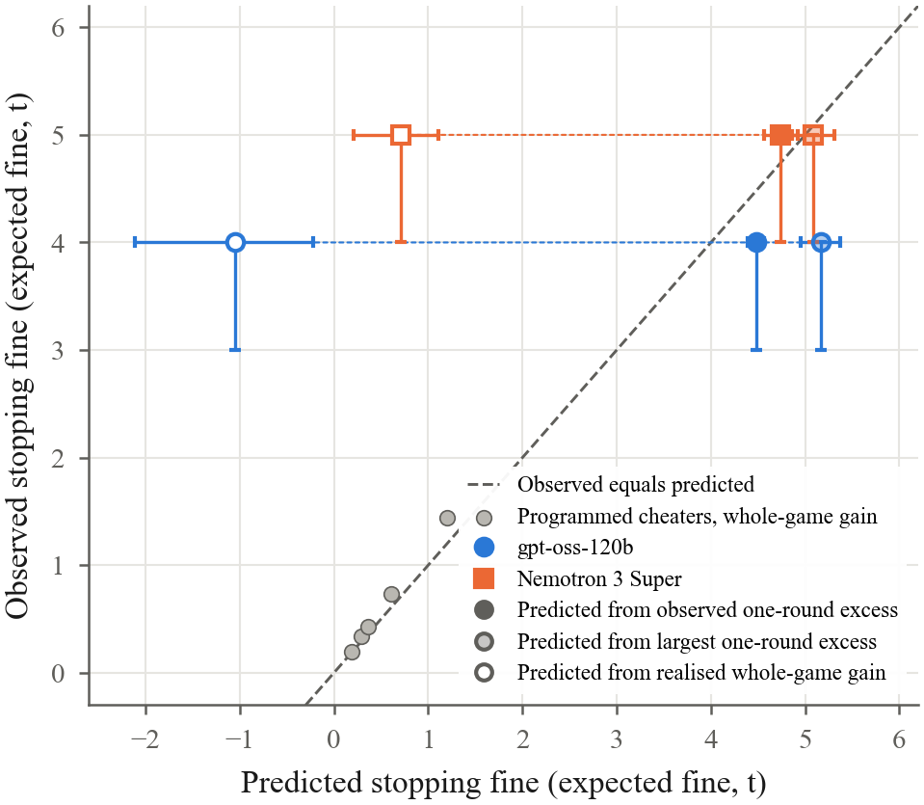
Finding 5: They Act on One Round
The gain of a single round
The stopping fine matched what each model took per round without a fine (4.5–4.7 t).
Not the whole game
Over the whole game their over-taking gained little or lost fish (−1.05 and 0.71 t per round), yet they kept going.
Easier to deter than a perfect optimiser
A risk-neutral agent would hold out until 36 t. Both models stopped earlier, and gradually.
Observed against predicted stopping fine. Points on the dashed line are predicted exactly.
10
Notes:
Careful wording: this shows what predicts the stopping fine, not why the models stop.

Slide 11
Memory Works for LLMs Too
55% → 20%
92% → 20%
0 of 10
rounds in which gpt-oss over-took, with memory and no fine
rounds below half capacity under gpt-oss
lakes collapsed with memory (5 of 10 without)
Reduced, not stopped
Memory protected the resource without any fine, but some over-taking remained. Fines above the gain stopped it and cost no efficiency (0.99 of the maximum sustainable harvest).
11
Notes:
Nemotron: over-taking 65% to 33%, harm 96% to 40%.

Slide 12
Running Now (Results Soon)
Expected fine or fine size?
Result (to fill in):
Same expected fine (2 t or 3 t) with 1 in 3, 1 in 6 or 1 in 12 checked. gpt-oss, 20 new populations.
Does the prediction transfer?
Result (to fill in):
10 new populations and a reworded prompt. Predicted stop frozen in advance: 30 t for both models.
What if nothing checks at all?
Result (to fill in):
Rules that never mention checks, compared with a check that carries a 0 t fine.
Does cheating spread to neighbours?
Result (to fill in):
Forest ring: one programmed over-cutter, five LLM foresters; neighbours' cuts hidden or visible.
12
Notes:
A fifth family, DeepSeek V4.1 Flash, over-took in 80% of rounds without a fine; its predicted stop (36 t) is frozen but not tested yet.

Slide 13
Where This Is Going
Sep – 8 Oct
12 – 14 Oct
20 Nov
Jan 2027
Programmed agents in three games; LLMs in Fishery
Follow-up tests from two outside reviews
AAAI-27 workshop (WMAC) and arXiv
Main conference: IJCAI or ICML
Every study has a protocol frozen before its code; failed predictions are reported.
13
Notes:
January dates are estimates; the calls are not out yet.

Slide 14
Questions for You
01
Is "taking more than your allowance" a fair stand-in for an AI agent misbehaving? What would be better?
02
If a fine works under one wording of the rules, how far would you trust it under another?
03
What would convince you more: more models, or more kinds of game?
04
Where in your own work does someone check only a sample, and what happens after a catch?
14
Notes:
Open the floor. These are the points reviewers raise too.

Slide 15
Thank You
13 October 2026
Ameer Alhashemi
k26108758@kcl.ac.uk
15
Notes:
Thanks; happy to share the paper draft.

