Slide 1
Fast-Food Nutrition Analysis:
A Data-Driven Exploration of Nutritional Insights Across Chains
Temurjon Ismailov 12/12/2024

Slide 2
Introduction
Question Behind the Analysis:
What are the nutritional differences across fast-food chains? Which items are the healthiest or least healthy?
Purpose:
Help consumers make informed dietary decisions.
Highlight areas for improvement for fast-food chains.
Who Benefits:
Health-conscious individuals.
Dietitians and nutritionists.
Fast-food companies aiming to enhance their menus.
Nutrition apps.

Slide 3
Methodology
Dataset
Mostly clean dataset from Kaggle.com, provided in CSV format.
Unit of Analysis
The analysis focused on individual menu items (e.g., burgers, fries, nuggets). Key features analyzed included calories, sodium, fat, carbs, and protein.
Tools Used:
I used Python (Jupyter Notebooks) for analysis, with libraries such as pandas, matplotlib, and seaborn for data manipulation and visualization.

Slide 4
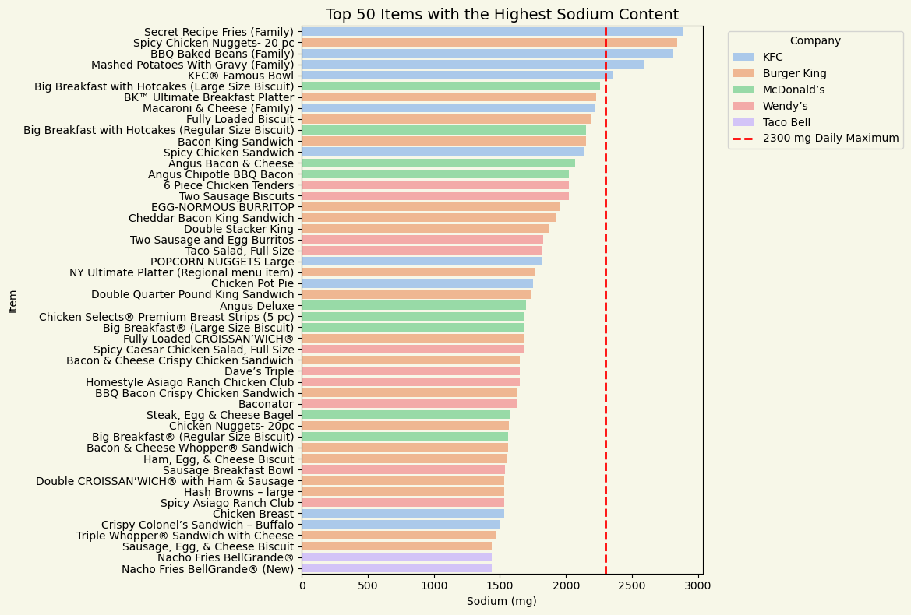
Key Insight #1
The top 50 items with the highest sodium content are dominated by KFC, with 5 of the top 10 exceeding the daily sodium limit.

Slide 5
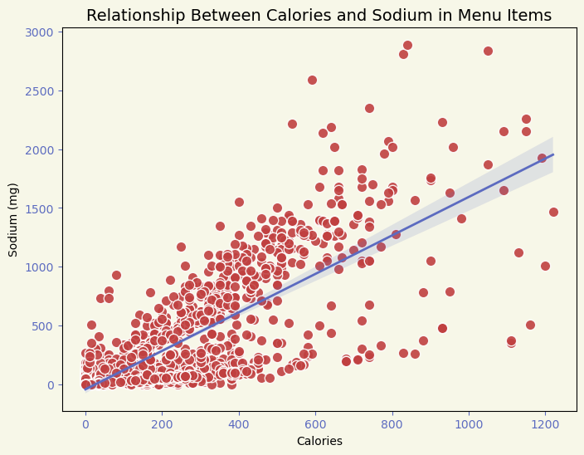
Key Insight #1
There is a strong positive correlation between sodium content and calories

Slide 6
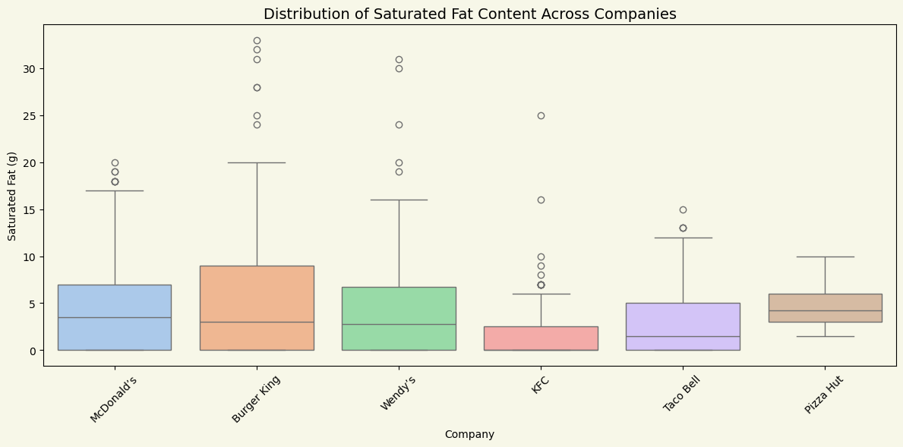
Key Insight # 2
Saturated fat levels vary significantly across chains. Pizza Hut has the highest averages, while KFC has the lowest. Outliers exist in almost every chain.

Slide 7
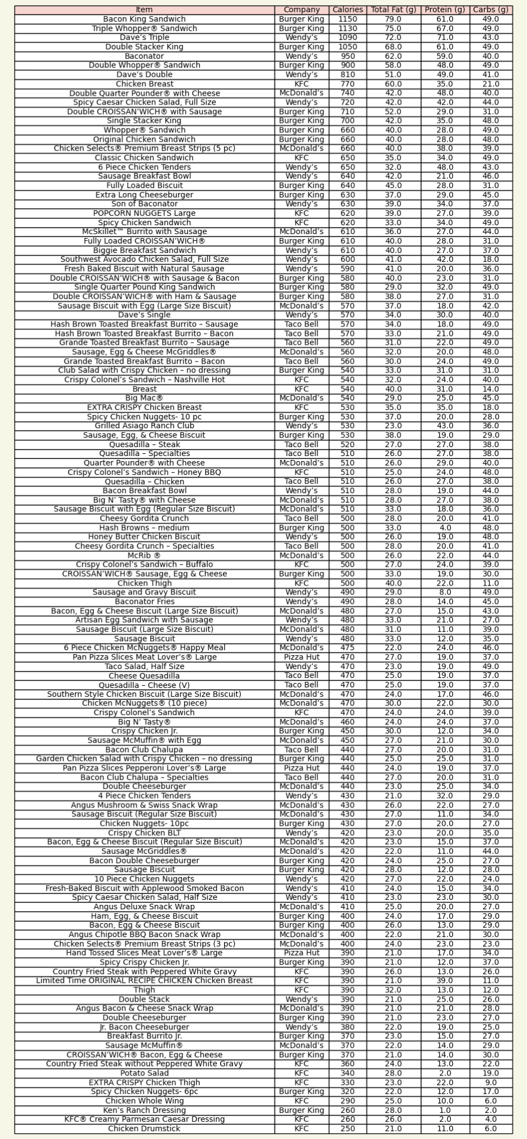
Key Insight #3
Keto-friendly options exist across all chains, but they vary widely in calorie count, offering flexibility for keto consumers.

Slide 8
New Questions/Unanswered Areas
Questions
Further exploration
How do trends in nutritional content change over time?
What is the relationship between price and nutritional content?
Additional dietary restrictions, including vegan, vegetarian, dairy-free, and gluten-free options, to cater to a wider audience.
Analyze data from more restaurant chains, especially higher-end fast-casual chains, to compare their offerings against traditional fast food in terms of nutrition and quality.

Slide 9
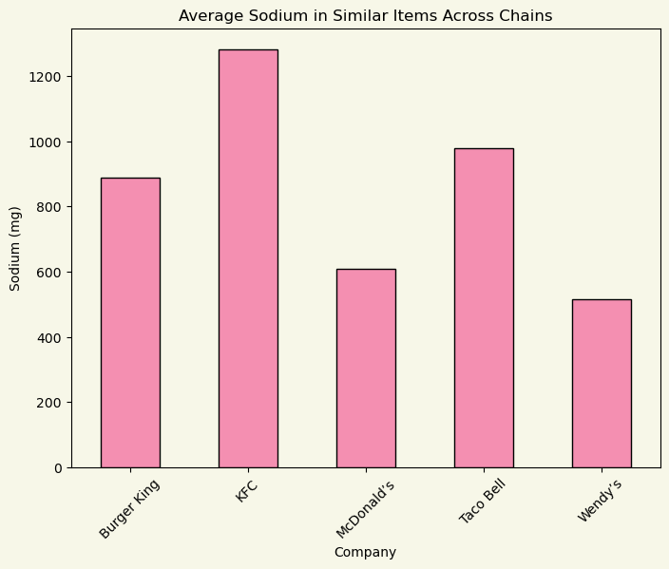
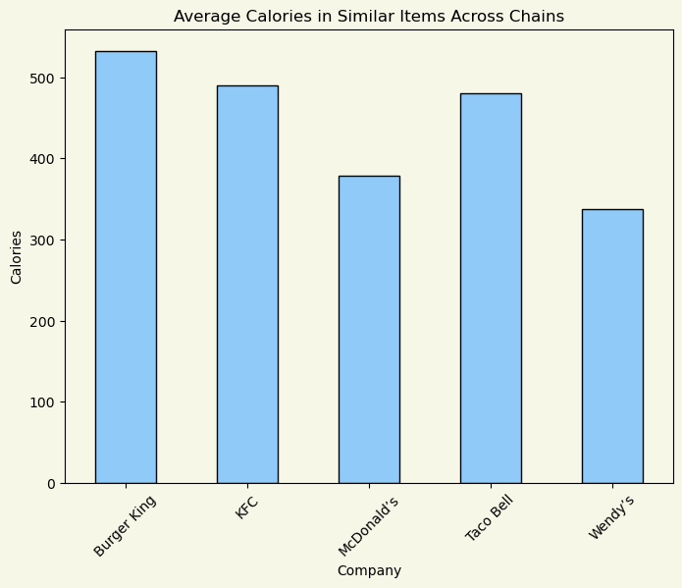
Appendix

