Slide 1


DTS405TC: Image Process and Computer Vision Lab 3
Mian Zhou, Ph.D.
Senior Associate Professor
School of AI and Advanced Computing
Building TC-D5033, 111 Taicang Avenue,
Xi'an Jiaotong-Liverpool University,
E-mail: Mian.Zhou@xjtlu.edu.cn
Tel: 88973349

Slide 2
Understanding Image Histograms
What is a Histogram?
A graphical representation of the frequency of each intensity level (0-255).
X-axis: Intensity values; Y-axis: Number of pixels.
Why use it?
To identify if an image is underexposed (dark), overexposed (bright), or has low contrast.
Key Functions:
cv2.calcHist(): The primary OpenCV function for calculating distributions.
plt.plot(): Visualizing the resulting data.

Slide 3
Grayscale vs. Color Histograms
Grayscale Histograms: A single curve showing the overall brightness distribution.
Color Histograms:
Visualizing the Blue, Green, and Red channels separately.
Helps in identifying "color casts" (e.g., an image that is too "warm" or "cool").
Technique: Iterating through the channels (0, 1, 2) and plotting them in their respective colors.

Slide 4
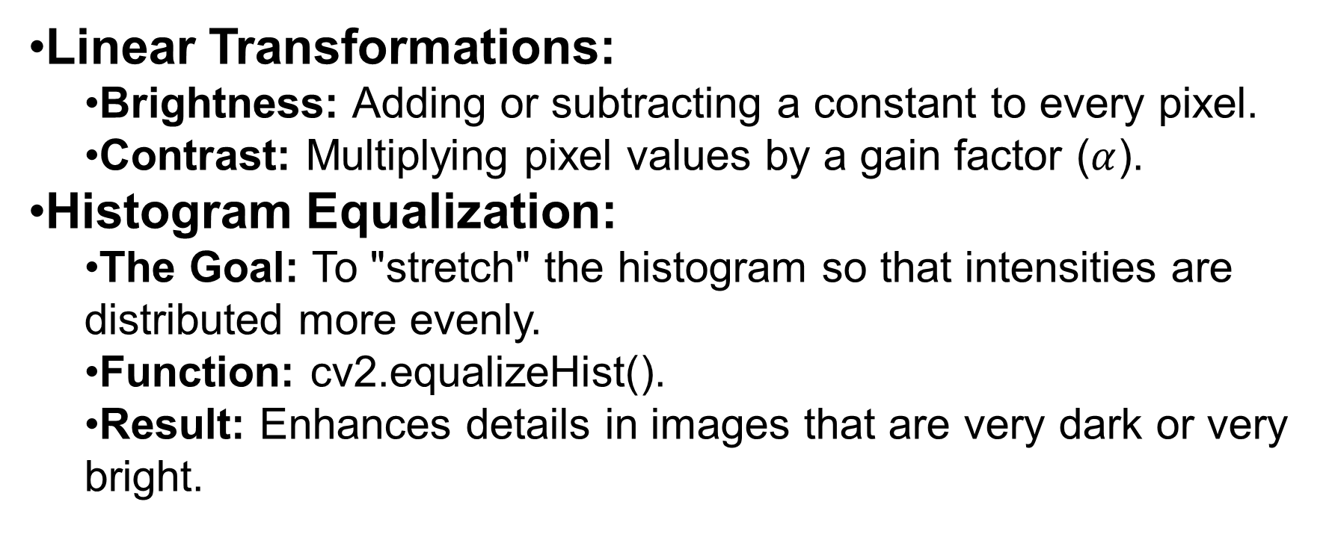
Intensity Transformations (Brightness & Contrast)
Linear Transformations:
Brightness: Adding or subtracting a constant to every pixel.
Contrast: Multiplying pixel values by a gain factor ($α$).
Histogram Equalization:
The Goal: To "stretch" the histogram so that intensities are distributed more evenly.
Function: cv2.equalizeHist().
Result: Enhances details in images that are very dark or very bright.

Slide 5
Non-linear Transformations
Log Transformation:
Expands dark pixels and compresses bright pixels.
Useful for visualizing details in Fourier Transforms or very dark images.
Gamma Correction (Power-Law):
Adjusts image "gamma" to account for how human eyes or screens perceive light.
s = c * r^γ

Slide 6
Thresholding for Simple Segmentation
What is Segmentation? Separating the "Foreground" (objects) from the "Background."
Simple Thresholding:
If pixel > threshold, set to 255 (White); else 0 (Black).
cv2.threshold(img, thresh, maxval, cv2.THRESH_BINARY).
Otsu’s Method:
Automatically finds the "optimal" threshold value by analyzing the histogram peaks.
Adaptive Thresholding:
Calculates thresholds for small regions. Essential for images with uneven lighting (shadows).

Slide 7
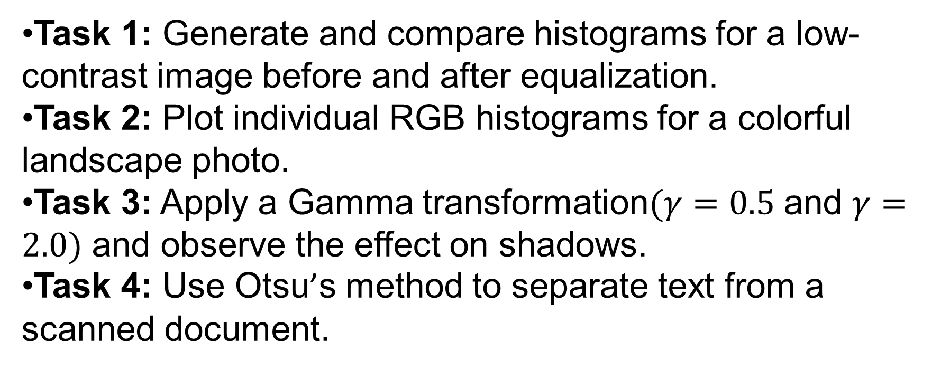
Lab Tasks (Student Exercises)
Task 1: Generate and compare histograms for a low-contrast image before and after equalization.
Task 2: Plot individual RGB histograms for a colorful landscape photo.
Task 3: Apply a Gamma transformation$(γ=0.5$ and $γ=2.0)$ and observe the effect on shadows.
Task 4: Use Otsu’s method to separate text from a scanned document.

Slide 8
Summary & Best Practices
Pixel Transforms are "point operations"—the new value of a pixel depends only on its original value.
Visualization is Key: Always look at the histogram before deciding which transformation to apply.
Preparation for Next Week: These techniques are the prerequisite for Spatial Filtering (Blurring and Sharpening).

Slide 9
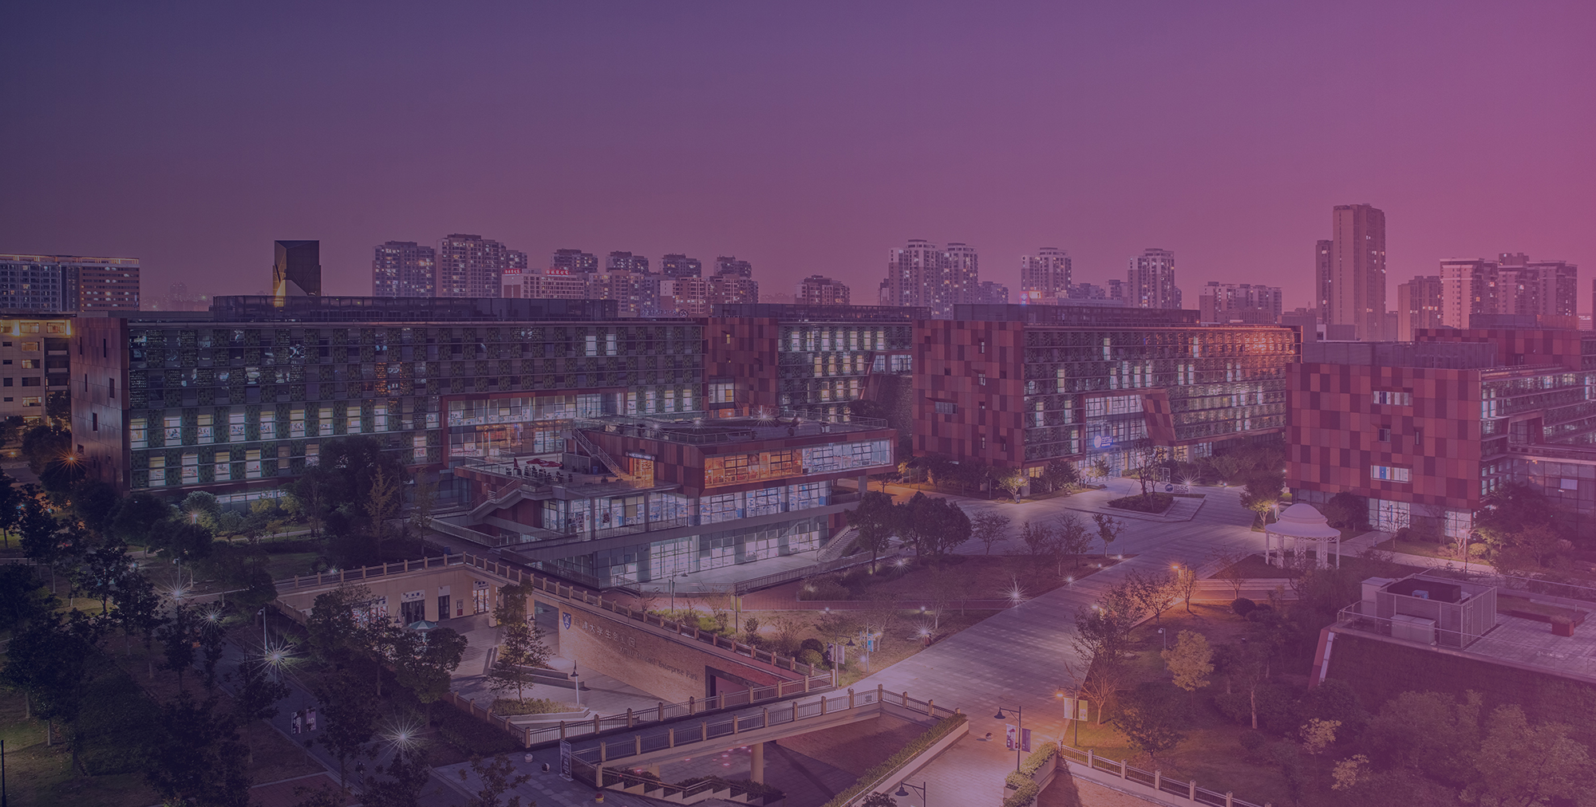


THANK YOU
Visit us
FOLLOW us
www.xjtlu.edu.cn

