Slide 1
Content Distribution Networks

Slide 2
Outline
Motivation
What is content distribution ?
Schemes for content distribution
  Web Caching
  Content Distribution Networks
  Peer-to-Peer File sharing (not covered)
CDN Internetworking
What content is/is not suitable for CDNs?
CDNs vs. Caches

Slide 3
Motivation: World Wide Wait
“slow access time” problem
The path contains a low-speed link.
The path contains at least one congested link.
The Web server is overloaded.

Slide 4
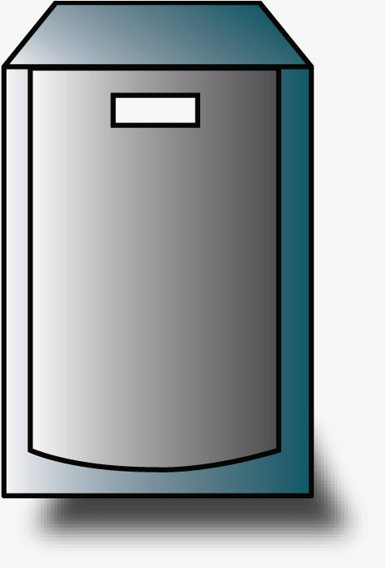

Slow Access Time Problem
World Wide Wait
Server Access Network
overloaded
CNN
network
Public Internet
CNN.com
congested link
low bandwidth link
ren.cis
eecis
Client Access Network

Slide 5
Server Farm
Server-1
Server-2
Server-n
Requests = R/n
L4-L7 Switch
Does load balancing
Requests = R
Internet

Slide 6
Client Network without a Web Cache
Total delay =
Internet delay +
Access delay
Internet delay=2 sec
Δ_{access link} = 15x100 Kb/1.5 Mbps = 1
Access delay =
HUGE
1.5 Mbps access link
Avg. object size = 100 Kbits
15 requests/sec
Δ_{LAN} = 15x100 Kb/100 Mbps = 0.015
100 Mbps LAN
Δ – traffic intensity

Slide 7
Web Cache: Basic operation
Web server
GET
Object present ?
No-> Fetch Object
Yes-> Send Object
RESPONSE
RESPONSE
RESPONSE
GET
GET
Cache
Client 1

Slide 8
Web Cache
Internet delay=2 Sec
Total delay =
(2 + .01) x 0.6 = 1.2 Sec
delay = tens of milliseconds
Δ_{AL} = 0.6
1.5 Mbps access link
Institutional
cache
Hit rate = 0.4
100 Mbps LAN
Δ – traffic intensity

Slide 9
Content Distribution Network of Caches
Web server
Web server
Parent
Proactive replication
Child 1
Child 2

Slide 10
Problems with discussed approaches:
Server farms and Caching proxies
Server farms do nothing about problems due to network congestion, or to improve latency issues due to the network
Caching proxies serve only their clients, not all users on the Internet
Content providers (say, Web servers) cannot rely on existence and correct implementation of caching proxies
Accounting issues with caching proxies.
For instance, www.cnn.com needs to know the number of hits to the advertisements displayed on the webpage.

Slide 11
CDN: Basic Idea
original content
Replica
congested
Replica
Not congested
Client

Slide 12
Content Distribution Networks
Mechanism for
replicating content on multiple servers in the internet.
providing clients with a means to determine the servers that can deliver the content fastest.

Slide 13
Terminology
Content: Any publicly accessible combination of text, images, applets, frames, MP3, video, flash, virtual reality objects, etc.
Content Provider: Any individual, organization, or company that has content that it wishes to make available to users.
Origin Server: Content providers server , where the content is first uploaded.
Surrogate Server: Content distributor’s server, where the replicated content is kept.

Slide 14
Players of the game
Yahoo,
MSNBC,
CNN
Content Provider
Send content
Content
Distributor
Akamai,
Digital Island,
AT&T
Sells servers
Install servers
Cisco,
Lucent,
Inktomi,
CacheFlow
H/W and S/W
Vendor
Hosting
Provider
Exodus

Slide 15
CDN: Distribution
Origin server in
North America
push content
Akamai CDN
CDN distribution node
push content
push content
CDN server in South
America
push
content
CDN server in Asia
CDN server in
Europe

Slide 16
CDN: Functional Components
Distribution Service
Redirection Service
Accounting and Billing system

Slide 17
CDN: Architecture
Origin
CDN
Request
Routing
Infrastructure
Distribution
and
Accounting
Infrastructure
Surrogate
Surrogate
Client

Slide 18
CDN: Request Routing Mechanisms
Best surrogate selected based on some metrics.
Techniques
  DNS based request routing
  Content Modification (URL rewriting)
  Anycast based
  Transport layer request routing
  Combination of multiple mechanisms

Slide 19
CDN: DNS based Request Routing
Measure to client DNS
www.cnn.com
Results
Akamai DNS
63.251.132.22
surrogate
63.210.135.39
ping
surrogate
www.cnn.com
63.251.132.22
ping
Session
www.cnn.com
63.251.132.22
Local DNS Server
128.4.4.12

Slide 20
Content Modification
CNN.com
Authoritative DNS server for cdn.com
PUT /images/*.gif
64.236.24.28
Index.html
GET www.cnn.com/index.html
DNS query: cdn.com ?
Index.html
64.236.24.28
...
<img src="http://www.cdn.com/cnn/images/1.gif”>
...
GET /cnn/images/1.gif
1.gif
DNS query: cdn.com ?
64.236.24.28
Client
Local DNS server

Slide 21
Metrics
Network Proximity (Surrogate to Client):
  Network hops (traceroute)
  RTT
  Internet mapping services (NetGeo, IDMaps)
  …
Surrogate Load:
  Number of active TCP connections
  HTTP request arrival rate
  Other OS metrics
  …
Bandwidth Availability

Slide 22
Full site delivery vs. Partial Site Delivery
Full Site Delivery : All the contents are delivered by the CDN (including HTML, images, and other objects).
Partial Site delivery: Only images, streaming media and other bandwidth intensive objects delivered by the CDN.

Slide 23
Content Distribution Internetworking: CDI
Interconnection of Content Networks – collaboration between caching proxies and CDNs, as well as between individual CDNs
Greater reach, larger scale, higher capacity, increased fault tolerance
Basic architecture involves gateways between various content networks

Slide 24
CDI: Architecture
Digital Island
ATT
Akamai
comcast
Cache network
Content Peering Gateway

Slide 25
Content Suitable for CDNs
Images
High-volume e-commerce transactions (thanksgiving sale)
Streaming media (audio and video) (media events)
Java Applets
Virtual Reality Objects
Flash content
Content NOT Suitable for CDNs
Personalized content (my.yahoo.com,…)
Dynamic Content
Secure Content

Slide 26
CDN vs. Caching Proxies
Caching Proxies | CDN
Used by ISP to reduce bandwidth consumption. | Used by Content Providers to increase QoS.
Operate Reactively | Operate Proactively
Caching proxies cater to their users (web clients) and not to content providers (web servers) | CDNs cater to the content providers (web servers) and clients
Caching proxies do not give control of the content to the content providers. | CDNs do

Slide 27
Summary and References
Caching
CDN
DNS based Request Routing
CDI
References:
Michael Rabinovich and Oliver Spatsheck, “Web Caching and
Replication “, Addison-Wesley 2001.
PPT slides by Janardhan Iyengar on “Overlay Networks”
PPT slides by Brad Cain on “Interconnection of Content Delivery Networks”
http://www.cis.udel.edu/~girish/856/cdn-bib.pdf

Slide 28
Questions
?

Slide 29
Proxy deployments
Non-transparent
      Explicit client configuration
      Browser auto configuration
      Proxy auto discovery
Transparent
      Connection “Hijacking” or interception.

Slide 30
Transparent proxy deployment:
Connection “Hijacking”
Internet
Other traffic
TCP port 80 traffic
ISP
Proxy

Slide 31
Client IP = a1
Proxy IP = a2
Origin Server IP = a3
SYN(a1 to a3)
SYN/ACK(a3 to a1)
ACK/HTTP request (a1 to a3)
SYN(a2 to a3)
SYN/ACK(a3 to a2)
ACK/HTTP request (a2 to a3)
Data (a3 to a2)
Data (a3 to a1)

