Slide 1
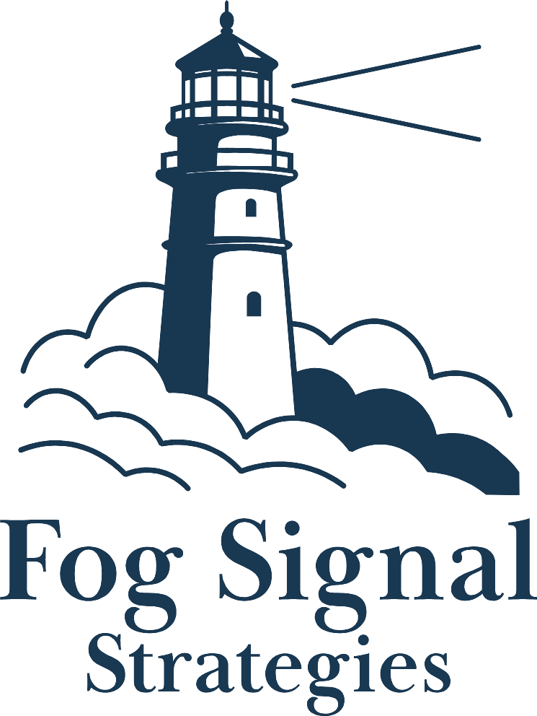
Bond Feasibility Survey
Results Presentation
Colorado Springs School District No. 11
Prepared by Fog Signal Strategies | March 2026

Slide 2





About Fog Signal Strategies
Strategic communications guidance for communities navigating their most critical moments.
Campaign Services
Research & Insights
Full-service campaign strategy for tax measures, school bonds, and local initiatives. 250+ campaigns advised nationwide.
Feasibility research, voter opinion surveys, focus groups, demographic analysis, and message testing — not just political polls.
Community Outreach
Public Affairs
Engagement strategies that meet stakeholders where they are — in schools, at meetings, and at their doorsteps.
Policy, stakeholder engagement, media strategy, and legislative communications for public agencies and coalitions.

Slide 3
Our Research Track Record
98%
250+
Campaigns advised nationwide across school, municipal, and special district measures
$2B+
In approved public funds supported by our research and strategic guidance
Accuracy Rate on Bond Measures
When our feasibility research indicates a measure is viable, it passes on Election Day 98% of the time.
15
Person national team with research, strategy, and creative under one roof
Recent Bond Measure Wins
65.87% Yes
$950M
66.42% Yes
$408M
57.83% Yes
$675M
San Juan USD
Fontana USD
Desert Sands USD
Sacramento County, CA (2024)
San Bernardino County, CA (2024)
Riverside County, CA (2024)

Slide 4



Why Feasibility Research, Not a Political Poll?
A political poll and feasibility research serve fundamentally different purposes.
The Goal of a Political Poll
The Goal of Feasibility Research
Capture a snapshot of voter sentiment at a single point in time. Useful for campaigns tracking a horse race, but not designed to test whether a measure can survive opposition.
Determine whether a measure can win on Election Day by stress-testing support against the strongest opposition arguments voters will actually encounter.
What This Means in Practice
Three Sequential Ballot Tests
25 Arguments Tested
Vulnerability Mapping
We measure initial support, then re-test after positive messaging, and again after the strongest opposition attacks — simulating the full campaign voters will experience.
12 positive and 13 negative arguments are presented to identify exactly which messages move voters and which attacks pose the greatest risk.
Instead of just reporting a number, we map where support is soft, who is persuadable, and what the opposition's strongest lines of attack will be.

Slide 5


Survey Methodology
Sample
852 registered voters in CSSD11 with midterm voting history
Administration
Text-to-web and phone, February – March 2026
Margin of Error
±3.4% at 95% confidence (more than 2x the prior 400-person sample)
Instrument
~50 items: issue importance, education quality, 3 ballot tests, 13 project prefs, 25 arguments
Weighting
Post-stratification by age to match the midterm likely voter universe

Slide 6
Data Integrity: How We Build the Sample
We don’t ask voters to tell us who they are — we already know.
Why We Don’t Use Self-Reported Demographics
Protecting the Bond’s Image
Demographic data — age, party registration, voting history, and geographic location — is sourced from five independent databases, including voter files from both major political parties. This eliminates the need to ask respondents to self-identify.
Self-reported data introduces bias: voters may misremember, round their age, or feel social pressure when asked about political affiliation. By using verified third-party records, we remove that variable entirely.
This survey was sent to over 20,000 registered voters. Asking political leaning questions would signal a political affiliation that the bond measure does not have — potentially harming the district’s reputation and the measure’s nonpartisan positioning.
Accounting for Imperfect Records
No database is perfect — some records may have outdated phone numbers or mismatched addresses. These errors are far less frequent than self-reporting inaccuracies, and we account for them in our margin of error calculations. That’s also why we targeted 852 completed responses: a large sample absorbs individual data imperfections.
Five data sources · Both major party voter files · No political leaning questions asked · 20,000+ voters contacted · 852 completed responses

Slide 7
Community Issue Priorities
"How important are each of the following issues to you?" (% Very Important)

Slide 8
Quality of Education Perceptions
39.3%
rate education positively
6% Excellent + 33.3% Good
45.3%
"Fair" or "Not Sure"
The largest persuadable audience — reachable through factual information
15.4%
rate education negatively
9.2% Poor + 6.2% Very Poor

Slide 9
Initial Ballot Test: Majority Support
58.5%
YES
31.0% Definitely Yes + 27.5% Probably Yes
31.3%
10.2%
NO
NOT SURE
Exceeds TABOR’s 50%+1 threshold. Stronger starting position than the 2021 bond (Issue 4B), which failed by just 11 votes.

Slide 10
Support Across Demographics: All Three Ballot Tests
% Probably or Definitely Yes at each stage of the survey
Support starts above 50% in every demographic and remains at or near majority even after the full opposition stress test. This is not a partisan issue.

Slide 11
Voter Priorities for Bond Funds
"Which projects would you prioritize?" (% selected as top priority)

Slide 12
Cross-Partisan Consensus on Priorities
All three groups rank the same core building needs in their top priorities. Even opponents recognize the legitimacy of the facility needs.

Slide 13
Strongest Positive Arguments
67%
Student safety & security
Fund increased safety measures to protect students and staff
67%
Career & technical education
Prepare students for healthcare, engineering, skilled trades
66%
Save money long-term
Aging buildings waste energy; upgrading saves on operating costs
66%
Fix aging facilities
Give all students access to 21st-century learning environments
Positive arguments reinforce existing support but have limited power to convert opponents — typical in feasibility research.

Slide 14
Opposition Vulnerabilities
The strongest attacks center on trust and accountability
76%
Board not transparent about school closures
74%
District has history of financial mismanagement
73%
No legally binding guarantee on spending
73%
$55M/year tax burden hurts families & seniors
71%
Bad time to raise taxes (inflation, high prices)
Opposition arguments routinely outperform positives in survey research. Testing them identifies vulnerabilities so a campaign can prepare. Many rely on emotional framing, not factual claims.

Slide 15
Ballot Test Journey
Support holds through the full stress test
The 7-point decline is typical of bond feasibility studies. Final support of 51.5% still clears the 50%+1 threshold even after full opposition exposure.

Slide 16
Vote Movement: Initial to Final
Initial Yes Voters
Initial Undecided
Initial No Voters
n = 498
n = 87
n = 267
74.1%
33.3%
77.9%
held firm
moved to Yes
remained No
16.7%
33.3%
15.4%
moved to No
moved to No
moved to Yes
9.2%
33.3%
6.7%
undecided
stayed undecided
undecided
Campaign priority: Harden the 26% of soft Yes voters who weakened under opposition messaging.

Slide 17
Comparison to Previous Polling
Cygnal — June 2025
Fog Signal — March 2026
400 respondents · ±4.88% MoE
852 respondents · ±3.4% MoE
+4.2 pts
−6.5 pts
2.1×
+1.5 pts
Initial Yes (54.3% → 58.5%)
Undecided (16.7% → 10.2%)
Sample Size (400 → 852)
Post-Messaging Yes (50% → 51.5%)

Slide 18





Key Takeaways
The bond measure is feasible
58.5% initial support exceeds TABOR’s 50%+1 threshold — stronger than the 2021 bond that failed by just 11 votes.
Support is broad and nonpartisan
Majority support across party lines, age groups, and school connection status.
Voters agree on what matters
Health, safety, and infrastructure are top priorities across all voter groups.
A proactive campaign is essential
Harden soft support and compete for undecideds through factual public information.
The data is stronger than ever
Support up, undecideds down, margin of error tighter vs. 2025 benchmark.

Slide 19
Recommended Next Steps
1
Community Awareness & Engagement
Launch the community engagement plan: town halls, listening sessions, school tours, and stakeholder meetings to build awareness around facility needs.
2
Measure Development & Refinement
Refine ballot language, funding structures, and accountability provisions based on voter priorities identified in this survey.
3
Messaging & Public Information
Develop factual messaging and FAQs addressing top voter concerns — especially transparency, financial oversight, and the tax impact.
4
Harden Soft Support
Target the 26% of Yes voters who weakened under opposition attacks with proactive factual information before opponents frame the narrative.
5
Prepare for the Ballot
Finalize measure structure, coordinate board approval timeline, and ensure full TABOR compliance ahead of the November 2026 election.

Slide 20

Questions & Discussion
Fog Signal Strategies
Carter James
cjames@fogsignalstrategies.com

