Slide 1
影像處理 03 強度轉換與空間濾波
教師:許閔傑、蕭兆翔
助教:莊媞涵

Slide 2
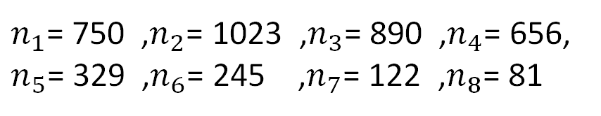



直方圖等化例題(1) 問題
假設有一張8階的64×64灰階影像，運用直方圖等化(HE)
找出轉換函數s=T(r)。
$n_{1}$= 750 ,$n_{2}$= 1023 ,$n_{3}$= 890 ,$n_{4}$= 656,
$n_{5}$= 329 ,$n_{6}$= 245 ,$n_{7}$= 122 ,$n_{8}$= 81
影像包含64×64=4096個像素。
$$CDF\left(r_{8}\right)=\sum_{i=1}^{8}{PMF\left(r_{i}\right)}$$
$=n_{1}+n_{2}+…n_{8}$
$=4096$
統計像素個數$n_{k}$
灰階$r_{k}$

Slide 3

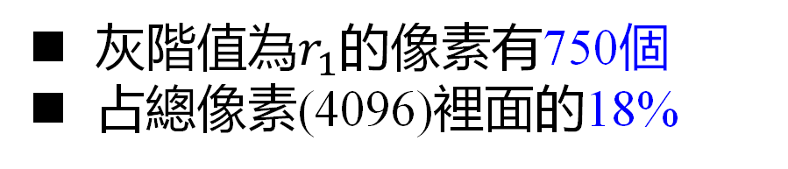

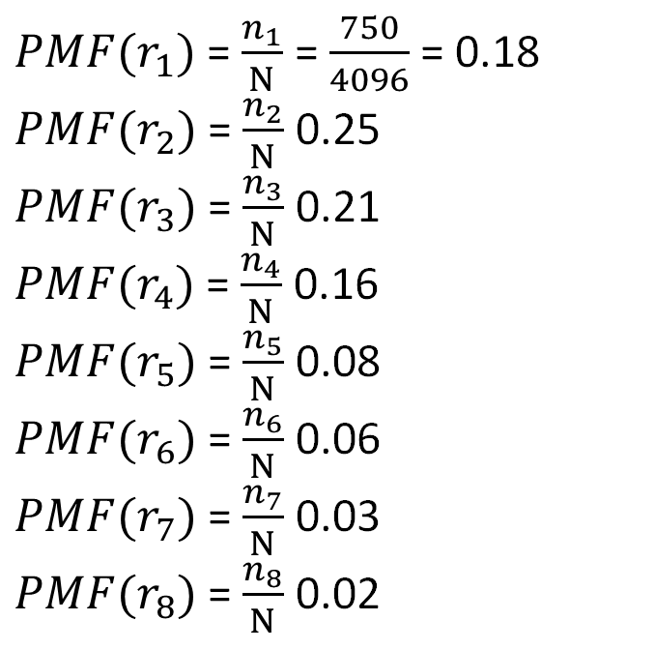

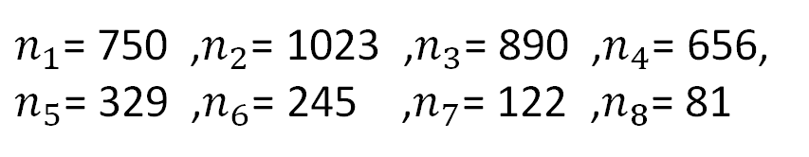
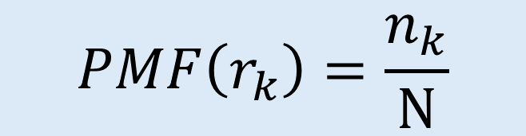
直方圖等化例題(1) 步驟一 計算PMF
$$PMF\left(r_{k}\right)=\frac{n_{k}}{N}$$
$n_{1}$= 750 ,$n_{2}$= 1023 ,$n_{3}$= 890 ,$n_{4}$= 656,
$n_{5}$= 329 ,$n_{6}$= 245 ,$n_{7}$= 122 ,$n_{8}$= 81
${PMF(r}_{1})$ = $\frac{n_{1}}{N}$ = $\frac{750}{4096}$ = 0.18
${PMF(r}_{2})$ = $\frac{n_{2}}{N}$ 0.25
${PMF(r}_{3})$ = $\frac{n_{3}}{N}$ 0.21
${PMF(r}_{4})$ = $\frac{n_{4}}{N}$ 0.16
${PMF(r}_{5})$ = $\frac{n_{5}}{N}$ 0.08
${PMF(r}_{6})$ = $\frac{n_{6}}{N}$ 0.06
${PMF(r}_{7})$ = $\frac{n_{7}}{N}$ 0.03
${PMF(r}_{8})$ = $\frac{n_{8}}{N}$ 0.02
灰階值為$r_{1}$的像素有750個
占總像素(4096)裡面的18%
25%
18%
2%
灰階$r_{k}$
$$r_{1}$$
$$r_{8}$$

Slide 4
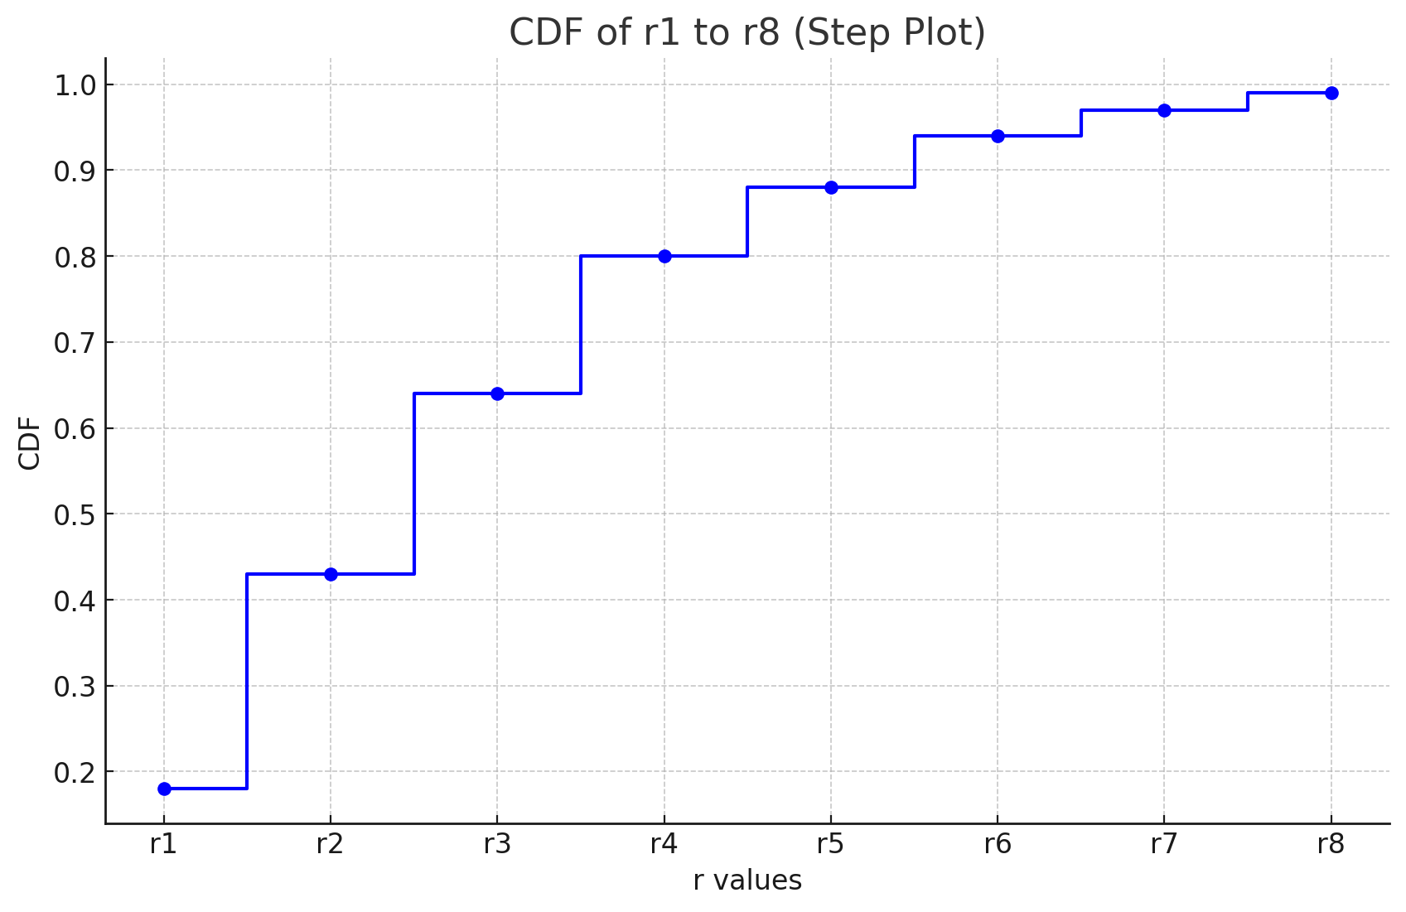
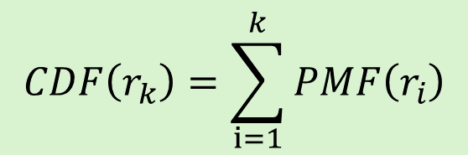
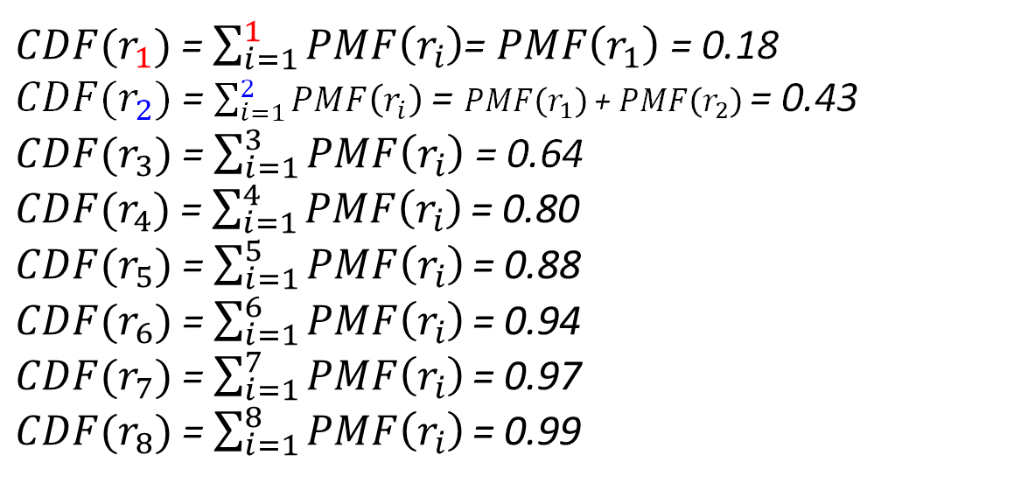
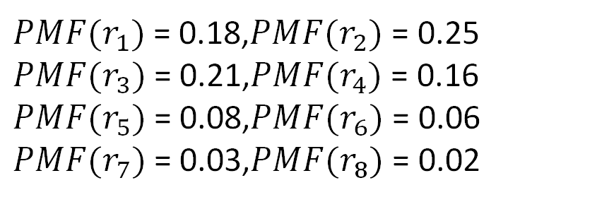
直方圖等化例題(1) 步驟二 計算CDF
${PMF(r}_{1})$ = 0.18,${PMF(r}_{2})$ = 0.25
${PMF(r}_{3})$ = 0.21,${PMF(r}_{4})$ = 0.16
${PMF(r}_{5})$ = 0.08,${PMF(r}_{6})$ = 0.06
${PMF(r}_{7})$ = 0.03,${PMF(r}_{8})$ = 0.02
$$CDF\left(r_{k}\right)=\sum_{i=1}^{k}{PMF\left(r_{i}\right)}$$
${CDF(r}_{1})$ = $\sum_{i=1}^{1}{PMF\left(r_{i}\right)}$= $PMF\left(r_{1}\right)$ = 0.18
${CDF(r}_{2})$ = $\sum_{i=1}^{2}{PMF\left(r_{i}\right)}$= $PMF\left(r_{1}\right)$ + $PMF\left(r_{2}\right)$ = 0.43
${CDF(r}_{3})$ = $\sum_{i=1}^{3}{PMF\left(r_{i}\right)}$ = 0.64
${CDF(r}_{4})$ = $\sum_{i=1}^{4}{PMF\left(r_{i}\right)}\text{= 0.}\text{80}$
${CDF(r}_{5})$ = $\sum_{i=1}^{5}{PMF\left(r_{i}\right)}\text{= 0.}\text{88}$
${CDF(r}_{6})$ = $\sum_{i=1}^{6}{PMF\left(r_{i}\right)}\text{= 0.}\text{94}$
${CDF(r}_{7})$ = $\sum_{i=1}^{7}{PMF\left(r_{i}\right)}\text{= 0.}\text{97}$
${CDF(r}_{8})$ = $\sum_{i=1}^{8}{PMF\left(r_{i}\right)}\text{= 0.}\text{99}$

Slide 5
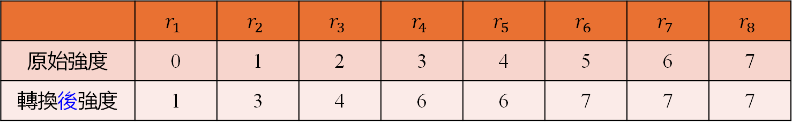



直方圖等化例題(1) 步驟三 計算s=T(r)
$$s_{k} =round(CDF\left(r_{k}\right)×(r_{max}−r_{min}))$$
$$s_{1} =round\left(CDF\left(r_{1}\right)×\left(7−0\right)\right)=round\left(0.18×7\right)=round\left(1.26\right)=1$$
$$s_{2} =round\left(CDF\left(r_{2}\right)×\left(7−0\right)\right)=round\left(0.43×7\right)=round\left(3.01\right)=3$$
…
 | $$r_{1}$$ | $$r_{2}$$ | $$r_{3}$$ | $$r_{4}$$ | $$r_{5}$$ | $$r_{6}$$ | $$r_{7}$$ | $$r_{8}$$
原始強度 | 0 | 1 | 2 | 3 | 4 | 5 | 6 | 7
轉換後強度 | 1 | 3 | 4 | 6 | 6 | 7 | 7 | 7
25%
25%
24%
18%
18%
21%
11%
2%
灰階$r_{k}$
灰階$r_{k}$
$$r_{1}$$
$$r_{8}$$
$$r_{1}$$
$$r_{8}$$

Slide 6
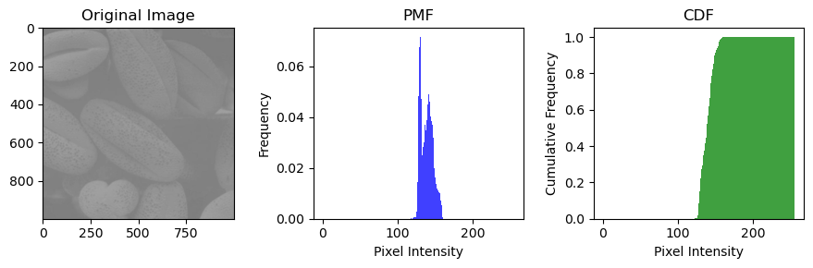
原始影像PMF、CDF

Slide 7
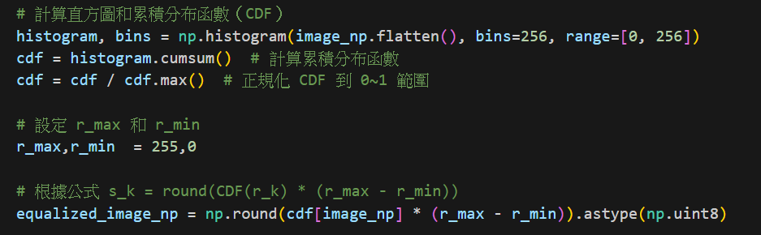
程式
Image_np
cdf[Image_np]
146 | 150 | 150
130 | 146 | 150
130 | 130 | 146
82.2% | 91.1% | 91.1%
22.3% | 82.2% | 91.1%
22.3% | 22.3% | 82.2%
查表，根據每個像素強度找到對應的CDF值
例如: CDF[146] = 0.822
表示強度146 的累積分佈有82.2%

Slide 8
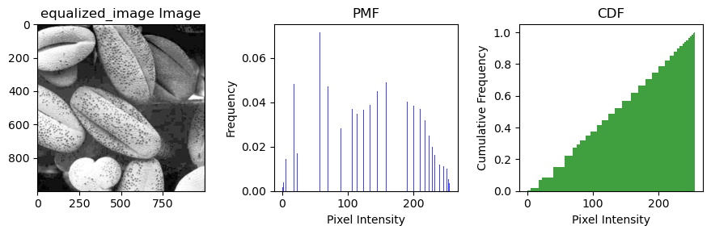
HE後影像PMF、CDF

Slide 9
比較

Slide 10
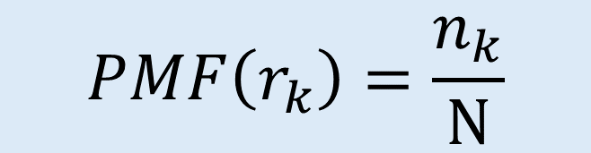


直方圖等化例題(1) 步驟一 計算PMF
$n_{1}$= 750 ,$n_{2}$= 1023 ,$n_{3}$= 890 ,$n_{4}$= 656,
$n_{5}$= 329 ,$n_{6}$= 245 ,$n_{7}$= 122 ,$n_{8}$= 81
統計像素個數$n_{k}$
$$PMF\left(r_{k}\right)=\frac{n_{k}}{N}$$
$$CDF\left(r_{k}\right)=\sum_{i=1}^{k}{PMF\left(r_{i}\right)}$$
灰階$r_{k}$

Slide 11
直方圖等化例題(1) 步驟三 計算s=T(r)
$$s_{k} =round(CDF\left(r_{k}\right)×(r_{max}−r_{min}))$$
$$s_{1} =round\left(CDF\left(r_{1}\right)×\left(7−0\right)\right)=round\left(0.18×7\right)=round\left(1.26\right)=1$$
$$s_{2} =round\left(CDF\left(r_{2}\right)×\left(7−0\right)\right)=round\left(0.43×7\right)=round\left(3.01\right)=3$$
…
 | $$r_{1}$$ | $$r_{2}$$ | $$r_{3}$$ | $$r_{4}$$ | $$r_{5}$$ | $$r_{6}$$ | $$r_{7}$$ | $$r_{8}$$
原始強度 | 0 | 1 | 2 | 3 | 4 | 5 | 6 | 7
轉換後強度 | 1 | 3 | 4 | 6 | 6 | 7 | 7 | 7
25%
25%
24%
18%
18%
21%
11%
2%
灰階$r_{k}$
灰階$r_{k}$
$$r_{1}$$
$$r_{8}$$
$$r_{1}$$
$$r_{8}$$

