Slide 1
影像處理 期中複習
教師:蕭兆翔
助教:陳信宏

Slide 2
第2章:索引、雙線性內插、仿射
Chapter 2: Indexing, Bilinear Interpolation, and Affine Transformation

Slide 3


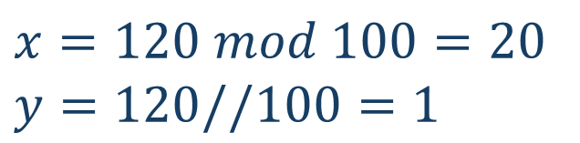
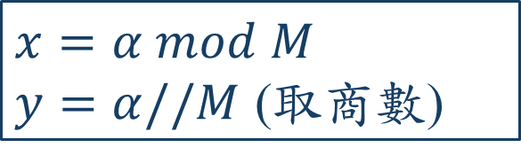
範例一:影像索引2D
M=100
x
Q:
已知索引值$α=120$,求(x,y)座標
Given the index value $α$, find (x,y).
N=50
Solution:
$$x=α mod M$$
$y=α//M$ (取商數)
$$x=120 mod 100=20$$
$y=120//100=1$
y
Ans:
(x,y) = (20,1)
#

Slide 4

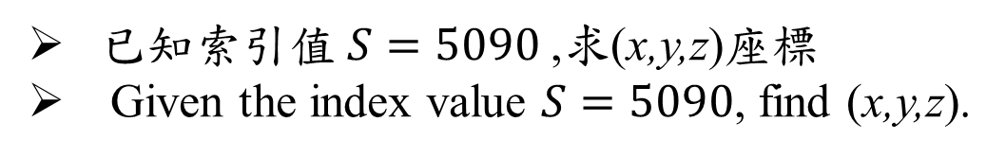
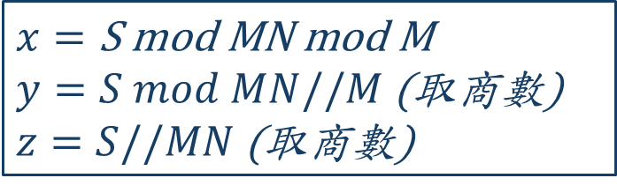
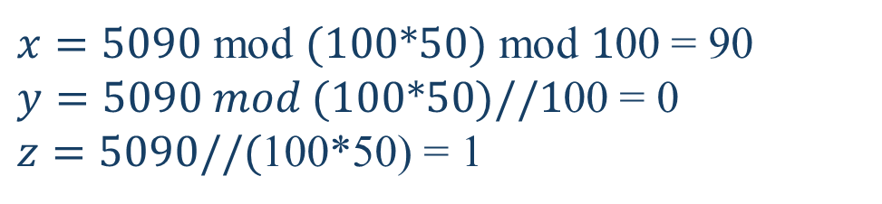
範例二:影像索引3D
z
Q:
已知索引值$S=5090$,求(x,y,z)座標
Given the index value $S=5090$, find (x,y,z).
P=60
M=100
x
$$x=\text{S} \text{mod} \text{MN} \text{mod} \text{M}$$
$y=S mod MN//M$ (取商數)
$z=S//MN$ (取商數)
Solution:
N=50
$x=5090 \text{mod} (100∗50) \text{mod} 1$00 = 90
$y=5090 mod (100∗50)//1$00 = 0
$z=5090//($100*50) = 1
y
Ans:
(x,y,z) = (90,0,1)
#

Slide 5
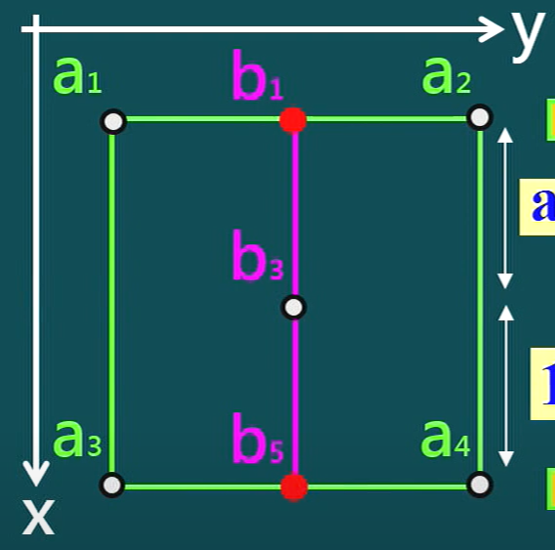


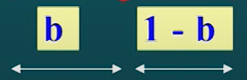
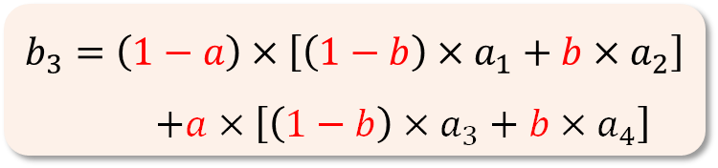
2-D 雙線性內插法(Bilinear Interpolation)
1-D線性內插法
$$f\left(n+a\right)=\left(1−a\right)×f\left(n\right)+a×f\left(n+1\right)$$
2-D線性內插法
$$b_{3}=\left(1−a\right)×\left[\left(1−b\right)×a_{1}+b{×a}_{2}\right]$$
$+a×\left[\left(1−b\right)×a_{3}+b{×a}_{4}\right]$

Slide 6




範例三:雙線性內插(Bilinear interpolation)
Q:
利用雙線性內插法，計算 f(2.7, 3.6) 的影像強度。
Use bilinear interpolation to compute f(2.7, 3.6) given the four corner values.
1
b=0.7
Sol:
f(2,3)=
20
f(3,3)=
30
$$b_{1}=\left(1−b\right)×a_{1}+b{×a}_{2}$$
$$b_{5}=\left(1−b\right)×a_{3}+b{×a}_{4}$$
a=0.6
$$b_{3}=\left(1−a\right)×b_{1}+a{×b}_{5}$$
1
f(2$.7,3$.6)=?
0.3×20 + 0.7×30 = 27
0.3×70 + 0.7×80 = 77
0.4×27 + 0.6×77 = 57
f(2,4)=
70
f(3,4)=
80
Ans:
f(2.7, 3.6) = 57
#

Slide 7
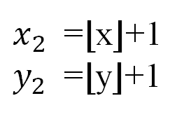

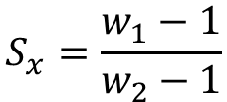
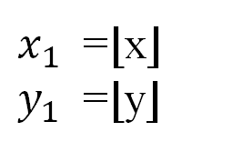

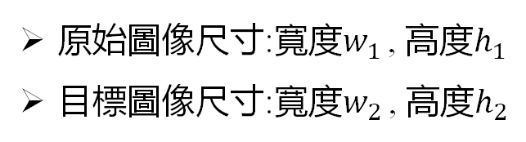
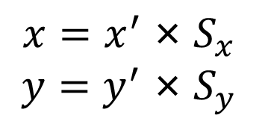


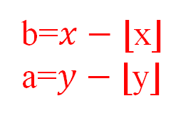

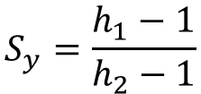

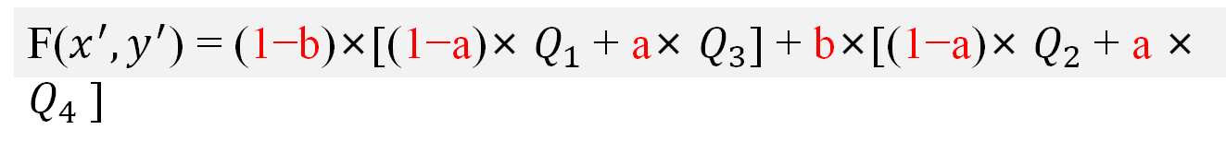
2-D 雙線性內插法 整理
Step1:縮放比例（Scaling Ratio）
Step3:計算目標圖值
原始圖像尺寸:寬度$w_{1}$ , 高度$h_{1}$
目標圖像尺寸:寬度$w_{2}$ , 高度$h_{2}$
$x_{1}$​ =⌊x⌋
$y_{1}$​ =⌊y⌋
$x_{2}$​ =⌊x⌋+1
$y_{2}$​ =⌊y⌋+1
b=$x−\text{⌊}\text{x}\text{⌋}$
a=$y−\text{⌊}\text{y}\text{⌋}$
b
$$S_{x}=\frac{w_{1}−1}{w_{2}−1}$$
$$S_{y}=\frac{h_{1}−1}{h_{2}−1}$$
$Q_{1}:$f($x_{1}$, $y_{1}$)
$Q_{2}:$f($x_{2}$, $y_{1}$)
a
Step2:映射到原圖
F($x^{′},y^{′}$)
要算目標圖F($x^{′},y^{′}$)的值
先算映射到原圖的f(x,y)
$Q_{3}:$f($x_{1}$, $y_{2}$)
$Q_{4}:$f($x_{2}$, $y_{2}$)
$${x=x^{′} \text{×} S}_{x}$$
$${y=y^{′} \text{×} S}_{y}$$
F($x^{′},y^{′}$) = (1−b)×[(1−a)× $Q_{1}$+ a× $Q_{3}$] + b×[(1−a)× $Q_{2}$+ a × $Q_{4}$]

Slide 8
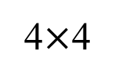
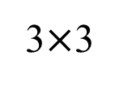
2-D 雙線性內插法 範例Example 2
Question: Using 2-D bilinear interpolation, find the value of the pixel marked ‘?’ in the $4×4$image.
4$×$4
3$×$3
 | ?
10 | 20 | 30
40 | 50 | 60
70 | 80 | 90

Slide 9
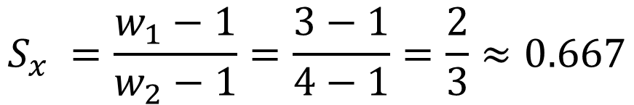
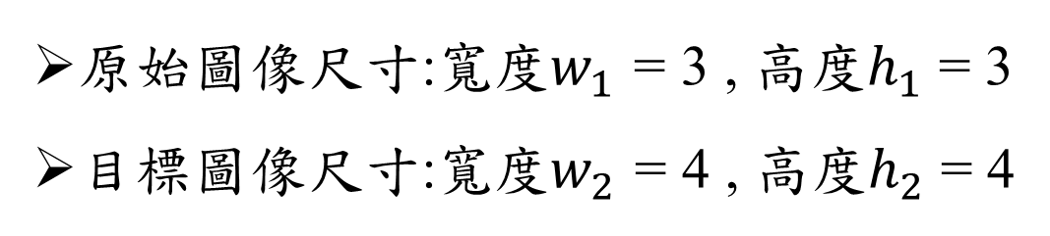
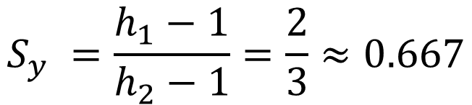
Step1:計算縮放比例
原始圖像尺寸:寬度$w_{1}$ = 3 , 高度$h_{1}$ = 3
目標圖像尺寸:寬度$w_{2}$ = 4 , 高度$h_{2}$ = 4
$$S_{x} =\frac{w_{1}−1}{w_{2}−1}=\frac{3−1}{4−1}=\frac{2}{3}≈0.667$$
$$S_{y} =\frac{h_{1}−1}{h_{2}−1}=\frac{2}{3}≈0.667$$
這個就是縮放後
Pixel與Pixel間的距離

Slide 10
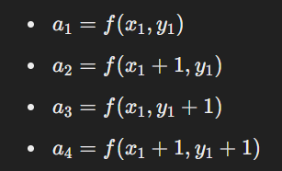





Step2:找鄰近四個點$α_{1}\sim α_{4}$
F: 目標圖
f:原圖
1
 | f(0.667,0.667)
 | ?
1
×0.667
F(1,1)
座標各減1 = 鄰近4個點
f(0,0) 10 | f(1,0) 20 | 30
f(0,1) 40 | f(1,1) 50 | 60
70 | 80 | 90
向下取整找$α_{1}$
f(0,0)
(0,0)
$$α_{1}$$
$$α_{2}$$
10 | 20 | 30
40 | 50 | 60
70 | 80 | 90
(1,0)
(0.67,0.67)
$$α_{3}$$
$$α_{4}$$
(0,1)
(1,1)

Slide 11
Step3:計算內插值(1)
1
1
0.667
0.6667 * 1 = 0.667
0.6667 * 1 = 0.667
0.667
10
20
10 | 20 | 30
40 | 50 | 60
70 | 80 | 90
10 | 20 | 30
40 | 50 | 60
70 | 80 | 90
0.667
40
50
F(1,1) = (1−0.6667)×[(1−0.6667)×10+0.6667×40]+
0.6667×[(1−0.6667)×20+0.6667×50] =36.6672

Slide 12
練習
Question: Using 2-D bilinear interpolation, find the value of the pixel marked ‘?’ in the $4×4$image.
4$×$4
3$×$3
 |  | ?
10 | 20 | 30
40 | 50 | 60
70 | 80 | 90
Ans: 63.36

Slide 13
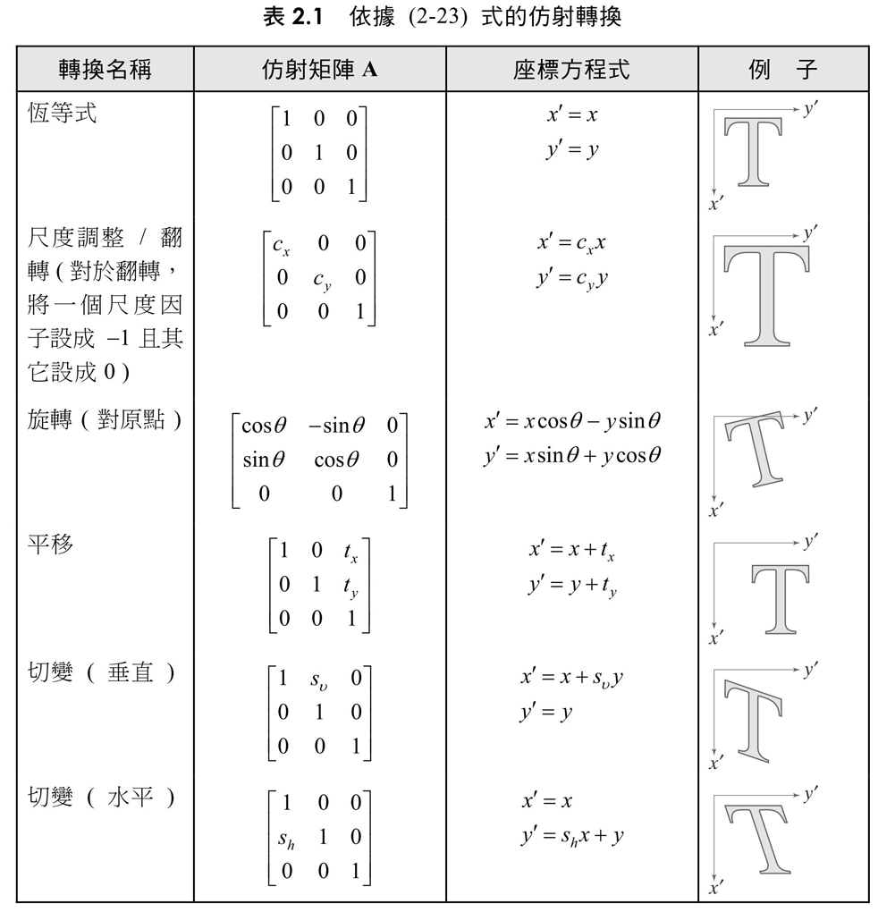
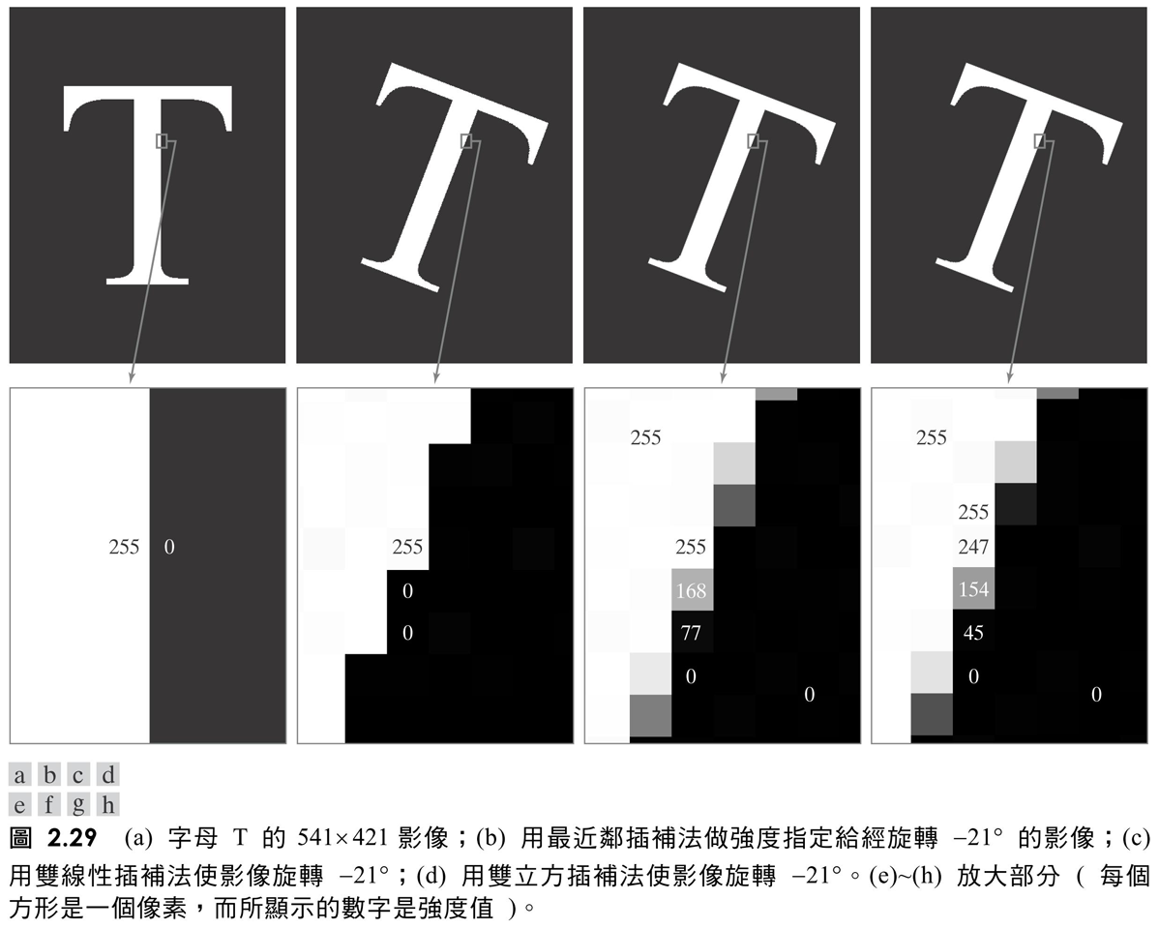
2.5 空間運算: 仿射轉換

Slide 14
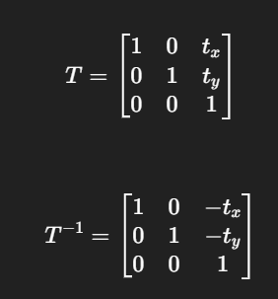
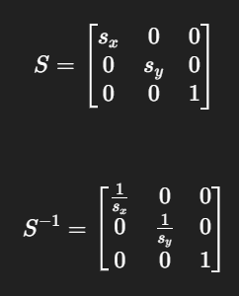
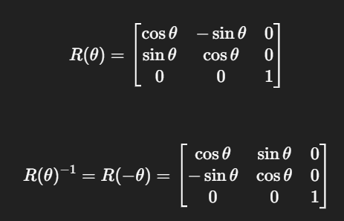
範例一:仿射轉換
寫出平移、縮放、旋轉 的仿射矩陣
寫出反平移、反縮放、反旋轉 的仿射矩陣
Q:
(可能抽幾個考而已)
(pick a few to test)
Write the affine matrices: translation, scaling, rotation
Write the inverse affine matrices: translation, scaling, rotation
Ans:
平移
translation
縮放
scaling
旋轉
rotation
反平移
inverse translation
反縮放
inverse scaling
反旋轉
inverse rotation

Slide 15
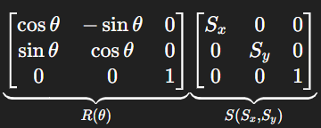
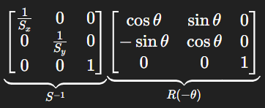
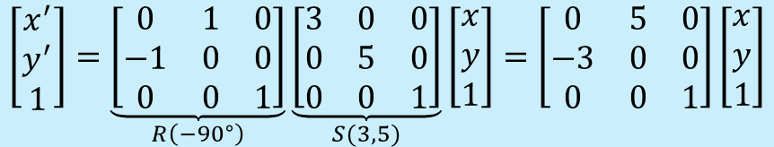
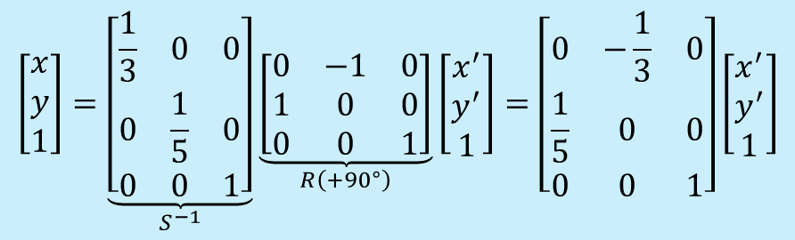
範例二:正逆仿射轉換
影像先縮放(S𝑥=3,S𝑦=5) ，再旋轉 𝜃 = -90 ∘
請寫出其仿射矩陣與逆仿射矩陣。
The image is first scaled (Sx=3, Sy=5), then rotated -90°.
Write its affine matrix and inverse affine matrix.
再轉R
先縮放S
ANS:
正向仿射矩陣
(affine matrix)
$$\left[\begin{matrix}x^{′} \\ y^{′} \\ 1\end{matrix}\right]=\underset{R\left(−{90}^{∘}\right)}{\underbrace{\left[\begin{matrix}0 & 1 & 0 \\ −1 & 0 & 0 \\ 0 & 0 & 1\end{matrix}\right]}}\underset{S(3,5)}{\underbrace{\left[\begin{matrix}3 & 0 & 0 \\ 0 & 5 & 0 \\ 0 & 0 & 1\end{matrix}\right]}}\left[\begin{matrix}x \\ y \\ 1\end{matrix}\right]=\left[\begin{matrix}0 & 5 & 0 \\ −3 & 0 & 0 \\ 0 & 0 & 1\end{matrix}\right]\left[\begin{matrix}x \\ y \\ 1\end{matrix}\right]$$
再反縮放
先反轉
ANS:
$$\left[\begin{matrix}x \\ y \\ 1\end{matrix}\right]=\underset{S^{−1}}{\underbrace{\left[\begin{matrix}\frac{1}{3} & 0 & 0 \\ 0 & \frac{1}{5} & 0 \\ 0 & 0 & 1\end{matrix}\right]}}\underset{R\left(+{90}^{∘}\right)}{\underbrace{\left[\begin{matrix}0 & −1 & 0 \\ 1 & 0 & 0 \\ 0 & 0 & 1\end{matrix}\right]}}\left[\begin{matrix}x^{′} \\ y^{′} \\ 1\end{matrix}\right]=\left[\begin{matrix}0 & −\frac{1}{3} & 0 \\ \frac{1}{5} & 0 & 0 \\ 0 & 0 & 1\end{matrix}\right]\left[\begin{matrix}x^{′} \\ y^{′} \\ 1\end{matrix}\right]$$
逆向仿射矩陣
(Inverse affine matrix)

Slide 16
第3章:直方圖等化、相關性、卷積
Chapter 3: Histogram Equalization, Correlation, and Convolution

Slide 17
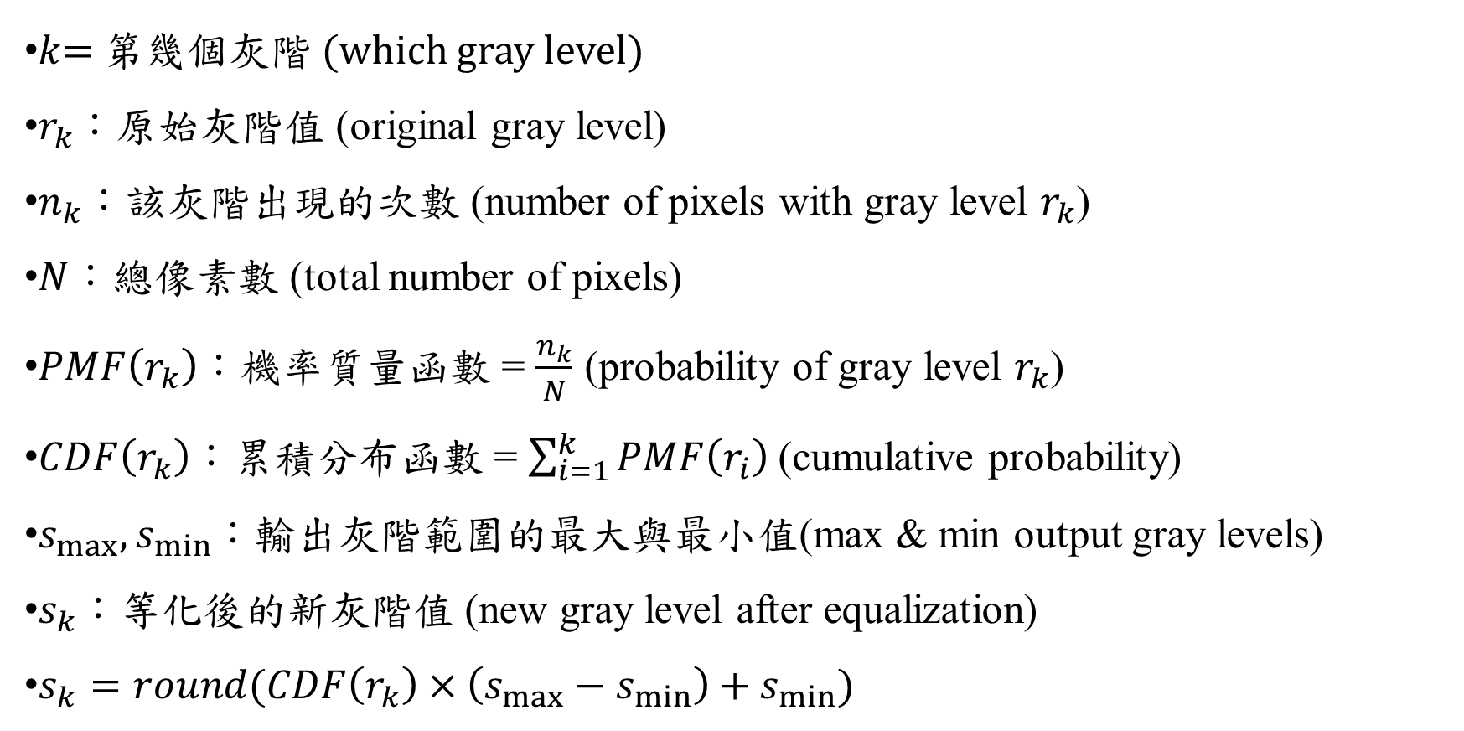
符號定義
$k$= 第幾個灰階 (which gray level)
$r_{k}$：原始灰階值 (original gray level)
$n_{k}$：該灰階出現的次數 (number of pixels with gray level $r_{k}$)
$N$：總像素數 (total number of pixels)
$PMF\left(r_{k}\right)$：機率質量函數 = $\frac{n_{k}}{N}$ (probability of gray level $r_{k}$)
$CDF\left(r_{k}\right)$：累積分布函數 = $\sum_{i=1}^{k}{PMF\left(r_{i}\right)}$(cumulative probability)
$s_{max},s_{min}$：輸出灰階範圍的最大與最小值(max & min output gray levels)
$s_{k}$：等化後的新灰階值 (new gray level after equalization)
$s_{k}=round(CDF\left(r_{k}\right)×\left(s_{max}−s_{min}\right)+s_{min})$

Slide 18

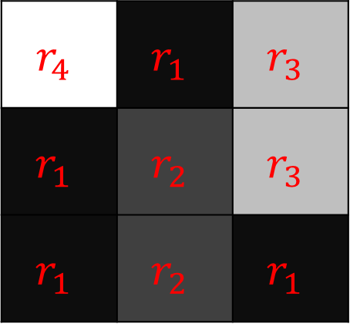
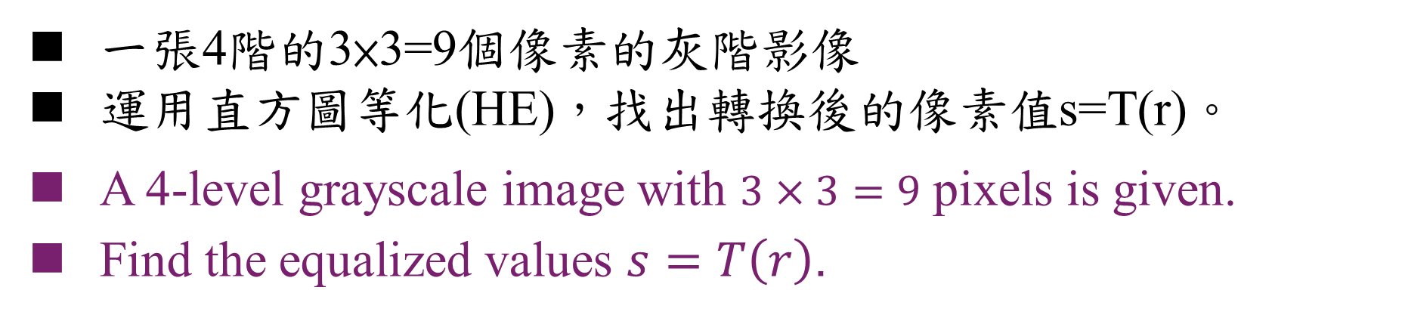
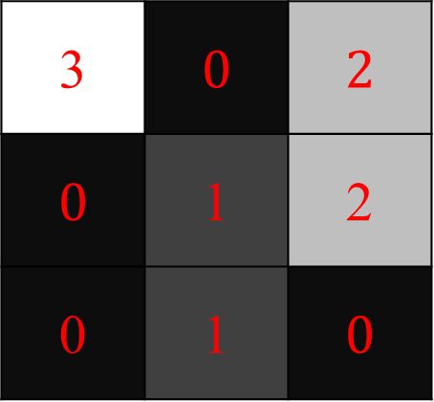
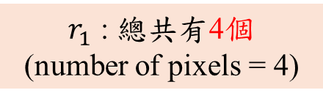
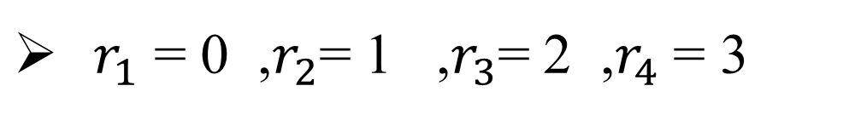
EX1:直方圖等化(Histogram Equalization)
一張4階的3×3=9個像素的灰階影像
運用直方圖等化(HE)，找出轉換後的像素值s=T(r)。
A 4-level grayscale image with $3×3=9$ pixels is given.
Find the equalized values $s=T\left(r\right)$.
$r_{1}$ = 0 ,$r_{2}$= 1 ,$r_{3}$= 2 ,$r_{4}$ = 3
$$r_{4}$$ | $$r_{1}$$ | $$r_{3}$$
$$r_{1}$$ | $$r_{2}$$ | $$r_{3}$$
$$r_{1}$$ | $$r_{2}$$ | $$r_{1}$$
3 | $0$ | $2$
$0$ | 1 | 2
0 | 1 | $0$
$n_{1}$= 4 ,$n_{2}$= 2 ,$n_{3}$= 2 ,$n_{4}$= 1
$r_{1}$ : 總共有4個
(number of pixels = 4)

Slide 19


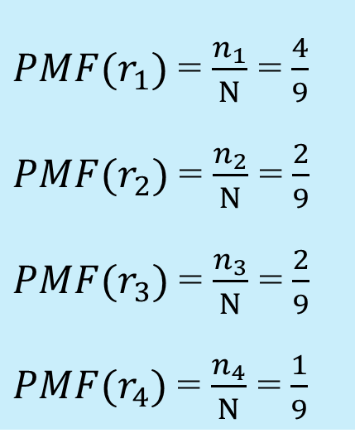
EX1:直方圖等化(HE) (1/3) 算PMF
一張4階的3×3=9個像素的灰階影像
運用直方圖等化(HE)，找出轉換後的像素值s=T(r)。
A 4-level grayscale image with $3×3=9$ pixels is given.
Find the equalized values $s=T\left(r\right)$.
${PMF(r}_{1})$ = $\frac{n_{1}}{N}$ = $\frac{4}{9}$
${PMF(r}_{2})$ = $\frac{n_{2}}{N}$ = $\frac{2}{9}$
${PMF(r}_{3})$ = $\frac{n_{3}}{N}$ = $\frac{2}{9}$
${PMF(r}_{4})$ = $\frac{n_{4}}{N}$ = $\frac{1}{9}$
$n_{1}$= 4 ,$n_{2}$= 2 ,$n_{3}$= 2 ,$n_{4}$= 1
會使用到的公式 :
$$PMF\left(r_{k}\right)=\frac{n_{k}}{N}$$

Slide 20
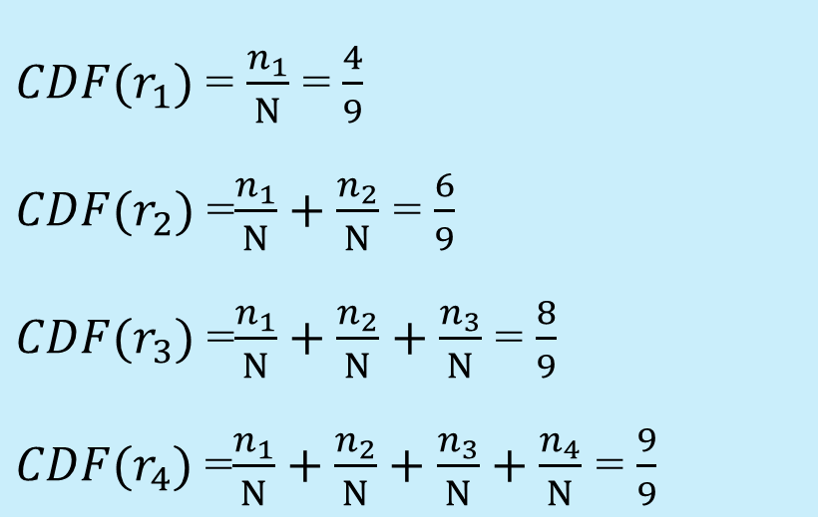

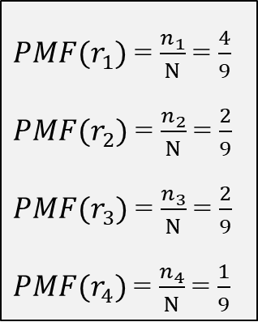
EX1:直方圖等化(HE) (2/3) 算CDF
${PMF(r}_{1})$ = $\frac{n_{1}}{N}$ = $\frac{4}{9}$
${PMF(r}_{2})$ = $\frac{n_{2}}{N}$ = $\frac{2}{9}$
${PMF(r}_{3})$ = $\frac{n_{3}}{N}$ = $\frac{2}{9}$
${PMF(r}_{4})$ = $\frac{n_{4}}{N}$ = $\frac{1}{9}$
${CDF(r}_{1})$ = $\frac{n_{1}}{N}$ = $\frac{4}{9}$
${CDF(r}_{2})$ =$\frac{n_{1}}{N}+\frac{n_{2}}{N}$ = $\frac{6}{9}$
${CDF(r}_{3})$ =$\frac{n_{1}}{N}+\frac{n_{2}}{N}+\frac{n_{3}}{N}$ = $\frac{8}{9}$
${CDF(r}_{4})$ =$\frac{n_{1}}{N}+\frac{n_{2}}{N}+\frac{n_{3}}{N}+\frac{n_{4}}{N}$ = $\frac{9}{9}$
會使用到的公式 :
$$CDF\left(r_{k}\right)=\sum_{i=1}^{k}{PMF\left(r_{i}\right)}$$

Slide 21
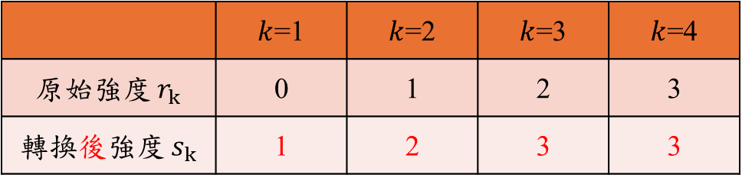
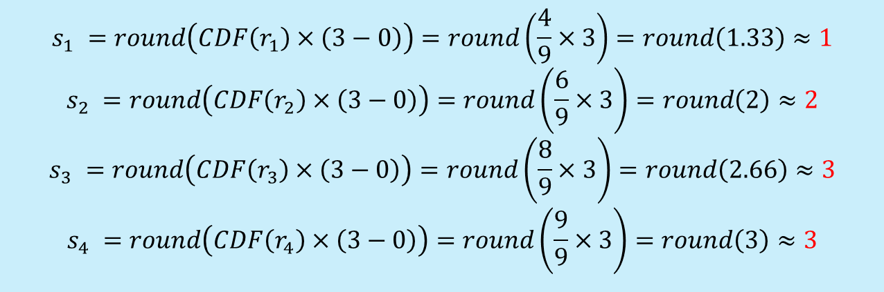
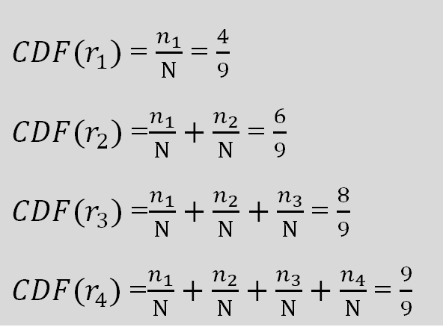
EX1:直方圖等化(HE) (3/3) 算s=T(r)
$$s_{k}=round(CDF\left(r_{k}\right)×\left(s_{max}−s_{min}\right)+s_{min})$$
$$s_{1} =round\left(CDF\left(r_{1}\right)×\left(3−0\right)\right)=round\left(\frac{4}{9}×3\right)=round\left(1.33\right)≈1$$
$$s_{2} =round\left(CDF\left(r_{2}\right)×\left(3−0\right)\right)=round\left(\frac{6}{9}×3\right)=round\left(2\right)≈2$$
$$s_{3} =round\left(CDF\left(r_{3}\right)×\left(3−0\right)\right)=round\left(\frac{8}{9}×3\right)=round\left(2.66\right)≈3$$
$$s_{4} =round\left(CDF\left(r_{4}\right)×\left(3−0\right)\right)=round\left(\frac{9}{9}×3\right)=round\left(3\right)≈3$$
${CDF(r}_{1})$ = $\frac{n_{1}}{N}$ = $\frac{4}{9}$
${CDF(r}_{2})$ =$\frac{n_{1}}{N}+\frac{n_{2}}{N}$ = $\frac{6}{9}$
${CDF(r}_{3})$ =$\frac{n_{1}}{N}+\frac{n_{2}}{N}+\frac{n_{3}}{N}$ = $\frac{8}{9}$
${CDF(r}_{4})$ =$\frac{n_{1}}{N}+\frac{n_{2}}{N}+\frac{n_{3}}{N}+\frac{n_{4}}{N}$ = $\frac{9}{9}$
 | $k$=1 | $k$=2 | $k$=3 | $k$=4
原始強度 $r_{k}$ | 0 | 1 | 2 | 3
轉換後強度 $s_{k}$ | 1 | 2 | 3 | 3
會使用到的公式 :
$$s_{k}=round(CDF\left(r_{k}\right)×\left(s_{max}−s_{min}\right)+s_{min})$$
#

Slide 22

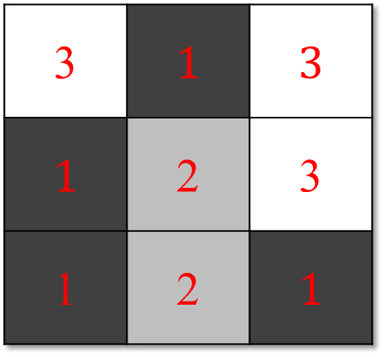
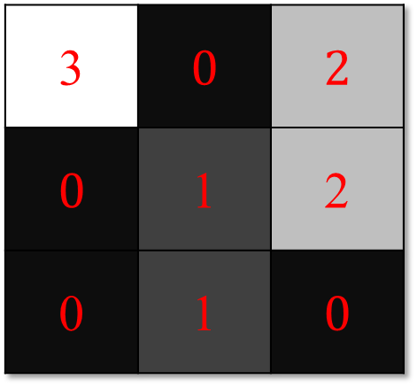
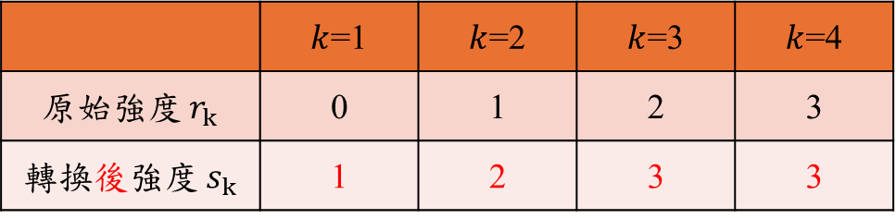
Extra Question
把算好的等化後灰階值 $s_{k}$填回原始影像。
Fill the equalized gray values $s_{k}$back into the original image.
 | $k$=1 | $k$=2 | $k$=3 | $k$=4
原始強度 $r_{k}$ | 0 | 1 | 2 | 3
轉換後強度 $s_{k}$ | 1 | 2 | 3 | 3
Before HE
After HE
3 | $0$ | $2$
$0$ | 1 | 2
0 | 1 | $0$
3 | $1$ | $3$
$1$ | 2 | 3
1 | 2 | $1$
#

Slide 23
Example1:相關性運算
5×5 大小影像
1 | 1 | 1 | 0 | 0
0 | 1 | 1 | 1 | 0
0 | 0 | 1 | 1 | 1
0 | 0 | 1 | 1 | 0
0 | 1 | 1 | 0 | 0
3×3 kernel
output
1 | 0 | 1
0 | 1 | 0
1 | 0 | 1
? | ? | ?
? | ? | ?
? | ? | ?
*
=

Slide 24
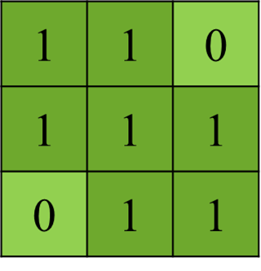
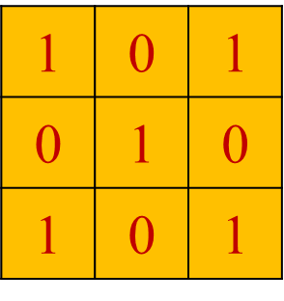
相關性運算
有一個影像f為大小為5*5，遮罩g大小為3*3，
求算f對g相關性運算，即 f☆g , padding = 0
做點積，同位置相乘，
之後全部相加
f
g
output
1 | 1 | 1 | 0 | 0
0 | 1 | 1 | 1 | 0
0 | 0 | 1 | 1 | 1
0 | 0 | 1 | 1 | 0
0 | 1 | 1 | 0 | 0
1 | 0 | 1
0 | 1 | 0
1 | 0 | 1
4 | 3 | 4
2 | 4 | 3
2 | 3 | 4
1 | 1 | 1
0 | 1 | 1
0 | 0 | 1
☆
=
Dot product: multiply matching elements, then sum the results.

Slide 25
補空白Pad
Padding=1 影像
(P=2時 會補兩圈0)
Padding後可以
往更左上角開始算
較不會損失邊緣特徵
影像
0 | 0 | 0 | 0 | 0
0 | 7 | 8 | 9 | 0
0 | 12 | 13 | 14 | 0
0 | 17 | 18 | 19 | 0
0 | 0 | 0 | 0 | 0
Kernel
1 | 0 | 0
0 | 1 | 0
0 | 0 | 1
0 | 0 | 0 | 0
0 | 7 | 8 | 9
0 | 12 | 13 | 14
0 | 17 | 18 | 19
7 | 8 | 9
12 | 13 | 14
17 | 18 | 19
1 | 0 | 0
0 | 1 | 0
0 | 0 | 1

Slide 26
卷積(Convolution)
f
g
有一個影像f為大小為3*3，遮罩g大小為3*3，求算f對g卷積，即 f＊g , padding = 1
1 | 2 | 3
4 | 5 | 6
7 | 8 | 9
1 | 2 | 3
4 | 5 | 6
7 | 8 | 9
＊
f
g上下顛倒，左右翻左後 成為g'
0 | 0 | 0 | 0 | 0
0 | 1 | 2 | 3 | 0
0 | 4 | 5 | 6 | 0
0 | 7 | 8 | 9 | 0
0 | 0 | 0 | 0 | 0
g'
output
9 | 8 | 7
6 | 5 | 4
3 | 2 | 1
26 | 56 | 54
84 | 165 | 144
134 | 236 | 186
0 | 0 | 0
0 | 1 | 2
0 | 4 | 5
9 | 8 | 7
6 | 5 | 4
3 | 2 | 1
＊
=
Dot product: multiply matching elements, then sum the results.

Slide 27
第4章:傅立葉變換
Chapter 4: Fourier Transform

Slide 28


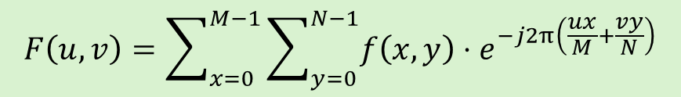
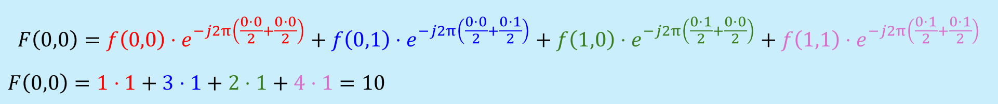
Example 1: 傅立葉變換
要將一張寬×高= 2×2的影像進行傅立葉轉換，我們可以使用離散傅立葉變換（DFT）公式來計算其頻譜。求傅立葉變換後的$F\left(0,0\right)$
影像2*2
頻譜2*2
頻譜2*2
影像= $\left[\begin{matrix}1 & 2 \\ 3 & 4\end{matrix}\right]$
1 | 2
3 | 4
? | ?
? | ?
10 | -2
-4 | 0
會使用到的公式 :
座標:
(0,0) | (1,0)
(0,1) | (1,1)
$$F\left(u,v\right)=\sum_{x=0}^{M−1}{\sum_{y=0}^{N−1}{f\left(x,y\right)}}⋅e^{−j2π\left(\frac{ux}{M}+\frac{vy}{N}\right)}$$
$$F\left(0,0\right)=f\left(0,0\right)⋅e^{−j2π\left(\frac{0⋅0}{2}+\frac{0⋅0}{2}\right)}+f\left(0,1\right)⋅e^{−j2π\left(\frac{0⋅0}{2}+\frac{0⋅1}{2}\right)}+f\left(1,0\right)⋅e^{−j2π\left(\frac{0⋅1}{2}+\frac{0⋅0}{2}\right)}+f\left(1,1\right)⋅e^{−j2π\left(\frac{0⋅1}{2}+\frac{0⋅1}{2}\right)}$$
$$F\left(0,0\right)=1⋅1+3⋅1+2⋅1+4⋅1=10$$

Slide 29

Example 1: Fourier Transform
To perform a Fourier Transform on a 2×2 image, we can use the Discrete Fourier Transform (DFT) formula to compute its spectrum. Find the value of 𝐹(0,0) after the Fourier Transform.
Image 2*2
Spectrum 2*2
Spectrum 2*2
Image= $\left[\begin{matrix}1 & 2 \\ 3 & 4\end{matrix}\right]$
1 | 2
3 | 4
? | ?
? | ?
10 | -2
-4 | 0
The formula to be used:
Coordinate:
(0,0) | (1,0)
(0,1) | (1,1)
$$F\left(u,v\right)=\sum_{x=0}^{M−1}{\sum_{y=0}^{N−1}{f\left(x,y\right)}}⋅e^{−j2π\left(\frac{ux}{M}+\frac{vy}{N}\right)}$$
$$F\left(0,0\right)=f\left(0,0\right)⋅e^{−j2π\left(\frac{0⋅0}{2}+\frac{0⋅0}{2}\right)}+f\left(0,1\right)⋅e^{−j2π\left(\frac{0⋅0}{2}+\frac{0⋅1}{2}\right)}+f\left(1,0\right)⋅e^{−j2π\left(\frac{0⋅1}{2}+\frac{0⋅0}{2}\right)}+f\left(1,1\right)⋅e^{−j2π\left(\frac{0⋅1}{2}+\frac{0⋅1}{2}\right)}$$
$$F\left(0,0\right)=1⋅1+3⋅1+2⋅1+4⋅1=10$$

Slide 30

Example 2: Fourier Transform
頻譜2*2
Spectrum 2*2
1 | 2
3 | 4
 | F(1,1)?

Slide 31







Image
2*2
1 | 2
3 | 4
10
 | F(1,1)?
Spectrum
2*2
$$F\left(1,1\right)=f\left(0,0\right)⋅e^{−j2π\left(\frac{1⋅0}{2}+\frac{1⋅0}{2}\right)}+f\left(0,1\right)⋅e^{−j2π\left(\frac{1⋅0}{2}+\frac{1⋅1}{2}\right)}+f\left(1,0\right)⋅e^{−j2π\left(\frac{1⋅1}{2}+\frac{1⋅0}{2}\right)}+f\left(1,1\right)⋅e^{−j2π\left(\frac{1⋅1}{2}+\frac{1⋅1}{2}\right)}$$
$$e^{−j2π\left(\frac{1⋅0}{2}+\frac{1⋅0}{2}\right)}=e^{−j2π\left(\frac{2}{2}\right)}\text{=}e^{−j2π}$$
$$e^{jθ}=\cos\left(θ\right)+j\sin\left(θ\right)$$
Euler’s formula!
$$(Θ=−2π)$$
$e^{−j2π}=\cos\left(−2π\right)+j\sin\left(−2π\right)=1+j0$ = 1
$$e^{−j2π\left(\frac{1⋅0}{2}+\frac{1⋅1}{2}\right)}=e^{−j2π\left(\frac{1}{2}\right)}\text{=}e^{−jπ}$$
$$(Θ=−π)$$
$e^{−jπ}=\cos\left(−π\right)+j\sin\left(−π\right)=−1+j0$ = -1

Slide 32




Image
2*2
1 | 2
3 | 4
10
 | F(1,1)?
Spectrum
2*2
$$F\left(1,1\right)=f\left(0,0\right)⋅e^{−j2π\left(\frac{1⋅0}{2}+\frac{1⋅0}{2}\right)}+f\left(0,1\right)⋅e^{−j2π\left(\frac{1⋅0}{2}+\frac{1⋅1}{2}\right)}+f\left(1,0\right)⋅e^{−j2π\left(\frac{1⋅1}{2}+\frac{1⋅0}{2}\right)}+f\left(1,1\right)⋅e^{−j2π\left(\frac{1⋅1}{2}+\frac{1⋅1}{2}\right)}$$
$$e^{−j2π\left(\frac{1⋅1}{2}+\frac{1⋅0}{2}\right)}=e^{−j2π\left(\frac{1}{2}\right)}\text{=}e^{−jπ}$$
Euler’s formula!
$$e^{jθ}=\cos\left(θ\right)+j\sin\left(θ\right)$$
$$(Θ=−π)$$
$e^{−jπ}=\cos\left(−π\right)+j\sin\left(−π\right)=−1+j0$ = -1
$$(Θ=−2π)$$
$$e^{−j2π\left(\frac{1⋅1}{2}+\frac{1⋅1}{2}\right)}=e^{−j2π\left(\frac{2}{2}\right)}\text{=}e^{−j2π}=\cos\left(−2π\right)+j\sin\left(−2π\right)=1+j0=1$$
頻譜2*2
$$F\left(1,1\right)=1⋅\left(1\right)+3⋅\left(−1\right)+2⋅\left(−1\right)+4⋅\left(1\right)=0$$
10 | ?
? | 0

Slide 33




Example 3 : Fourier Transform
Image f(x,y) 3*3
Spectrum $\left|F\left(u,v\right)\right|$ 3*3
1 | 2 | 3
4 | 5 | 6
7 | 8 | 9
$$\left|F\left(0,1\right)\right|$$
Q: Find the magnitude of $\left|F\left(0,1\right)\right|$ ?
Fourier Transform
$$F\left(u,v\right)=\sum_{x=0}^{M−1}{\sum_{y=0}^{N−1}{f\left(x,y\right)}}⋅e^{−j2π\left(\frac{ux}{M}+\frac{vy}{N}\right)}$$
Magnitude Spectrum
$$Magnitude=\left|F\left(u,v\right)\right|=\sqrt{{實部\left(F\left(u,v\right)\right)}^{2}+{虛部\left(F\left(u,v\right)\right)}^{2}}$$
$$∣F\left(u , v\right)∣=\sqrt{\left(\text{Re}{(F\left(u,v\right))}^{2}+\left(\text{Im}{(F\left(u,v\right))}^{2}\right.\right.}$$

Slide 34













Fourier Spectrum
Fourier Transform
$$F\left(u,v\right)=\sum_{x=0}^{M−1}{\sum_{y=0}^{N−1}{f\left(x,y\right)}}⋅e^{−j2π\left(\frac{ux}{M}+\frac{vy}{N}\right)}$$
1 radian = 180/π degrees
$$u x$$
$$v y$$
$$F\left(0,1\right)=f\left(0,0\right)⋅e^{−j2π\left(\frac{0⋅0}{3}+\frac{1⋅0}{3}\right)}$$
$$+f\left(0,1\right)⋅e^{−j2π\left(\frac{0⋅0}{3}+\frac{1⋅1}{3}\right)}$$
$$+f\left(0,2\right)⋅e^{−j2π\left(\frac{0⋅0}{3}+\frac{1⋅2}{3}\right)}$$
$$+f\left(1,0\right)⋅e^{−j2π\left(\frac{0⋅1}{3}+\frac{1⋅0}{3}\right)}$$
$$+f\left(1,1\right)⋅e^{−j2π\left(\frac{0⋅1}{3}+\frac{1⋅1}{3}\right)}$$
$$+f\left(1,2\right)⋅e^{−j2π\left(\frac{0⋅1}{3}+\frac{1⋅2}{3}\right)}$$
$$+f\left(2,0\right)⋅e^{−j2π\left(\frac{0⋅2}{3}+\frac{1⋅0}{3}\right)}$$
$$+f\left(2,1\right)⋅e^{−j2π\left(\frac{0⋅2}{3}+\frac{1⋅1}{3}\right)}$$
$$+f\left(2,2\right)⋅e^{−j2π\left(\frac{0⋅2}{3}+\frac{1⋅2}{3}\right)}$$
$$u v$$
$$x y$$
$$F\left(0,1\right)=1⋅e^{−j\left(\frac{0π}{3}\right)}$$
$$+4⋅e^{−j\left(\frac{2π}{3}\right)}$$
$$+7⋅e^{−j\left(\frac{4π}{3}\right)}$$
$$+2⋅e^{−j\left(\frac{0π}{3}\right)}$$
$$+5⋅e^{−j\left(\frac{2π}{3}\right)}$$
$$+8⋅e^{−j\left(\frac{4π}{3}\right)}$$
$$+3⋅e^{−j\left(\frac{0π}{3}\right)}$$
$$+6⋅e^{−j\left(\frac{2π}{3}\right)}$$
$$+9⋅e^{−j\left(\frac{4π}{3}\right)}$$
$$f(0,0)$$
$\frac{4∗180}{3}=$ ${240}^{°}$

Slide 35







Fourier Spectrum
$$e^{jθ}=\cos\left(θ\right)+j\sin\left(θ\right)$$
$$F\left(0,1\right)=1∗(\cos\left(−0^{°}\right)+jsin\left({−0}^{°}\right))$$
$$+ 4∗(\cos\left({−120}^{°}\right)+jsin\left(−{120}^{°}\right))$$
$$+ 7∗(\cos\left({−240}^{°}\right)+jsin\left(−{240}^{°}\right))$$
$$+2∗(\cos\left({−0}^{°}\right)+jsin\left({−0}^{°}\right))$$
$$+5∗(\cos\left({−120}^{°}\right)+jsin\left(−{120}^{°}\right))$$
$$+8∗(\cos\left({−240}^{°}\right)+jsin\left({−240}^{°}\right))$$
$$+3∗(\cos\left({−0}^{°}\right)+jsin\left({−0}^{°}\right))$$
$$+6∗(\cos\left({−120}^{°}\right)+jsin\left({−120}^{°}\right))$$
$$+9∗(\cos\left({−120}^{°}\right)+jsin\left({−240}^{°}\right))$$
$$F\left(0,1\right)=1∗(1+j0)$$
$$+ 4∗(−0.5+j\left(−0.866\right))$$
$$+ 7∗(−0.5+j(0.866))$$
$$+2∗(1+j0)$$
$$+5∗\left(−0.5+j\left(−0.866\right)\right)$$
$$+8∗(−0.5+j(0.866))$$
$$+3∗(1+j0)$$
$$+6∗(−0.5+j\left(−0.866\right))$$
$$+9∗(−0.5+j(0.866))$$

Slide 36







Fourier Spectrum
$$e^{jθ}=\cos\left(θ\right)+j\sin\left(θ\right)$$
$$F\left(0,1\right)=(1+0j)$$
$$+(−2−j3.464)$$
$$+ (−3.5+j(6.062))$$
$$+(2+j0)$$
$$+(−2.5−j4.33)$$
$$+(−4+j6.928)$$
$$+(3+j0)$$
$$+(−3−j5.196)$$
$$+(−4.5+j7.794)$$
$$F\left(0,1\right)=−13.5+7.794j$$
$$Magnitude=\left|F\left(u,v\right)\right|=\sqrt{{實部\left(F\left(u,v\right)\right)}^{2}+{虛部\left(F\left(u,v\right)\right)}^{2}}$$
Spectrum $\left|F\left(u,v\right)\right|$
45 | 5.196 | 5.196
$$15.588$$ | 0 | 0
15.588 | 0 | 0
$$\left|F\left(0,1\right)\right|=\sqrt{{\left(−13.5\right)}^{2}+{\left(7.794\right)}^{2}}=15.588$$
#
#

Slide 37
重點公式整理
(Key formula summary)

Slide 38









公式整理
索引
值方圖等化
索引值$S=x+My+MNz=x+M(y+Nz)$
$$PMF\left(r_{k}\right)=\frac{n_{k}}{N}$$
$$CDF\left(r_{k}\right)=\sum_{i=1}^{k}{PMF\left(r_{i}\right)}$$
$z=S/MN$ (取商數)
$y=S mod MN/M$ (取商數)
$x=\text{S} \text{mod} \text{MN} \text{mod} \text{M}$
$$s_{k}=round(CDF\left(r_{k}\right)×\left(s_{max}−s_{min}\right)+s_{min})$$
仿射
相關性
卷積
傅立葉變換、頻譜
$$F\left(u,v\right)=\sum_{x=0}^{M−1}{\sum_{y=0}^{N−1}{f\left(x,y\right)}}⋅e^{−j2π\left(\frac{ux}{M}+\frac{vy}{N}\right)}$$
$$e^{jθ}=\cos\left(θ\right)+j\sin\left(θ\right)$$
$$Magnitude=\left|F\left(u,v\right)\right|=\sqrt{{實部\left(F\left(u,v\right)\right)}^{2}+{虛部\left(F\left(u,v\right)\right)}^{2}}$$

Slide 39
公式整理 2-D 雙線性內插法
Step1:縮放比例（Scaling Ratio）
Step3:計算目標圖值
原始圖像尺寸:寬度$w_{1}$ , 高度$h_{1}$
目標圖像尺寸:寬度$w_{2}$ , 高度$h_{2}$
$x_{1}$​ =⌊x⌋
$y_{1}$​ =⌊y⌋
$x_{2}$​ =⌊x⌋+1
$y_{2}$​ =⌊y⌋+1
b=$x−\text{⌊}\text{x}\text{⌋}$
a=$y−\text{⌊}\text{y}\text{⌋}$
b
$$S_{x}=\frac{w_{1}−1}{w_{2}−1}$$
$$S_{y}=\frac{h_{1}−1}{h_{2}−1}$$
$Q_{1}:$f($x_{1}$, $y_{1}$)
$Q_{2}:$f($x_{2}$, $y_{1}$)
a
Step2:映射到原圖
F($x^{′},y^{′}$)
要算目標圖F($x^{′},y^{′}$)的值
先算映射到原圖的f(x,y)
$Q_{3}:$f($x_{1}$, $y_{2}$)
$Q_{4}:$f($x_{2}$, $y_{2}$)
$${x=x^{′} \text{×} S}_{x}$$
$${y=y^{′} \text{×} S}_{y}$$
F($x^{′},y^{′}$) = (1−b)×[(1−a)× $Q_{1}$+ a× $Q_{3}$] + b×[(1−a)× $Q_{2}$+ a × $Q_{4}$]

