Slide 1
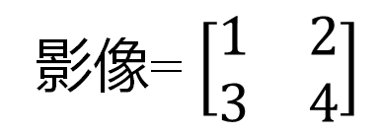

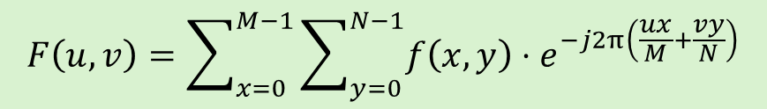
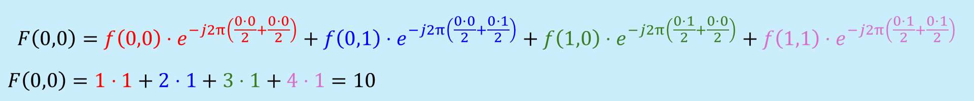
Example 1: 傅立葉變換
要將一張寬×高= 2×2的影像進行傅立葉轉換，我們可以使用離散傅立葉變換（DFT）公式來計算其頻譜。求傅立葉變換後的$F\left(0,0\right)$
影像2*2
頻譜2*2
頻譜2*2
影像= $\left[\begin{matrix}1 & 2 \\ 3 & 4\end{matrix}\right]$
1 | 2
3 | 4
? | ?
? | ?
10 | -2
-4 | 0
會使用到的公式 :
$$F\left(u,v\right)=\sum_{x=0}^{M−1}{\sum_{y=0}^{N−1}{f\left(x,y\right)}}⋅e^{−j2π\left(\frac{ux}{M}+\frac{vy}{N}\right)}$$
$$F\left(0,0\right)=f\left(0,0\right)⋅e^{−j2π\left(\frac{0⋅0}{2}+\frac{0⋅0}{2}\right)}+f\left(0,1\right)⋅e^{−j2π\left(\frac{0⋅0}{2}+\frac{0⋅1}{2}\right)}+f\left(1,0\right)⋅e^{−j2π\left(\frac{0⋅1}{2}+\frac{0⋅0}{2}\right)}+f\left(1,1\right)⋅e^{−j2π\left(\frac{0⋅1}{2}+\frac{0⋅1}{2}\right)}$$
$$F\left(0,0\right)=1⋅1+2⋅1+3⋅1+4⋅1=10$$

Slide 2
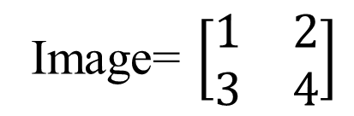
Example 1: Fourier Transform
To perform a Fourier Transform on a 2×2 image, we can use the Discrete Fourier Transform (DFT) formula to compute its spectrum. Find the value of 𝐹(0,0) after the Fourier Transform.
Image 2*2
Spectrum 2*2
Spectrum 2*2
Image= $\left[\begin{matrix}1 & 2 \\ 3 & 4\end{matrix}\right]$
1 | 2
3 | 4
? | ?
? | ?
10 | -2
-4 | 0
The formula to be used:
$$F\left(u,v\right)=\sum_{x=0}^{M−1}{\sum_{y=0}^{N−1}{f\left(x,y\right)}}⋅e^{−j2π\left(\frac{ux}{M}+\frac{vy}{N}\right)}$$
$$F\left(0,0\right)=f\left(0,0\right)⋅e^{−j2π\left(\frac{0⋅0}{2}+\frac{0⋅0}{2}\right)}+f\left(0,1\right)⋅e^{−j2π\left(\frac{0⋅0}{2}+\frac{0⋅1}{2}\right)}+f\left(1,0\right)⋅e^{−j2π\left(\frac{0⋅1}{2}+\frac{0⋅0}{2}\right)}+f\left(1,1\right)⋅e^{−j2π\left(\frac{0⋅1}{2}+\frac{0⋅1}{2}\right)}$$
$$F\left(0,0\right)=1⋅1+2⋅1+3⋅1+4⋅1=10$$

Slide 3
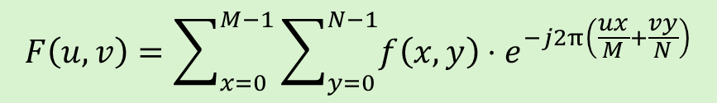
Example 2: Fourier Transform
頻譜2*2
Spectrum 2*2
1 | 2
3 | 4
 | F(1,1)?

Slide 4

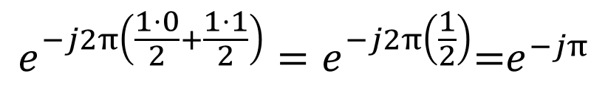
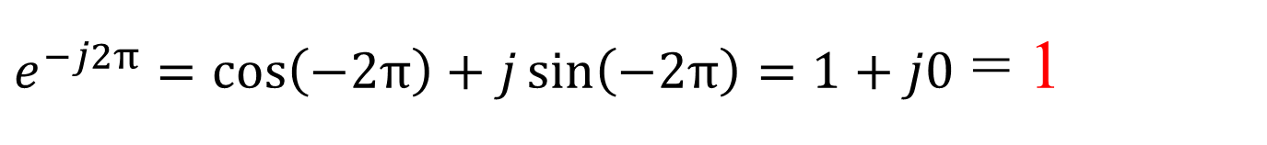

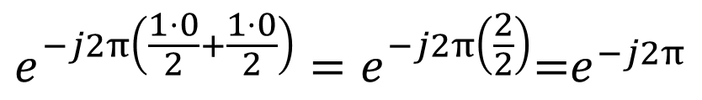
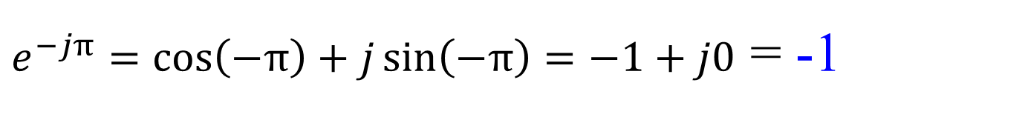

Image
2*2
1 | 2
3 | 4
10
 | F(1,1)?
Spectrum
2*2
$$F\left(1,1\right)=f\left(0,0\right)⋅e^{−j2π\left(\frac{1⋅0}{2}+\frac{1⋅0}{2}\right)}+f\left(0,1\right)⋅e^{−j2π\left(\frac{1⋅0}{2}+\frac{1⋅1}{2}\right)}+f\left(1,0\right)⋅e^{−j2π\left(\frac{1⋅1}{2}+\frac{1⋅0}{2}\right)}+f\left(1,1\right)⋅e^{−j2π\left(\frac{1⋅1}{2}+\frac{1⋅1}{2}\right)}$$
$$e^{−j2π\left(\frac{1⋅0}{2}+\frac{1⋅0}{2}\right)}=e^{−j2π\left(\frac{2}{2}\right)}\text{=}e^{−j2π}$$
$$e^{jθ}=\cos\left(θ\right)+j\sin\left(θ\right)$$
Euler’s formula!
$$(Θ=−2π)$$
$e^{−j2π}=\cos\left(−2π\right)+j\sin\left(−2π\right)=1+j0$ = 1
$$e^{−j2π\left(\frac{1⋅0}{2}+\frac{1⋅1}{2}\right)}=e^{−j2π\left(\frac{1}{2}\right)}\text{=}e^{−jπ}$$
$$(Θ=−π)$$
$e^{−jπ}=\cos\left(−π\right)+j\sin\left(−π\right)=−1+j0$ = -1

Slide 5
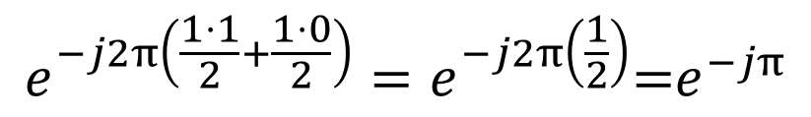
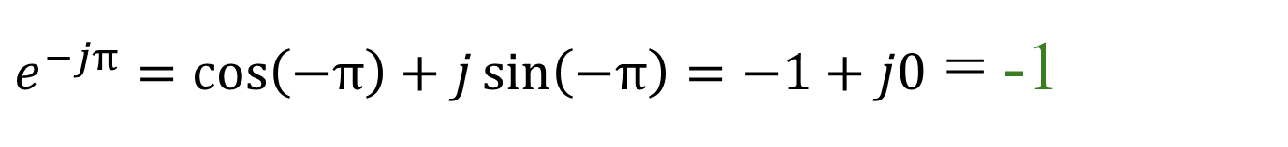


Image
2*2
1 | 2
3 | 4
10
 | F(1,1)?
Spectrum
2*2
$$F\left(1,1\right)=f\left(0,0\right)⋅e^{−j2π\left(\frac{1⋅0}{2}+\frac{1⋅0}{2}\right)}+f\left(0,1\right)⋅e^{−j2π\left(\frac{1⋅0}{2}+\frac{1⋅1}{2}\right)}+f\left(1,0\right)⋅e^{−j2π\left(\frac{1⋅1}{2}+\frac{1⋅0}{2}\right)}+f\left(1,1\right)⋅e^{−j2π\left(\frac{1⋅1}{2}+\frac{1⋅1}{2}\right)}$$
$$e^{−j2π\left(\frac{1⋅1}{2}+\frac{1⋅0}{2}\right)}=e^{−j2π\left(\frac{1}{2}\right)}\text{=}e^{−jπ}$$
Euler’s formula!
$$e^{jθ}=\cos\left(θ\right)+j\sin\left(θ\right)$$
$$(Θ=−π)$$
$e^{−jπ}=\cos\left(−π\right)+j\sin\left(−π\right)=−1+j0$ = -1
$$(Θ=−2π)$$
$$e^{−j2π\left(\frac{1⋅1}{2}+\frac{1⋅1}{2}\right)}=e^{−j2π\left(\frac{2}{2}\right)}\text{=}e^{−j2π}=\cos\left(−2π\right)+j\sin\left(−2π\right)=1+j0=1$$
頻譜2*2
$$F\left(1,1\right)=1⋅\left(1\right)+2⋅\left(−1\right)+3⋅\left(−1\right)+4⋅\left(1\right)=0$$
10 | ?
? | 0

Slide 6

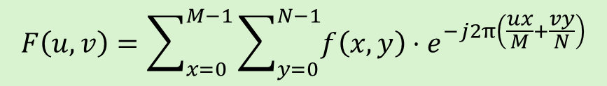


Example 3 : Fourier Transform
Image f(x,y) 3*3
Spectrum $\left|F\left(u,v\right)\right|$ 3*3
1 | 2 | 3
4 | 5 | 6
7 | 8 | 9
$$\left|F\left(0,1\right)\right|$$
Q: Find the magnitude of $\left|F\left(0,1\right)\right|$ ?
Fourier Transform
$$F\left(u,v\right)=\sum_{x=0}^{M−1}{\sum_{y=0}^{N−1}{f\left(x,y\right)}}⋅e^{−j2π\left(\frac{ux}{M}+\frac{vy}{N}\right)}$$
Magnitude Spectrum
$$Magnitude=\left|F\left(u,v\right)\right|=\sqrt{{實部\left(F\left(u,v\right)\right)}^{2}+{虛部\left(F\left(u,v\right)\right)}^{2}}$$
$$∣F\left(u , v\right)∣=\sqrt{\left(\text{Re}{(F\left(u,v\right))}^{2}+\left(\text{Im}{(F\left(u,v\right))}^{2}\right.\right.}$$

Slide 7













Fourier Spectrum
Fourier Transform
$$F\left(u,v\right)=\sum_{x=0}^{M−1}{\sum_{y=0}^{N−1}{f\left(x,y\right)}}⋅e^{−j2π\left(\frac{ux}{M}+\frac{vy}{N}\right)}$$
1 radian = 180/π degrees
$$u x$$
$$v y$$
$$F\left(0,1\right)=f\left(0,0\right)⋅e^{−j2π\left(\frac{0⋅0}{3}+\frac{1⋅0}{3}\right)}$$
$$+f\left(0,1\right)⋅e^{−j2π\left(\frac{0⋅0}{3}+\frac{1⋅1}{3}\right)}$$
$$+f\left(0,2\right)⋅e^{−j2π\left(\frac{0⋅0}{3}+\frac{1⋅2}{3}\right)}$$
$$+f\left(1,0\right)⋅e^{−j2π\left(\frac{0⋅1}{3}+\frac{1⋅0}{3}\right)}$$
$$+f\left(1,1\right)⋅e^{−j2π\left(\frac{0⋅1}{3}+\frac{1⋅1}{3}\right)}$$
$$+f\left(1,2\right)⋅e^{−j2π\left(\frac{0⋅1}{3}+\frac{1⋅2}{3}\right)}$$
$$+f\left(2,0\right)⋅e^{−j2π\left(\frac{0⋅2}{3}+\frac{1⋅0}{3}\right)}$$
$$+f\left(2,1\right)⋅e^{−j2π\left(\frac{0⋅2}{3}+\frac{1⋅1}{3}\right)}$$
$$+f\left(2,2\right)⋅e^{−j2π\left(\frac{0⋅2}{3}+\frac{1⋅2}{3}\right)}$$
$$u v$$
$$x y$$
$$F\left(0,1\right)=1⋅e^{−j\left(\frac{0π}{3}\right)}$$
$$+4⋅e^{−j\left(\frac{2π}{3}\right)}$$
$$+7⋅e^{−j\left(\frac{4π}{3}\right)}$$
$$+2⋅e^{−j\left(\frac{0π}{3}\right)}$$
$$+5⋅e^{−j\left(\frac{2π}{3}\right)}$$
$$+8⋅e^{−j\left(\frac{4π}{3}\right)}$$
$$+3⋅e^{−j\left(\frac{0π}{3}\right)}$$
$$+6⋅e^{−j\left(\frac{2π}{3}\right)}$$
$$+9⋅e^{−j\left(\frac{4π}{3}\right)}$$
$$f(0,0)$$
$\frac{4∗180}{3}=$ ${240}^{°}$

Slide 8



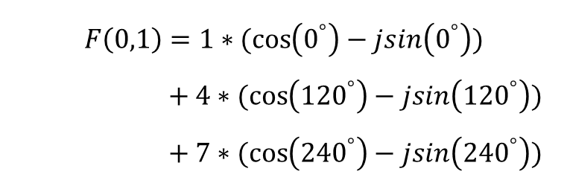



Fourier Spectrum
$$e^{jθ}=\cos\left(θ\right)+j\sin\left(θ\right)$$
$$F\left(0,1\right)=1∗(\cos\left(0^{°}\right)−jsin\left(0^{°}\right))$$
$$+ 4∗(\cos\left({120}^{°}\right)−jsin\left({120}^{°}\right))$$
$$+ 7∗(\cos\left({240}^{°}\right)−jsin\left({240}^{°}\right))$$
$$+2∗(\cos\left(0^{°}\right)−jsin\left(0^{°}\right))$$
$$+5∗(\cos\left({120}^{°}\right)−jsin\left({120}^{°}\right))$$
$$+8∗(\cos\left({240}^{°}\right)−jsin\left({240}^{°}\right))$$
$$+3∗(\cos\left(0^{°}\right)−jsin\left(0^{°}\right))$$
$$+6∗(\cos\left({120}^{°}\right)−jsin\left({120}^{°}\right))$$
$$+9∗(\cos\left({120}^{°}\right)−jsin\left({240}^{°}\right))$$
$$F\left(0,1\right)=1∗(1−j0)$$
$$+ 4∗(−0.5−j0.866)$$
$$+ 7∗(−0.5−j(−0.866))$$
$$+2∗(1−j0)$$
$$+5∗(−0.5−j0.866)$$
$$+8∗(−0.5−j(−0.866))$$
$$+3∗(1−j0)$$
$$+6∗(−0.5−j0.866)$$
$$+9∗(−0.5−j(−0.866))$$

Slide 9


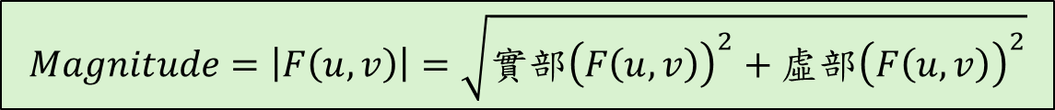




Fourier Spectrum
$$e^{jθ}=\cos\left(θ\right)+j\sin\left(θ\right)$$
$$F\left(0,1\right)=(1−0j)$$
$$+(−2−j3.464)$$
$$+ (−3.5+j(6.062))$$
$$+(2−j0)$$
$$+(−2.5−j4.33)$$
$$+(−4+j6.928)$$
$$+(3−j0)$$
$$+(−3−j5.196)$$
$$+(−4.5+j7.794)$$
$$F\left(0,1\right)=−13.5+7.794j$$
$$Magnitude=\left|F\left(u,v\right)\right|=\sqrt{{實部\left(F\left(u,v\right)\right)}^{2}+{虛部\left(F\left(u,v\right)\right)}^{2}}$$
Spectrum $\left|F\left(u,v\right)\right|$
$$15.588$$
$$\left|F\left(0,1\right)\right|=\sqrt{{\left(−13.5\right)}^{2}+{\left(7.794\right)}^{2}}=15.588$$
#
#

