Slide 1
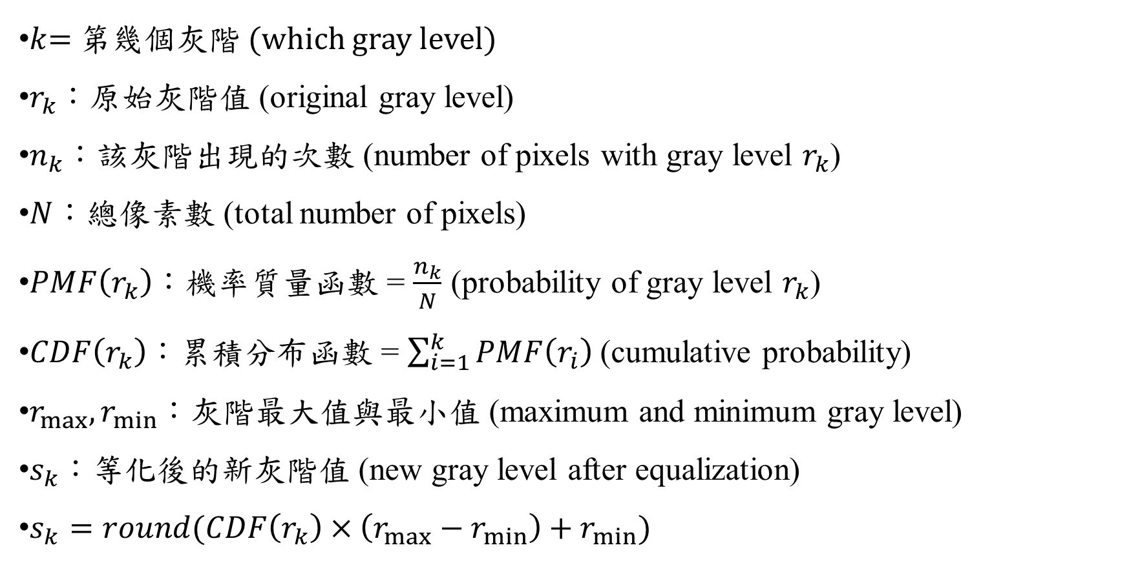
符號定義
$k$= 第幾個灰階 (which gray level)
$r_{k}$：原始灰階值 (original gray level)
$n_{k}$：該灰階出現的次數 (number of pixels with gray level $r_{k}$)
$N$：總像素數 (total number of pixels)
$PMF\left(r_{k}\right)$：機率質量函數 = $\frac{n_{k}}{N}$ (probability of gray level $r_{k}$)
$CDF\left(r_{k}\right)$：累積分布函數 = $\sum_{i=1}^{k}{PMF\left(r_{i}\right)}$(cumulative probability)
$r_{max},r_{min}$：灰階最大值與最小值 (maximum and minimum gray level)
$s_{k}$：等化後的新灰階值 (new gray level after equalization)
$s_{k}=round(CDF\left(r_{k}\right)×\left(r_{max}−r_{min}\right)+r_{min})$

Slide 2
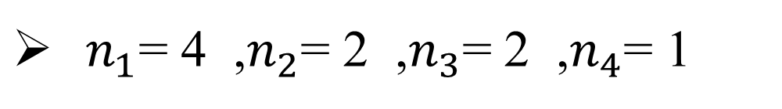
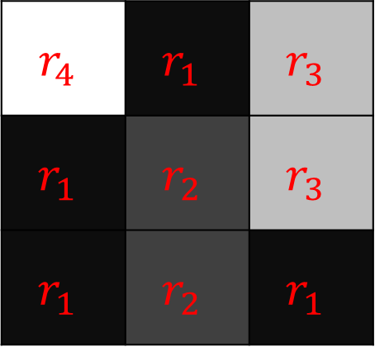
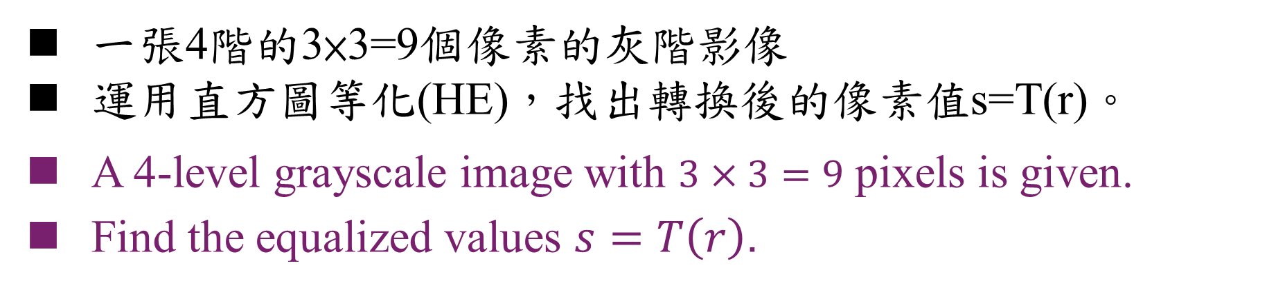
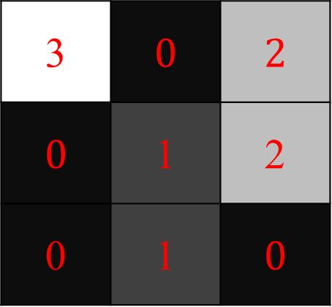
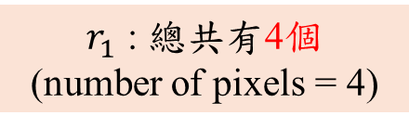
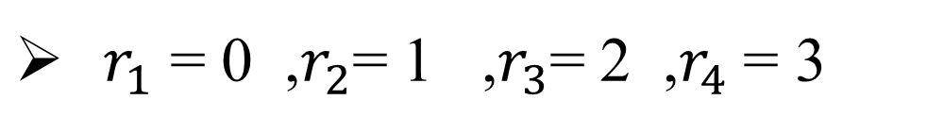
EX1:直方圖等化(Histogram Equalization)
一張4階的3×3=9個像素的灰階影像
運用直方圖等化(HE)，找出轉換後的像素值s=T(r)。
A 4-level grayscale image with $3×3=9$ pixels is given.
Find the equalized values $s=T\left(r\right)$.
$r_{1}$ = 0 ,$r_{2}$= 1 ,$r_{3}$= 2 ,$r_{4}$ = 3
$$r_{4}$$ | $$r_{1}$$ | $$r_{3}$$
$$r_{1}$$ | $$r_{2}$$ | $$r_{3}$$
$$r_{1}$$ | $$r_{2}$$ | $$r_{1}$$
3 | $0$ | $2$
$0$ | 1 | 2
0 | 1 | $0$
$n_{1}$= 4 ,$n_{2}$= 2 ,$n_{3}$= 2 ,$n_{4}$= 1
$r_{1}$ : 總共有4個
(number of pixels = 4)

Slide 3

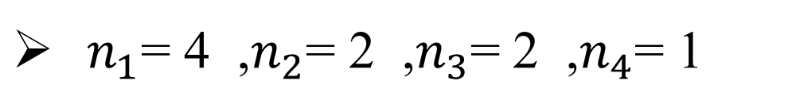
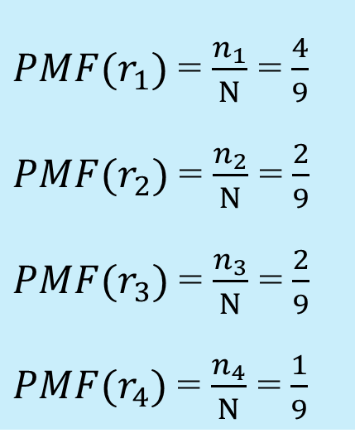
EX1:直方圖等化(HE) (1/3) 算PMF
一張4階的3×3=9個像素的灰階影像
運用直方圖等化(HE)，找出轉換後的像素值s=T(r)。
A 4-level grayscale image with $3×3=9$ pixels is given.
Find the equalized values $s=T\left(r\right)$.
${PMF(r}_{1})$ = $\frac{n_{1}}{N}$ = $\frac{4}{9}$
${PMF(r}_{2})$ = $\frac{n_{2}}{N}$ = $\frac{2}{9}$
${PMF(r}_{3})$ = $\frac{n_{3}}{N}$ = $\frac{2}{9}$
${PMF(r}_{4})$ = $\frac{n_{4}}{N}$ = $\frac{1}{9}$
$n_{1}$= 4 ,$n_{2}$= 2 ,$n_{3}$= 2 ,$n_{4}$= 1
會使用到的公式 :
$$PMF\left(r_{k}\right)=\frac{n_{k}}{N}$$

Slide 4
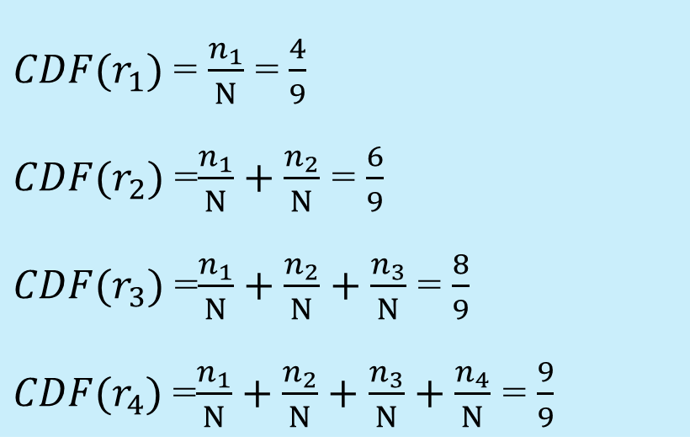

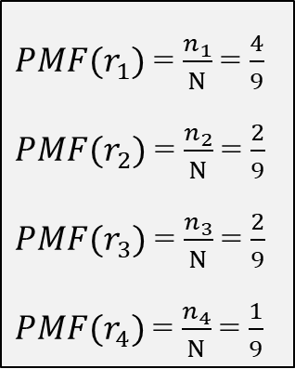
EX1:直方圖等化(HE) (2/3) 算CDF
${PMF(r}_{1})$ = $\frac{n_{1}}{N}$ = $\frac{4}{9}$
${PMF(r}_{2})$ = $\frac{n_{2}}{N}$ = $\frac{2}{9}$
${PMF(r}_{3})$ = $\frac{n_{3}}{N}$ = $\frac{2}{9}$
${PMF(r}_{4})$ = $\frac{n_{4}}{N}$ = $\frac{1}{9}$
${CDF(r}_{1})$ = $\frac{n_{1}}{N}$ = $\frac{4}{9}$
${CDF(r}_{2})$ =$\frac{n_{1}}{N}+\frac{n_{2}}{N}$ = $\frac{6}{9}$
${CDF(r}_{3})$ =$\frac{n_{1}}{N}+\frac{n_{2}}{N}+\frac{n_{3}}{N}$ = $\frac{8}{9}$
${CDF(r}_{4})$ =$\frac{n_{1}}{N}+\frac{n_{2}}{N}+\frac{n_{3}}{N}+\frac{n_{4}}{N}$ = $\frac{9}{9}$
會使用到的公式 :
$$CDF\left(r_{k}\right)=\sum_{i=1}^{k}{PMF\left(r_{i}\right)}$$

Slide 5
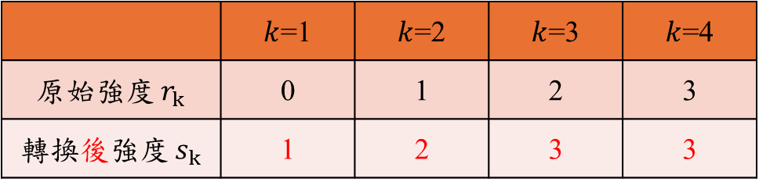
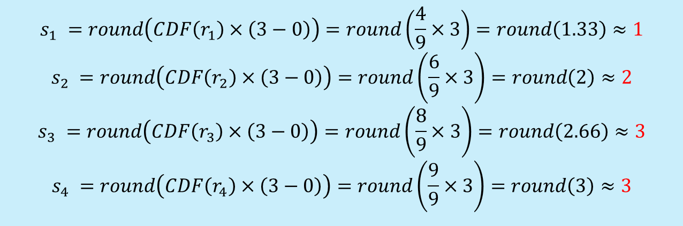
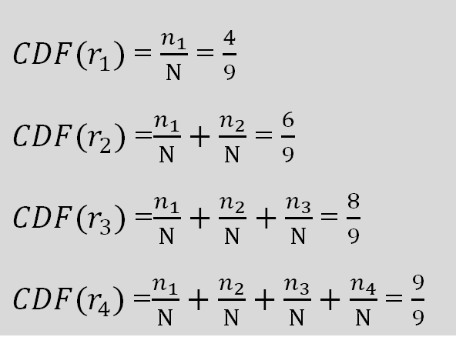
EX1:直方圖等化(HE) (3/3) 算s=T(r)
$$s_{k} =round(CDF\left(r_{k}\right)×\left(r_{max}−r_{min}\right)+s_{min})$$
$$s_{1} =round\left(CDF\left(r_{1}\right)×\left(3−0\right)\right)=round\left(\frac{4}{9}×3\right)=round\left(1.33\right)≈1$$
$$s_{2} =round\left(CDF\left(r_{2}\right)×\left(3−0\right)\right)=round\left(\frac{6}{9}×3\right)=round\left(2\right)≈2$$
$$s_{3} =round\left(CDF\left(r_{3}\right)×\left(3−0\right)\right)=round\left(\frac{8}{9}×3\right)=round\left(2.66\right)≈3$$
$$s_{4} =round\left(CDF\left(r_{4}\right)×\left(3−0\right)\right)=round\left(\frac{9}{9}×3\right)=round\left(3\right)≈3$$
${CDF(r}_{1})$ = $\frac{n_{1}}{N}$ = $\frac{4}{9}$
${CDF(r}_{2})$ =$\frac{n_{1}}{N}+\frac{n_{2}}{N}$ = $\frac{6}{9}$
${CDF(r}_{3})$ =$\frac{n_{1}}{N}+\frac{n_{2}}{N}+\frac{n_{3}}{N}$ = $\frac{8}{9}$
${CDF(r}_{4})$ =$\frac{n_{1}}{N}+\frac{n_{2}}{N}+\frac{n_{3}}{N}+\frac{n_{4}}{N}$ = $\frac{9}{9}$
 | $k$=1 | $k$=2 | $k$=3 | $k$=4
原始強度 $r_{k}$ | 0 | 1 | 2 | 3
轉換後強度 $s_{k}$ | 1 | 2 | 3 | 3
會使用到的公式 :
$$s_{k} =round(CDF\left(r_{k}\right)×\left(r_{max}−r_{min}\right)+s_{min})$$
#

Slide 6

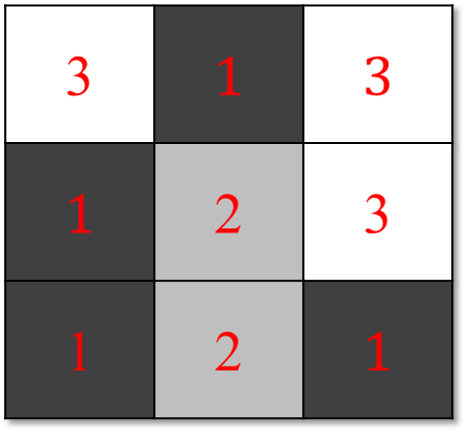
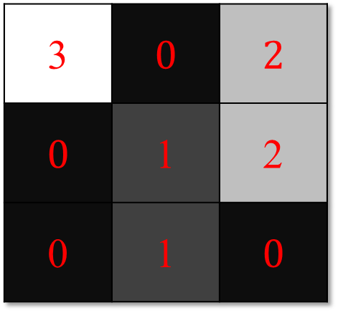
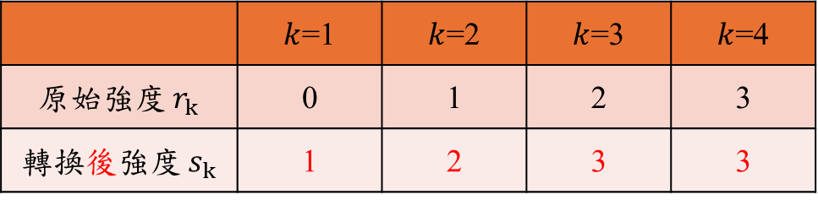
Extra Question
把算好的等化後灰階值 $s_{k}$填回原始影像。
Fill the equalized gray values $s_{k}$back into the original image.
 | $k$=1 | $k$=2 | $k$=3 | $k$=4
原始強度 $r_{k}$ | 0 | 1 | 2 | 3
轉換後強度 $s_{k}$ | 1 | 2 | 3 | 3
Before HE
After HE
3 | $0$ | $2$
$0$ | 1 | 2
0 | 1 | $0$
3 | $1$ | $3$
$1$ | 2 | 3
1 | 2 | $1$
#

