Slide 1

COVID-19 and Pre-existing health condition EDA
Does COVID-19 really worsen the pre-existing illness ?
Which underlying conditions can worsen the illness with COVID-19? Is pre-existing lung or Immunocompromised(immune) at highest risk for severe illness from COVID-19 ?

Slide 2
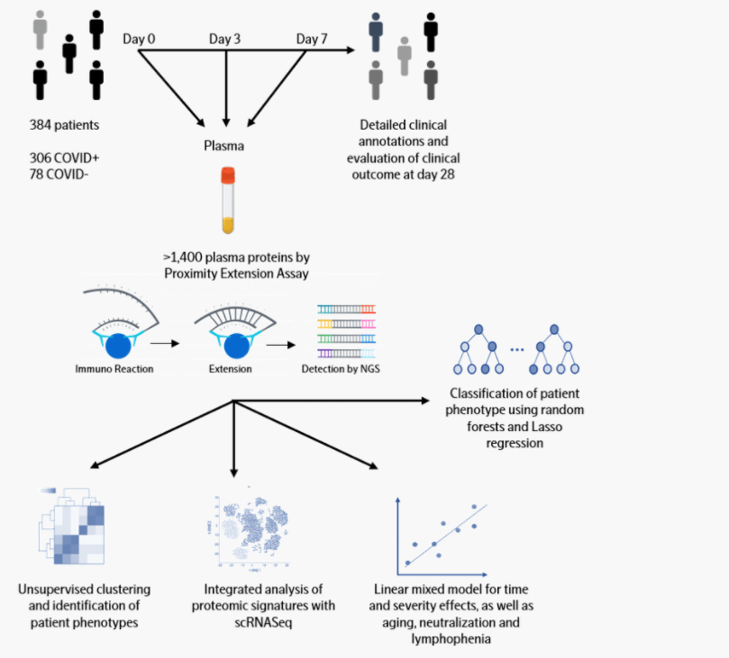

Olink Data
Collected from Massachusetts General Hospital (MGH)

Slide 3
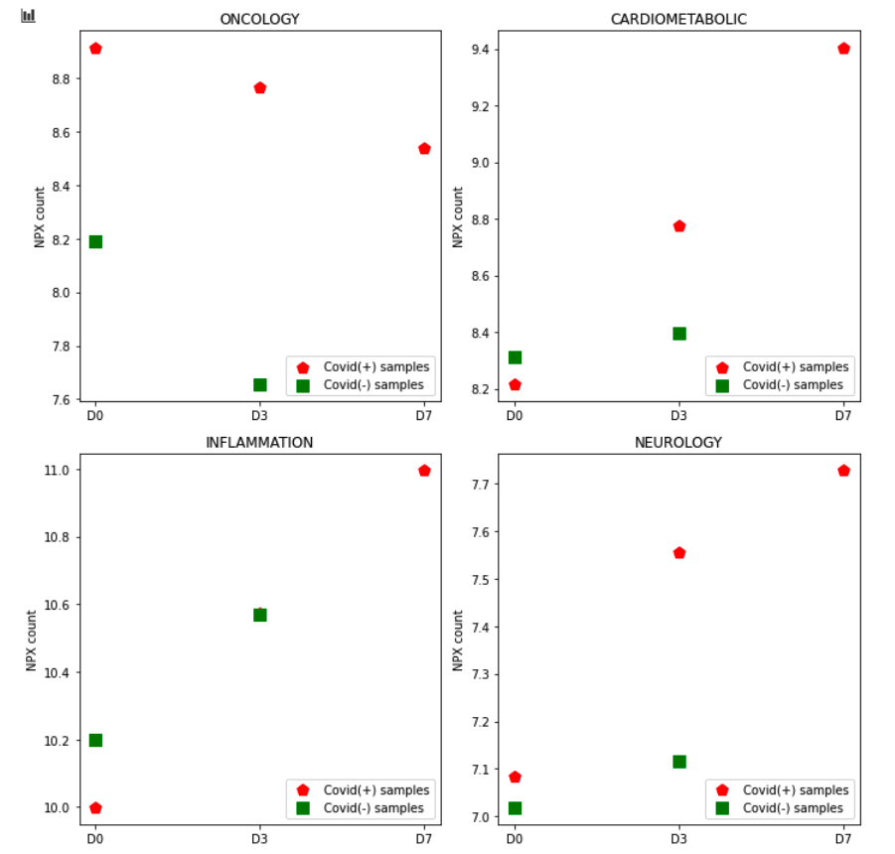
Start with Lung Disease patient group
Compare NPX count between Lung+Covid vs Lung+No-Covid

Slide 4
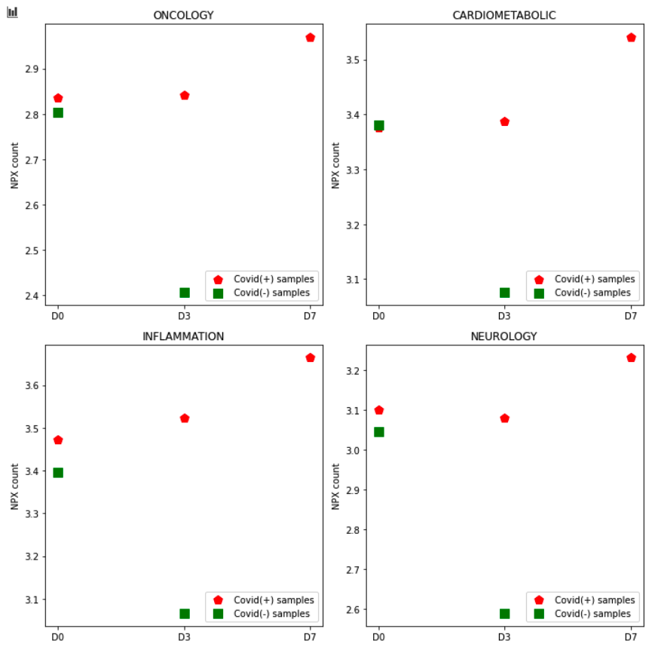
Next is Kidney patients group

Slide 5
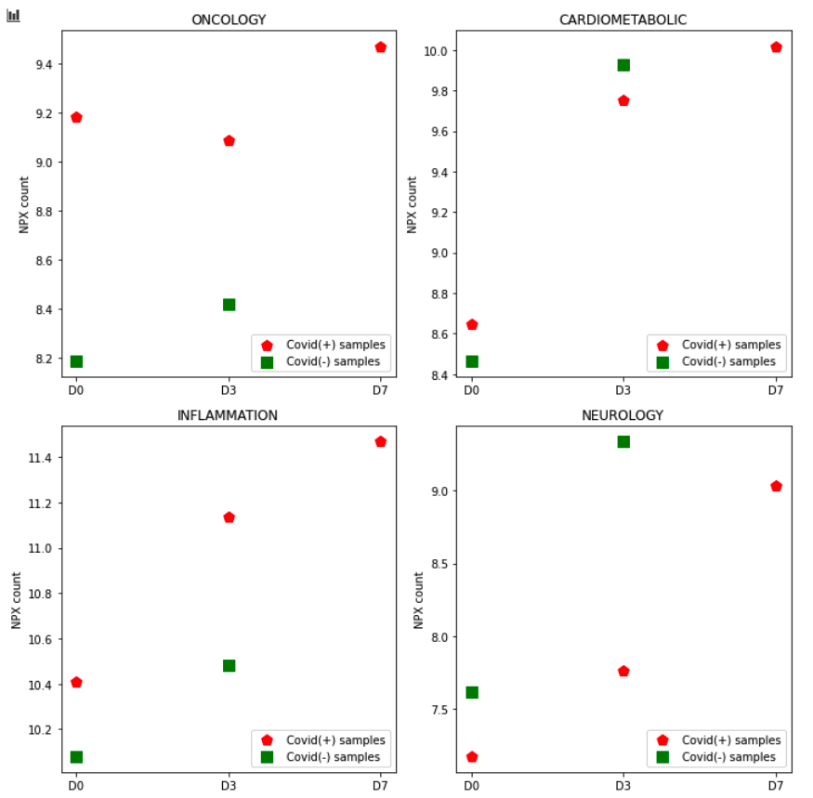
And Immuno patients group

Slide 6
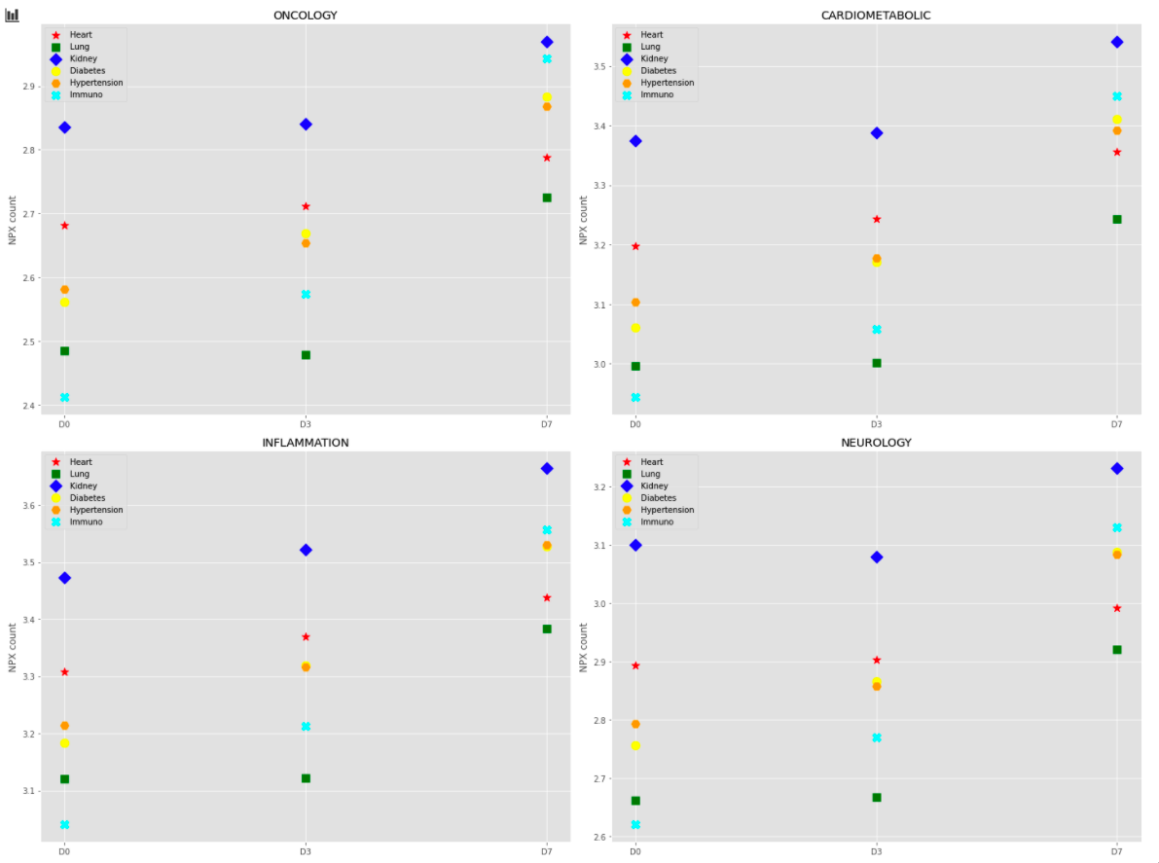
So, which group is the worst?
Kidney group → Immuno group
this is new, so let’s do the hypothesis test to verify the frequency lung/immune case being sere vs the frequency that the kidney being severe

Slide 7
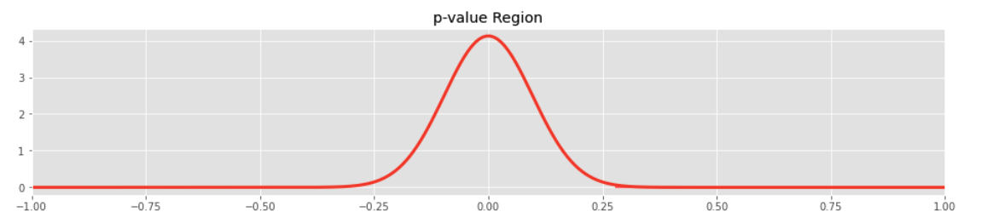
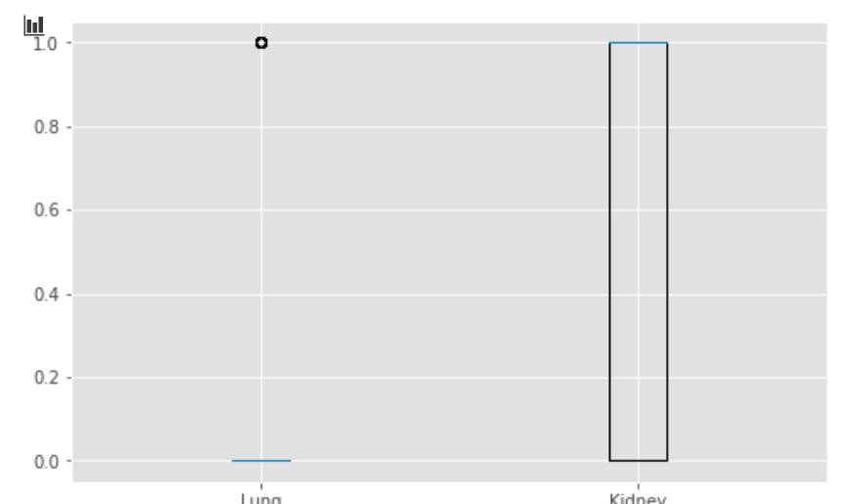
-My null hypothesis is that the frequency Lung disease case being severe is equal to the frequency that Kidney being severe. My rejection threshold level is 3% -Alternate hypothesis is the Kidney grp has higher severe frequency
P value: 0.00019 with Ttest
P value: 0.0001 with ztest
Reject:Null Hyp
Lung group has 66 patients with 16 being severe
Kidney group has 41 patients with 25 being severe
With 1 being severe and 0 being non-severe

Slide 8
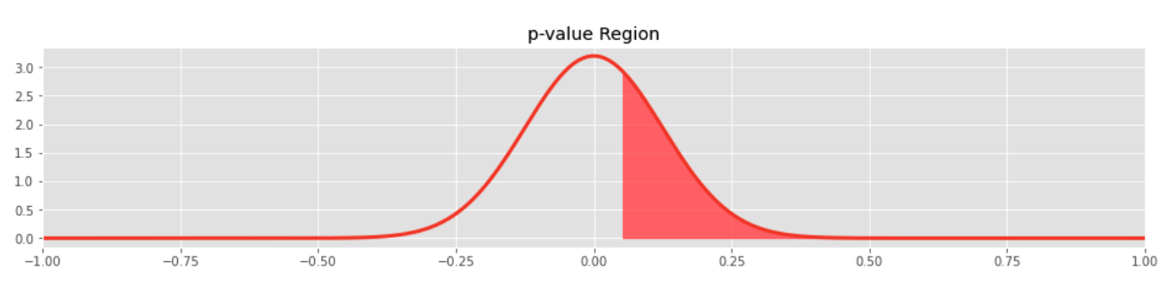
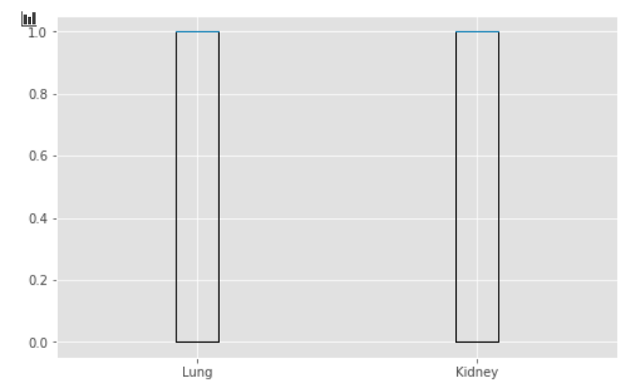
-My null hypothesis is that the frequency Immuno disease case being severe is equal to the frequency that Kidney being severe. My rejection threshold level is 3% -Alternate hypothesis is the Kidney grp has higher severe frequency
P value: 0.69765 with Ttest
P value: 0.65498 with ztest
Can’t reject Null Hypothesis
Immuno group has 25 patients with 14 being severe
Kidney group has 41 patients with 25 being severe
With 1 being severe and 0 being non-severe

