Slide 1
Electronic System Design 3003 Figure of Merit (2) Worked Examples
Dr Sajjad Hussain
Thanks to Prof. Duncan Bremner
Sajjad.Hussain.2@glasgow.ac.uk

Slide 2
Integrate-and-Hold circuit:- Revisited
If S1 connects to V_{in} circuit is an integrator
If S1 connects to 0V circuit is a memory
How can we use analysis to improve performance?

Slide 3
Figure of merit (1)
To improve performance we need a better opamp…
Performance depends significantly on I_{B} and V_{OS}.
Make this bit good!
TL071CP: F = 200pA · 2MΩ + 10mV = 10.4mV
Note that F is a function of the external circuit: Different
circuits have different Figures of Merit. There is no “Best” opamp

Slide 4
Figure of Merit (2)
Having downloaded data on many opamps use a spreadsheet to calculate F. Using the same data set as before:

Slide 5
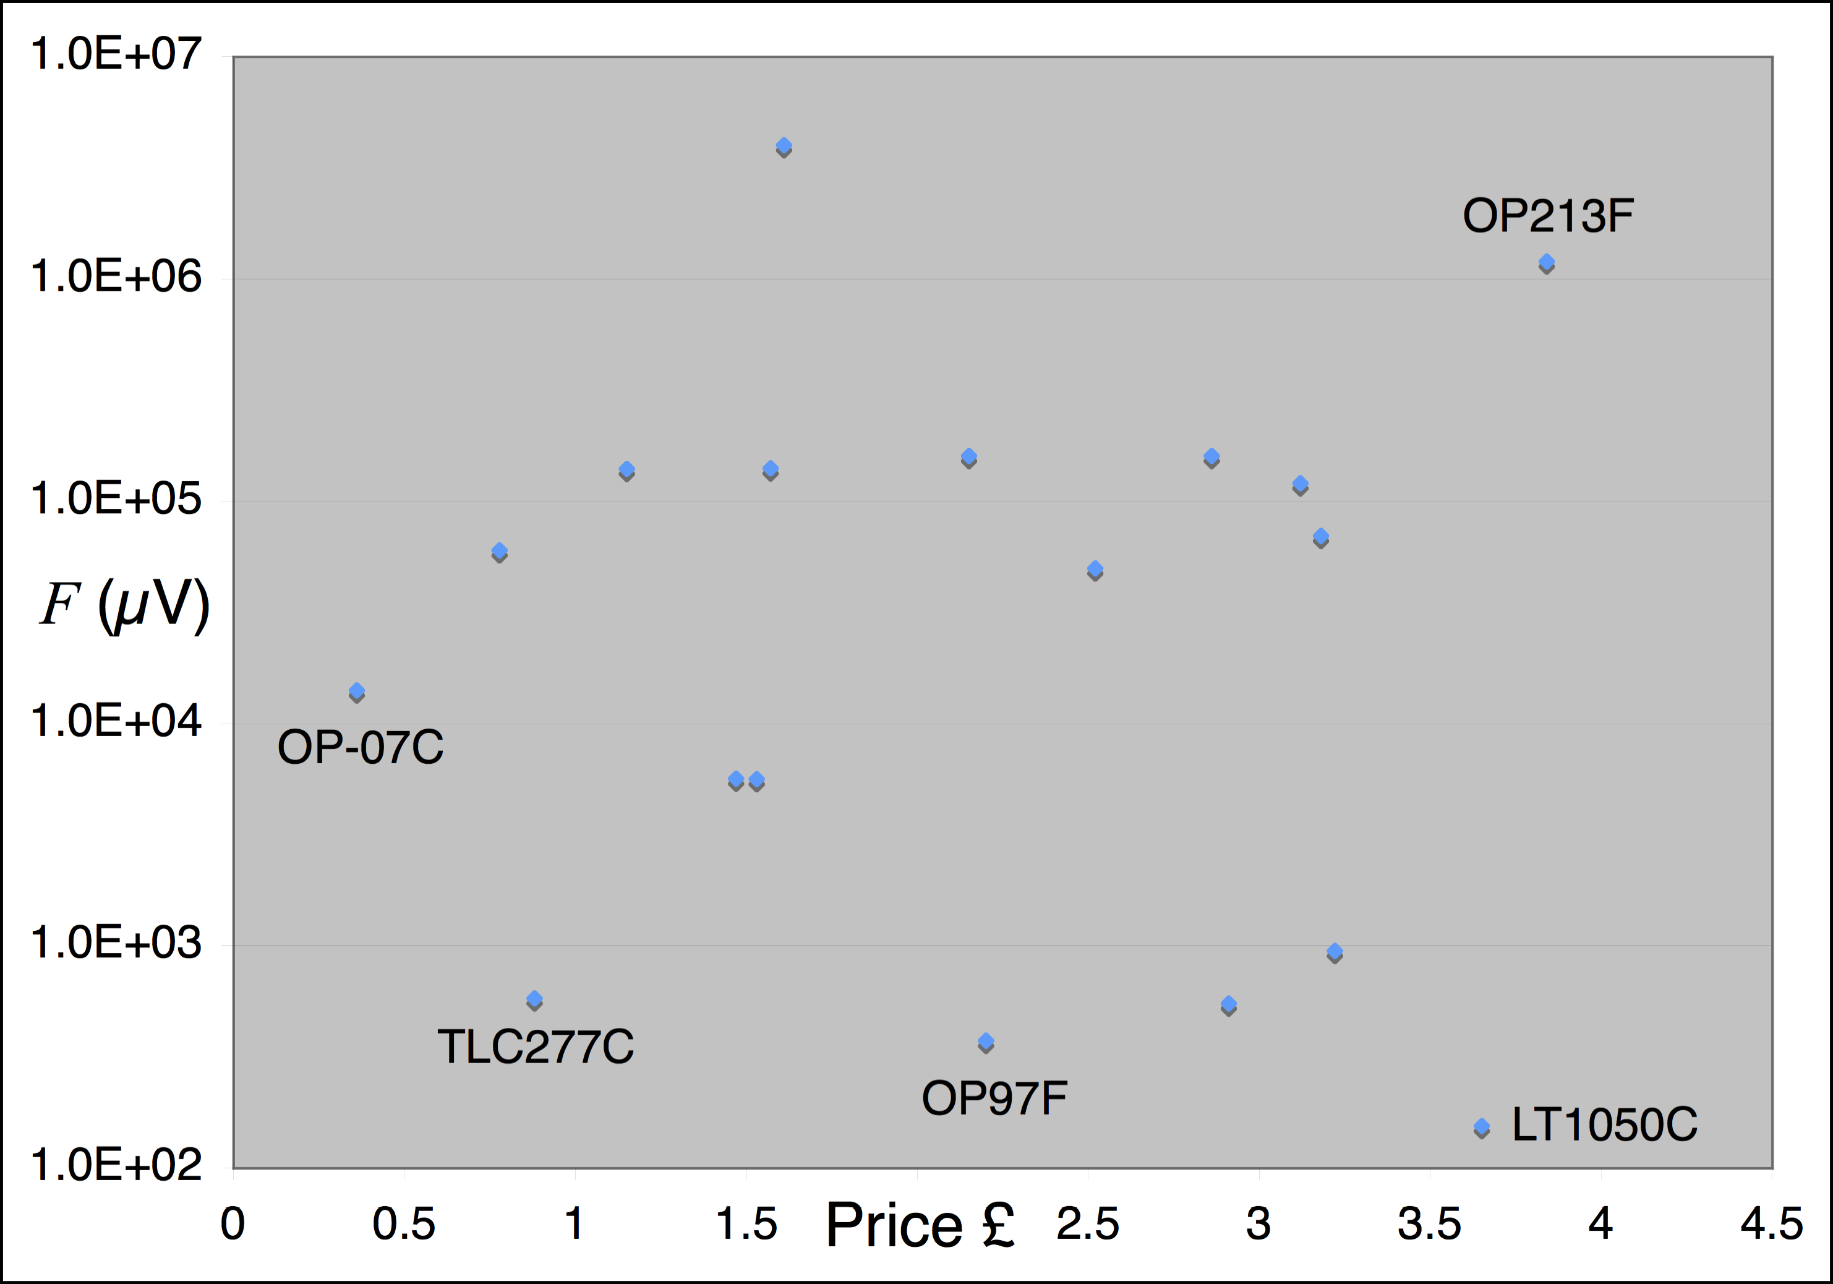
Figure of Merit (3)
TLC277 is 4x worse
Than the best and is 88p (dual). Best is LT1050C, 4x more expensive.
OP213 is even more expensive and second worst.
Choose cheapest which meets spec.

Slide 6
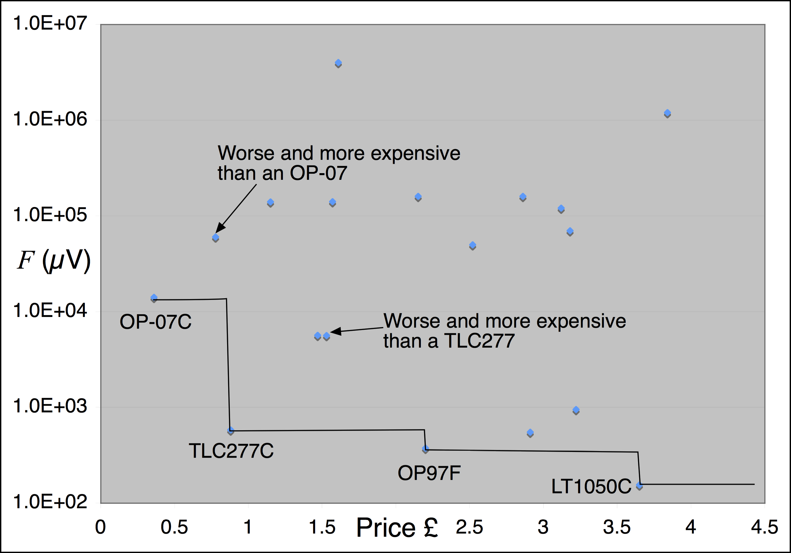
Figure of Merit (4)
Only good choices are OP07, then TLC277, then OP97, then
LT1050. All others are more expensive than a better opamp.

Slide 7
Figure of Merit(5)
Things to take away
• “Best” opamp depends on what it is used for
• Second worst design is 8 000x worse than the best for the same price
• Good cheap design is only 4x worse than most expensive
Money does not buy success!
• Expensive design may have other problems (chopper)
• Hunting for components is a pain (=> acquire favourites)
Proper system design is always worth it.

Slide 8
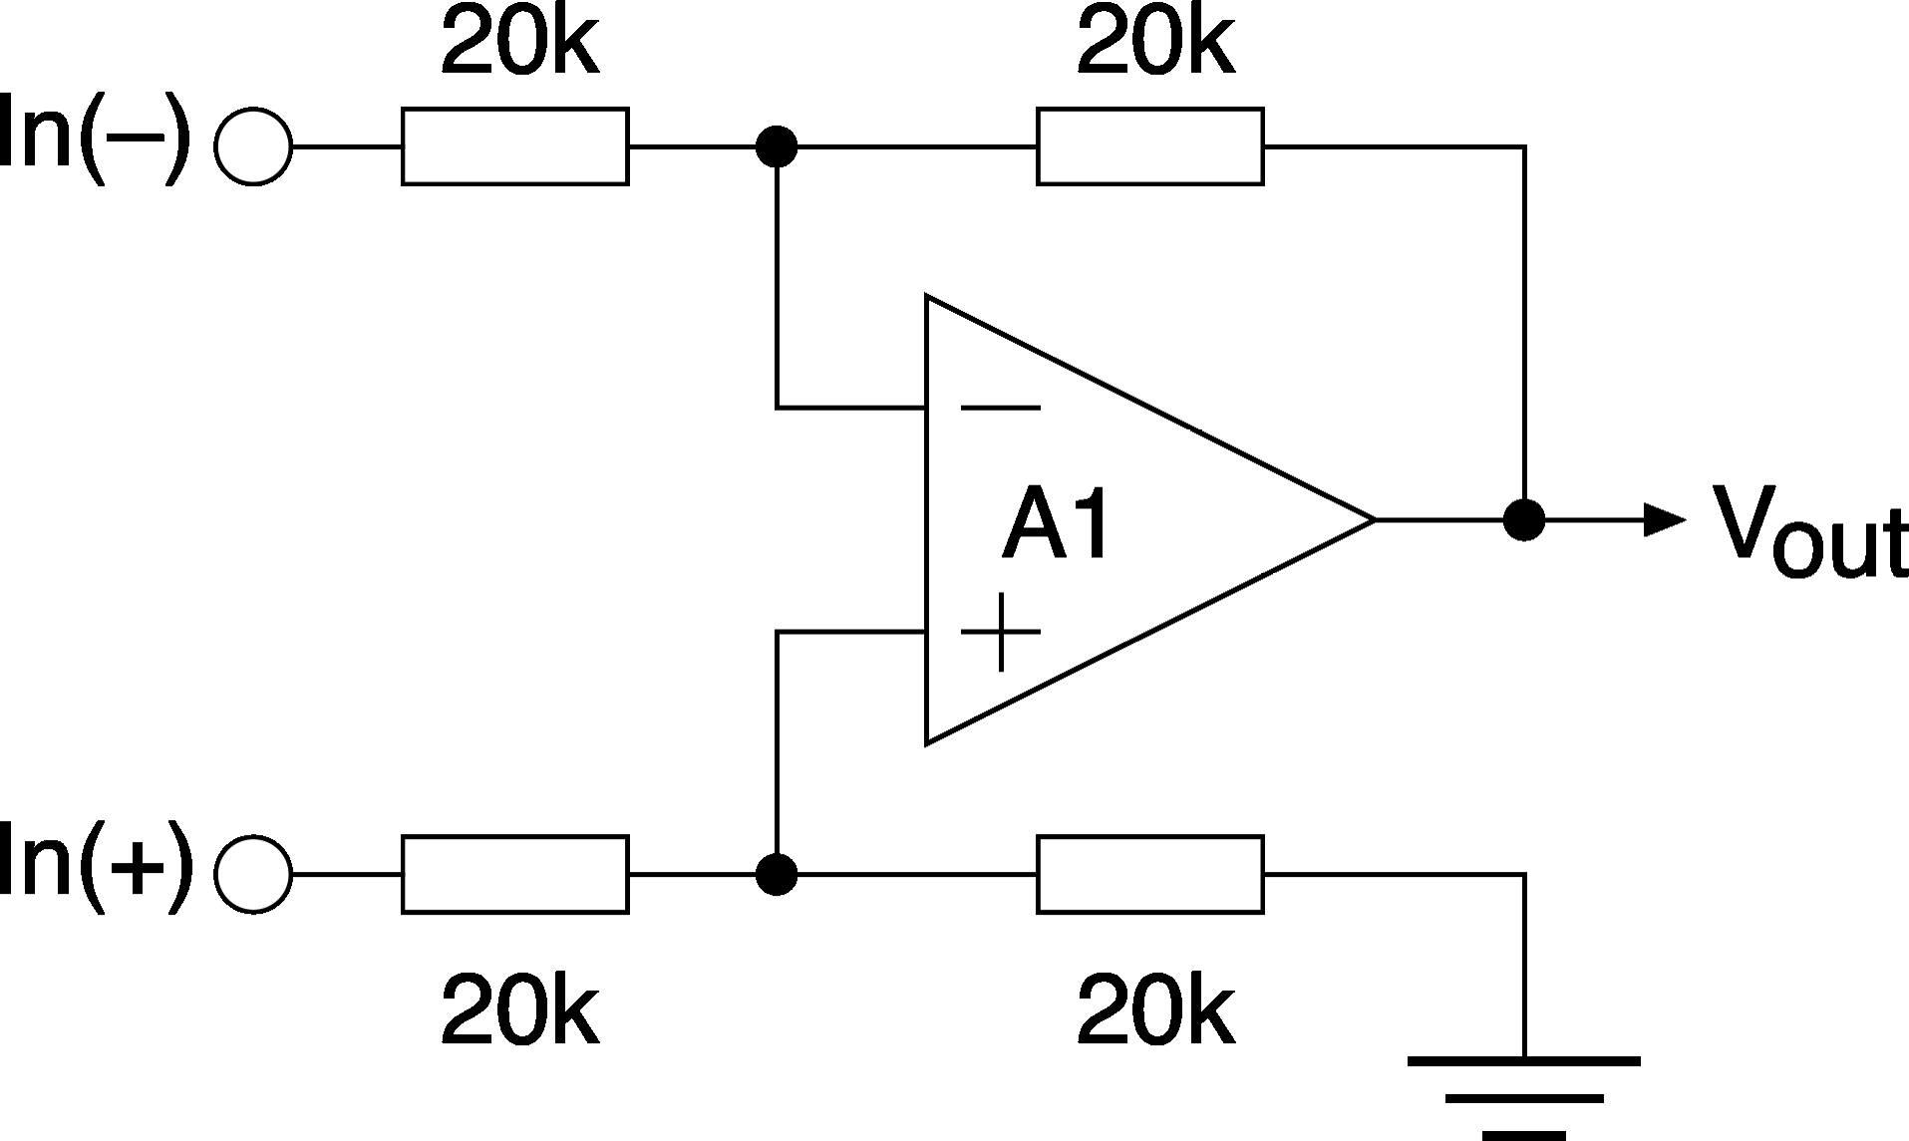
Figure of Merit Example 2
Differential amplifier
Note: Impedances are already matched: Ignore I_{B}, just I_{OS}

Slide 9
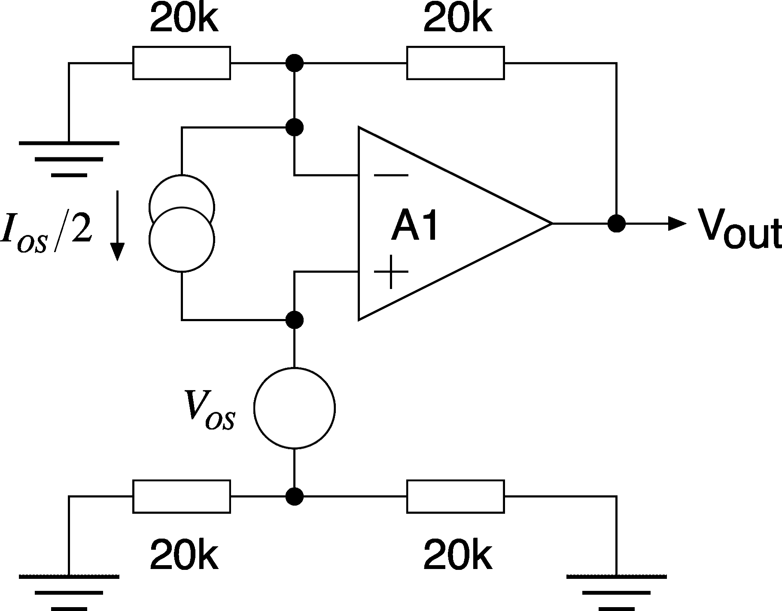
Figure of Merit Example 2 (2)
Calculate error RTO: (Set inputs to zero: Superposition!)

Slide 10
Figure of Merit Example 2 (3)
Let this be the figure of merit:

Slide 11
Figure of Merit Example 2 (4)
Using the same set of opamps:

Slide 12
Figure of Merit Example 2 (5)
Graphing:
Worse than an OP-07
(More error for more money)
OP07
F(µV)
OP277
OP97
LT1097
OP177
LT1050
Price (£)

Slide 13
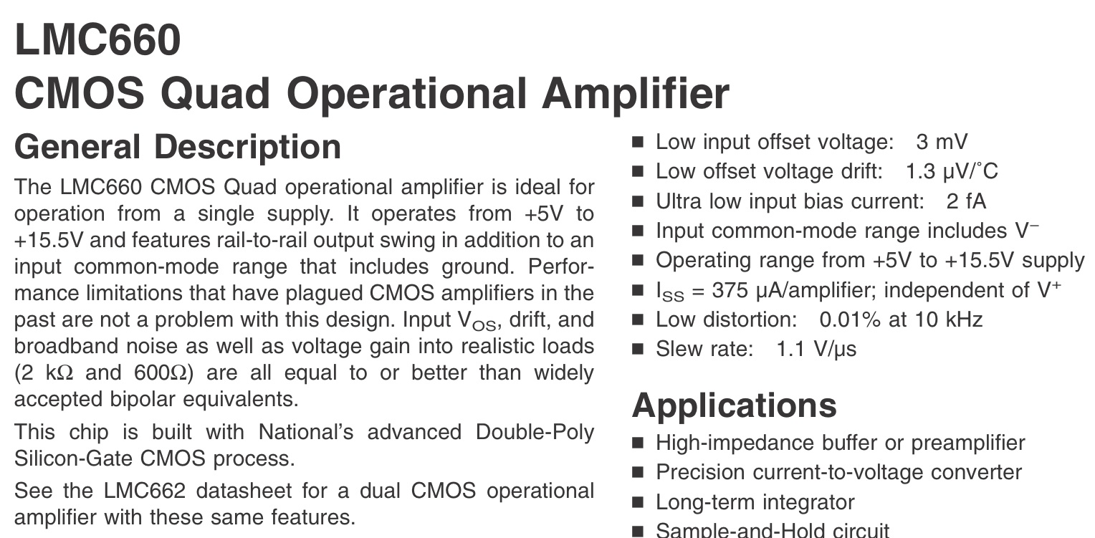
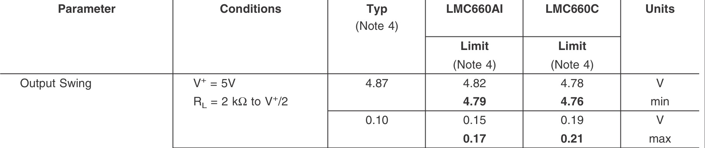
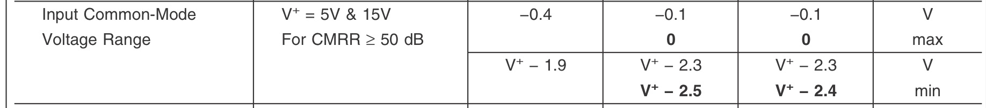
Final check
Final choice: Read the datasheet for other specifications which may be important, especially changes with time, temperature, power supply etc. Also any “Unusual” normal specifications (LMC660)
Incompatible with its own
output!

Slide 14
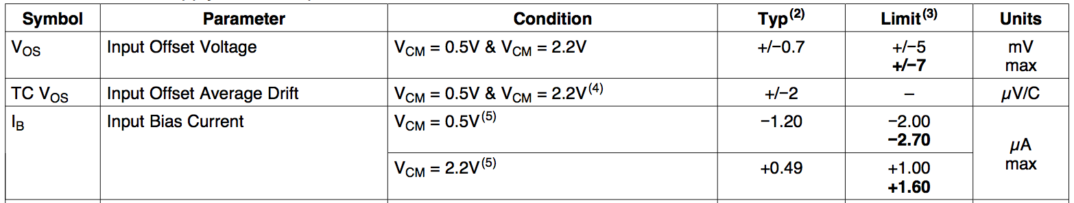
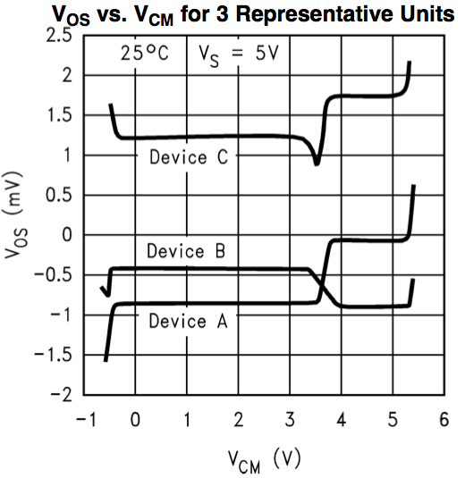
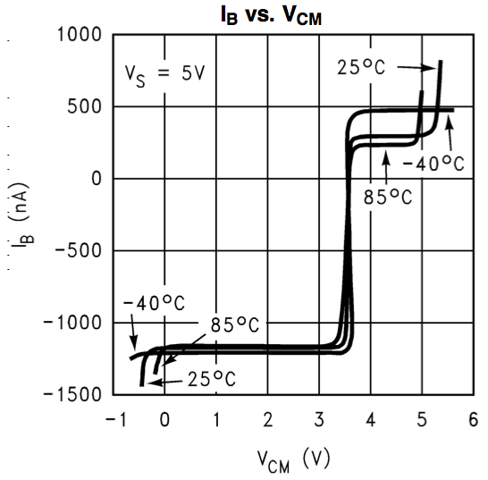
Final Check (2)
Single supply opamp LM8261:
Parameter varies
A lot with V_{CM}!
e.g. dI_{B}/dV_{CM}
=R_{IN}

Slide 15
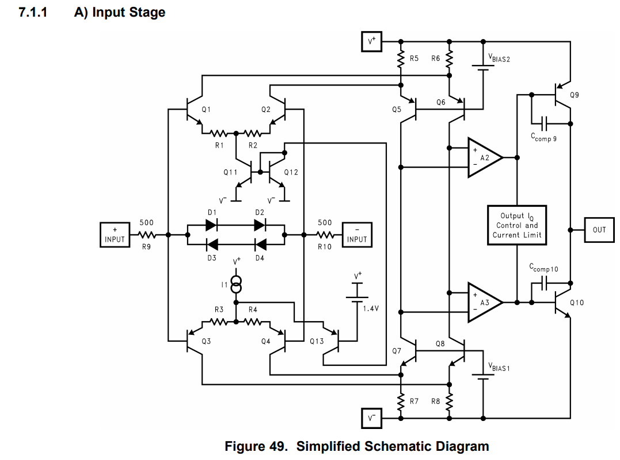
LM8261: Why is this happening: check the datasheet !
And these devices operate here…
These devices operate here…
=0V
Read the datasheet to find out the full story!!!

Slide 16

Thank you
谢谢

