Slide 1
NanoSim
Yina Arenas
Mona Sergi
Tamal Saha

Slide 2
Overview
Focus of the project
Nanosim as a case study
Role playing simulation
Different types of participants and services
Deliver content according to participants properties
Agenda:
Lifecycle
Risk Analysis and Mitigation
Requirements and Specifications
Architecture
Implementation
Source code management

Slide 3

Life Cycle
Spiral/Evolutionary model
2 weeks
Risk analysis
Requirement analysis
Preliminary architecture design
Wiki
3 weeks
Complement initial architecture adding web service layer
Data access layer
Initial services
3 weeks
Service implementation
Functional testing

Slide 4

Risk Analysis
The first step our spiral model
The risks:
Scope and time management
Team background
Git/SVN
Extensibility/Flexibility
GWT
Correctness

Slide 5

Requirements & Specifications
Requirements
For developers
Easy extension
For instructors
Small time setup
For the students:
User friendly environment
Fulfilment of pedagogical goal
Access from different locations
No extra installation on the end user’s system

Slide 6
Requirements & Specifications
Specifications:
Database independency
Access control
Services
Group / user management
Budget transactions
Mail
Proposal
Research
Patent

Slide 7
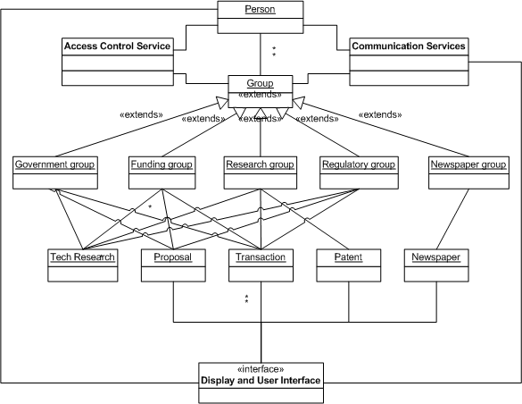
Architecture

Slide 8
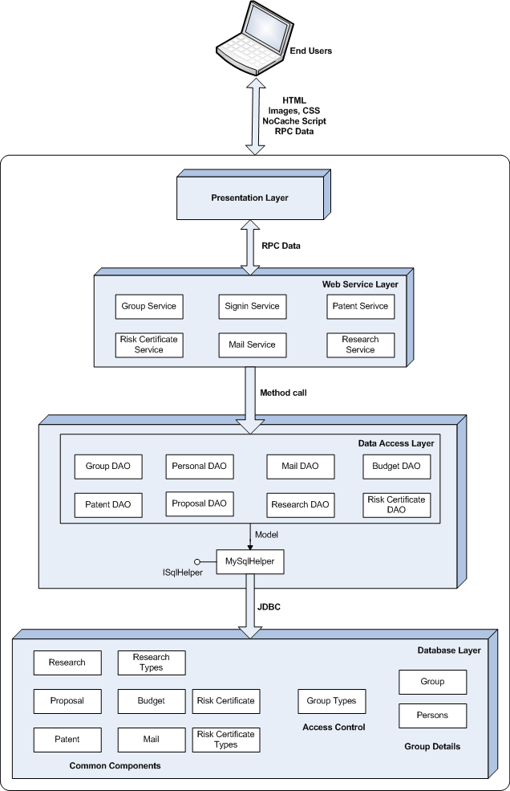

Slide 9
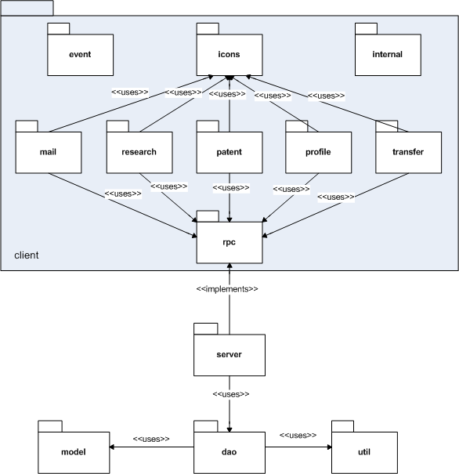
Implementation

Slide 10

Source code management

Slide 11

Testing
Functional testing

Slide 12
Conclusion
Developed an understanding of the challenges involved in developing software
Better literature comprehension by doing an actual project implementation.
Learned about new technologies
Got further insight on the interaction strategies and team work skills by using a collaborative development environment.

Slide 13

Any questions?

