Slide 1

Malignant Commentes Classifier using Machine Learning
By- TAMALI SAHA
Internship Batch No- 33

Slide 2

Introduction to Malignant Comments Classifier
People can now freely express themselves online due to the growth of social media. However, concurrently, this has led to the emergence of conflict and hatred, making online spaces hostile for users. Despite the fact that researchers have discovered that hate is an issue on a number of platforms, there aren't any models for detecting hate online. Online hatred has been identified as a significant hazard on social media websites, including abusive language, aggressiveness, cyberbullying, hatefulness, and many more. The most common environment for such harmful behaviour is social media platforms.

Slide 3
Introduction to Malignant Comments Classifier
On various social media platforms, there has been a striking rise in the number of instances of cyberbullying and trolls. People are criticising many celebrities and influencers, and they frequently encounter harsh and abusive remarks. Anyone can suffer from the mental effects of this, which can include despair, mental disease, self-hatred, and suicidal thoughts.
Internet comments are bastions of hatred and vitriol. While online anonymity has provided a new outlet for aggression and hate speech, machine learning can be used to fight it. The problem we sought to solve was the tagging of internet comments that are aggressive towards other users. This means that insults to third parties such as celebrities will be tagged as unoffensive, but “u are an idiot” is clearly offensive

Slide 4

Problem Statement
Our goal is to build a prototype of online hate and abuse comment classifier which can used to classify hate and offensive comments so that it can be controlled and restricted from spreading hatred and cyberbullying.

Slide 5
Data Sources and their formats
There are two set of data, training and testing. Training dataset has 159571 rows and 8 columns in other hand the testing dataset has 153164 rows and 2 columns. The model will train with the help of training dataset. It has 6 integer datatype and 2 object datatype. All integer datatype are actually binary in nature.

Slide 6
Data Pre-processing
1. ' --', 'null', 'NA', ' ' are not present in the traing and testing dataset.
2. Drop the unnecessary column ‘id’ from both dataset.
3. calculate the comment length before cleaning.
4. Here, the comments are 6 different type. If anyone is present the comment tagged as a malignant comment (bad/ negative) comment. So let’s make a new column named. If it is 0= Good comment, 1= malignant comment.

Slide 7
Exploratory Data Analysis
Let’s start the observation exploration of feature analysis.

Slide 8
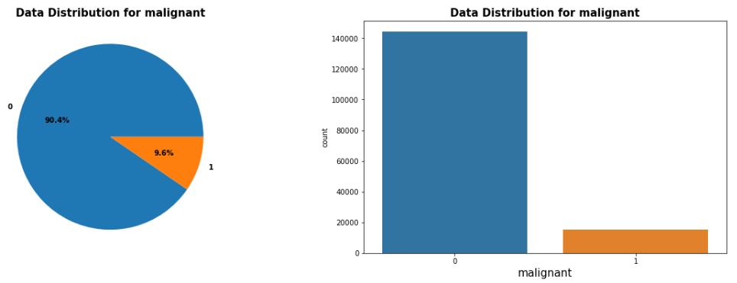
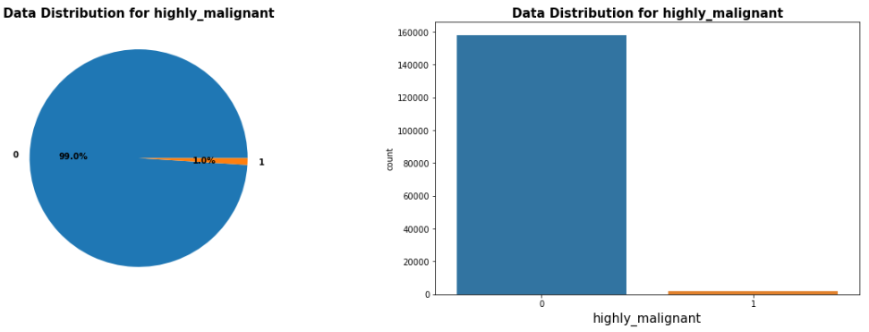
Different feature’s data Distribution
Observations:
1. For malignant comment distribution around 10% comment is malignant while 90% are good comments.
2. For highly_malignant comment distribution around 1% comment is highly_malignant while 99% are good comments.

Slide 9
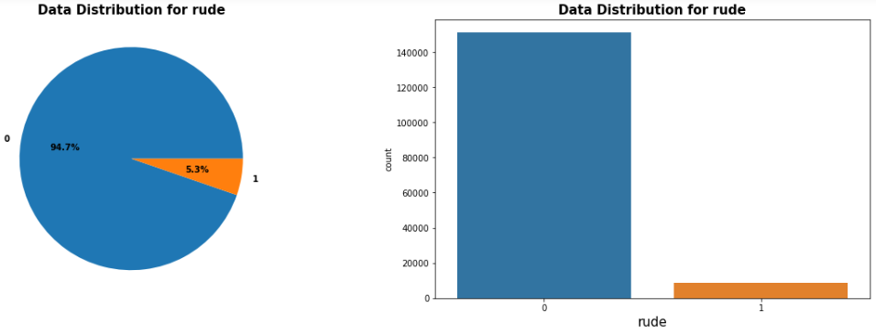
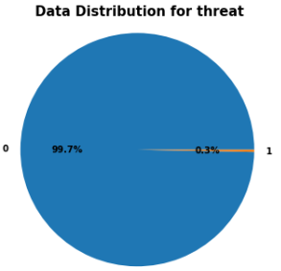
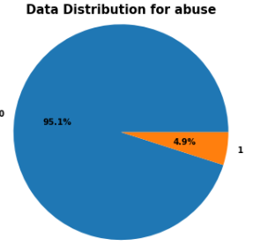
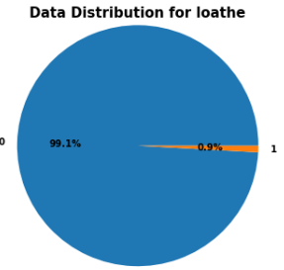
Different feature’s data Distribution

Slide 10
Observations:
For rude comment distribution around 5% comment is rude while 95% are good comments.
For loathe comment distribution around 1% comment is rude while 99% are not loathe comments.
3. For threat comment distribution only 0.3% comment is highly_malignant while 99.7% are not threatening comments.
4. For abuse comment distribution around 5% comment is rude while 95% are good comments.

Slide 11
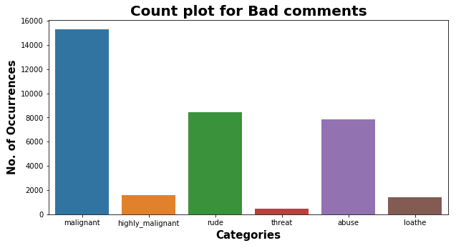
1. The maximum negative comments comes with Malignant in nature followed by rude categories. 2. Very few comments comes with threatening nature. 3. Total percentage of negative comment is 10.2% while good comment is 89.8%. 4. Around 90% comments are good while rest 10% comments are Negative in nature. 5. Out of total negative comments around 43.58% are malignant in nature followed by 24.07% are rude comments.
The above graph is the count plot of different types of Bad comments

Slide 12
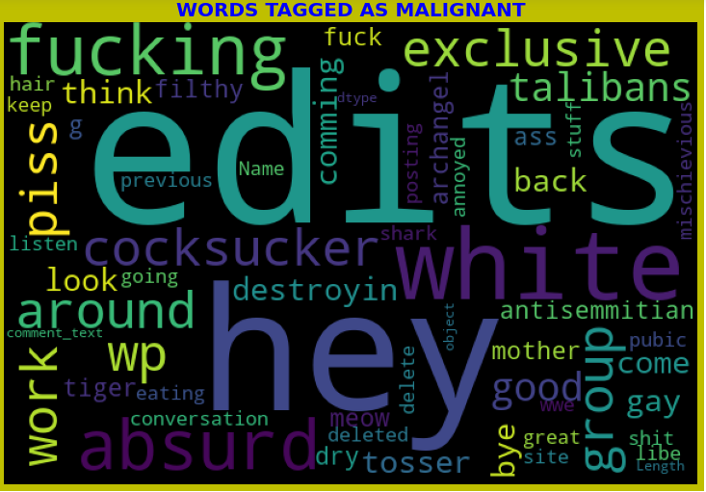
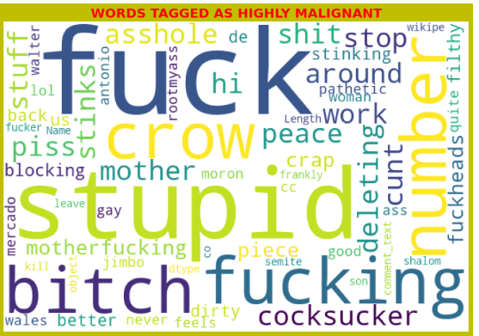
Word Cloud for different Feature:
We can see from the word clouds above that small texts are given less weight in their respective comment types than large texts are.

Slide 13
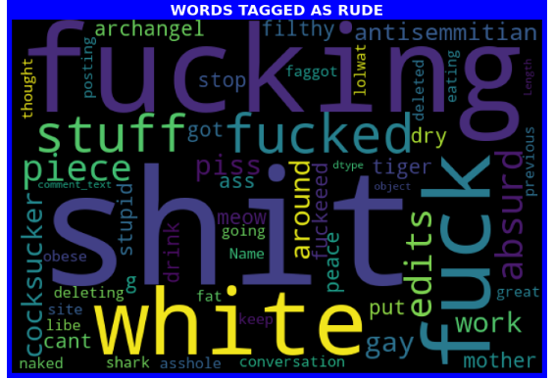
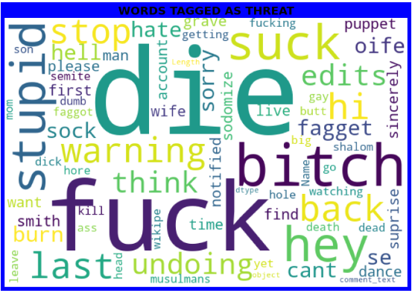
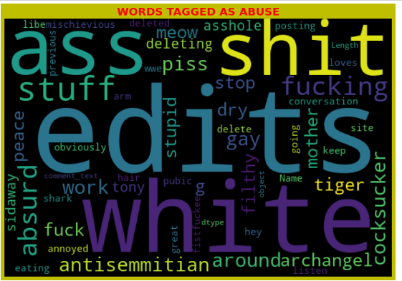
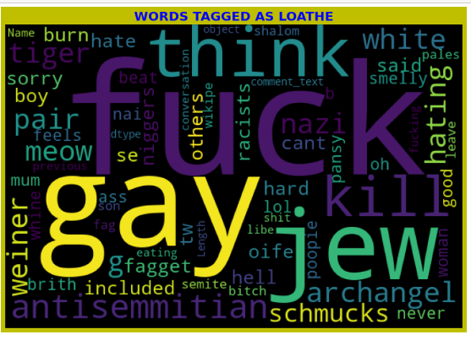

Slide 14
Observations:
1. From word cloud of malignant comments, it is clear that it mostly consists of words like edits, hey, white, fucking, absurd, piss, cocksucker, Taliban etc.
2. From word cloud of highly malignant comments, it is clear that it mostly consists of words like fuck, stupid, fucking, stupid, cocksucker, crow, piss, bitch, around, asshole etc.
3. From word cloud of rude comments, it is clear that it mostly consists of words like shit, fucking, stuff, fucked, white, absurd, piece etc.
4. From word cloud of threat comments, it is clear that it mostly consists of words like die, bitch, fuck, suck, stupid, back, hey, hi, back, last etc.
5. From word cloud of abuse comments, it is clear that it mostly consists of words like edits, white, ass, stuff, shit, piss, fucking, cocksucker, antisemmitian, gay etc.
6. From word cloud of abuse comments, it is clear that it mostly consists of words like fuck, gay, jew, kill, antisemmitian, think etc.

Slide 15
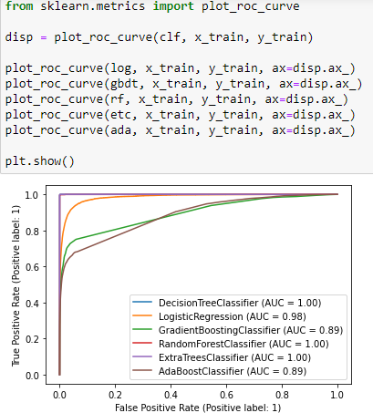
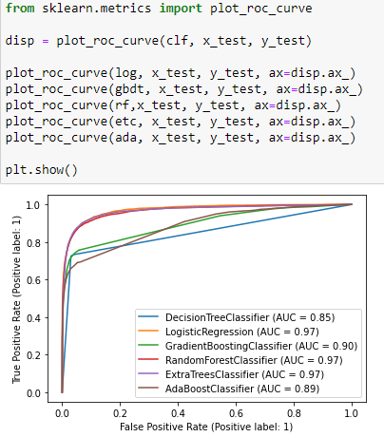
AUC- ROC Curve:

Slide 16
Machine Learning Model Building

Slide 17
Machine Learning Algorithm Used
The different classification algorithm used in this project to build ML model are as below:
Logistic Regression
Decision Tree Classifier
Gradient Boosting Classifier
Random Forest Classifier
Extra Trees Classifier
Ada Boost Classifier

Slide 18
Key Findings and Conclusions of the Study
Here, we observed the various detrimental effects that toxic or damaging social media remarks have on society. The ability to quickly and effectively identify remarks as hazardous could have a wide range of positive effects while also reducing the negative ones. We have also seen how easily accessible algorithms can be used in this way to handle this difficulty. It was shown in our particular investigation that a logistic regression solution offers a significant improvement in classification compared to any other approach.

Slide 19
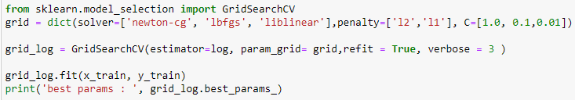
Hyperparameter tuning:
Best params: {'C': 1.0, 'penalty': 'l1', 'solver': 'liblinear'}Here accuracy score is slightly improved after using hyper parameter tuning. First, accuracy score was 0.957762013385807, but after applying hyper parameter tuning it is 0.9624495525530795.
Here for Random Forest, Logistic Regression and Extra tree classifier, the AUC score is same. Here also we take Logistic Regression for final model. So it is the final model for this dataset.
Here accuracy score is slightly improved after using hyper parameter tuning. First, accuracy score was 0.957762013385807, but after applying hyper parameter tuning it is 0.9624495525530795
Best params: {'C': 1.0, 'penalty': 'l1', 'solver': 'liblinear'}

Slide 20
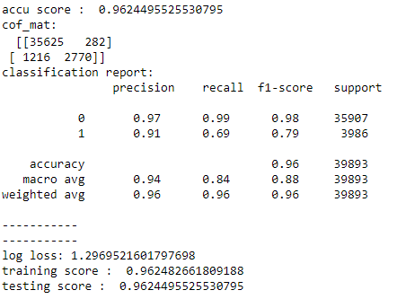
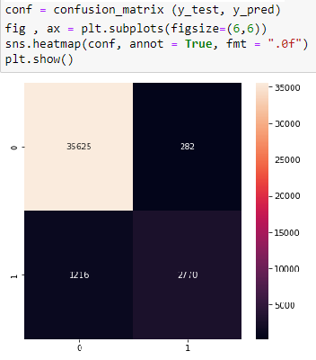
Final Model and Confusion Matrix:

Slide 21
Limitations of this work and Scope for Future Work
Additionally, the following studies are examples that might be taken into account for future work in this field:
We offer the following strategy to enhance NLP classifiers: Convolutional neural networks (CNN) and Support vector clustering (SVC) are two additional algorithms that can be used to enhance the performance of existing classifiers. In the present study, the issue was reduced to two classes, although it is worthwhile to pursue the primary objective of six classes of remarks.
For text processing and text classification, we also advocate the use of SVM. To achieve the best results, a grid search is necessary for hyper-parameter optimization.

Slide 22


