Slide 1

Micro-Credit Defaulter predication using Machine Learning
By- TAMALI SAHA
Internship Batch No- 33

Slide 2

Introduction to Micro Credit
Microcredit is a popular type of microfinance in which a very small loan is offered to a person in order to assist them in starting their own small business or becoming self-employed. These borrowers typically have low incomes, especially those from less developed nations (LDCs).

Slide 3
Problem Statement
Telecom provider provide micro-credit on mobile balances to be paid back in 5 days.
Loan Varity :
Loan amount of 5 - Payback amount 6 (in Indonesian Rupiah)
Loan amount of 10 - Payback amount 12 (in Indonesian Rupiah)
Build a model which can be used to predict in terms of a probability for each loan transaction, whether the customer will be paying back the loaned amount within 5 days of insurance of loan. In this case, Label ‘1’ indicates that the loan has been payed i.e. Non- defaulter, while, Label ‘0’ indicates that the loan has not been payed i.e. defaulter.

Slide 4
Data Sources and their formats
Micro Credit Defaulter dataset contain 209593 rows and 37 columns.
To determine the data format, info() method is used. There are total 3 categorical columns among 37 columns.
Data integrity check is perform for missing values, duplicate data, data error.
Target feature is label and it is int datatype. But it is binary. So the problem is a Classification problem.
No null values, whitespaces, ‘NA’, ‘-’ are present in dataset.

Slide 5
Data Pre-processing
pdate is an object datatype. Need to convert in in date format. Then Extracting new columns for day, month and year out of ‘pdate’
By mistake, "-" (minus) is typed in front of all negative values. To remedy errors, negative numbers are transformed into absolute positive values.
Drop unnecessary column like , 'Unnamed: 0', 'p_year','pcircle‘.
All negative min value except medianmarechprebal90, medianmarechprebal30 are deleted by replacing with abs of corresponding values.
The maximum value in maxamnt_loans30 is not reliable as maximum value is 12. Replacing values greater than 12 into category of zero.

Slide 6
Exploratory Data Analysis
Let’s start the observation exploration of feature analysis.

Slide 7
Project Flow Tasks Perform
Check the presence of duplicate or any data error.
Missing values present in data set.
Imputation of missing value with mean, median or mode is performed.
Feature Engineering for extraction of few new features out of existing features.
Feature selection
Label Encoding of Categorical features
Splitting of dataset into input & target feature
Standard Scaling of data
Finding Final model with respect to best Accuracy Score, CV Score.

Slide 8
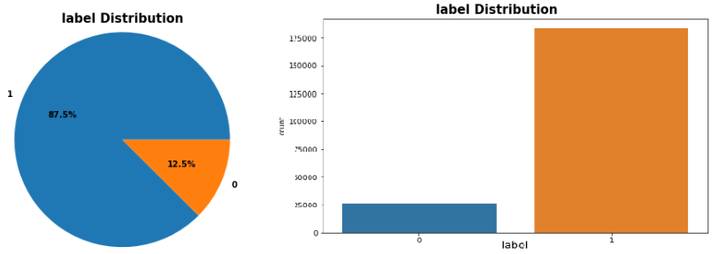
Target Variable Label Distribution
Observations:
Here Label ‘1’ indicates that the loan has been payed i.e. Non- defaulter, while, Label ‘0’ indicates that the loan has not been payed i.e. defaulter.
Maximum customers around 87.5% are Non-defaulter (label = 1).
Here the dataset is imbalanced.

Slide 9
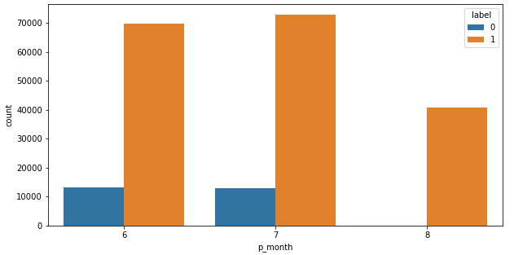
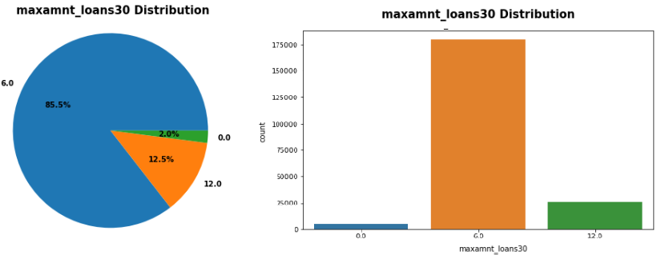
Observations:
Observations:
1. Maximum defaulter are from month 6 and 7.
2. There are no defaulter for month 8.
3. Maximum number of people had taken maxamnt_loans30 equal to 6 as the loan amount and the percentage is 85.5%.
4. The number of people had not taken loan in last 30 days is 4291 which is 2.0%.
5. Obviously maximum defaulter are from maxamnt_loans30 = 6 group.

Slide 10
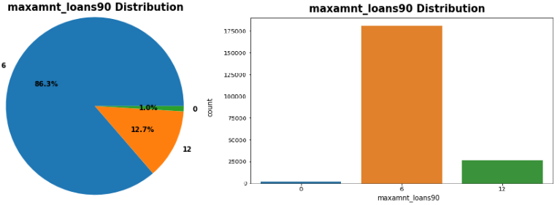
1. Maximum number of people had taken maxamnt_loans90 equal to 6. 2. The number of people had not taken loan in last 90 days is 2043 which is 1.0%. 3. Obviously maximum defaulter are from maxamnt_loans90 = 6 group. 4. For maxamnt_loans30= 0, there are defaulter. But for maxamnt_loans90= 0, there are no defaulter.

Slide 11
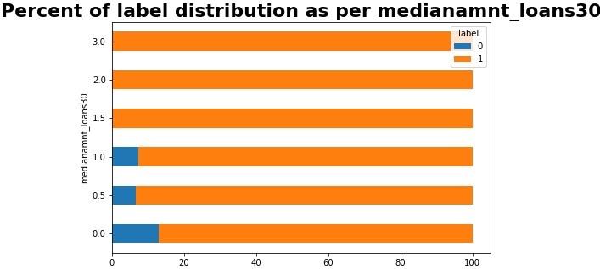
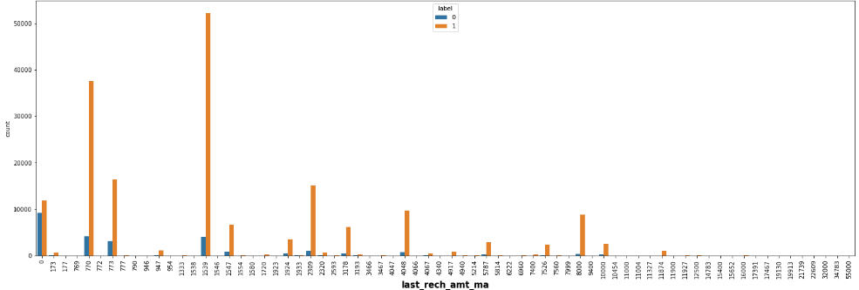

Slide 12
Observations:
Maximum medianamnt_loans30 that is Median of amounts of loan taken by the user in last 30 days is 0.0.
No defaulter for medianamnt_loans30 equal to 1.5, 2.0, 3.0
Maximum medianamnt_loans90 that is Median of amounts of loan taken by the user in last 90 days is 0.0.
No defaulter for medianamnt_loans90 equal to 1.5, 2.0, 3.0
Amount of last recharge of main account is maximum for 770, 1539.
Max defaulter are from last_rech_amt_ma=0.

Slide 13
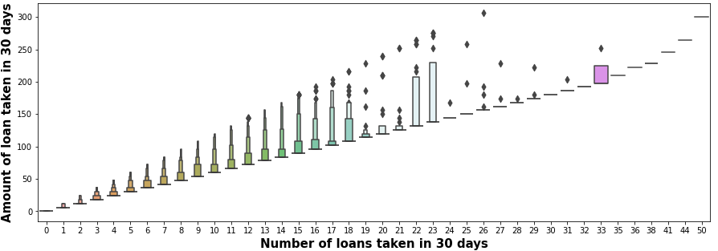
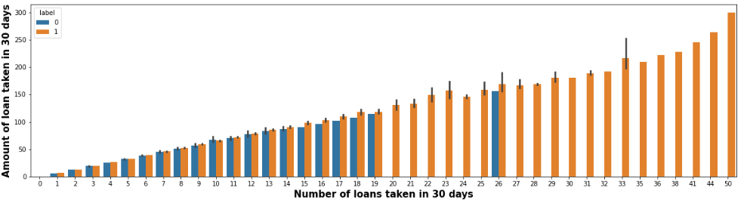

Slide 14
Observations:
Maximum number of loans taken by the people is 50 and the loan amount is equivalent to 300.
Minimum number of loans taken by the people is 0.
No defaulter are there if Number of loans taken in 30 days is in 30 to 50.

Slide 15
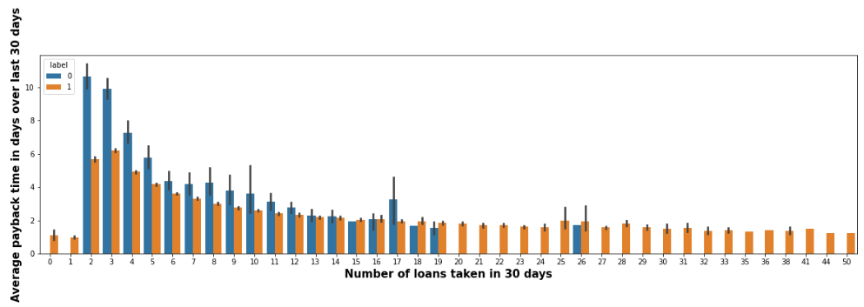
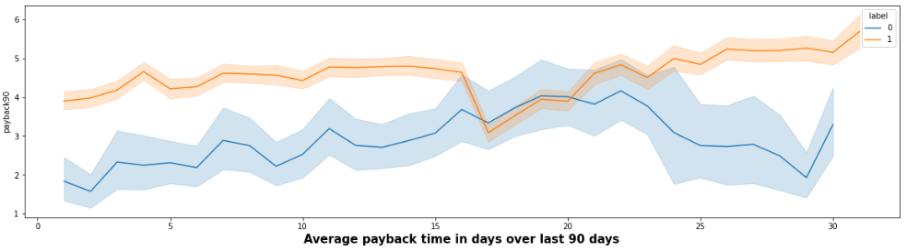

Slide 16
Observations:
The Average payback time over last 30 days is higher for people who had taken 2 and 3 times the loan in 30 days.
The users with less number of loan taking are more the defaulters.
If Number of loans taken in 30 days is increased, the defaulters are decreased.
Average payback time in days over last 90 days is higher for Non- defaulter users.

Slide 17
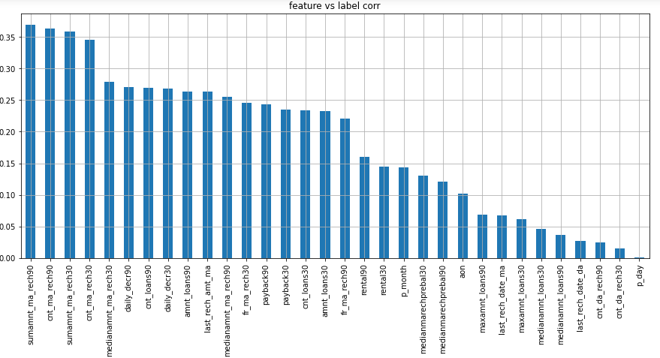
Correlation:
All the features are correlated with target.
sumamnt_ma_rech90, cnt_ma_rech90, sumamnt_ma_rech30, cnt_ma_rech30 are highly correlated with each other

Slide 18
Machine Learning Model Building

Slide 19
Machine Learning Algorithm Used
The different regression algorithm used in this project to build ML model are as below:
Logistic Regression.
DecisionTreeClassifier
GradientBoostingClassifier
RandomForestClassifier
ExtraTreesClassifier
AdaBoostClassifier

Slide 20
ML Model Building Flow
Standard Scaling of Data
Splitting Training Data Using test_train_split
Finding Best Random state
Training ML Model on Different Algorithms
Hyper Parameter Tuning of every model
Apply 5 Fold Cross Validation with every different Model
Selection of Best Model Based on Evaluation Criteria
Saving final Model
Find best contributed feature among all of the features.
Predicating Test Dataset using Final Model

Slide 21
Key Findings and Conclusions of the Study
Tables of Findings using different algorithms after Hyper Parameter Tuning
Algorithm |  | Accuracy Score | Recall | Precision | F1 Score | Mean CV Score | Std Deviation
Logistic Regression |  | 0.7670 | 0.77 | 0.77 | 0.77 | 0.7628 | 0.0017
DecisionTreeClassifier |  | 0.8728 | 0.87 | 0.87 | 0.87 | 0.8755 | 0.0004
GradientBoostingClassifier |  | 0.800 | 0.80 | 0.80 | 0.80 | 0.7985 | 0.0033
RandomForest Classifier |  | 0.9331 | 0.93 | 0.93 | 0.93 | 0.9355 | 0.0015
ExtraTrees Classifier |  | 0.9472 | 0.95 | 0.95 | 0.95 | 0.9497 | 0.0007
Ada Boost Classifier |  | 0.7779 | 0.78 | 0.78 | 0.78 | 0.7738 | 0.0029

Slide 22
Conclusion:
Here Extra Trees Classifier giving maximum Accuracy Score, minimum RMSE Value, Maximum CV Score and minimum Standard Deviation. So Extra Trees Classifier is selected as best model.

Slide 23
Limitations of this work and Scope for Future Work
Primarily, the dataset is a huge dataset. But as the target variable is imbalanced, here we need to apply oversampling method. But then the dataset is bigger than earlier. If I use under sampling, the running time may be less as compared to now.
Accuracy score can increase with hyper parameter tuning with several different parameter. As it takes a lot of time, I am not able to use lot of parameters here for tuning.

Slide 24


