Slide 1
Project Presentation On “Customer Retention”
Presented by Tamali Saha

Slide 2
Agenda:
Overview
Problem Statement
What is customer Retention?
Why is customer retention important?
Exploratory data analysis
Visualization
Conclusion

Slide 3
Overview
Here we study a customer retention dataset which is collected from the Indian online shoppers. Results indicate the e-retail success factors, which are very much critical for customer satisfaction. Here we analyse
The criteria to achieve the Customer Retention
Overall analysis on the problem
Make conclusion for betterment

Slide 4
Problem Statement
Customer satisfaction has emerged as one of the most important factors that guarantee the success of online store; it has been posited as a key stimulant of purchase, repurchase intentions and customer loyalty. A comprehensive review of the literature, theories and models have been carried out to propose the models for customer activation and customer retention. Five major factors that contributed to the success of an e-commerce store have been identified as: service quality, system quality, information quality, trust and net benefit. The research furthermore investigated the factors that influence the online customers repeat purchase intention. The combination of both utilitarian value and hedonistic values are needed to affect the repeat purchase intention (loyalty) positively.

Slide 5
What is customer Retention?
Customer retention refers to a group of strategies used by a company to enhance the proportion of returning customers and the profitability of each individual client. Utilizing customer retention tactics enables you to give and receive more value from your existing customer base. You want to make sure the clients you've worked so hard to get will stick around, enjoy doing business with you, and continue to find value in your offerings.

Slide 6
Why is customer retention important?
Focusing on client retention makes sense for a variety of reasons, including:
1. Keeping current clients is up to five times less expensive than finding new ones. 2. A sale to an established customer has a 60-70% occurring rate. 3. Maintaining the present clients fosters loyalty and word-of-mouth referrals. 4. Existing customers are more likely than new customers to spend 30% more on a new product. 5. Gains in revenue and client lifetime value are correlated with better Customer Retention Values (LCV). 6. Long-term clients can offer insightful information and suggestions for the next brand campaigns and tactics.

Slide 7
Exploratory data analysis
First make the system (Jupyter NoteBook) suitable for work by importing necessary libraries.
Import data as csv file and read the data.
Check data shape: 269 rows and 71 columns
Check null values: No null values are present
Check duplicate entries by row wise: No duplicate entry
Check value counts and other statistical parameters.
Replace the duplicate entries(same meaning) of unique values of a specific feature(column).

Slide 8
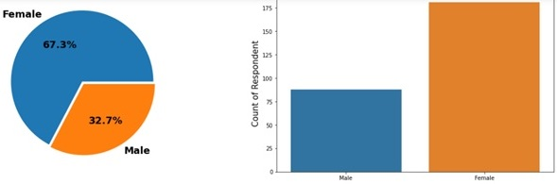
Exploratory data analysis Take a look on data visualization

Slide 9
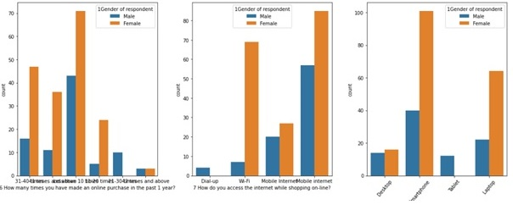
Exploratory data analysis Take a look on data visualization

Slide 10
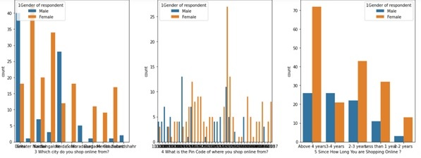
Exploratory data analysis Take a look on data visualization

Slide 11
Exploratory data analysis Here we visualize some data analysis in pie plot and bar plot. In this way we visualize all features detail of their respective unique values and made the following observations.
The maximum of gender column are Female with 66.9%
For age group 51 and above the max number of customer are Male
As age increased, the tendency of shopping is decreased.
Most of female shopping since 4 Yrs.
Around 70% customers are use mobile internet while shopping.
Maximum customer are from Delhi followed by Greater Noida.
No female had made shopping in range of 21-30 times
In Bulandshahr and Moradabad the customer number is least and they are male.
Max user are use Google Chrome as their browser followed by safari.

Slide 12
Exploratory data analysis
Content marketing and display Advert is less popular than Search Engine.
There is no Desktop and Tablet with IOS/Mac OS. Max IOS/Mac are in Smartphone
Mozilla Firefox is used only by device with 5 inch screen size.
Content Marketing is mainly access by IOS/Mac user.
Max laptop have Window OS
In Gurugram around 90% customer are in the age group over 51 years.
171 customer sometimes abandon shopping cart.
The customer who explore less than 5 mins before making purchase have very less tendency to abandon cart.
It can conclude that the website is more popular to the young aged customer as all the response from them are very positive form all aspects.
54.3 % customer are strongly agreed that Shopping online is convenient and flexible
Over 90% customer are agreed that User satisfaction cannot exist without trust.

Slide 13
Conclusion
Maximum customer says that, the most reliable website from different parameter is Amazon. But still it need to do some improvement like disturbance free shopping experience during promotion, corresponding product price early during promotion, Need to give more payment options to customers etc.
Maximum customers says that, Myntra has the drawback of having late declaration of price.
Benefit of Flipkart is fast delivery of products and convenient to use.
Delivery time of Paytm need to reduce.
Max customers uses there debit/credit cards for there payment.
Paytm and Snapdeal has maximum drawbacks it is because of their dead old strategies
Snapdeal and Paytm have many drawbacks of having limited payment modes, not much secure, liable and also they have a complaint of late delivery.

Slide 14


