Slide 1

Presentation on Flight Price Prediction using Machine Learning
By- TAMALI SAHA
Internship Batch No- 33

Slide 2

Introduction to Flight Price Prediction
Customers are seeking to get the lowest price for their ticket, while airline companies are trying to keep their overall revenue as high as possible and maximize their profit. India is the third-biggest avionics showcase in 2020 and the biggest by 2030.

Slide 3

Introduction to Flight Price Prediction
The airline industry is regarded as one of the most progressive, employing sophisticated strategies and ways to dynamically allocate airline rates. These sectors strive to maintain the highest feasible total income and increase profit. The client typically pays more or the airline firm loses money when there is a mismatch between the number of seats available and the number of passengers who want to book them. The majority of airline corporations have cutting-edge technologies and skills that allow them to manage the pricing process. Furthermore, the task of determining on optimal pricing is challenging for everyone due to airline competition. Anyone who has purchased a plane ticket is aware of how costs may change suddenly.

Slide 4
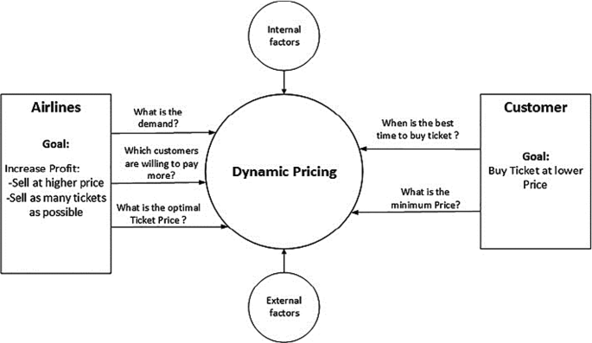

Slide 5
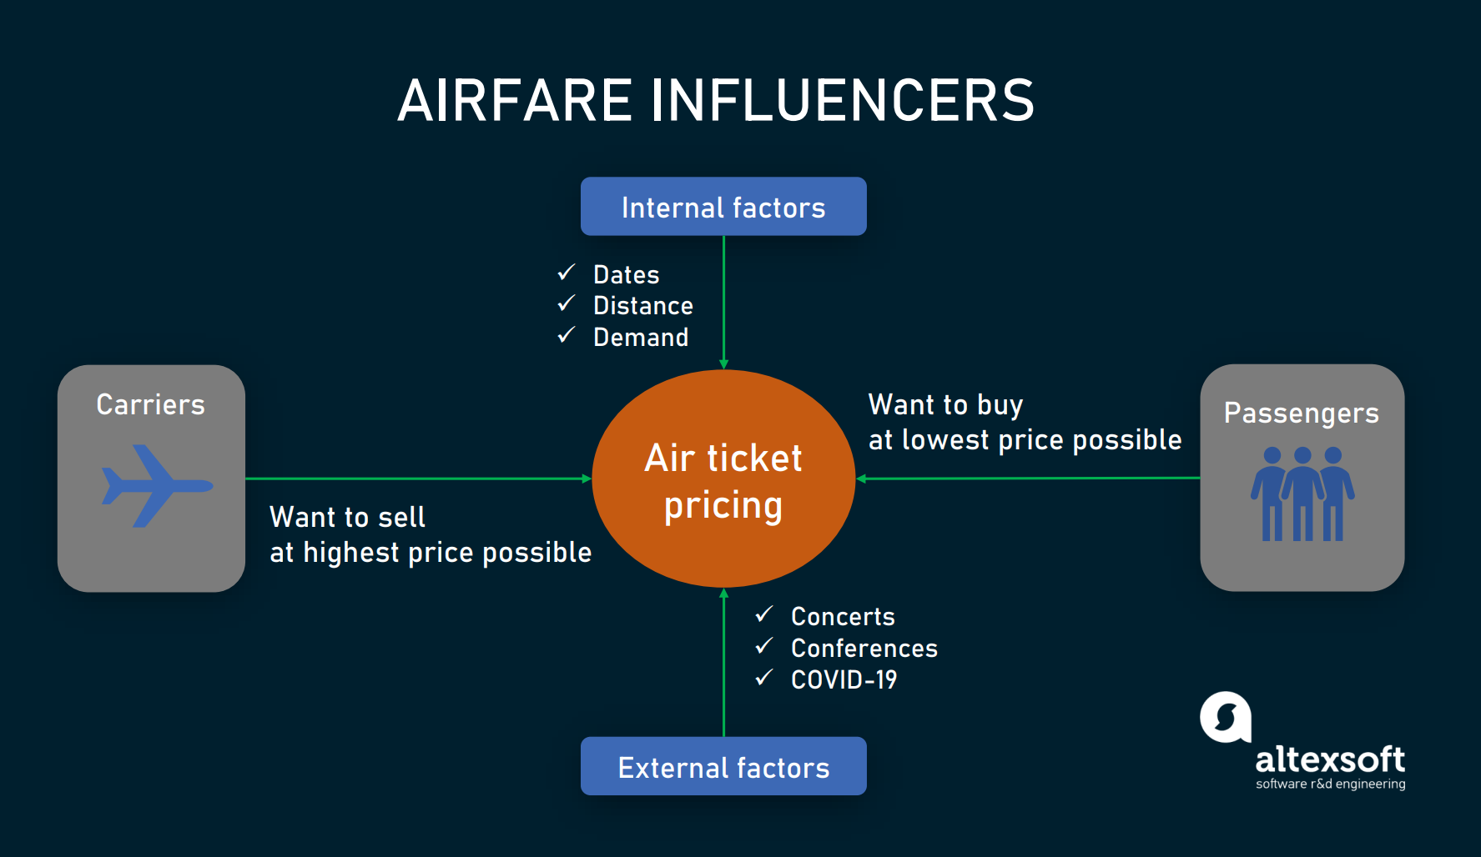
Introduction to Flight Price Prediction
First phase of problem modelling involves data scraping of flights from internet. For that purpose, flight data is scrap from www.yatra.com for different timeframe of 9th Jan 2023 to 21 st April 2023. Data is scrape for flights on route of Kolkata to Bangalore. Data is scrap for Economy class, Premium Economy class & Business class flights. Next phase is data cleaning & pre-processing for building ML Model. Our objective is to predict flight prices which can be resolve by use of regression-based algorithm. Further Hyper parameter tuning performed to build more accurate model out of best model.

Slide 6
Problem Statement
Anyone who has booked a flight ticket knows how unexpectedly the prices vary. The cheapest available ticket on a given flight gets more & less expensive over time. This usually happens as an attempt to maximize revenue based on –
Time of purchase patterns (making sure last-minute purchases are expensive)
Keeping the flight as full as they want it (raising prices on a flight which is filling up in order to reduce sales and hold back inventory for those expensive last-minute expensive purchases)
So, you have to work on a project where you collect data of flight fares with other features and work to make a model to predict fares of flights.

Slide 7
Data Sources and their formats
Part_1: Web Scraping Strategy employed in this project as follows
Selenium will be used for web scraping data from www.yatra.com.
Flights on route of Kolkata to Bangalore in duration of 9th Jan 2023 to 21 st April 2023.
Data is scrap in three parts: 1. Economy class flight price extraction 2. Premium Economy class flight price extraction 3. Business class price extraction.
Selecting features to be scrap from website.
Web scraping code executed for above mention details.
Exporting final data in Excel file.
Total 7 algorithms used for the training and testing of this data and then final prediction done.

Slide 8
Data Pre-processing
1. Dataset contain flight detail of around 2350 Flights on route Kolkata to Bangalore.
2. Dataset has 11 features like Airlines names, Journey class etc.
3. ' --', 'null', 'NA', ' ' are not present in the dataset.
4. Conversion of Duration column from hr & Minutes format into Minutes.
5. New column for ‘Day’ & ‘Date’ is extracted from Date column.

Slide 9
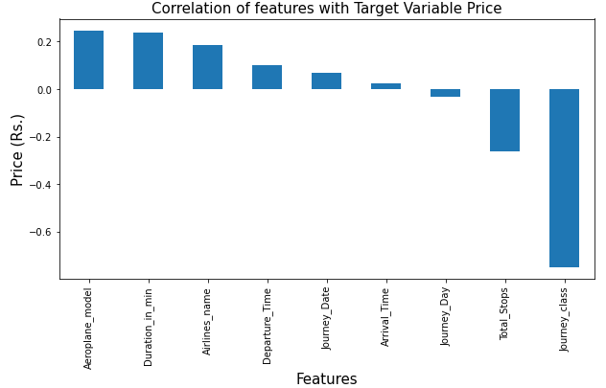
Correlation with Target Variable
We can class is highly correlated with target variable Price.
Most of features are moderately & poorly correlated with each other.

Slide 10
Exploratory Data Analysis
Let’s start the observation exploration of feature analysis.

Slide 11
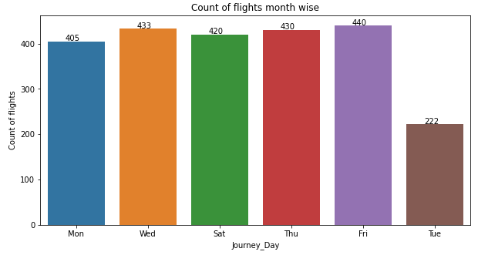
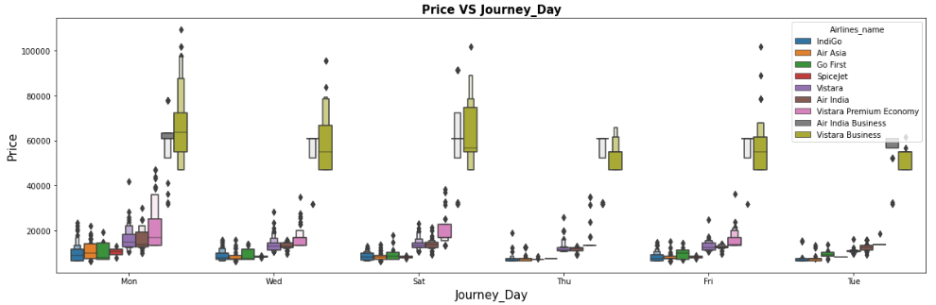
Observations:
1. On Tuesday minimum flights run while on Friday maximum flights run.
2. Eveyday all of the three types of flights are running and very obviously business class's cost is high than other two for each days.
3. Maximum Avg. Fare for Business Flights is on Monday while minimum Avg. Fare for Business flights on Tuesday.
4. For Ecomony Flights & Premium Ecomony Flights: Minimum Avg. Fare on Thusday.
5. For Ecomony Flights & Premium Ecomony Flights: Maximum Avg. Fare on Monday.

Slide 12
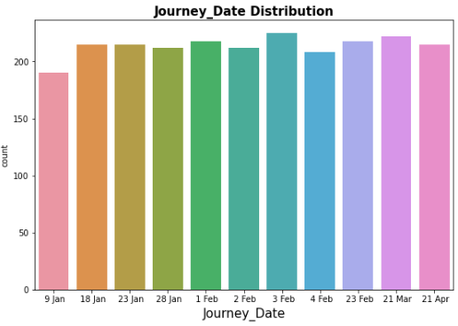
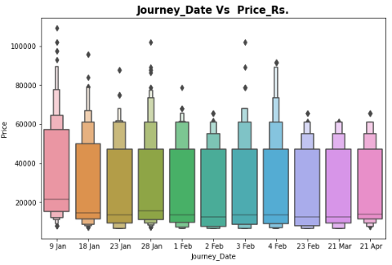
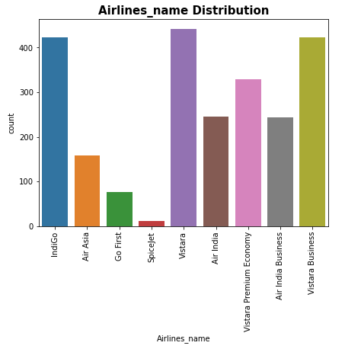
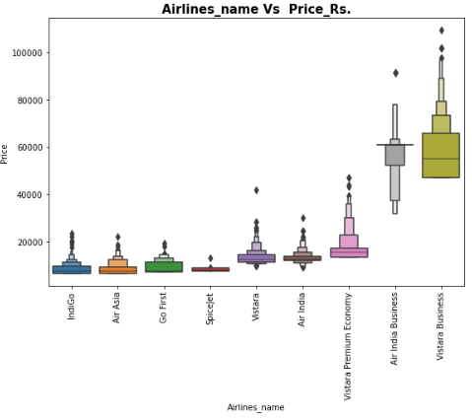

Slide 13
Observations:
1. We have scrapped overall same percent of data in this big dataset.
2. All the data scrapped on 8th January, 2023. So for 9th January the rate is maximum and for March and April the price is least than earlier.
3. We can see maximum number of flights run by Vistara Economy while minimum Flights run by Spicejet.
4. Around 28% of flights of Business Class.
5. For Economy class, SpiceJet flight is cheaper than Vistara and Air India.

Slide 14
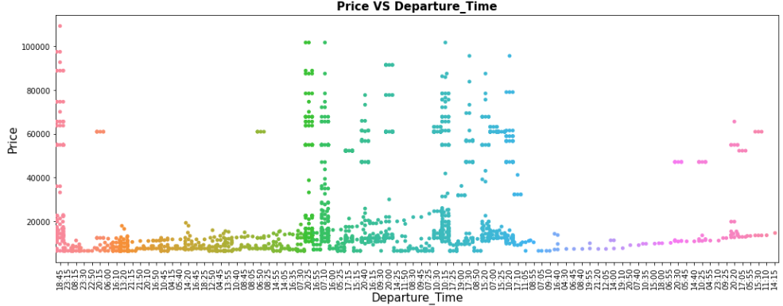
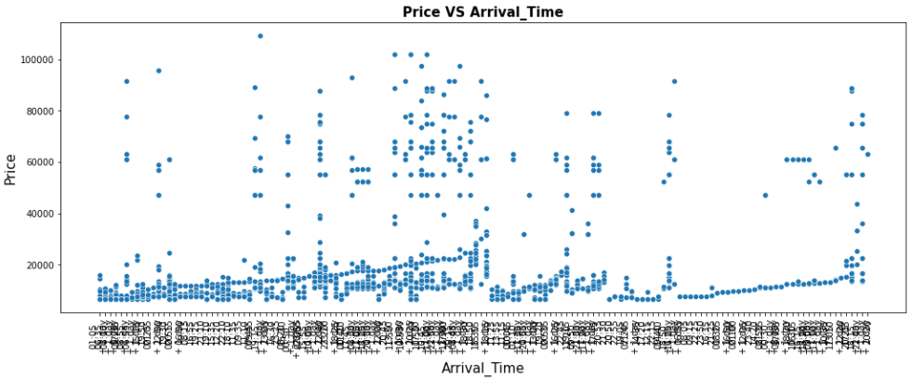

Slide 15
Observations:
1. There is no such relation between departure_time and number of flights. Though maximum flights departed at 10.15 am.
2. No such relation between arrival_time and departure_time with price of the flight.
3. Around 82% flights are 1 stop from kolkata to Bangalore. Obviously these flights have high flight duration compare to Non-stop Flight
4. Only 7.3% of flights do not have any stop in there route.
5. Most of the cases, Vistara Business class flight is 1 stop and its price is also high than others.

Slide 16
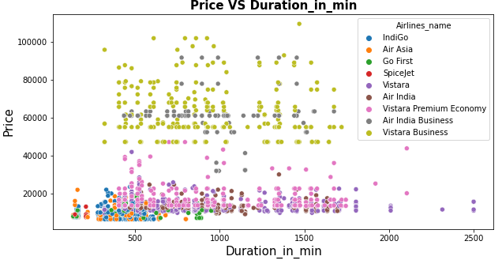
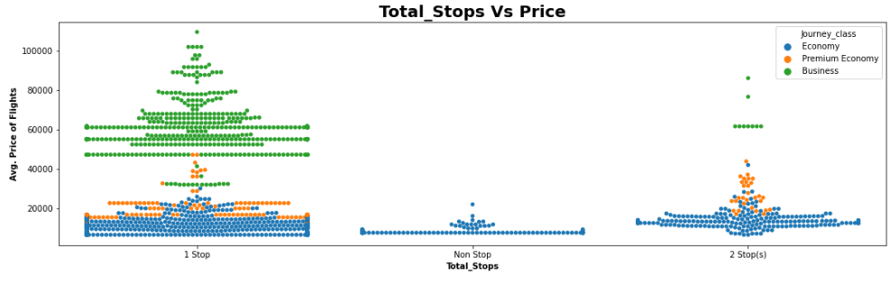

Slide 17
Observations:
1. Outliers are present in the Duration dataset.
2. No such relation between duration and price of the flight.
3. 57.7% flights are of Ecomony class, as they are low cost of flight & most of people prefer it.
4. There are more business class flights than Premuim Ecomony flights. It strange because Business class is costlier than Premuim Ecomony class.
5. As number of Stops increase the duration of flights increases for economy class.
6. For Premium economy or Business class there are no nonstop flights.
7. Very surprisingly for Business class the duration of 1 stop flight is more than 2 stops.
8. For both maximum and minimum duration of flight, the flight type is Economy class.
9. For four consecutive day in February 2023 (1st Feb to 4th Feb), maximum average price is for 4th February 2023, Saturday.
10. For every stops, maximum average price is for Business class and minimum for economy class.
11. Every day, between three differnt journey class, maximum duration is for Premium Economy class.
12. There is no non stop flight for Business and Premium Economy class.

Slide 18
Machine Learning Model Building

Slide 19
Machine Learning Model Building
This problem can be solve using regression-based machine learning algorithm.
Methodology to Build Machine Learning Model:
Encoding Categorical data into Numerical data
Scaling data using Standard Scalar
Splitting data in training & test data using train_test_split from model_selection
Implementing various Regression Based Algorithm to build ML Model
Conducting Hyper Parameter tuning for each model to get best score for 7 different model
Conducting cross validation
Saving Final Tuned Model

Slide 20
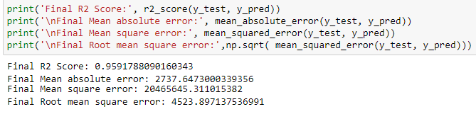
Final ML Hyper Parameter Tuned Model (Gradient Boosting Regressor)

Slide 21
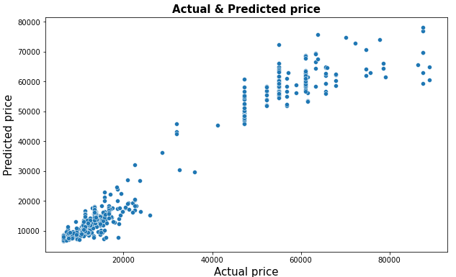
Visualize the variation of actual test data and predicted data:

Slide 22
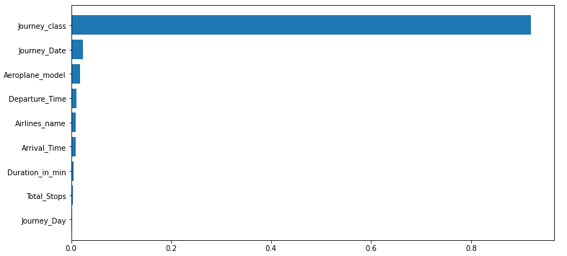
Important Feature Selection
The observations are as followes:
1. Journey class is the most important feature for predicting price.
2. Total duration of journey,total stops, journey day are the less importance feature.

Slide 23
Limitations & future scope:
In this study we focus on flights on route of Kolkata to Bangalore, more route can incorporate in this project to extend it beyond present investigation.
For all 6 ML models, we receive a subpar cross-validation score in this case. This study focuses on a small number of random days. If more dates could be included or more other features were used, this CV score might have improved.
Time series analysis can be performed over this model.

Slide 24


