Slide 1

FAKE NEWS CLASSIFICATION PROJECT
By- TAMALI SAHA
Internship Batch No- 33

Slide 2

INTRODUCTION TO FAKE NEWS CLASSIFICATION
For both printed and digital media, the reliability of information has long since become a problem that has an impact on society and business. Because of how quickly and magnified information spreads on social networks, faulty or misleading material has a great chance of having a real-world influence on millions of users in a matter of minutes. Many public concerns regarding this issue, as well as proposed solutions, have recently been voiced.

Slide 3
INTRODUCTION TO FAKE NEWS CLASSIFICATION
One of the biggest issues of our time is fake news. It has a significant impact on both our offline and online conversation. One can even argue that false news currently represents a clear and present threat to the democracy and social stability of the West. Fake news has been around for a very long time, almost as long as it took for news to become widely disseminated following the invention of the printing press in 1439. There is no universally accepted definition of what constitutes "fake news," despite the fact that there has been a long history of fake news on social media. Appropriate clarifications are required in order to effectively direct the future paths of false news detection research.

Slide 4

Problem Statement
You can find many datasets for fake news detection on Kaggle or many other sites. I download these datasets from Kaggle. There are two datasets one for fake news and one for true news. In true news, there is 21417 news, and in fake news, there is 23481 news. You have to insert one label column zero for fake news and one for true news. We are combined both datasets using pandas built-in function.

Slide 5
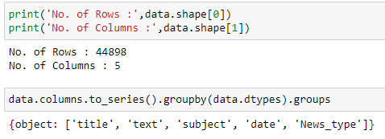
Data Sources and their formats
There are one set of data. The dataset has 44898 rows and 5 columns. Primarily it has 5 columns where some columns are unnecessary.
Later the dataset is divided into two parts, training and testing. After determine the proper model, the model is applied to predict the target variable for the test dataset.

Slide 6
Data Pre-processing
1. ' --', 'null', 'NA', ' ' are not present in the dataset.
2. Drop the unnecessary column from both dataset.
3. calculate the comment length before cleaning.
4. Rename the two final columns as news_type and text.
5. Encoding type column.
6. Doing NLP steps.

Slide 7

Natural Language Processing:
Apply all necessary steps on massage body column for cleaning the dataset. The steps are as follows.
1. First lowercased strings from the given string by converting each uppercase character to lowercase for the full news text.
2. Now simplifying text by converting different short form of words (contractions) to the actual words.
3. Then removing any special characters.
4. By using WordNetLemmatizer, lemmatize the news text.

Slide 8
Exploratory Data Analysis
Let’s start the observation exploration of feature analysis.

Slide 9
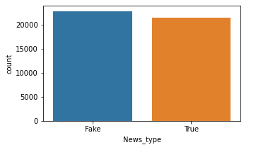
Different feature’s data Distribution
Observations:
There are two type of News_type, True and False. The percentage of two different type is around 50%. We can say that, the dataset is totally balanced.

Slide 10
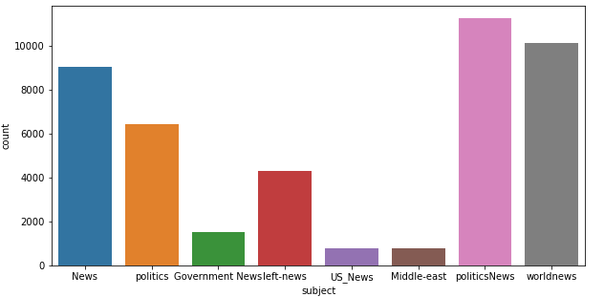
Visualize the News Subject column:
There are total 8 types of subject. Of them , politicsNews type is maximum(25%) and Middle-east is minimum (just 1%).

Slide 11
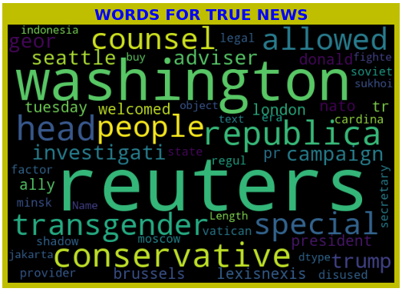
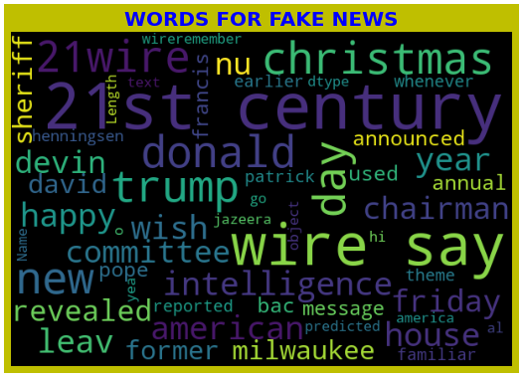
Word Cloud for Fake and True: No such observation is noted from the below images.

Slide 12
Machine Learning Model Building

Slide 13
Machine Learning Algorithm Used
The different classification algorithm used in this project to build ML model are as below:
Logistic Regression
Decision Tree Classifier
Linear SVC
Multinomial Naïve Bayes Classifier
As per 4 different model, Both DecisionTreeClassifier and LinearSVC is good for this particular dataset. By AUC- ROC curve also every 4 models are good. Here we take linear SVC as final one.

Slide 14
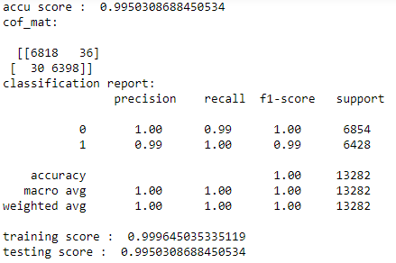
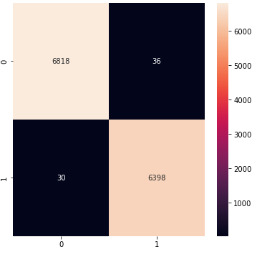
Final Model and Confusion Matrix:

Slide 15
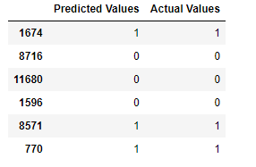
Let’s see the 6 random dataset of actual and predicted target variable.

Slide 16


