Slide 2
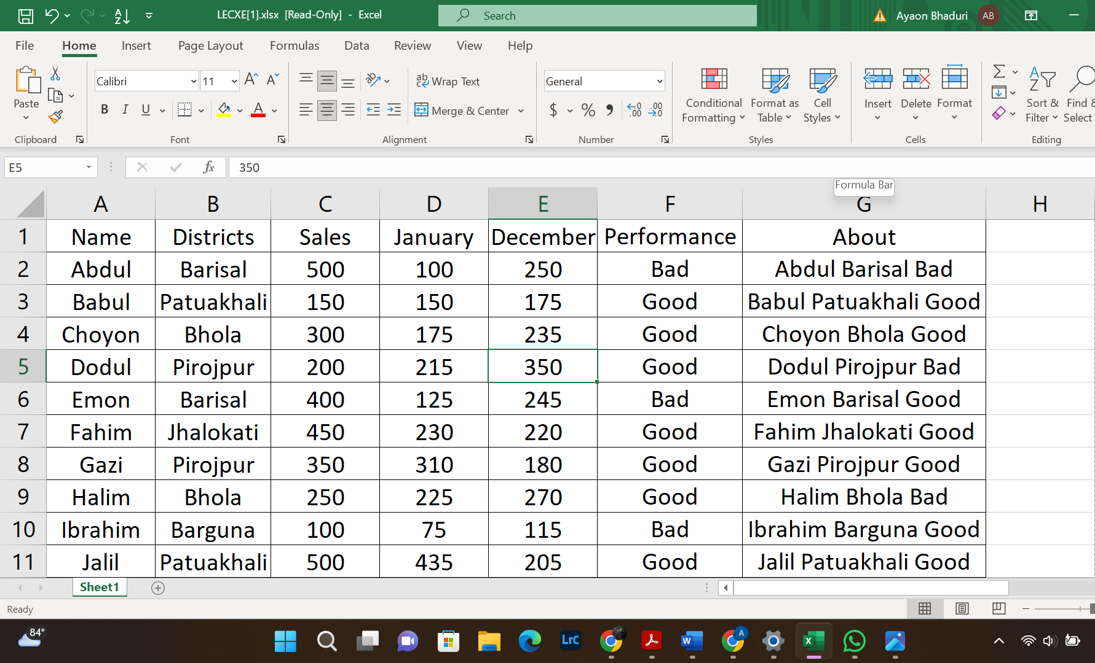
EXCEL FORMULAS

Slide 3
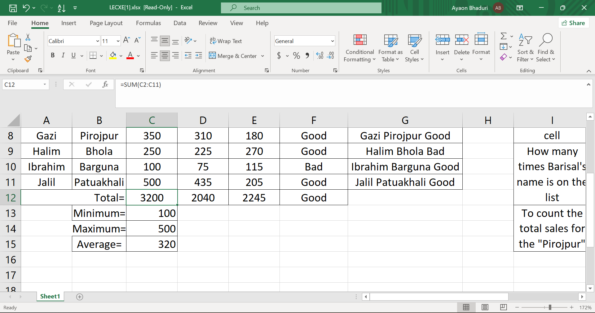
SUM EQUATION

Slide 4

MINIMUM

Slide 5

MAXIMUM

Slide 6

AVERAGE

Slide 7
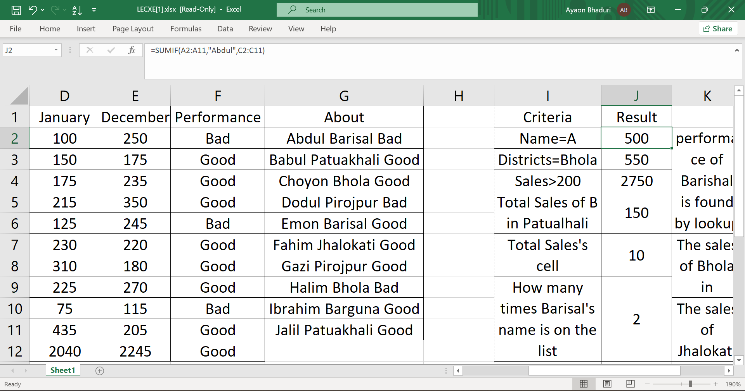
SUMIF

Slide 8
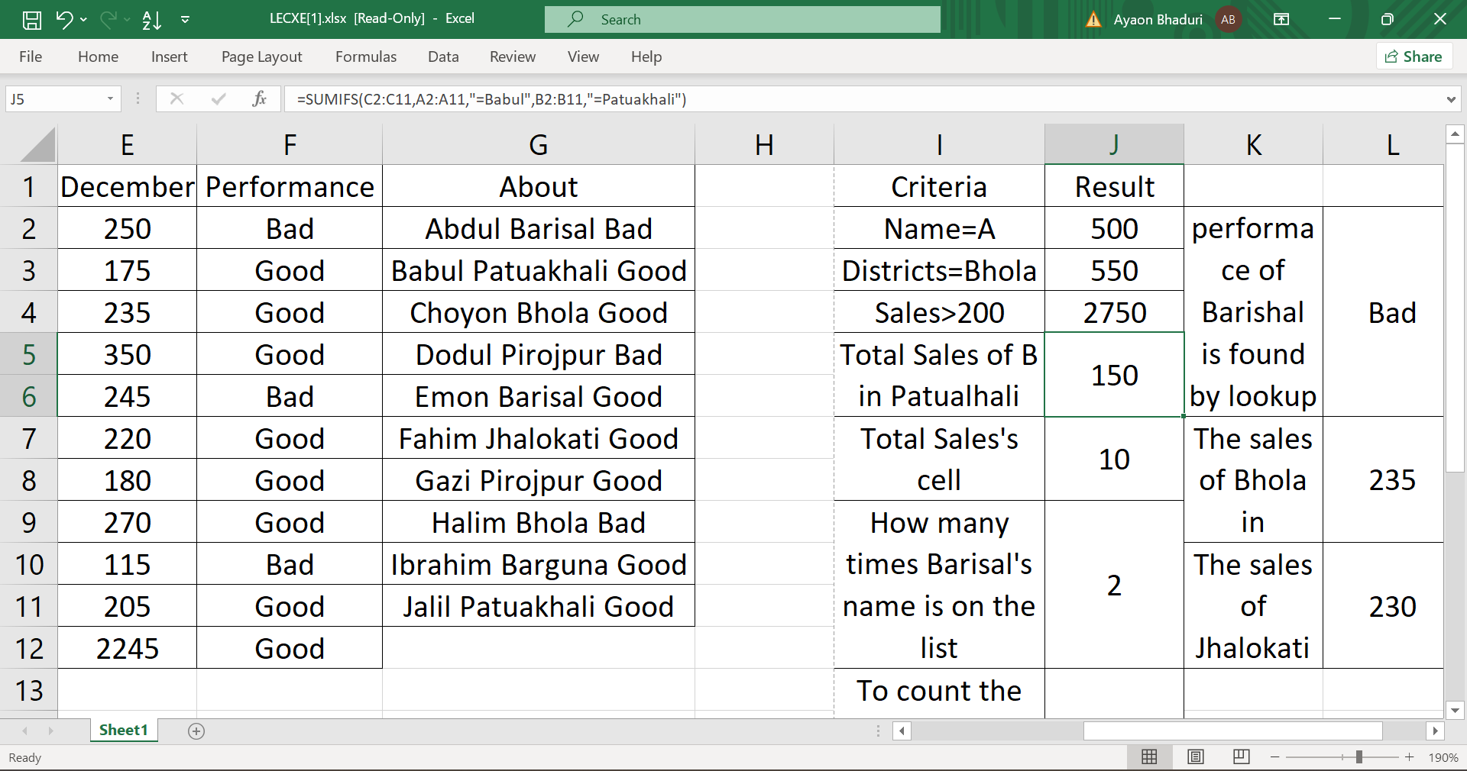
SUMIFS

Slide 9
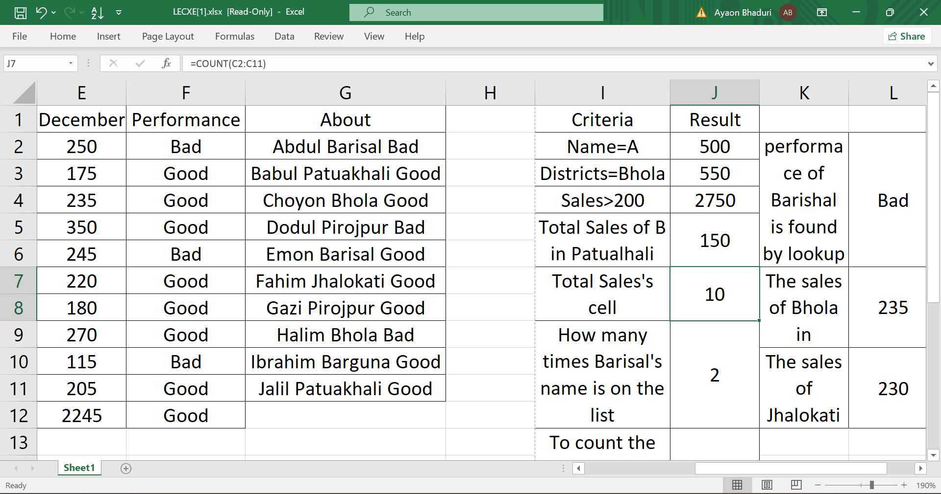
COUNT

Slide 10
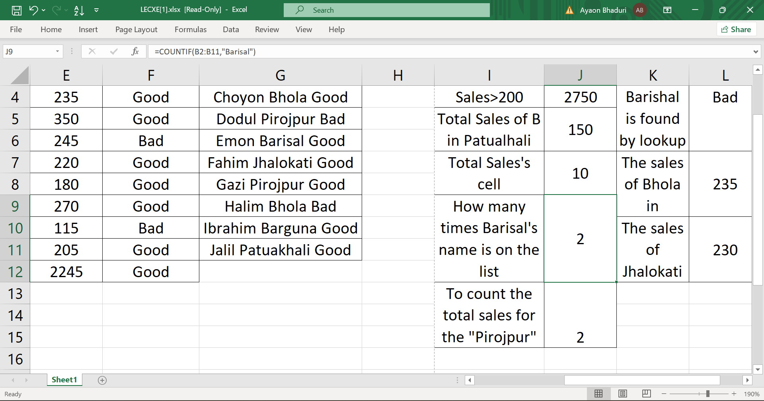
COUNTIF

Slide 11
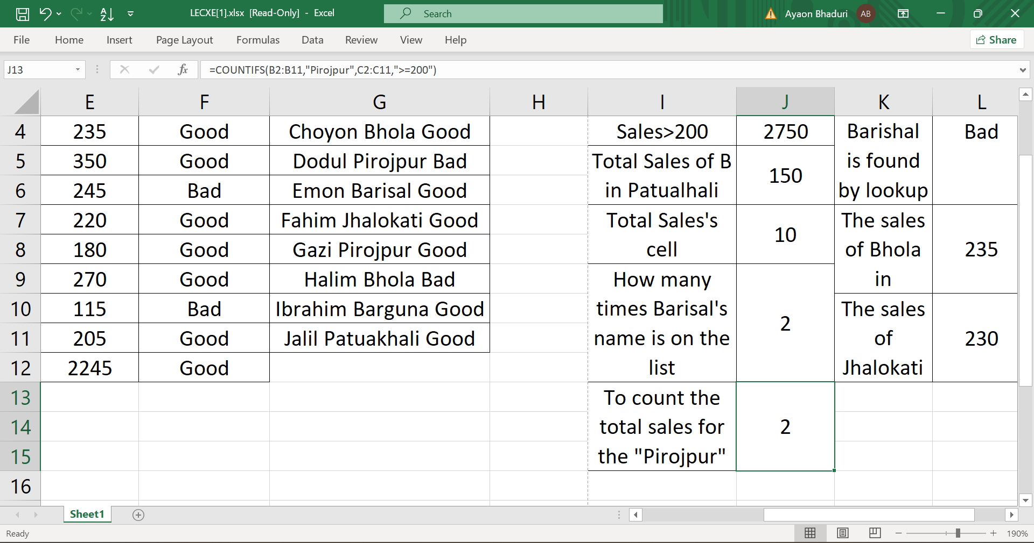
COUNTIFS

Slide 12
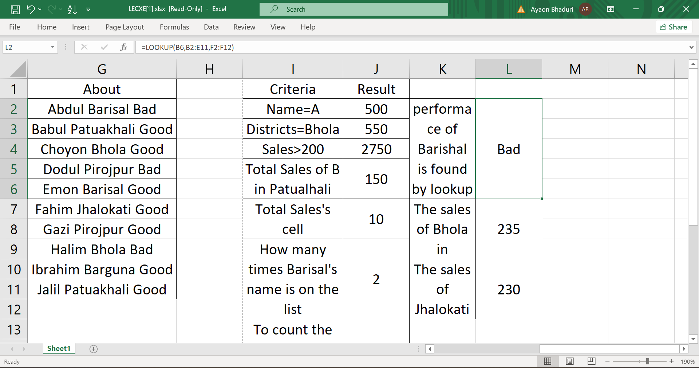
LOOK UP

Slide 13
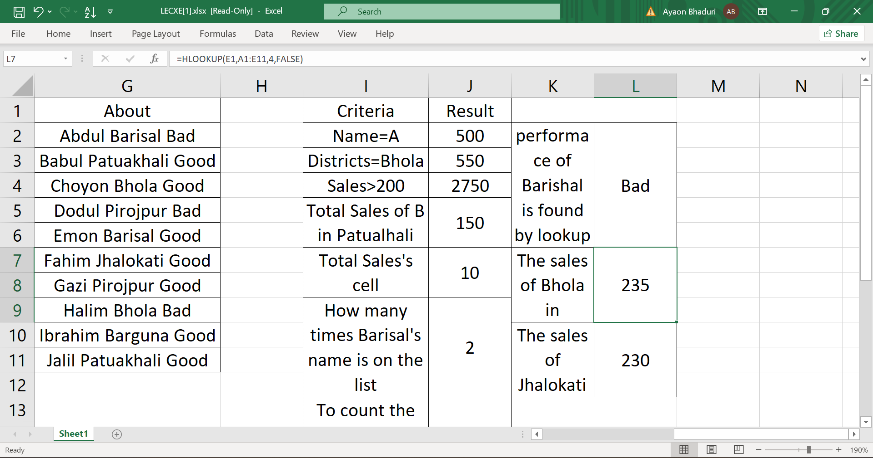
H-LOOK UP

Slide 14
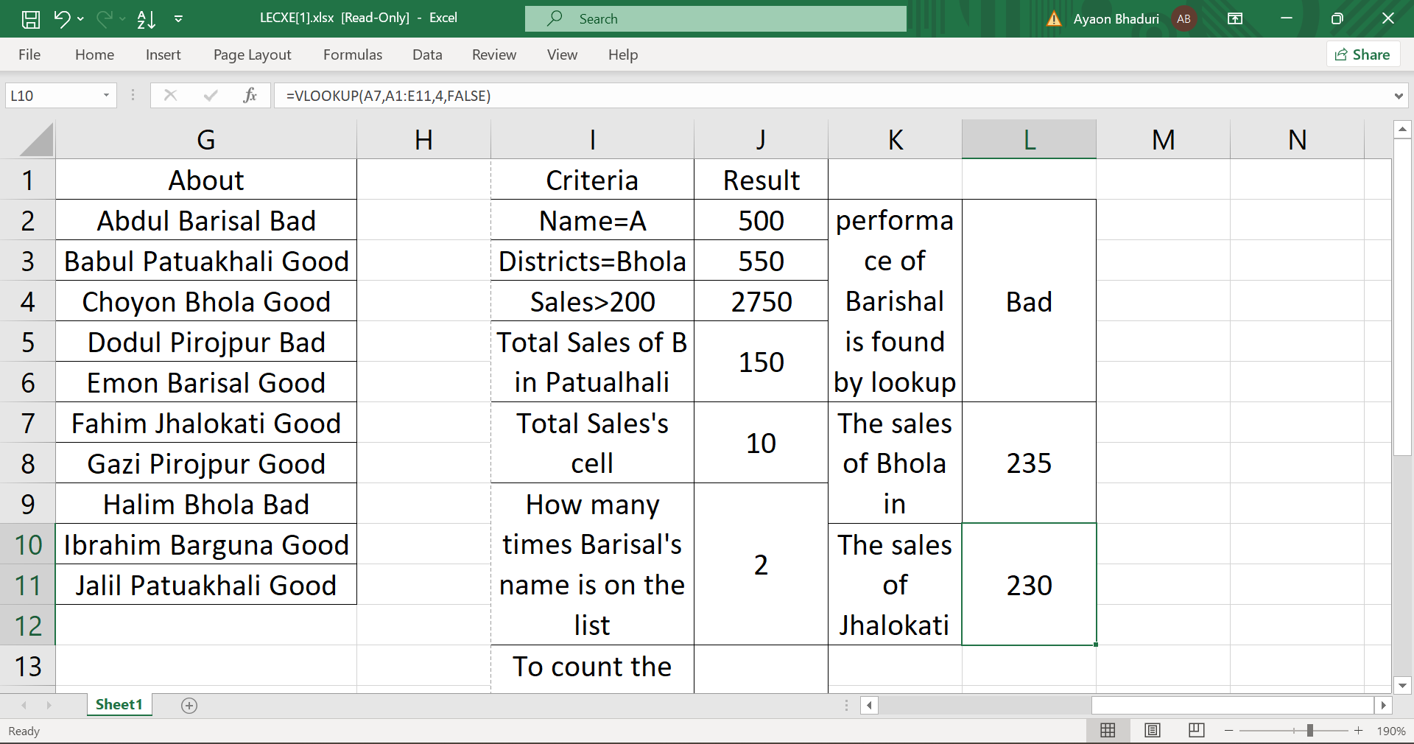
V-LOOK UP

Slide 15
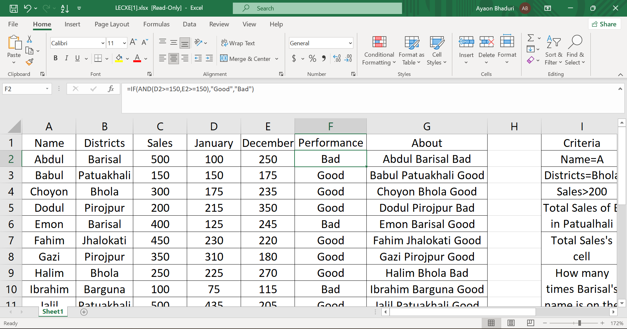
IF&AND

Slide 16
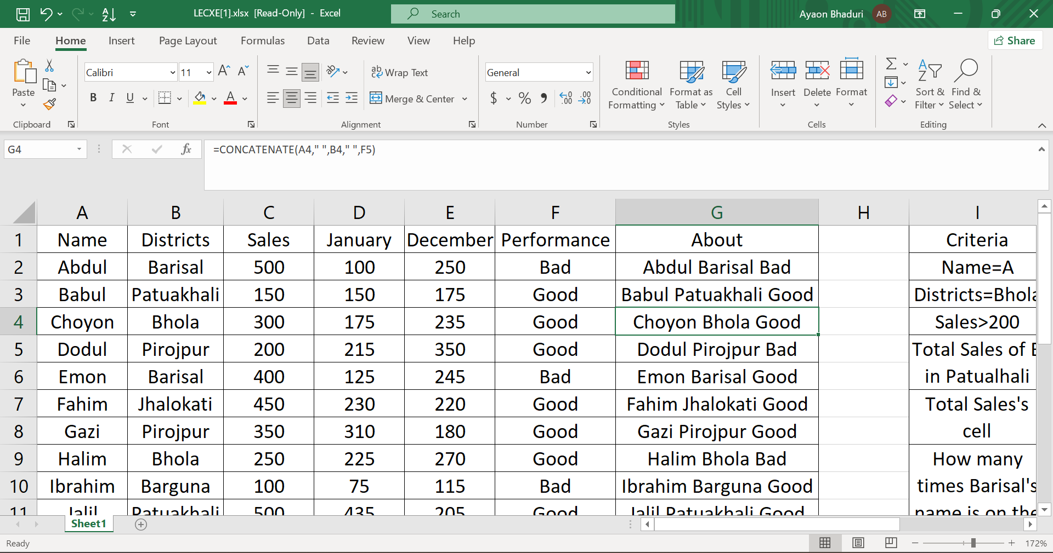
CONCATENATE

