Slide 1
Web Development
Medical Hub
Team Details:
Tamanna Kansal (2210992436)
Himanshi(2210990403)
Faculty Coordinator:Mr. Mustakim Shaikh
:
Chitkara University Institute of Engineering and Technology,
Chitkara University, Punjab

Slide 2
Table of Contents
Introduction
Problem Statement
Technical Details
Key Features
Significance
Scope
Code Snippets
Conclusion
References/Links

Slide 3
Introduction
MEDICAL HUB
A medical appointment scheduler is a tool or system designed to streamline the process of scheduling and managing appointments for healthcare providers and patients.
It serves as a centralized platform where patients can request appointments, view available time slots, and receive confirmation details, while healthcare providers can efficiently manage their schedules, allocate resources, and coordinate patient visits.
By leveraging a medical appointment scheduler, healthcare providers can streamline their administrative processes, improve patient satisfaction, and optimize resource utilization, ultimately enhancing the overall efficiency and quality of healthcare delivery.

Slide 4
Problem Statement
High No-Show Rates: Patients frequently miss their scheduled appointments, leading to wasted resources and disruptions in patient care.
Inefficiencies in Manual Booking Systems: Overcome the inefficiencies, errors, and delays caused by manual booking methods, especially in larger healthcare practices.
Patient Accessibility and Engagement: Patients often struggle to access convenient appointment slots, navigate scheduling systems, and receive timely reminders, resulting in frustration and decreased engagement with healthcare services.

Slide 5
Technical Details
Frontend (React)
React.js (with Hooks + Context API / Redux for state management)
React Router DOM (routing & navigation)
Axios / Fetch (API calls to Express backend)
Backend (Node.js + Express.js)
Node.js (server runtime)
Express.js (REST API framework)
JWT (authentication & authorization)
bcrypt.js (password hashing)
MongoDB

Slide 6
Key Features
Authentication
Login, Signup (Patients, Doctors, Admin)
JWT-based token storage (in localStorage or httpOnly cookie)
Role-based route protection
Search doctors (specialization, location, availability)
Book, cancel, reschedule appointments
View prescriptions, lab reports, medical history
Payment integration(Stripe)
Blog listing page (title, author, summary, thumbnail)
Product catalog with categories (medicines, OTC, supplements, equipment)

Slide 7
Significance
Enhanced Efficiency: Automates the scheduling process, reducing manual errors and administrative burden, allowing healthcare providers to focus more on patient care.
Improved Patient Engagement: Provides an intuitive and accessible platform for patients to book, manage, and receive reminders for their appointments, enhancing their overall experience and satisfaction.
Accessible Healthcare: Offers convenient access to healthcare services, particularly beneficial for individuals with mobility issues or busy schedules.
User-friendly Interface: Provides a user-friendly interface for booking and managing appointments, leading to increased patient satisfaction.

Slide 8
Scope
Appointment Management: Develop a user-friendly interface for patients to book, reschedule, and cancel appointments easily.
Notification System: Implement automated reminders via SMS, email, or push notifications to reduce no-show rates.
Responsive Design: Ensure the application is responsive and accessible across various devices to accommodate different user needs..
Data Security: Implement robust security measures to protect patient data and ensure compliance with healthcare regulations.
Scalability: Design the system to handle a growing number of users and appointments while maintaining performance and reliability.

Slide 9
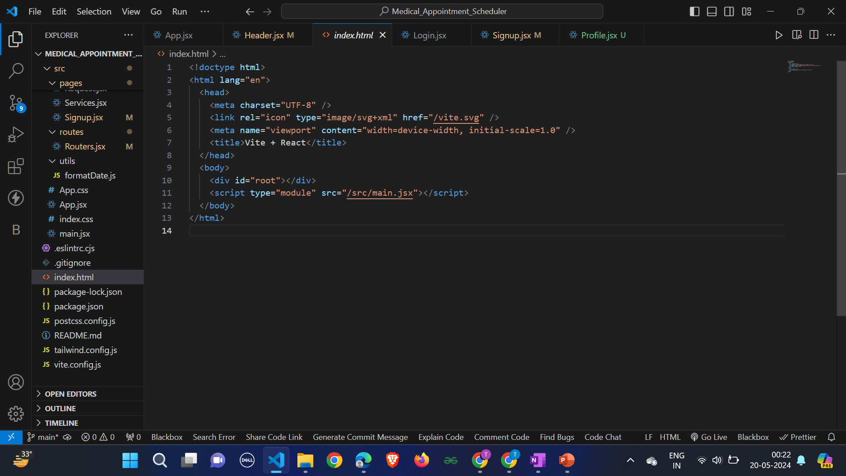
Code Snippets

Slide 10
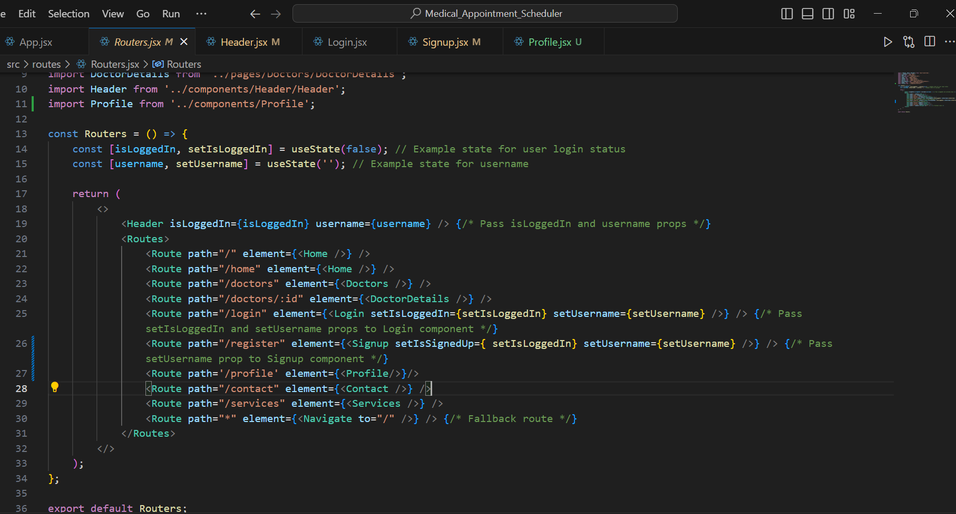
Code Snippets
Single-page application router: Enables seamless navigation across various sections for effortless user experience.

Slide 11
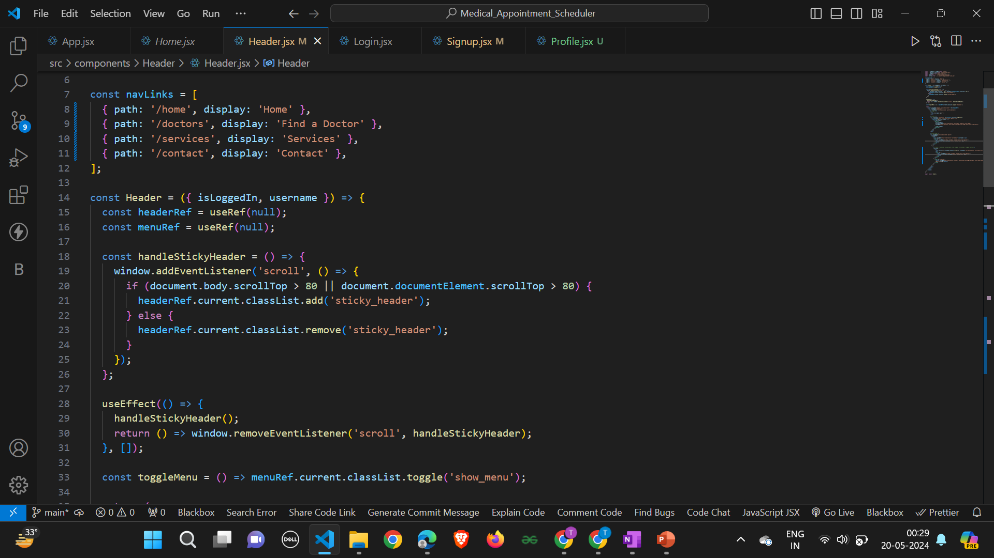
Code Snippets

Slide 12
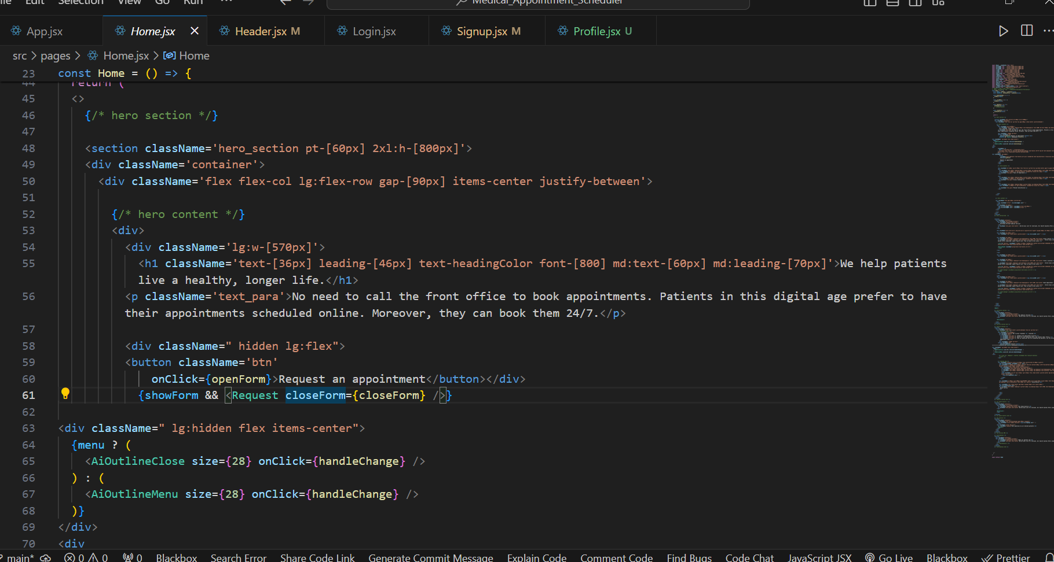
Code Snippets

Slide 13
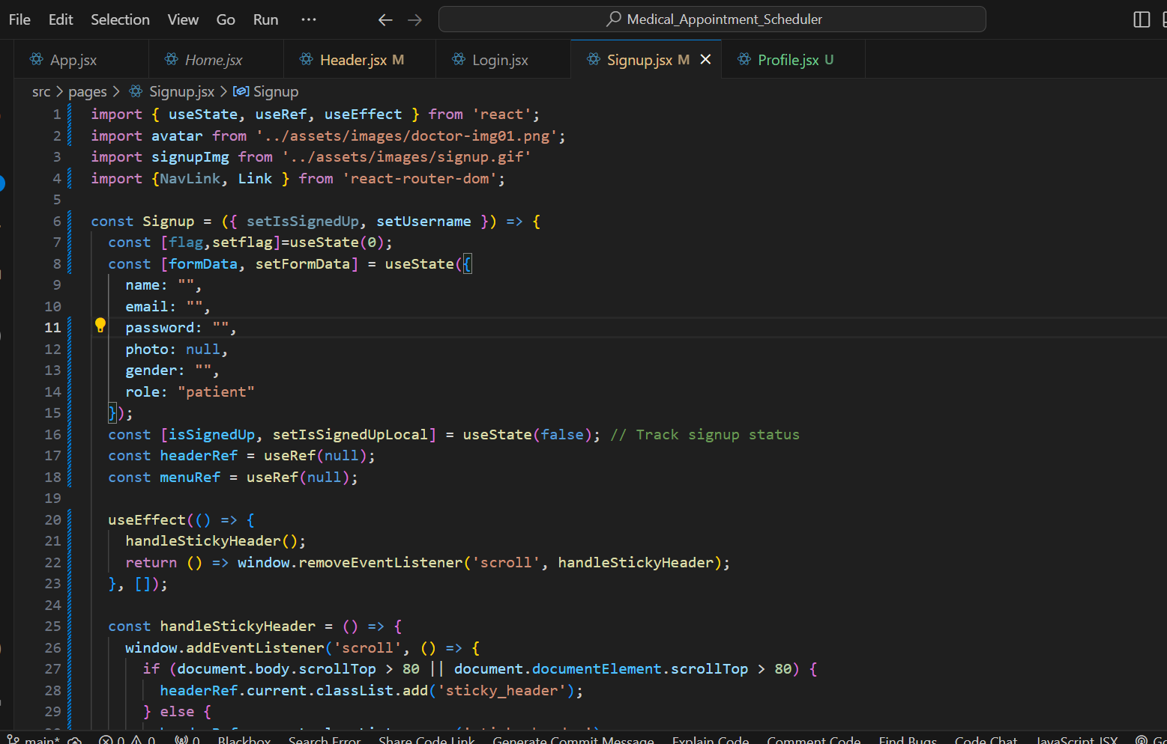
Code Snippets

Slide 14
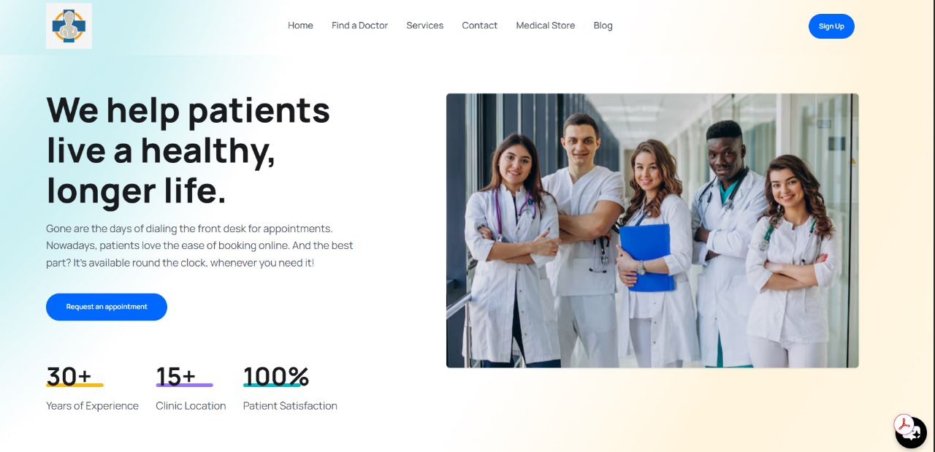
Code Snippets

Slide 15
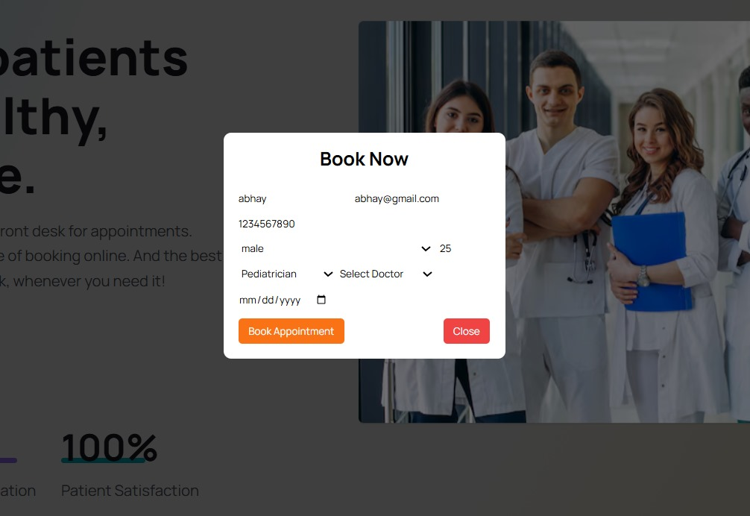
Code Snippets

Slide 16
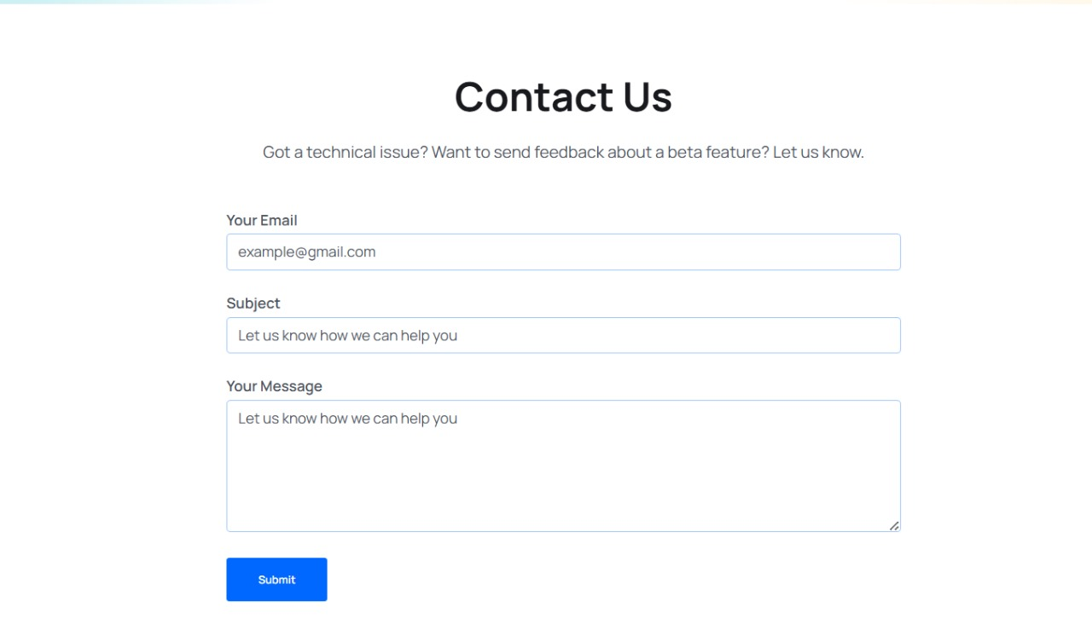
Code Snippets

Slide 17
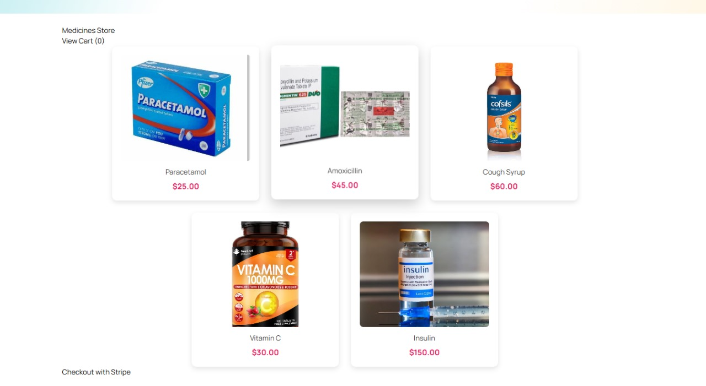
Code Snippets

Slide 18
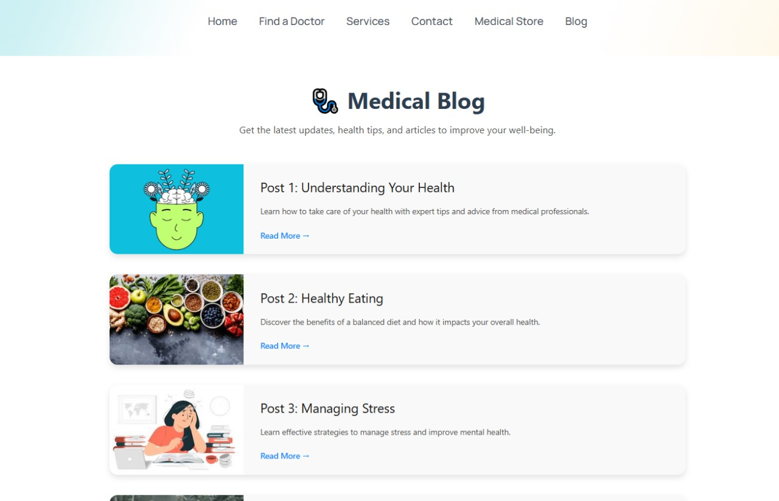
Code Snippets

Slide 19
Conclusion
With a comprehensive set of features outlined in the scope, including appointment booking, notification systems, and user authentication, the scheduler meet the diverse needs of both healthcare providers and patients.
With its user-friendly interface and mobile accessibility, Medicare saves time and effort.
With user-friendly features like automated reminders and easy appointment management, the scheduler aims to elevate the patient experience, leading to higher satisfaction levels and increased engagement with healthcare services.

Slide 20
References/Links used
Mozilla Developer Network (MDN) - HTML Documentation: https://developer.mozilla.org/en-US/docs/Web/HTML
W3Schools - CSS Tutorial: https://www.w3schools.com/Css/
YouTube: https://www.youtube.com/
JavaScript.info - JavaScript Documentation: https://javascript.info/

Slide 21


