Slide 1
Customer-Facing
Resolution Agent
SK-204
Delhi → Goa
Cancelled
SK-118
Mumbai → Bengaluru
Delayed 4h
SK-305
Delhi → Hyderabad
Delayed 6h
An airline disruption desk that decides inside policy, and escalates when it cannot.
Tamanna-23csu309
B.Tech CSE (Data Science), NCU
AIONOS · Agentic AI Factory
Assignment 3 · Sep 2026
Notes:
One agent, three live disruption cases from the data pack. The claim I'm making: it resolves inside policy and never invents authority it doesn't have.

Slide 2
What the agent has to get right
Seven behaviours from the brief, and where each one lives in the build
Understand intent
Ask only what's needed
1
Claude classifies each message into a fixed request enum — never free-form.
2
Identity comes from the PNR. The one question asked is the one the rule leaves open.
Use supplied data only
Execute the right action
3
Profiles, bookings and rules are transcribed into one grounding object. No outside facts.
4
A deterministic engine maps request + booking state to an entitlement.
Handle anger and confusion
Escalate on missing authority
5
Mood is read separately from intent, so tone changes and the decision doesn't.
6
Five prohibited categories short-circuit the engine into a ticket.
Preserve the record
7
Every message, intent, verdict and rule is timestamped and exportable.
SkyLink Resolution Desk · Assignment 3
2
Notes:
These seven map one-to-one onto the brief's bullet list. Each one has a named home in the code.

Slide 3
Inputs, sources and assumptions
Everything the agent knows, and the three things I decided for it
Sources used
Assumptions I made
The grounding rule
3 customer profiles — tier, contact, 12-month history
4 booking rows — PNR, flight, route, status
5 service rules — cancellation, delay, refund, fare, tier
Allowed vs prohibited action list
3 sample conversations — read for tone only, never as fact
Identity is pre-verified
The model writes sentences.
It never writes entitlements.
The chat opens from the booking, so the agent doesn't re-ask for the PNR.
Delay bands are exclusive
"More than 5 hours" means 4h gets voucher + lounge, not a hotel.
Amounts, rules, eligibility and escalation are computed in JavaScript from the data pack. If the language model is switched off, the agent still reaches exactly the same verdicts — only the wording changes.
Cancellation ≠ delay
A cancelled flight goes to rebooking or refund, not to the delay compensation table.
Declining isn't escalating
Saying no inside policy is desk work. Only approving beyond policy needs a human.
That is what makes it defensible in an interview.
No web access, no invented flights, no invented amounts.
SkyLink Resolution Desk · Assignment 3
3
Notes:
The prohibited list is the spine of the design. Hallucinated generosity is the real failure mode for a customer-facing agent, so policy never touches the model.

Slide 4
Architecture
Five layers. Only the first and last are language models.
Interface
Chat panel, scenario switcher, live decision rail, audit tab, JSON export.
Grounding store
Read by every layer, written by none:
· 3 customer profiles
· 4 booking rows
· 7 rule clauses (R1–R5)
· 5 prohibited categories (P1–P5)
· ₹1,500 waiver ceiling
Intent layer · Claude
Reads the message and last six turns. Returns a fixed-enum request list plus a mood label. Falls back to a keyword parser if the model is unavailable.
Policy engine · code
Pure function of (requests, booking, session flags). Emits execute / decline / escalate / ask, each carrying its rule id.
Action + escalation
Applies entitlements once, opens ESC tickets, flags the choice the customer still owes.
Case record
Turns, verdicts, rule ids, tickets and timestamps — exported as one JSON file.
Reply layer · Claude
Given the verdicts as the only permitted content. May not add, soften or invent an outcome.
Single HTML page, no backend, no build step — opens from a link or from file://.
SkyLink Resolution Desk · Assignment 3
4
Notes:
The seam between layer 2 and layer 3 is the whole design. Intent is fuzzy and the model is good at it; entitlement is exact and code is good at it.

Slide 5
What happens in one turn
A message from Priya, end to end
1
Message arrives
"I want the full refund in cash and a free business upgrade."
Why the verdicts come first
2
Intent extracted
refund · refund_alt_method · free_upgrade · mood: angry
The decision rail fills in before a single word of the reply is generated. So the reviewer can see that the sentence follows the verdict, not the other way round.
If the model is declined or offline, step 6 falls back to wording assembled from the verdicts themselves. Steps 1–5 and 7 never change.
3
Engine evaluates
Booking says SK-204 cancelled by the airline, Gold tier, no choice made yet.
4
Verdicts emitted
Refund → execute (R1+R3). Cash → escalate (P5). Upgrade → escalate (P1+R5).
5
Actions applied
Refund initiated. Two tickets opened. Rail updates before the reply is written.
6
Reply written
Claude wording, constrained to those three outcomes and nothing else.
7
Record appended
Seven audit entries, each timestamped with its rule id.
SkyLink Resolution Desk · Assignment 3
5
Notes:
Worth demoing live: point at the rail filling in, then at the reply appearing after it.

Slide 6
The policy engine
Every branch, and the clause it comes from
Customer asks for
Condition
Verdict
Rule
Loyalty tier
Rebooking
Flight cancelled by the airline
Execute free
R1
Gold and Platinum get first access to next-available seats. Nothing else. The engine adds R5 to a rebooking verdict and never to a compensation one.
Refund
Cancelled, original payment method
Execute
R1+R3
Refund to cash / other method
Any
Escalate
P5
Meal voucher
Any delay
Execute ₹500
R2a
Lounge access
Delay over 3 hours
Execute
R2b
Declining is not failing
Hotel
Delay over 5 hours
Execute, hours only
R2c
A no that cites the clause and offers what does apply is a correct resolution. Escalation is reserved for things the desk genuinely cannot decide.
Hotel
Delay 5 hours or less
Decline
R2c
Full night's hotel
Any
Escalate
P1
Free upgrade or goodwill
Any tier, including Platinum
Escalate
P1+R5
Move to higher-fare flight
Voluntary change
Execute, customer pays
R4
Waive fare difference
Above ₹1,500
Escalate
P2
Legal action or complaint
Any
Escalate immediately
P4
SkyLink Resolution Desk · Assignment 3
6
Notes:
Twelve branches, all traceable to a clause in section 3 or 4 of the data pack.

Slide 7
Scenario 1 and 2
Priya, cancelled. Arvind, delayed four hours.
Priya Nair
Arvind Kulkarni
Gold · SK4821X · SK-204 Delhi → Goa cancelled
Silver · TR1190B · SK-118 Mumbai → Bengaluru delayed 4h
Asks what happens now
Frustrated, missing a client meeting
Agent offers the choice R1 gives her — free rebooking within 24 hours or a full refund — and does not pick for her.
Voucher and lounge access applied straight away under R2b — before he has to ask.
Picks the refund
Asks for a hotel
Executed. Full amount, 7 business days, original payment method (R3).
Declined. Hotel cover starts above 5 hours; this delay is 4. The clause is quoted and the alternative restated.
Furious: cash refund + free business upgrade
Asks what he actually gets
Cash → escalated (P5). Upgrade → escalated (P1). Gold gives seat priority, not goodwill (R5). The refund already granted stays granted.
Repeats the two live entitlements. No escalation — nothing here is above desk authority.
Anger changes the opening sentence. It does not change a single verdict.
The hard case is the honest no, delivered without escalating to look helpful.
SkyLink Resolution Desk · Assignment 3
7
Notes:
Arvind is the scenario most agents get wrong — they either invent a hotel or escalate a decision they were allowed to make.

Slide 8
Scenario 3 and the escalation path
Meher, delayed six hours, asking for two things above the line
Meher Kaur
What an escalation carries
Platinum · WL7742 · SK-305 Delhi → Hyderabad delayed 6h
Ticket id tied to the case id
The clause that removed the agent's authority
The exact ask, in the customer's own words
Tier, PNR and disruption context
Every entitlement already applied, so the human doesn't repeat it
Automatic under R2c
Meal voucher, lounge access and a hotel covering the delayed hours — applied on the first message.
Full night's stay
Escalated (P1). The clause says delayed hours only, so extending it is compensation beyond policy.
Move to the higher-fare flight
And what it never does
Allowed (R4). It is a voluntary change, so the ₹2,000 difference is hers. Platinum priority still applies to the seat.
Predict the supervisor's answer, hint that it will probably be approved, or withdraw an entitlement the customer already has. Escalation moves the decision; it doesn't promise the outcome.
Refuses to pay the difference
Escalated (P2). ₹2,000 is above the ₹1,500 ceiling, so the agent promises nothing and hands it up.
SkyLink Resolution Desk · Assignment 3
8
Notes:
Meher is the scenario with two independent escalations in one conversation, plus entitlements that stay live throughout.

Slide 9
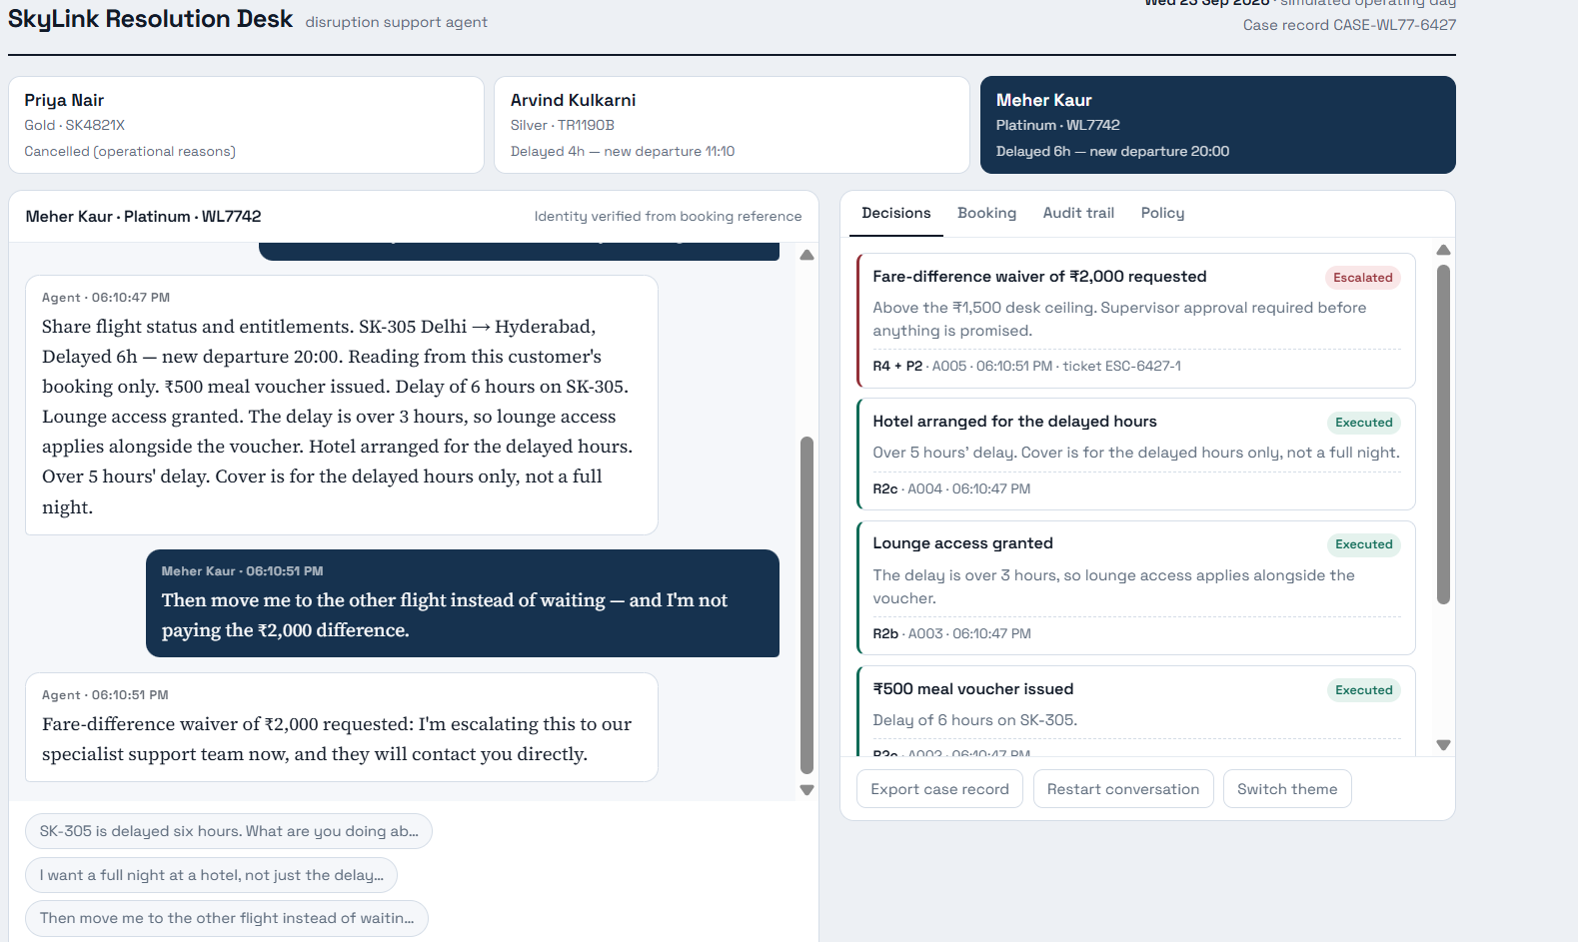
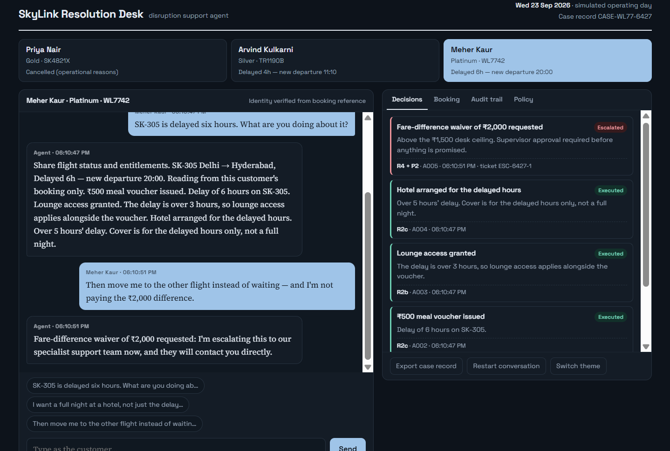
The interface behind Scenario 3
Meher Kaur’s case, open in the live prototype — the decision rail matches every verdict from the previous slide
Light theme
Dark theme
CASE-WL77-6427 — the decision rail lists a rule id, ticket number and status for every verdict.
Same conversation, same escalation ticket (ESC-6427-1) — theme is a display setting, not a policy difference.
SkyLink Resolution Desk · Assignment 3
9

Slide 10
Honest limits, and where it goes next
What is real
What is simulated
The intent layer, the policy engine, the escalation logic, the conversation record and the export are all working code you can break in front of me.
Rebooking, vouchers, lounge, hotel and refunds are recorded as actions, not sent to a reservation system. The data pack has no inventory to book against.
What I would not ship yet
The one-week version
Free-text identity verification, multi-PNR households, partial refunds, and a supervisor queue that writes its decision back into the same case record.
Swap the grounding object for a policy service, put the rule matrix behind a versioned config so ops can change a ceiling without a deploy, and log every verdict for audit sampling.
Live prototype
https://skylink-resolution-agent.vercel.app/?
Repository and demo video links in the submission form.
Notes:
Close on the limits slide deliberately — knowing what isn't real is the thing that survives a defence round.

