Slide 1
GIT (Version Control System)

Slide 2
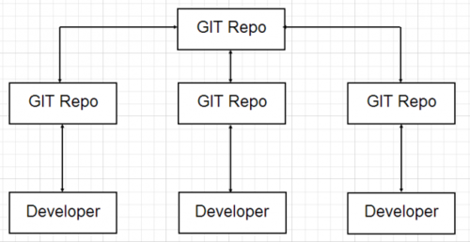
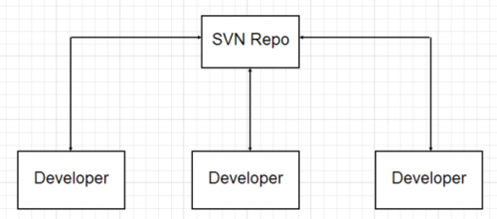
Version control system
GIT – Open source, Fast, Distributed version control and source code management system.
Subversion (SVN) – has one central repository

Slide 3
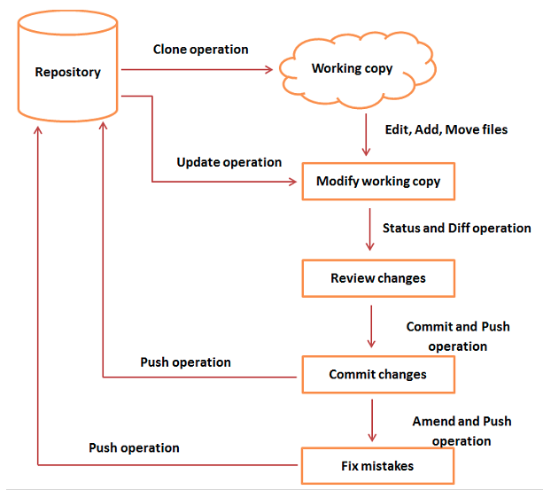

Slide 4
Git - Clone Operation
> mkdir projects
> cd projects
> git clone https://github.com/user/pythonproject.git
> cd pythonproject
> ls

Slide 5
Git- Perform Changes
> git status
On branch master
Your branch is up to date with 'origin/master’.
nothing to commit, working tree clean
> git add student.py
> git add src/
> git commit -m “Implemented student class”
> git push origin master

Slide 6
Git - Managing Branches
To create a new git branch (feature branch, bugfixing branch, etc)
> git branch new_branch
> git branch
* master
new_branch
> git checkout new_branch
Switched to branch 'new_branch'
> git branch
master
* new_branch

Slide 7
Git - Managing Branches
Shortcut to Create and Switch Branch
> git checkout -b feature_branch
Switched to a new branch ‘feature_branch’
> git branch
master
new_branch
* feature_branch

Slide 8
Git - Managing Branches (Deleting git branch)
> git checkout master
Switched to branch 'master’
> git branch -D new_branch
Deleted branch new_branch (was 5776472).
> git branch
* master
feature_branch

Slide 9
Git - Managing Branches
Renaming a git branch
> git branch -m old_branch_name new_branch_name
Fetching all the latest work of a branch
> git fetch origin master
> git pull
> git pull origin master
git pull fetches (git fetch) the new commits and merges (git merge) these into your local branch.
If your remote or upstream branch is not created yet then (-u for upstream)
> git push -u origin feature

Slide 10
Git - Managing Branches (Git merge)
To merge a feature_branch with master branch
> git branch
> git checkout master
> git merge origin/feature_branch
> git push origin master

Slide 11
Git - Review Changes
> git log
commit cbe1249b140dad24b2c35b15cc7e26a6f02d2277
Author: Mohsin Uddin <mmuddin@ewubd.edu>
Date: Wed Sep 11 08:05:26 2013 +0530
Implemented Student function
> git show cbe1249b140dad24b2c35b15cc7e26a6f02d2277
For viewing the commit details

Slide 12
Git stash
Suppose you are implementing a new feature for your product. Your code is in progress and suddenly a customer escalation comes. Because of this, you have to keep aside your new feature work for a few hours. You cannot commit your partial code and also cannot throw away your changes. So you need some temporary space, where you can store your partial changes and later on commit it.
> git stash
Now you can safely switch the branch and work elsewhere.
> git stash list
> git stash pop

Slide 13
Admin Level Git Features

Slide 14
Installation
> sudo apt-get install git-core
> git --version
> git config --global user.name “Mohsin”
> git config --global user.email “mmuddin@ewubd.edu”
> git config --list

Slide 15
Git - Create New User
add new group
> groupadd dev
add new user
> useradd -G dev -d /home/gituser -m -s /bin/bash gituser
change password
> passwd gituser

Slide 16
Git- Create a Bare Repository
> pwd
/home/gituser
> mkdir project.git
> cd project.git
> ls
> git -- bare init
Initialized empty Git repository in /home/gituser-m/project.git/

Slide 17
Git tagging
> git tag
v1.0
V2.0
> git tag -l "v1.8.5*”
v1.8.5
v1.8.5-rc0
v1.8.5-rc1

Slide 18
Git Tagging
> git tag -a v1.4 -m "my version 1.4”
> git show v1.4
> git push origin v1.4
> git push origin - - tags
> git tag -d v1.4

Slide 19
Useful links
https://www.sourcetreeapp.com/
https://gitforwindows.org/
https://git-scm.com/download/win

